Slide 1
DP Biology Internal Assessment
Introduction: What is the IA?
Closer look at each section
Referencing
Example titles
What does an IA look like?
Your tasks before the summer
Key dates
Common mistakes

Slide 2
1. Introduction: What is the IA?

Slide 3
1. Introduction: What is the IA?
20% of final mark
Makes up 10 hours of practical time
Compulsory for both SL and HL students
Same requirements for both SL and HL students
An investigation into a personal interest
Internally assessed by a teacher, some externally moderated by IB examiners

Slide 4
1. Introduction: What is the IA?
Made up of 5 sections of criteria (set by the IB)
Personal Engagement: 2 marks
Exploration: 6 marks
Analysis: 6 marks
Evaluation: 6 marks
Communication: 4 marks
(Total 24 marks)
Cannot do same as someone else in the year
Cannot do the same for your EE and IA
Cannot be a practical we do or learn about in the syllabus
Cannot be the same as your Group 4 Project

Slide 5
1. Introduction: What is the IA?
12 pages maximum (including bibliography)
No appendices
No name
Minimum font size 11 for body of text
Candidate number at top of page
No cover page or content page
One chance for full written feedback from teacher (first draft)
Then some minor changes after before final report handed in

Slide 6
2. Closer look at each section

Slide 7
2. Closer look at each section
Made up of 5 sections of criteria (set by the IB)
Personal Engagement: 2 marks
Exploration: 6 marks
Analysis: 6 marks
Evaluation: 6 marks
Communication: 4 marks
(Total 24 marks)

Slide 8
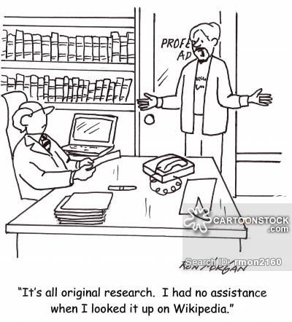
3. Referencing

Slide 9
3. Referencing
Anything that is not your own work MUST be referenced.
Main areas that include referencing:
Background information and introduction
Pictures, images, diagrams, graphs that are not drawn/generated by you
Explanations of variables (why they need to be controlled)
Conclusion
Improvements
Extensions to experiment

Slide 10
3. Referencing
Superscript number after the sentence/paragraph/quote.
Numbers should refer to footnotes at the bottom of your page to show the sources. These are numbered, not alphabetical.
Bibliography at the end will be alphabetical – not numbered.
Footnotes and bibliography are both MLA format.
Sources should be RELIABLE. No Wikipedia!

Slide 11
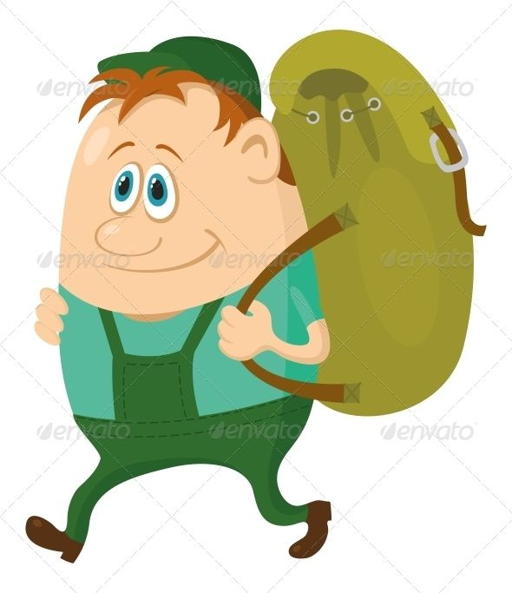
3. Referencing
In the body of your work…
Bob really enjoys going hiking with his dog (refer to image 1). He goes hiking every day for 30 minutes.⁽¹⁾ Sometimes at the weekend he heads out for four hour hikes.⁽²⁾ There are many trails he is able to use, as Hong Kong is actually very green.⁽¹⁾
For your footnotes for this specific page…
Marley, Bob. ”Best Hikes in Hong Kong.” www.bobmarley.com. 10th May 2004. Web. 15th June 2017.
Jones, Eric. ”How Green is Hong Kong?” England: Penguin Publishers. 2009. pp 155 – 156.
Image 1: Bob on a hike ⁽¹⁾

Slide 12
3. Referencing
In your bibliography (alphabetical)
Jones, Eric. ”How Green is Hong Kong?” England: Penguin Publishers. 2009. Print. pp 155 – 156.
Marley, Bob. ”Best Hikes in Hong Kong.” www.bobmarley.com. 10th May 2004. Web. 15th June 2017.
FOR A WEBSITE: Author surname, author name. “Title.” Website. Date published. Medium. Date accessed.
FOR A BOOK: Author surname, author name. “Title.” Location published: Publisher. Date published. Medium. Page numbers.
FOR A JOURNAL: Author surname, author name. “Title.” Name of journal. Volume number. Date of publication. Page numbers. Name of database. Medium. Date accessed.

Slide 13
4. What does an IA look like?
Annotated IA example

Slide 14
5. Example titles
What are you interested in? Could you turn that into an IA?
Remember:
Cannot do same as someone else in the year
Cannot do the same for your EE and IA
Cannot be a practical we do or learn about in the syllabus
Cannot be the same as your Group 4 Project
Try to make it creative and interesting
YOU MUST CONFIRM YOUR TOPIC WITH ME BEFORE YOU START TO RESEARCH

Slide 15
6. Your tasks
Before the summer…
Choose a general topic
Confirm your topic is okay with me
Create your research question
Materials list confirmed and submitted to technicians
Start to draft exploration
During the summer…
Complete your exploration
You need a minimum of a research question, materials and method before the start of Y12

Slide 16
7. Key dates

Slide 17
7. Key dates: JW
 | SL | HL
Practical work | Start: Monday 4th Sept End: Friday 15th Sept Inclusive of all lessons | Start: Monday 18th Sept End: Friday 29th Sept Inclusive of all lessons
First submission | Tuesday 3rd October Hard copy Turnitin | Wednesday 1st November Hard copy Turnitin
Final submission | Wednesday 15th November Hard copy Turnitin | Wednesday 13th December Hard copy Turnitin
Both SL and HL students will have time during lessons as well to write up their work both before the first submission and the final submission. This may differ between HL and SL due to teaching materials, holidays and other deadlines.
Both SL and HL students will receive one on one feedback from their teacher after their first submission, however all cannot be done at the same time due to number of students. Students will receive written feedback at the same time, however some students will receive their oral feedback before others, this cannot be avoided.
Practical work may be extended if required, and students may come back during lunch time and after school, so long as a teacher or technicians is present to supervise.
All practical work must be done in school under the supervision of teachers or technicians.

Slide 18
7. Key dates: TK
 | All Students
Practical work | Start: Monday 18th Sept End: Friday 29th Sept Inclusive of all lessons
First submission | Wednesday 1st November Hard copy Turnitin
Final submission | Wednesday 13th December Hard copy Turnitin
Students in both Biology classes will have time during lessons as well to write up their work both before the first submission and the final submission. This may differ between each class due to teaching materials, holidays and other deadlines.
Both SL and HL students will receive one on one feedback from their teacher after their first submission, however all cannot be done at the same time due to number of students. Students will receive written feedback at the same time, however some students will receive their oral feedback before others, this cannot be avoided.
Practical work may be extended if required, and students may come back during lunch time and after school, so long as a teacher or technicians is present to supervise.
All practical work must be done in school under the supervision of teachers or technicians.

Slide 19
8. Common Mistakes
Personal engagement
Research question
Too many variables
Materials list
Uncertainties
Method
Qualitative observations
Conclusion
Presentation of work

Slide 20
8. Common mistakes
Personal Engagement
One sentence describing how much you like to grow cucumbers is not enough
This needs to be felt throughout the report – with clear links in the introduction and conclusion
Why is this important to you?
If your report or topic is not creative and shows little initiative you will lose out here.

Slide 21
8. Common mistakes
Research Question
This should include your IV (with range), DV, organism name and units.
Should also be concise and focused
How do different plant hormones (auxin, cytokinin, gibberellin and commercial fertilizer Plantmate) affect the growth of mung beans (Vigna radiate), measured by the root grown from the seed of the bean after 48 hours in mm?
How do different plant hormones affect the growth of mung beans?

Slide 22
8. Common mistakes
Too many variables = Too much data
You only need to investigate ONE independent variable and ONE dependent variable…
How does increasing the temperature affect the efficiency of five different antibacterial face washes on two different types of bacteria?
How does increasing the temperature affect the efficiency of Dove antibacterial face wash on E. coli?
This has THREE variables that need to be measured
Different temperatures
Different face washes
Different bacteria
This has ONE variable that need to be measured
Different temperatures

Slide 23
8. Common mistakes
Materials lists
Very easy to display as a table – means you do not forget anything and it is very clear
Equipment | Quantity/Volume/Mass | Uncertainty
50mL Beaker | 5 | +/- 5mL
Electronic scale (g) | 1 | +/- 0.005g
Distilled water | 50mL | -
30cm Ruler | 1 | +/- 0.05cm
Must Include:
All equipment used in method
Size
Quantity/volume/mass
Uncertainty
Units
WHAT IS THIS?

Slide 24
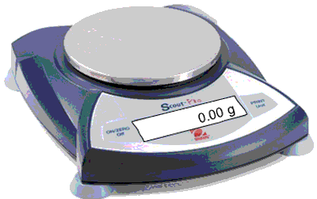
8. Common mistakes
Uncertainties
Any piece of measuring equipment will have an uncertainty – this needs to be included in your materials list
Half the smallest measurement you can make on that piece of equipment
+/- shows the error could be above or below your reading
This can measure to 0.01g
Uncertainty = +/- 0.005g

Slide 25
8. Common mistakes
What is the uncertainty of a 30cm ruler?
Half the smallest measurement you can make on that piece of equipment
+/- shows the error could be above or below your reading
This can measure to ____________
Uncertainty =_______________

Slide 26
8. Common mistakes
What is the uncertainty of a 30cm ruler?
Half the smallest measurement you can make on that piece of equipment
+/- shows the error could be above or below your reading
This can measure to 0.1cm (or 1mm)
Uncertainty = +/- 0.05cm (or 0.5mm)

Slide 27
8. Common mistakes
Method
This needs to be very clear and fully repeatable.
The person reading it should be able to understand what to do very easily
Do not forget to describe clearly at the end of your method:
What you are measuring and recording
How many repeats/trials you will be doing

Slide 28
8. Common mistakes
Qualitative Observations
EVERY SINGLE INTERNAL ASSESSMENT MUST HAVE THESE
What observations did you make during your investigation?
During the investigation, after three days, all leaves on 5 out of the 10 plants used went completely brown in colour.
The plants growing in pots with a smaller area began to grow sideways, compared to plants growing in larger pots which grew almost completely vertically.
It was also noted that there was another species of bacteria growing inside the petri dish, as there were some areas where the colonies growing were predominantly red

Slide 29
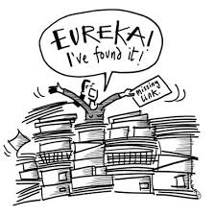
8. Common mistakes
Conclusion
You must re-state your research question clearly. This is what you need to answer in your conclusion.
Back this up with your raw data and your processed data
Research Question
Collect Data
Analyse data
Draw conclusion
HAVE YOU ANSWERED YOUR QUESTION?

Slide 30
8. Common mistakes
Presentation of work
This is worth 4 marks out of 24!
Tables should be on the same page
Sub headings for each section
Table numbers and titles
Graphs should be visible and labelled correctly
Check your spelling
Make sure your units match the whole way through
Make sure you uncertainties match the whole way through
The reader should not have to re-read part
Get someone to read through to ensure it makes sense
First impressions count

