Slide 1
Understand how sound waves behave
State how sound travels
Bronze
Describe what causes an echo
Silver
Explain what an insulator is
Gold

Slide 4
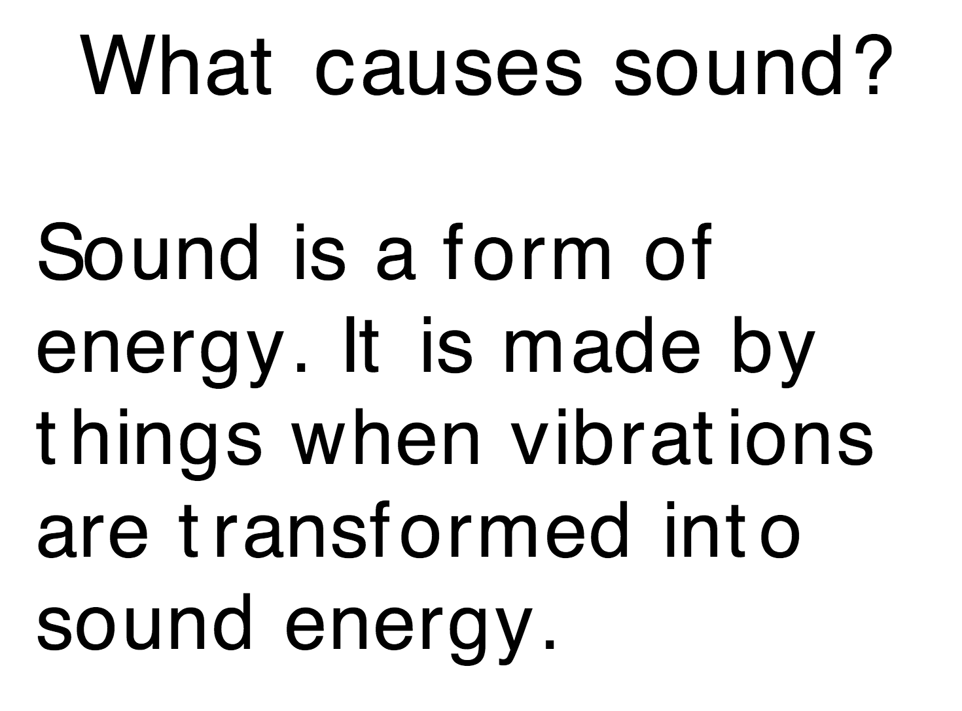

Slide 6
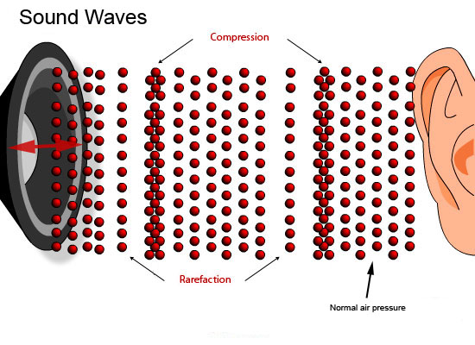
Particles

Slide 10
Bell Jar experiment

Slide 11
Bell Jar experiment
When the bell is switched on you can hear it ringing.

Slide 12
Bell Jar experiment
When the bell is switched on you can hear it ringing. When the air is pumped out of the bell jar, the ringing gets quieter

Slide 13
Bell Jar experiment
When the bell is switched on you can hear it ringing. When the air is pumped out of the bell jar, the ringing gets quieter It is almost silent when the pump is stopped.

Slide 14
Bell Jar experiment
When the bell is switched on you can hear it ringing. When the air is pumped out of the bell jar, the ringing gets quieter It is almost silent when the pump is stopped.
You can hear the ringing because the air is carrying the sound wave.

Slide 15
Bell Jar experiment
When the bell is switched on you can hear it ringing. When the air is pumped out of the bell jar, the ringing gets quieter It is almost silent when the pump is stopped.
You can hear the ringing because the air is carrying the sound wave. When the air is pumped out, the sound wave cannot travel as there are no air particles to vibrate and pass on the energy.

Slide 16
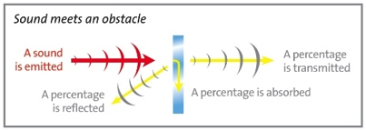
Depends on the object
When sound waves meet an object
Reflect
Absorb
Transmit

Slide 17
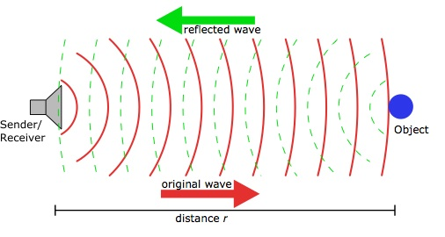
Echoes

Slide 18
Your Task
You are a designer of a house. Each person in the family has different needs – you need to plan what materials should be used to cater for this.

Slide 19
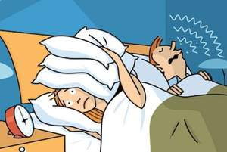
Daddy
Just had a new baby
Snores very loudly when sleeping
Likes to make tools (involves hitting metal with hammers)

Slide 20
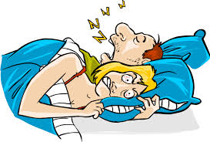
Mummy
Just had a new baby
Very tired – needs a lot of sleep
Moved into the loft room as husband snores too loudly every night

Slide 21
Daughter
New baby
5 months old
Screams and cries when hungry
Mummy and daddy must be able to hear her when she cries so they can feed her

Slide 22
Son
Plays the drums
Drums were too heavy to carry upstairs so he has a ground floor room

Slide 23
Granny
Although old she has great hearing
Super grumpy
Cannot walk up the stairs so has a ground floor room
Likes to read – so needs peace and quiet
Gets headaches from too much noise

Slide 24
Design a house
Mummy’s room
The family has 5 members.
Granny = Loves to read in the peace and quiet
Daddy = Loves to make tools and snores, must hear baby
Mummy = Loves to sleep, must hear baby
Son = Loves to play the drums
Daughter = Screams and cries when hungry
You must keep the house in the design to the right. However you can use any materials you wish for each room.
Design your room by drawing it
Label your materials
Explain why you used those materials
Describe what an insulator is
Describe what an echo is
Daddy’s room
Daughter’s room
Son’s room
Granny’s room
Complete this in pairs on a piece of A3 paper. You have the lessons on Tuesday and Thursday. You have 10 mins of the lesson on Friday to hand it in. You can complete for homework.

Slide 25
Understand how sound waves behave
State how sound travels
Bronze
Describe what causes an echo
Silver
Explain what an insulator is
Gold

