Slide 1
Think of the human body.
What conditions in the body are controlled?
What happens if they change?

Slide 2
6.6 Hormones, homeostasis and reproduction
Homeostasis and the control of blood glucose
Define homeostasis
Describe the principle of negative feedback
Describe the roles of hormones in the control of blood glucose

Slide 4
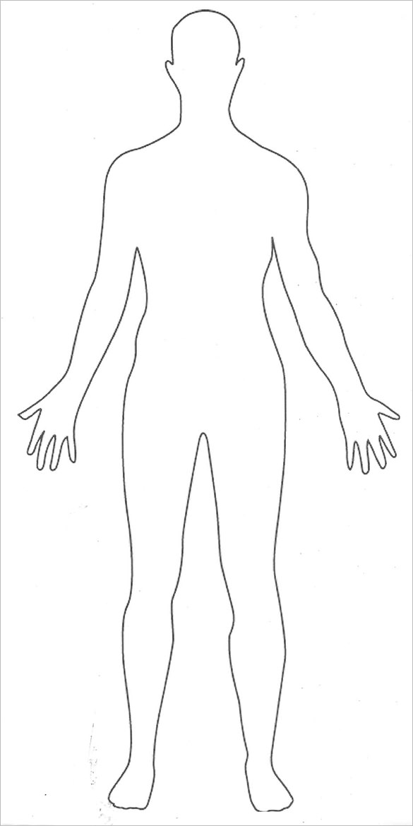
Glands.
Draw on the location of the glands in the body. Label them. Find out what hormones they produce
What is a hormone

Slide 5
Example

Slide 6
Negative Feedback
Read the information and create a flow diagram to show how blood glucose levels are controlled

Slide 8
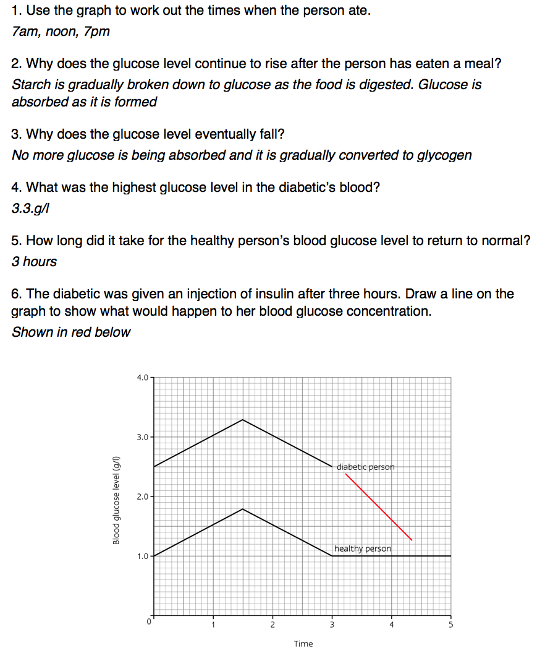
Work Sheet

Slide 9
Diabetes
Insulin
 | Cause | Symptoms | Treatment
Type I diabetes
Type II diabetes
Summerise the text and complete the tabel

Slide 10
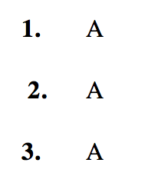
Exam Qs

Slide 11
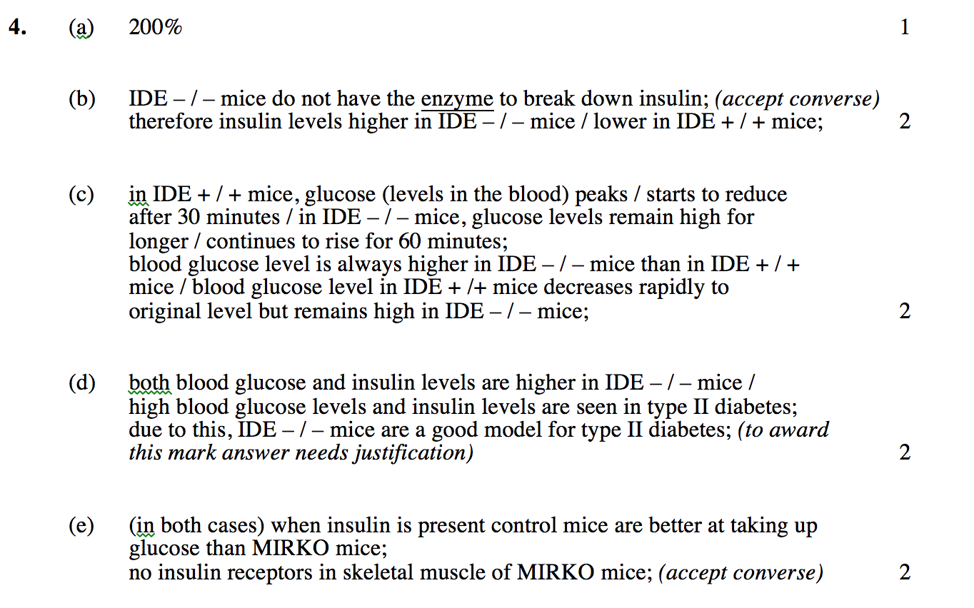

Slide 12
