Slide 1
The boxes are for pictures

Slide 2
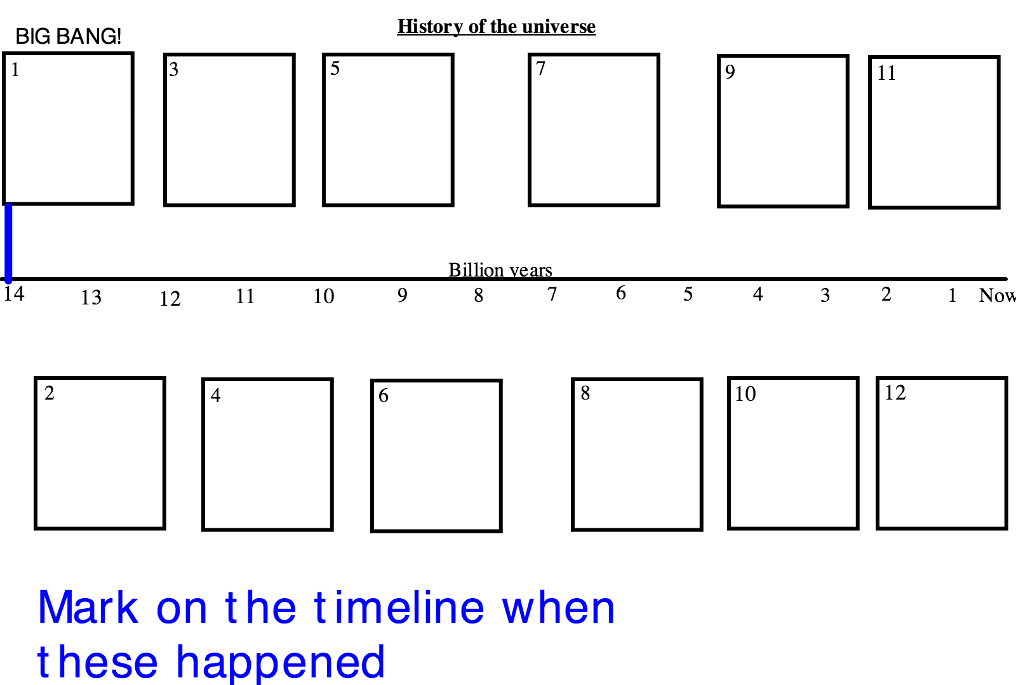
Cosmic Calendar
Pale Blue Dot

Slide 3
Expanding Universe
What is the evidence for the expanding universe?

