Slide 1
10.2 Inheritance
Skills:
Calculation of the predicted genotypic and phenotypic ratio of offspring of dihybrid crosses involving unlinked autosomal genes
Identification of recombinants in crosses involving two linked genes
Use of a chi-squared test on data from dihybrid crosses
Understanding:
Unlinked genes segregate independently as a result of meiosis
Gene loci are said to be linked if on the same chromosome
Variation can be discrete or continuous
The phenotypes of polygenic characteristics tend to show continuous variation
Chi-squared tests are used to determine whether the difference between an observed and expected frequency distribution is statistically significant
Nature of science:
Looking for patterns, trends and discrepancies: Mendel used observations of the natural world to find and explain patterns and trends. Since then, scientists have looked for discrepancies and asked questions based on further observations to show exceptions to the rules. For example, Morgan discovered non-Mendelain ratios in his experiments with Drosophia
Applications:
Completion and analysis of Punnett squares for dihybrid traits
Morgan’s discovery of non-Mendelian ratios in Drosophia
Polygenic traits such as human height may also be influenced by environmental factors

Slide 2
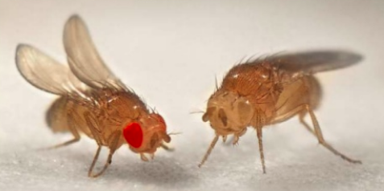
Drosophila – Diploid number = 8
Each gene is found at a specific region of the chromosome – locus. Homologous pairs of chromosomes have the same genes at the same loci

Slide 3
Linked Genes
The genes for yellow body and white eyes are inherited together. They are NOT independently assorted. They appear on the sex chromosome so they show sex linkage
The genes for black body and purple eyes are inherited together. They are NOT independently assorted. They appear on the chromosome 2 so they show autosomal gene linkage

Slide 4
Gene Linkage

Slide 5
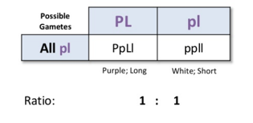
Remember what this is..
Homologous pair with alleles

Slide 9
