Slide 2
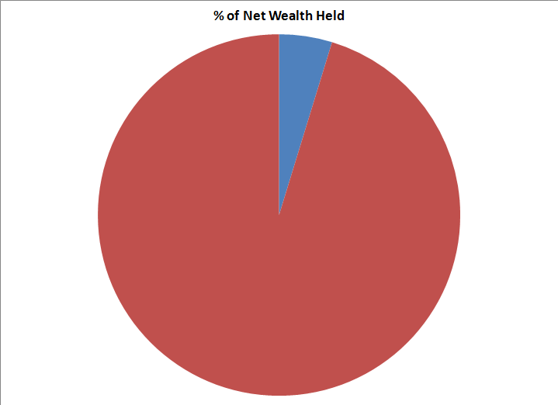
Non coding DNA
Coding
Not all DNA codes for a polypeptide to be made
May have another useful function
Non-coding sequences of DNA
e.g. STRs
Another example: Promotor
Non Coding
Applications:
The promoter as an example of non-coding DNA with a function

Slide 3
7.2 Transcription and gene expression
Understanding:
Gene expression is regulated by proteins that bind to specific base sequences in DNA
The environment of a cell and of an organism has an impact on gene expression
Nucleosomes help to regulate transcription in eukaryotes
Transcription occurs in a 5’ to 3’ direction
Eukaryotic cells modify mRNA after transcription
Splicing of mRNA increases the number of different proteins an organism can produce
Applications:
The promoter as an example of non-coding DNA with a function
Skills:
Analysis of changes in DNA methylation patterns
Nature of science:
Looking for patterns, trends and discrepancies: there is mounting evidence that the environment can trigger heritable changes in epigenetic factors

Slide 4
7.2 Transcription and Gene Expression Gene Expression
Describe the role of promoters in gene expression in prokaryotes
Describe how E.coli regulates genes involved in lactose break down

Slide 5
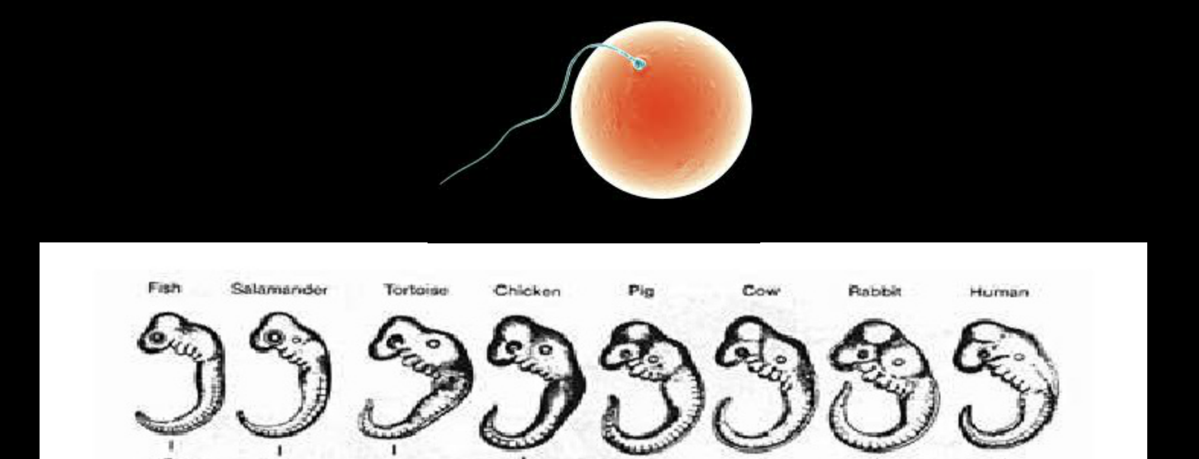
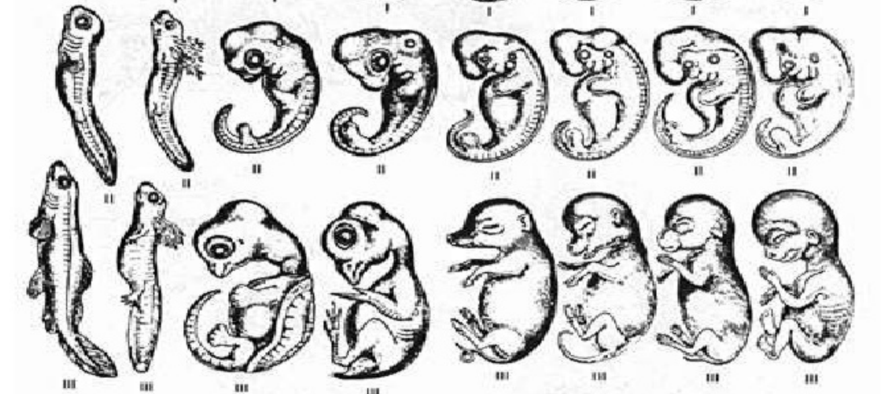

Slide 8
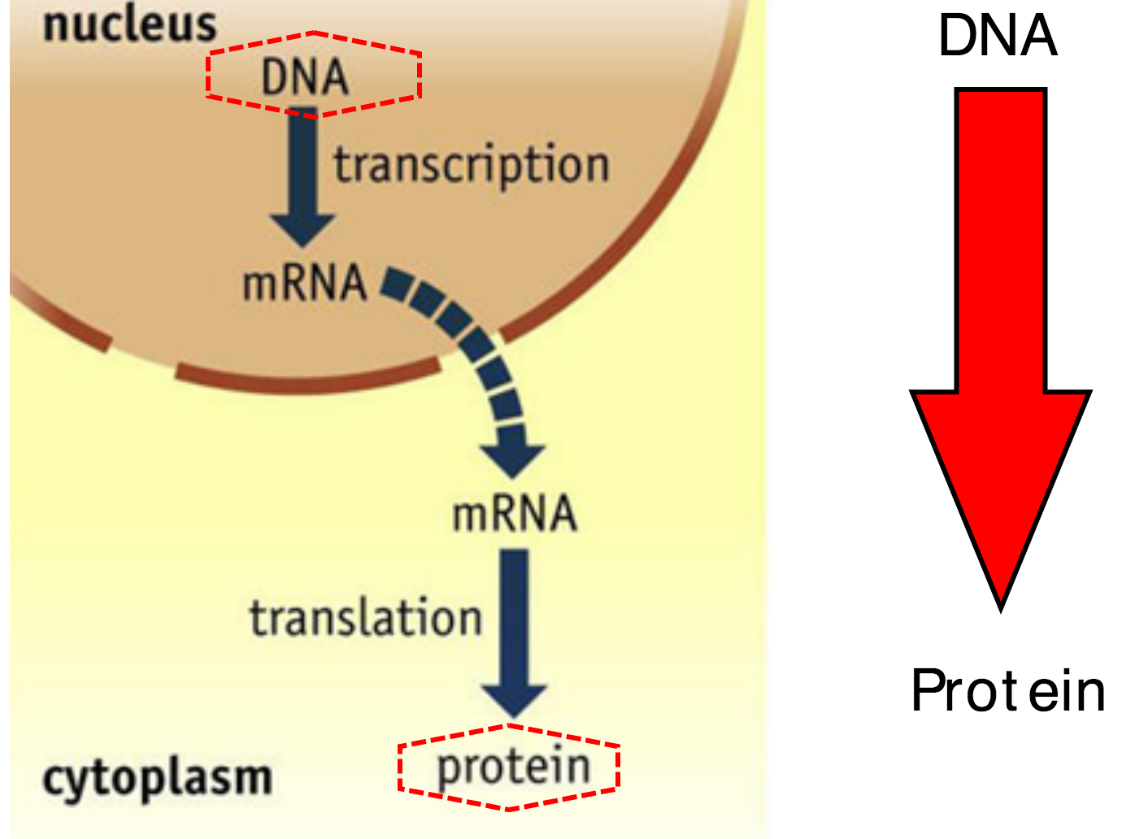

Slide 9
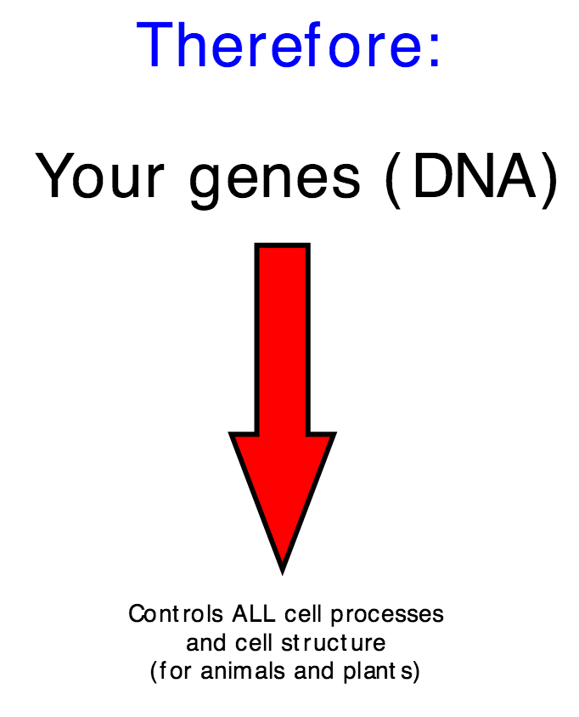

Slide 10
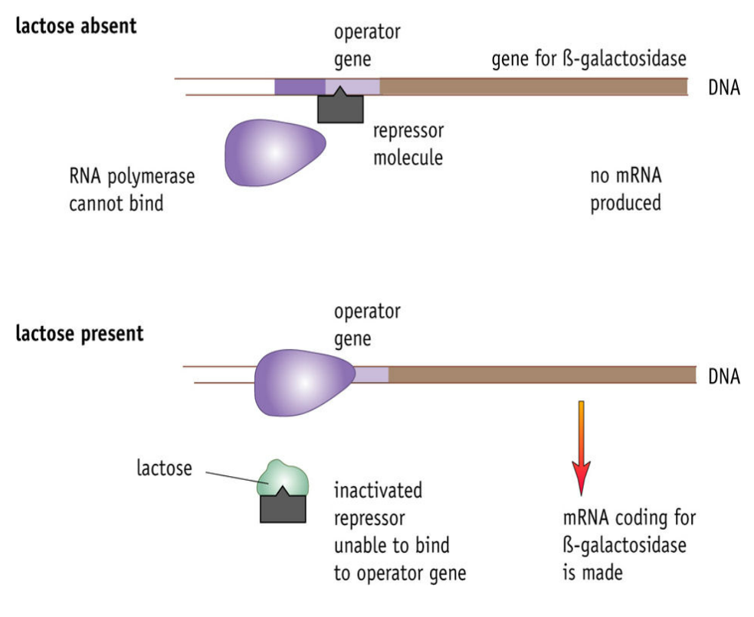
Operator region
Promoter region
Promoter region
Prokaryote

Slide 11
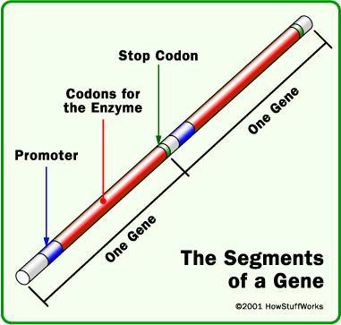
Proteins that can switch genes on/off are transcription factors.
Different transcription factors are produced at different times depending on a cell’s function or the development of the organism
Sections on the DNA where transcription factors bind to can be silencers (slow transcription) or enhancers (speed up transcription)
RNA polymerase binds the promoter region

Slide 12
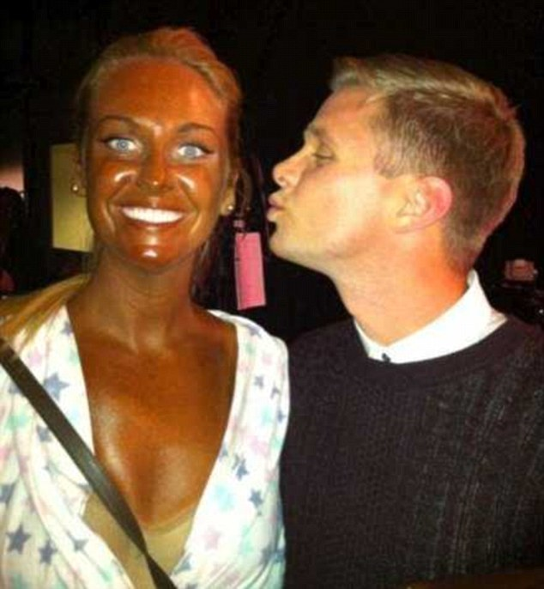
Genes or the Environment
Some of our characteristics (caused by proteins) seem to be influenced by our genes and the environment.
Can you think of an example?
Our skin colour is determined by our genes but can change due to the environment

Slide 13
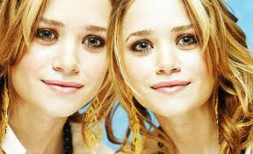
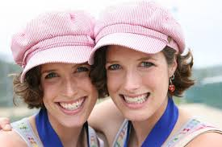
When scientists want to investigate if a characteristic is caused by genes, the environment (or both) what groups of people can they use?
Complete data Q on 356

Slide 15
How else can different genes be expressed? (apart from transcription factors)

Slide 16
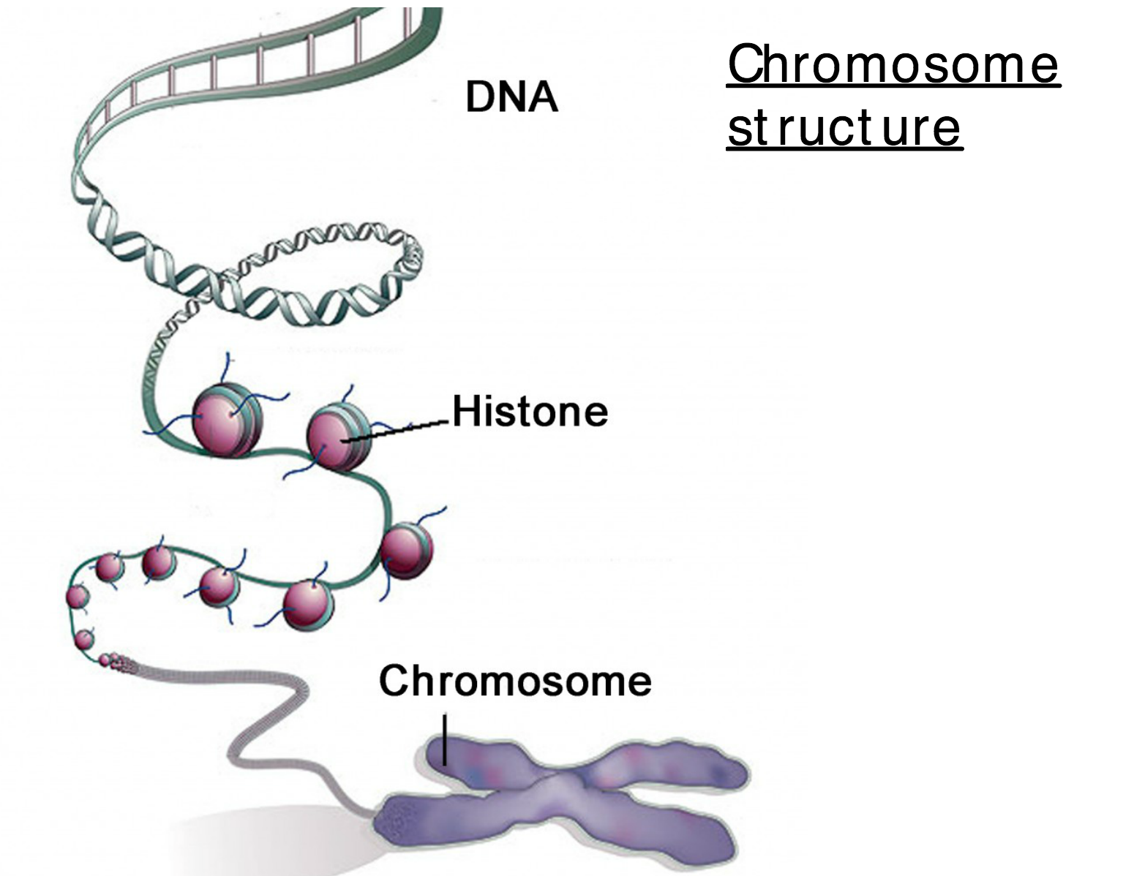
Histones and DNA are called?
How many histone proteins are
In one of these?

