Slide 1
Sharing our Planet
Ecology –
Ecosystems and food webs

Slide 2
Definitions
Ecosystem
Habitat
Population
Ecosystem

Slide 6
What starts every food chain?
Food chains

Slide 8
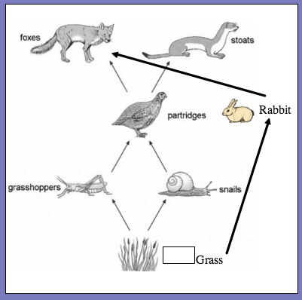

Slide 9
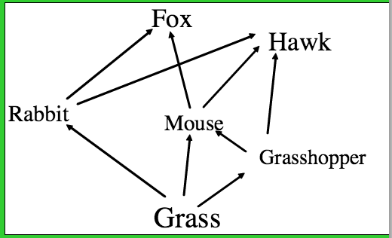

Slide 11
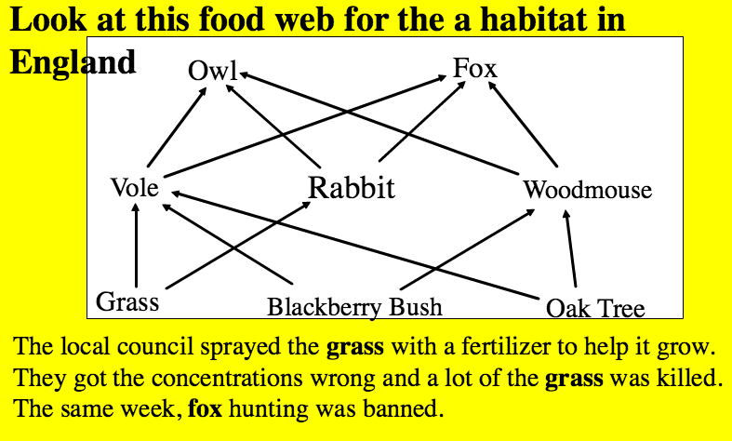
Write a letter to the local politician explaining your concern for the other organisms and what you predict will happen

Slide 12
Ocean food chain

