Slide 1
4.2 Energy Flow
Skills:
- Quanitative representations of energy flow
Understanding:
Most ecosystems rely on a supply of energy from sunlight
Light energy is converted to chemical energy in carbon compounds by photosynthesis
Chemical energy in carbon compounds flows through food chains by means of feeding
Energy released by respiration is used in living organisms and converted to heat
Living organisms cannot convert heat to other forms of energy
Heat is lost from ecosystems
Energy losses between trophic levels restrict the length of food chains and the biomass of higher trophic levels
Nature of science:
Looking for patterns, trends and discrepancies: plants and algae are mostly autotrophic but some are not
Understanding:
The supply of inorganic nutrients is maintained by nutrient cycling
Ecosystems have the potential to be sustainable over long periods of time

Slide 3
Food chains, food webs and energy flow
Identify an organism’s role in a food web
Construct food webs
State what food chains represent
Describe the role of producers in food chains
Explain the loss of energy from food chains
The greatest story ever told - maybe

Slide 7
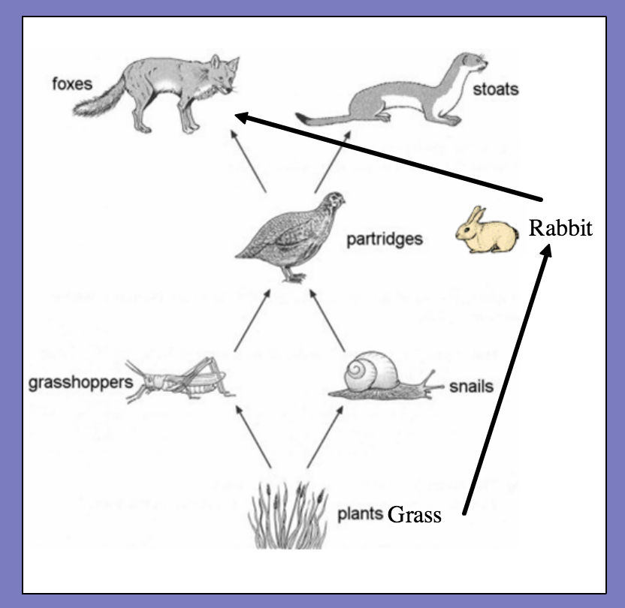

Slide 8
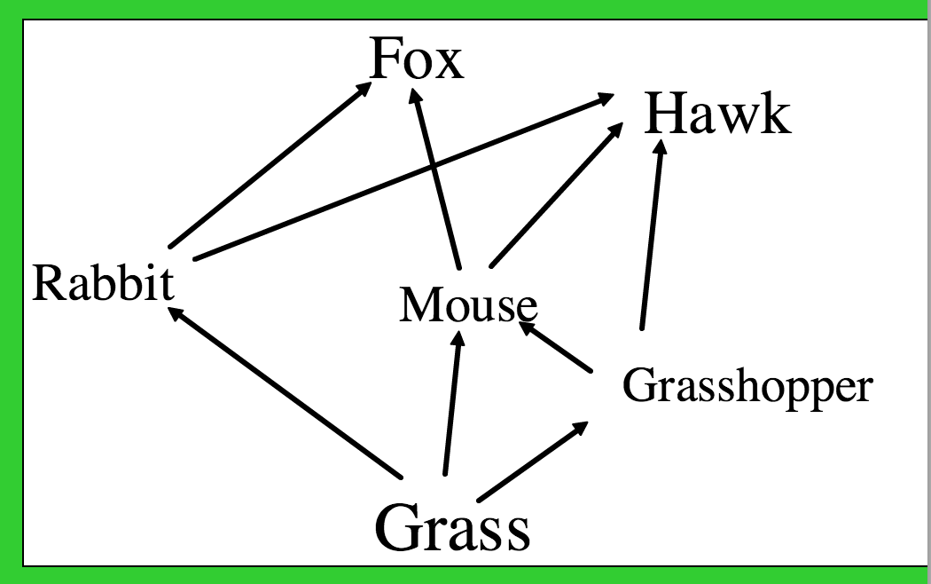

Slide 10
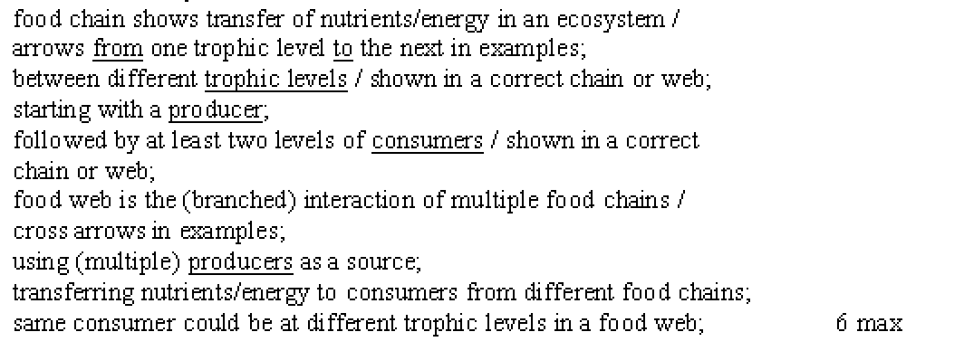
(6)

Slide 11
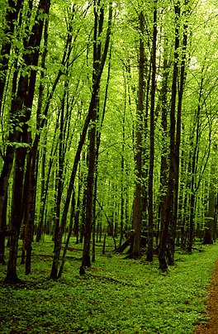
Virtually every food chain starts with green plants. They provide the source of energy for every organism above them in the food chain.
So where do they get their energy from?

Slide 12
Radiation from the Sun (light energy)
The Sun’s light energy is used by autotrophs for photosynthesis, to make new biomass.
Biomass is the dry mass of living material in an animal or plant.
Heterotrophs eat this biomass

Slide 13
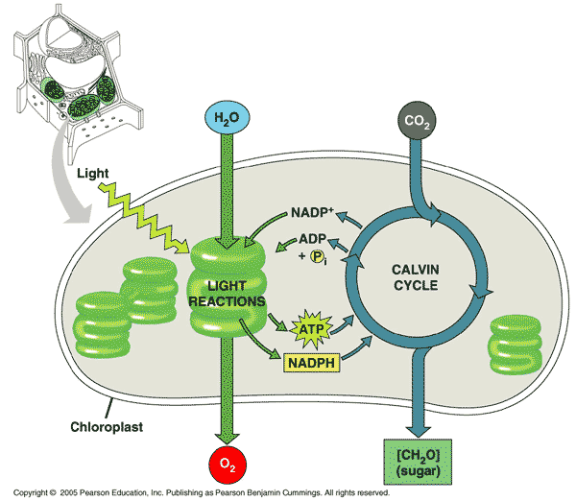
Energy
Light energy
is converted to chemical energy
(carbon compounds such as glucose, lipids, proteins)
Plants respire but most of this ‘locked up’ energy is available for heterotrophs.
This energy passes down food chains

Slide 14
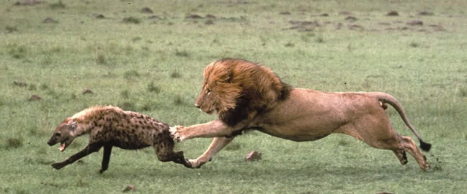
Energy release
mmmmm…carbon compounds
Organisms need energy for cell activities
Synthesising molecules (RNA, DNA, proteins)
Active transport mechanisms
Moving things around inside the cells (spindles move chromosomes)
ATP provides this energy. Cells produce ATP from respiration. Respiration uses those carbon compounds.

Slide 15
Respiration
All cells produce ATP during respiration
The oxidation reactions involved are exothermic (release heat energy)
The energy released is used to synthesise ATP
Respiration converts chemical energy in glucose into ATP
Not all chemical energy transferred to ATP
Some is converted to heat energy and released
Why bother converting from glucose to ATP?

Slide 16
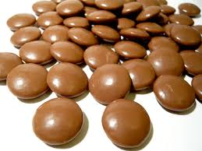

Slide 17
Energy conversions
Organisms can perform energy conversions:
Light energy to chemical energy in photosynthesis

Slide 18
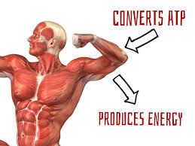
Energy conversions
Chemical energy to kinetic energy in muscle contraction

Slide 19
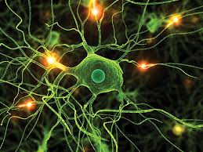
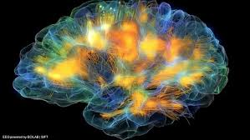
Energy conversions
Chemical energy to electrical energy in nerve cells
Heat energy is always produced

Slide 20
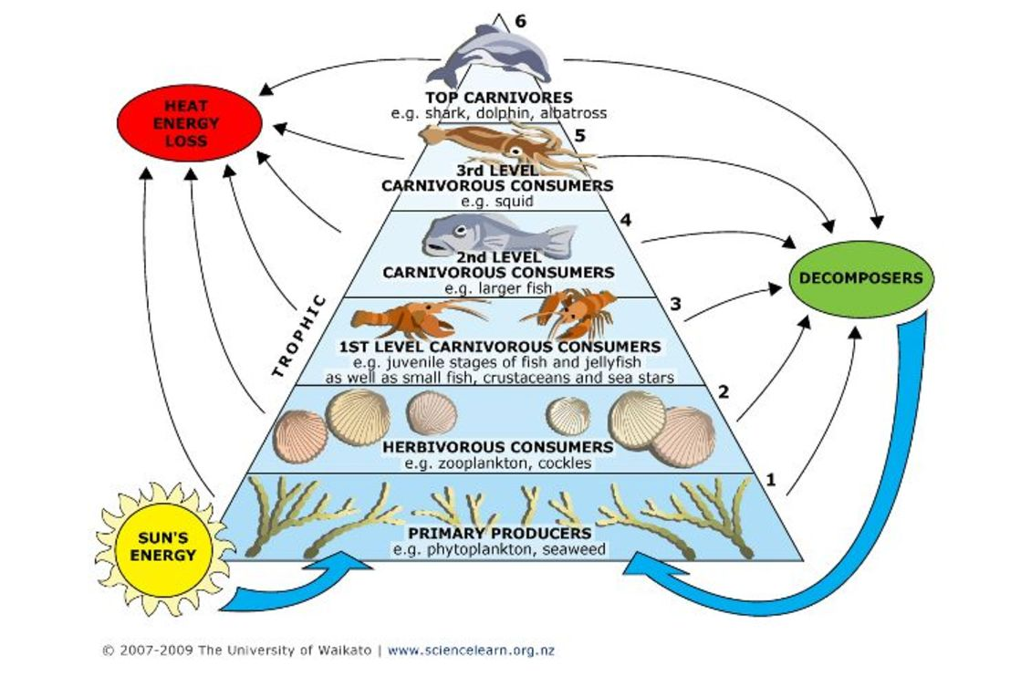
Why don’t food chains go on forever?

Slide 21
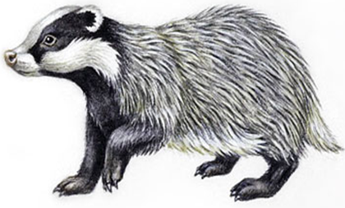
Why don’t food chains go on forever?

Slide 22
Why is energy lost at each stage in a food chain?
Energy is transferred along food chains from one stage to the next.
Not all can be absorbed by organisms at the next one.
The amount of available energy decreases from one stage to the next.
Energy lost from heat production in respiration
Not all parts of the organism consumed
Faeces/waste
Most food chains are short. There are rarely more than four stages, because a lot of energy is lost at each stage so cannot be passed on to the next trophic level.

Slide 23
Pyramids of energy

Slide 24
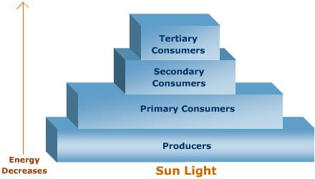
Pyramids of energy
Represent amount of energy converted to new biomass by each trophic level in a community.
Bar chart with a bar for each trophic level.
Amount of energy measured per unit area per year.
Units: Kilojoules per metre squared per year (KJm⁻²yr⁻¹)
Length of each bar proportional to amount of energy it shows

Slide 25
Qs

Slide 26
Pyramids of energy
Construct the following pyramid of energy on graph paper:
Producers: 10,000 KJm⁻²yr⁻¹
Primary consumers: 1000 KJm⁻²yr⁻¹
Secondary consumers: 100 KJm⁻²yr⁻¹
Tertiary consumers: 10 KJm⁻²yr⁻¹

Slide 27
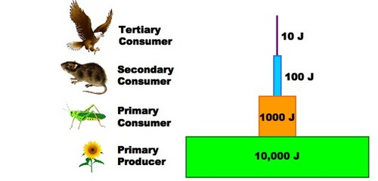
KJm⁻²yr⁻¹
KJm⁻²yr⁻¹
KJm⁻²yr⁻¹
KJm⁻²yr⁻¹

