Slide 1
FEEDING METHODS

Slide 2
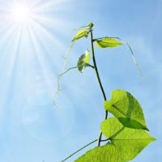
Autotrophs
Make own organic molecules as a source of food
Involves photosynthesis
Take in light energy from the sun, combine with inorganic substances and obtain a source of chemical energy
Plants are used as food for other organisms so are producers

Slide 3
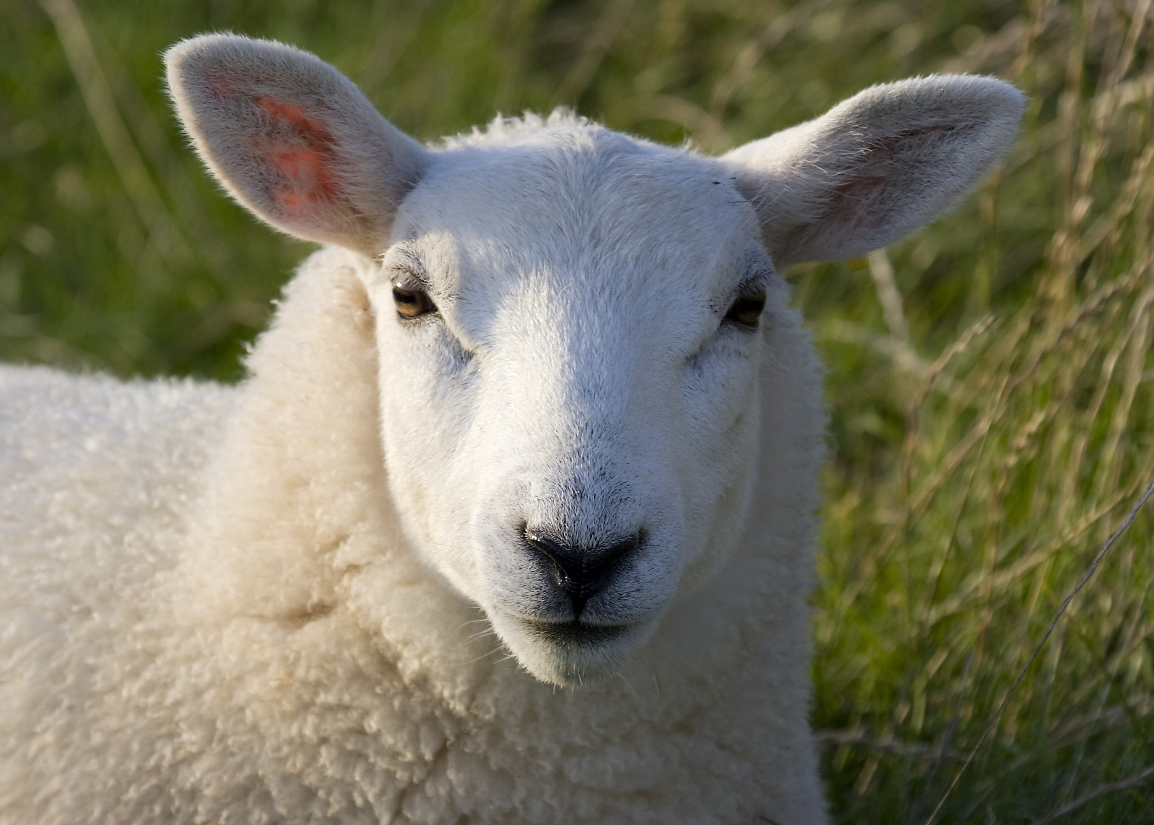
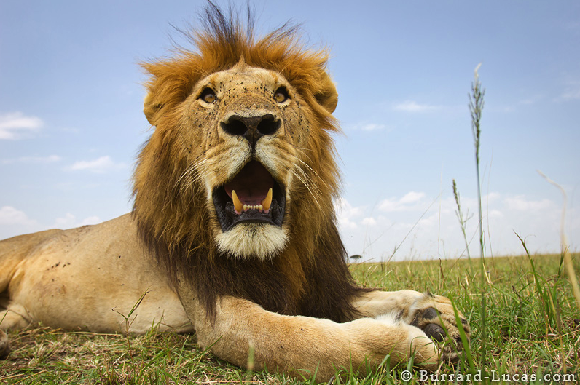
Heterotrophs
Cannot make own food from inorganic matter
Must obtain organic molecules from other organisms.
Chemical energy from other autotrophs or heterotrophs
Rely on other organisms for food = consumers

Slide 4
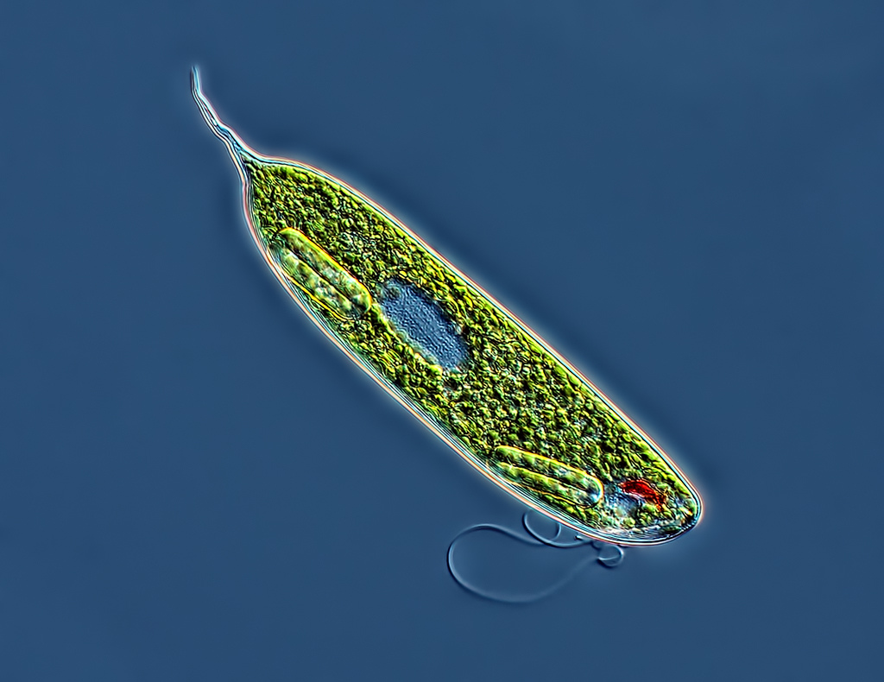
Euglena
Both autotroph and heterotroph
Has chloroplasts and carries out photosynthesis when there is enough light
Feed on detritus and smaller organisms by endocytosis

Slide 5
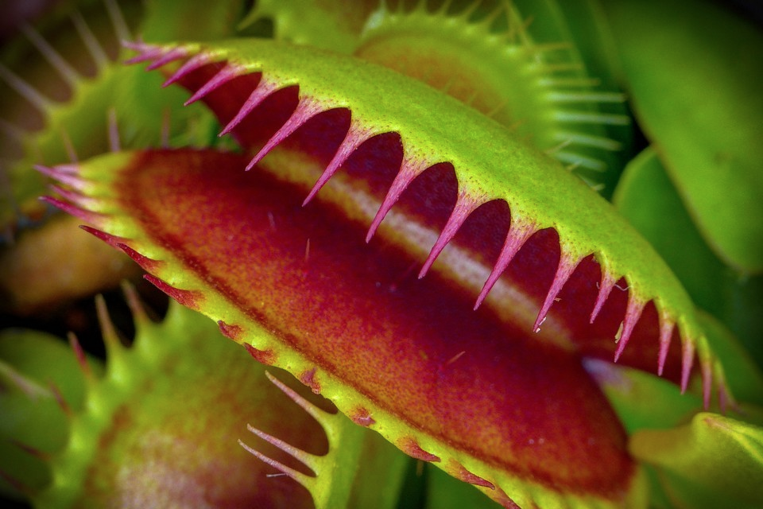
Carnivorous plants (Venus fly trap)
Both autotroph and heterotroph

Slide 6
Feeding methods

Slide 7
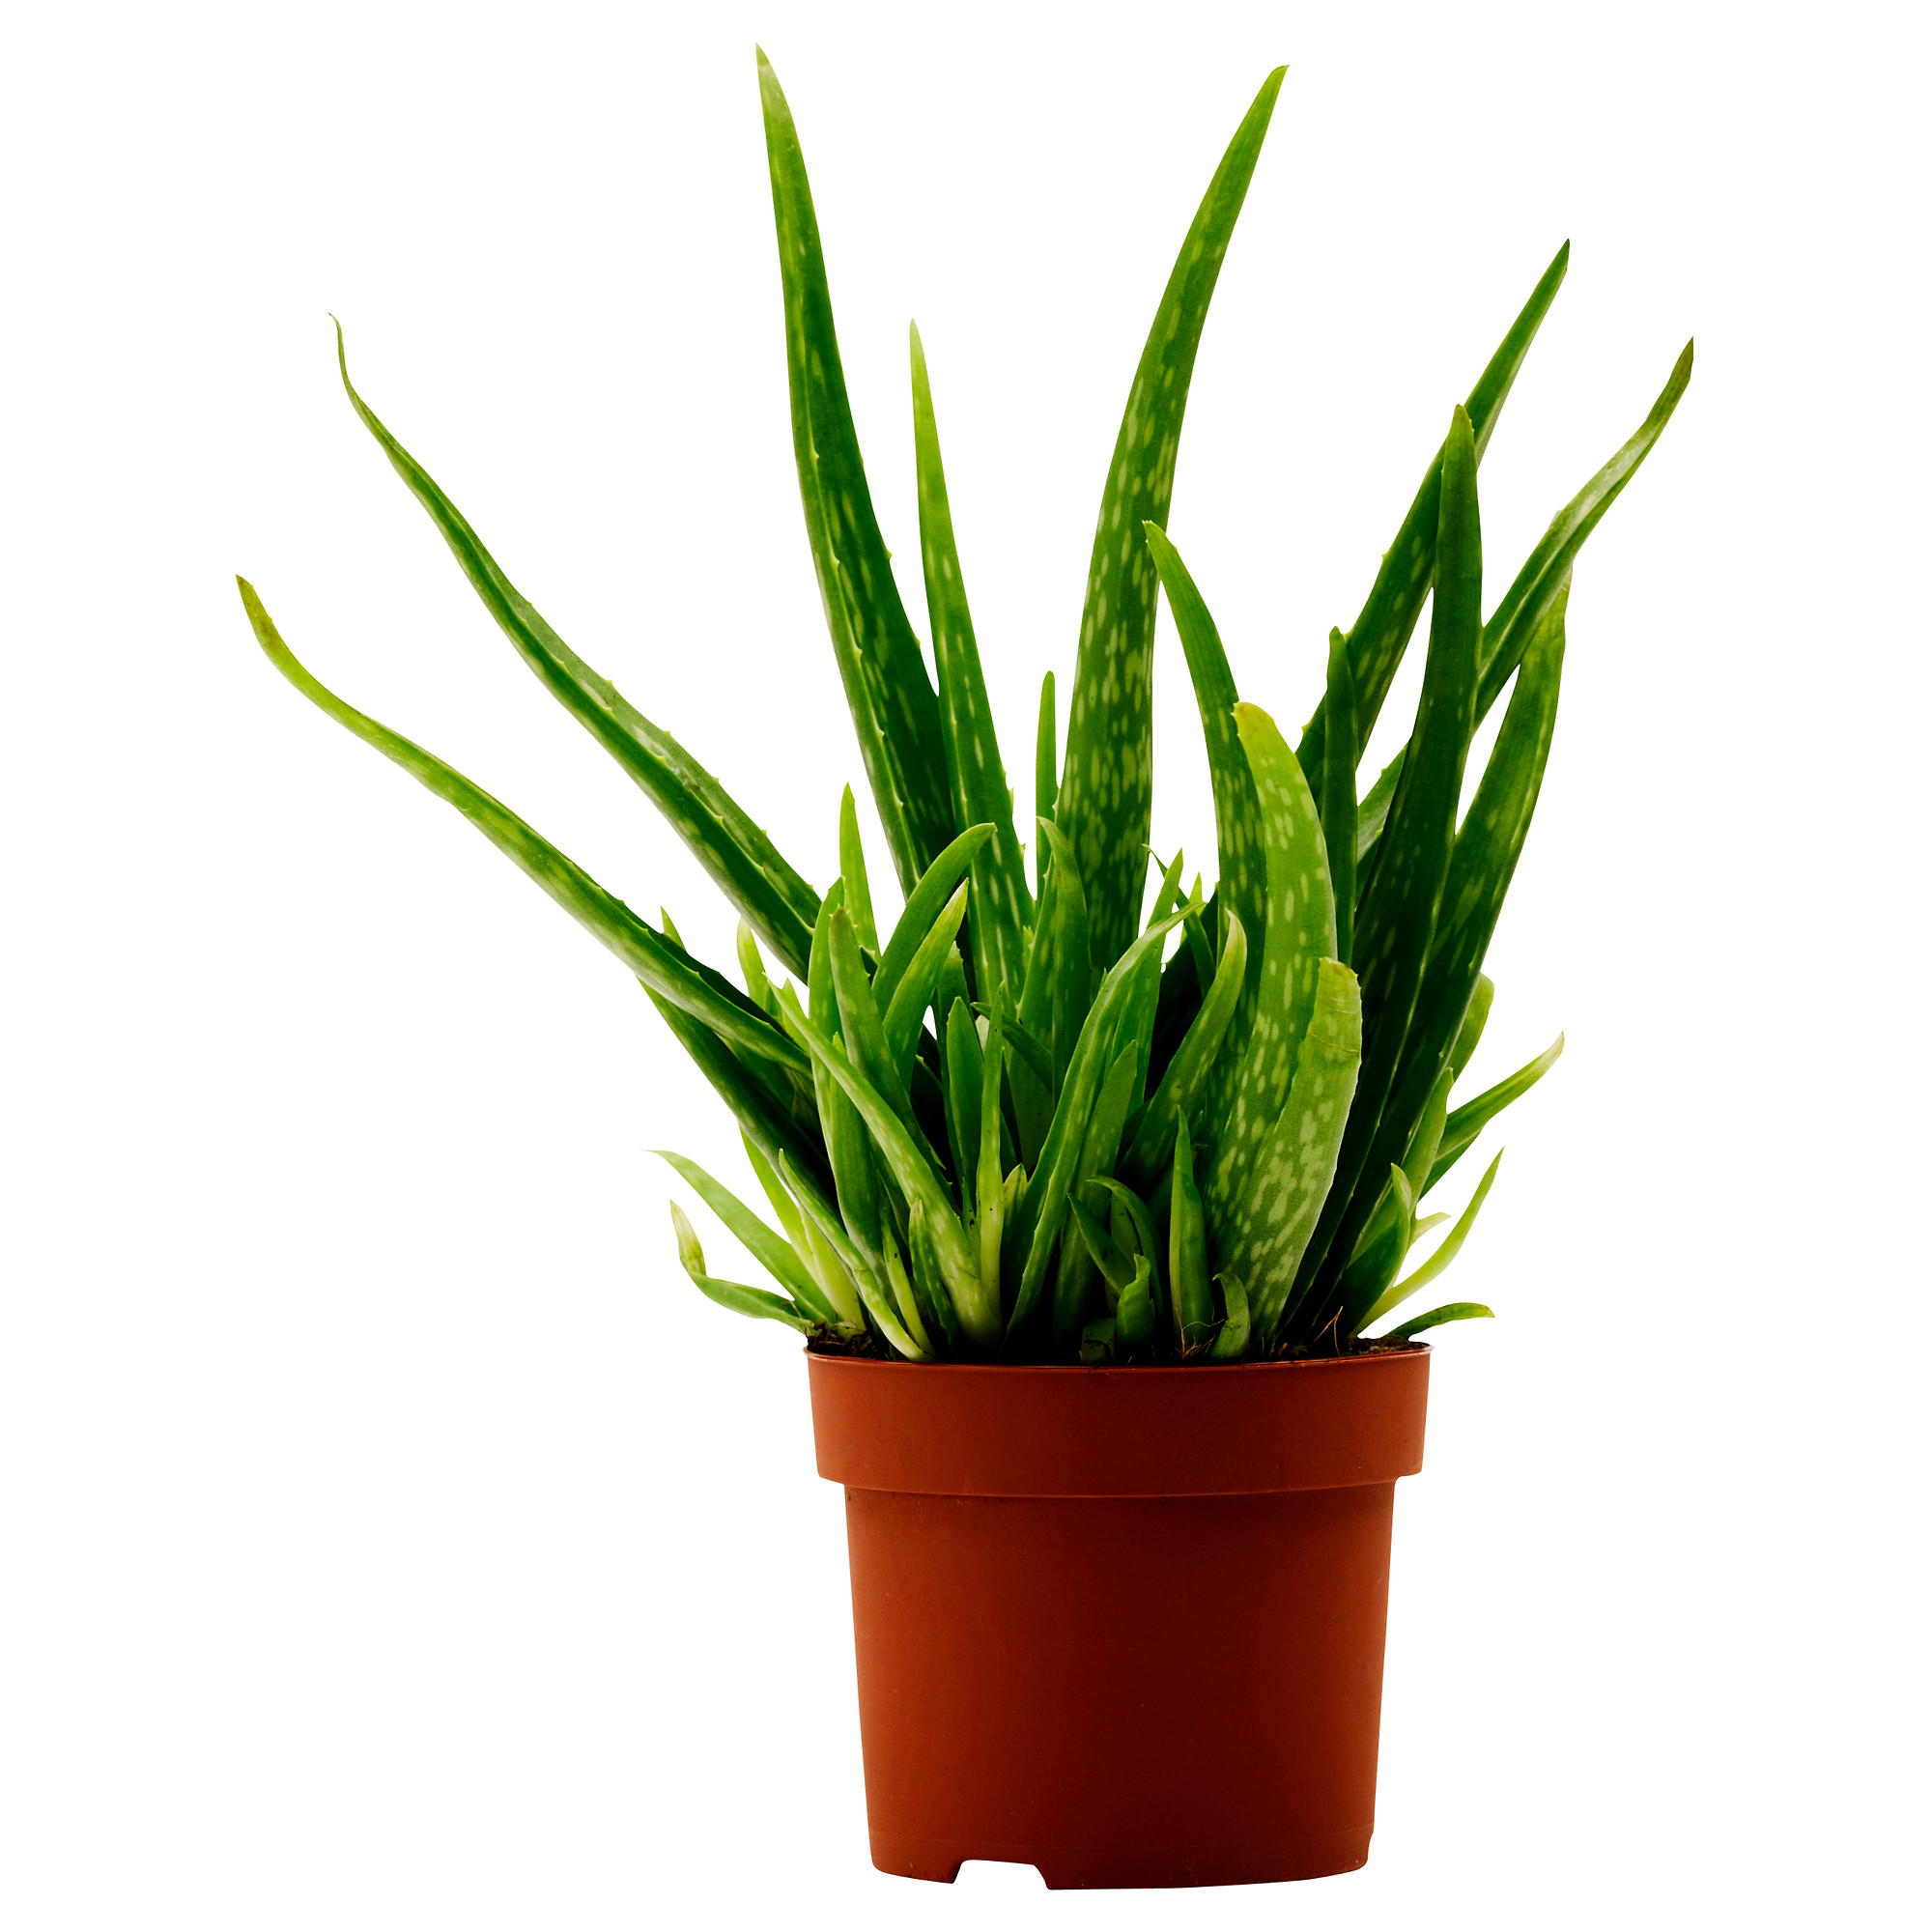
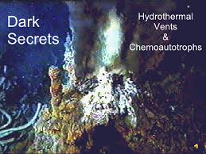
Producers
Photoautotrophs Chemoautotrophs
Hydrothermal vents
Light
Chemicals

Slide 8
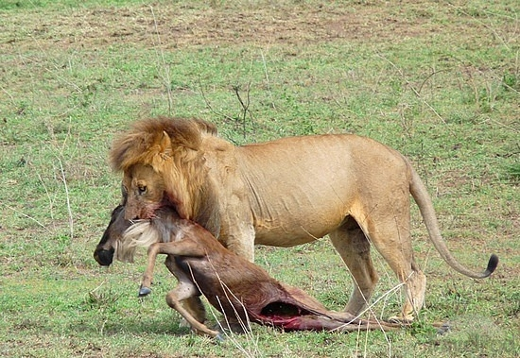
Consumers
Ingest other organisms (alive or recently dead)
Cannot just lie out in the sun to make food like a plant
Digest food and absorb nutrients

Slide 9
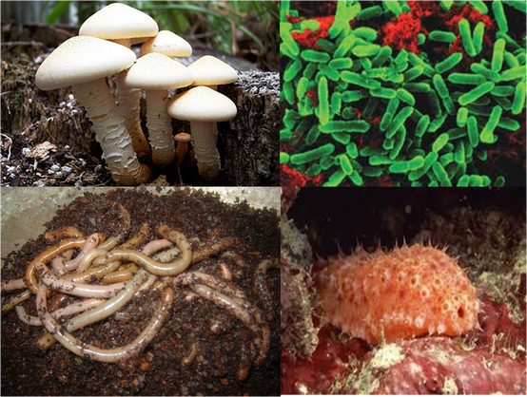
Decomposers
1. Detritivores
2. Saprotrophs

Slide 10
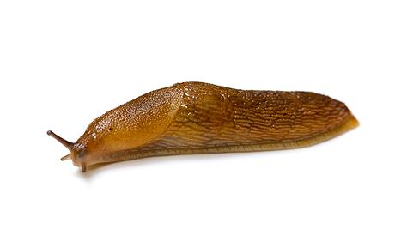
Detritivores
Heterotrophs
Use dead organic matter as nutrient source – internal digestion
Faeces from animals
Dead leaves
Dead animals

Slide 11
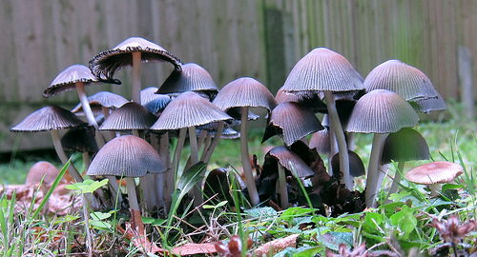
Saprotrophs
Heterotrophs
Use dead organic matter as nutrient source – external digestion
Secrete digestive enzymes onto dead matter and digest externally
Absorb the products of digestion
A fungus is more closely related (genetically) to a horse than it is a plant

Slide 12
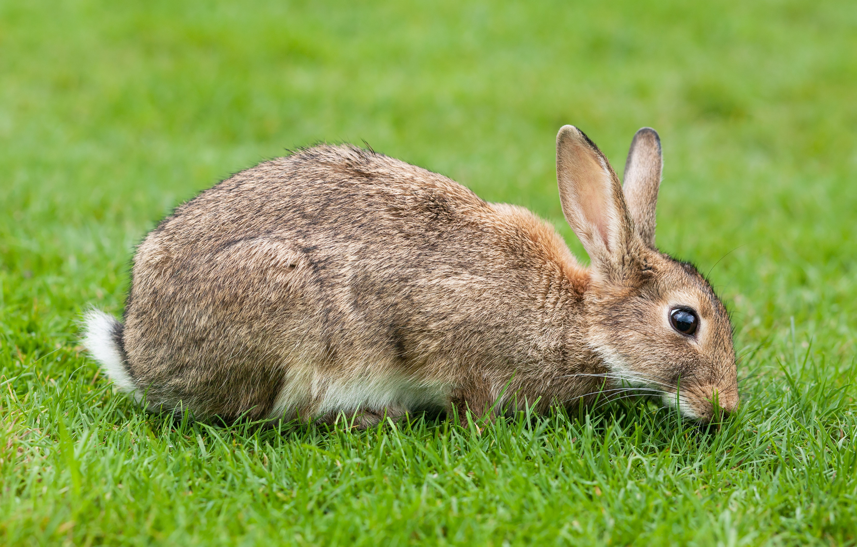
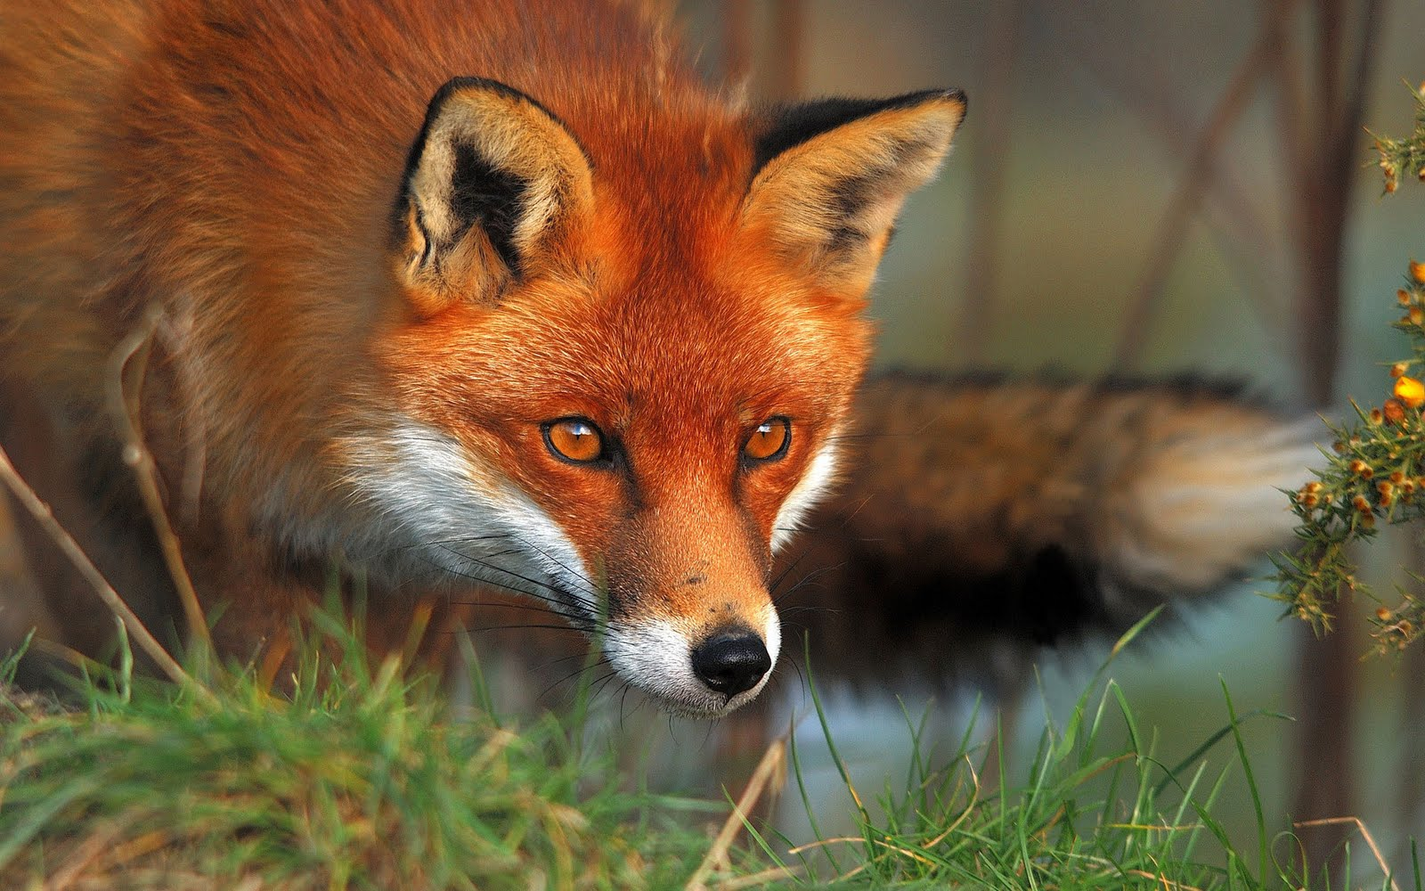
Communities
Populations of different species living and interacting with each other
All species depend on their relationship with another species

