Slide 1
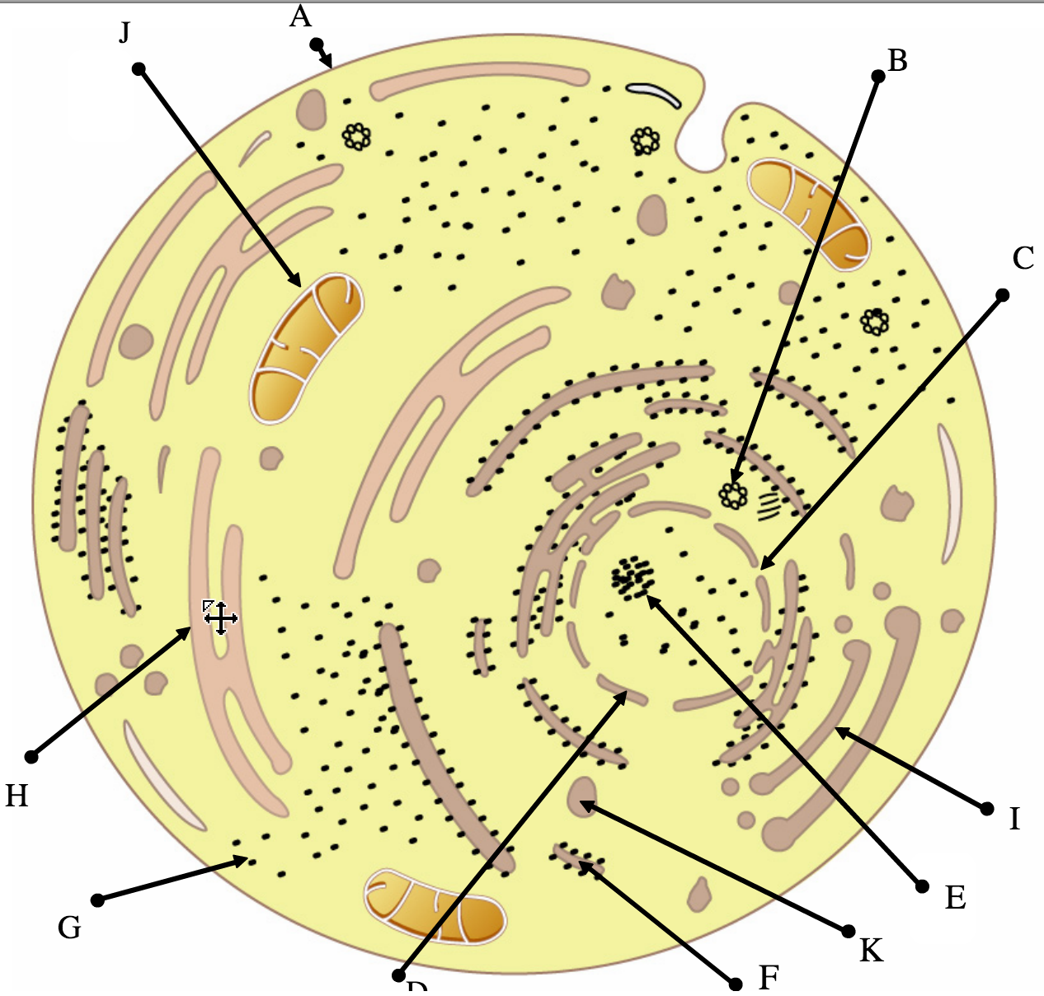
Tour of the eukaryotic cell

Slide 2
1.4 Membrane Transport
Applications:
Structure and function of sodium potassium pumps for active transport and potassium channels for facilitated diffusion in axons
Tissues or organs to be used in medical procedures must be bathed in a solution with the same osmolarity as the cytoplasm to prevent osmosis
Understanding:
Particles move across membranes by simple diffusion, facilitated diffusion, osmosis and active transport
The fluidity of membranes allows materials to be taken into cells by endocytosis or released by exocytosis
Vesicles move materials within cells
Skills:
Estimation of osmolarity in tissues by bathing samples in hypotonic and hypertonic solutions
Nature of science:
Experimental design: accurate quantitative measurements in osmosis experiments are essential

Slide 3
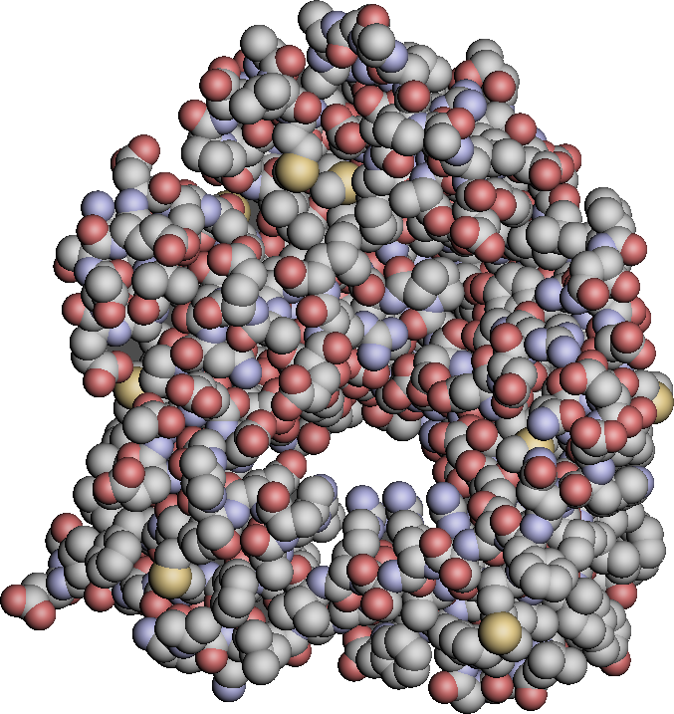
How will I cross?!

Slide 4
Transport across a membrane Exocytosis and Endocytosis
Link membrane structure to bulk transport
Define exocytosis and endocytosis
Describe vesicle movement within cells

Slide 5
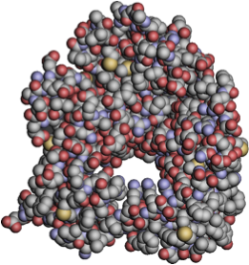
Vesicle

Slide 6
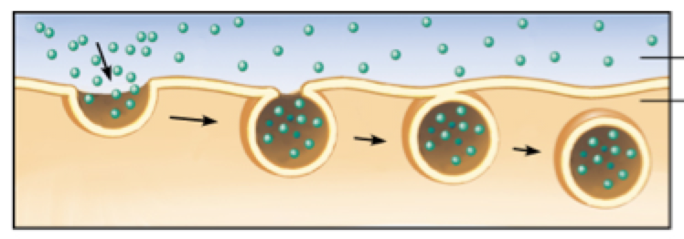
Endocytosis – large molecules entering cells
Annotate the diagram to describe endocytosis

Slide 7
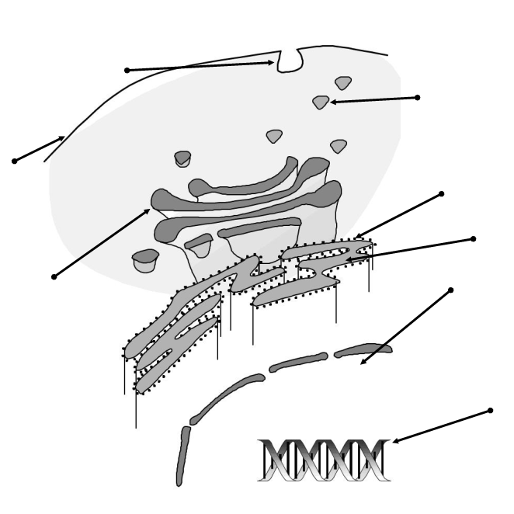
Transport using vesicles within the cell
Label diagram
What happens at the ribosome, rER and golgi?
How do proteins move between the rER and golgi?
How are proteins transported from the golgi out of the cell?
Pg 35

Slide 8
Exocytosis Large molecules exiting the cell
Annotate to describe exocytosis
transport

Slide 9
Q1 - Describe the process of endocytosis.
a. (plasma) membrane encloses/engulfs/folds in solid particles/fluid/molecules;
b. fluidity of the membrane allows endocytosis;
c. plasma membrane pulls inwards;
d. membrane pinches off/seals back on itself/edges fuse;
e. vesicle/vacuole formed;
f. vesicle breaks away from plasma membrane/moves into cytoplasm;
g. active process / endocytosis/vesicle formation requires energy/ATP;

Slide 10
