Slide 1
Levels of organisation and Prokaryotic vs Eukaryotic Cells
1.2 Ultrastructure of Cells
Describe the levels of organisation in multicellular organisms
Distinguish between prokaryotic and eukaryotic cells
Draw and label a eukaryotic cell cell

Slide 3
GIANT CELL
Cell or Organelle | True size in (um)
Average Plant Cell length | 30 um
Nucleus | 7.5 um
Nucleolus | 2.5 um
Plasma Membrane | 0.009 um thick
Mitochondrion | 1 um wide x 8 um long
Chloroplast | 2 um wide x 5 um long
Ribosome | 0.025 um
Rough Endoplasmic Reticulum | 0.5 um thick (vary in length. Look at diagrams for sensible size)
Golgi Complex | 1 um thick (vary in length. Look at diagrams for sensible size). Vesicles – diameter 1um
Vacuole | 50-80% of volume of cell
Lysosomes | 0.2-2 um circular (vary)
Cell Wall | 1-2 um thick

Slide 4
The Giant 2D Cell lab
Method
You and your group (total of 2-3 people) are responsible to create a diagram of an organelle to scale. Use this sheet to help you create your model.
You will also be responsible for a 1 min presentation about your organelle. Your speeches will be presented while standing in a giant cell.
Creating the Organelles
The Giant Plant Cell is shaped like a giant rectangle. You have been provided with a chart of actual cell organelle sizes.
You must calculate the size of your giant organelle so that it is proportionately correct for the huge cell. Remember um stands for micrometers.
You also need to research the function of the organelle for your short presentation.

Slide 5
Eukaryotic Cell Organelles
Match the micrograph, diagram and function of the organelles.
Once matched you need to draw a diagram of each organelle and summerise the function in less than 10 words.
Photo | Diagram | Function

Slide 7
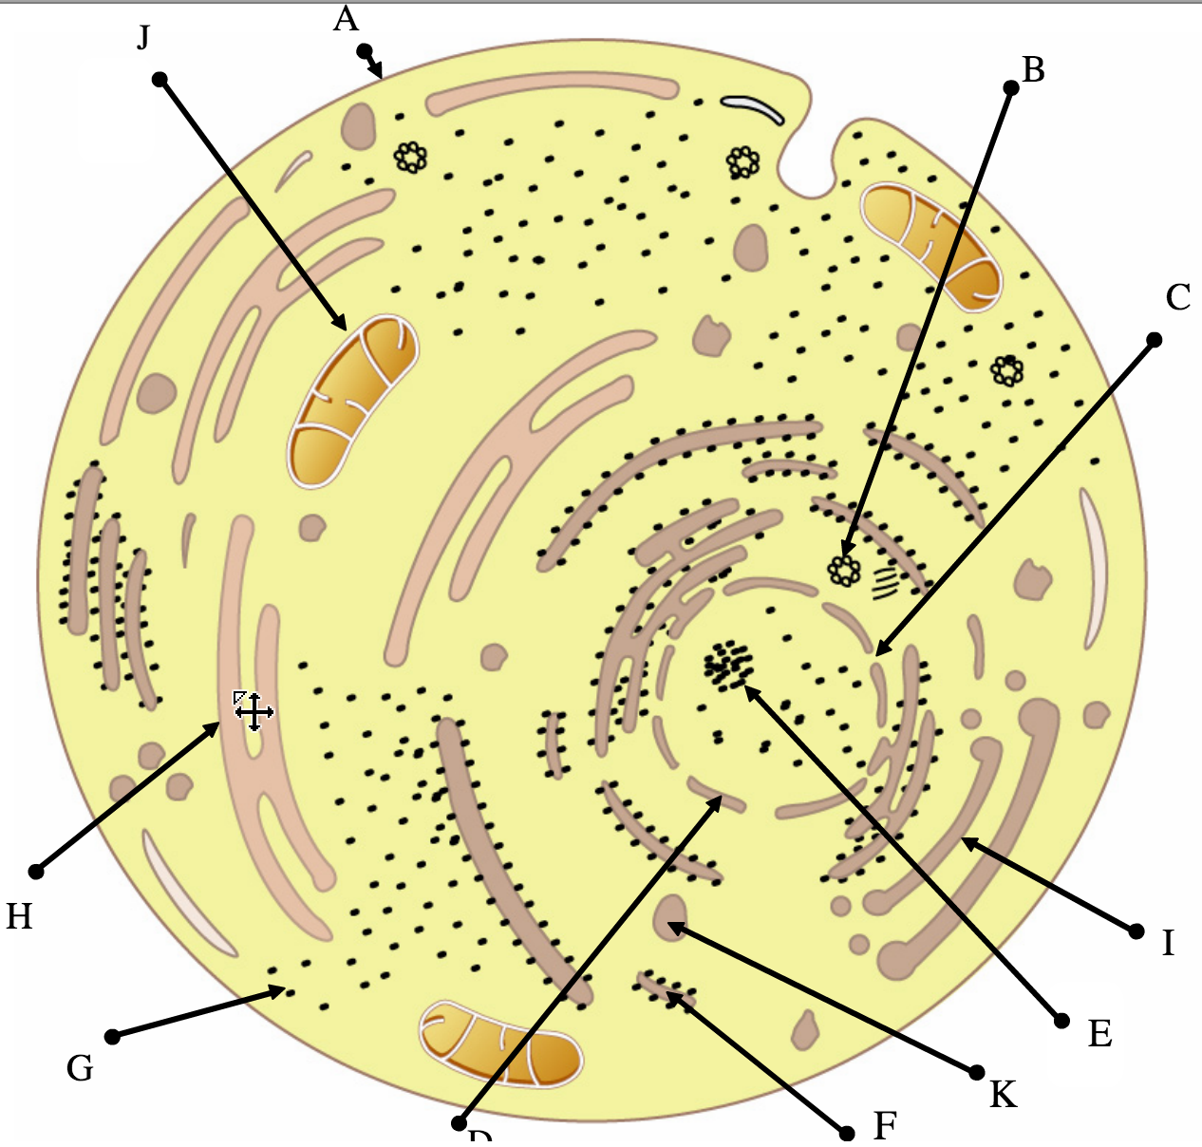
Tour of the eukaryotic cell
D

Slide 8
Pancreatic and Palisade Cells
Look at the micrographs on page 24.
Draw a diagram of each cell. Label the diagram and explain how these cells are adapted for their function.

