Slide 1
If I get a cell….
….from some unidentified tissue. The DNA has all decomposed. How can I get information on the genetic make up of the organism?

Slide 2
Define…
Genome
All the genes present in an organism
Proteome
All the proteins produced by a cell/organism

Slide 3
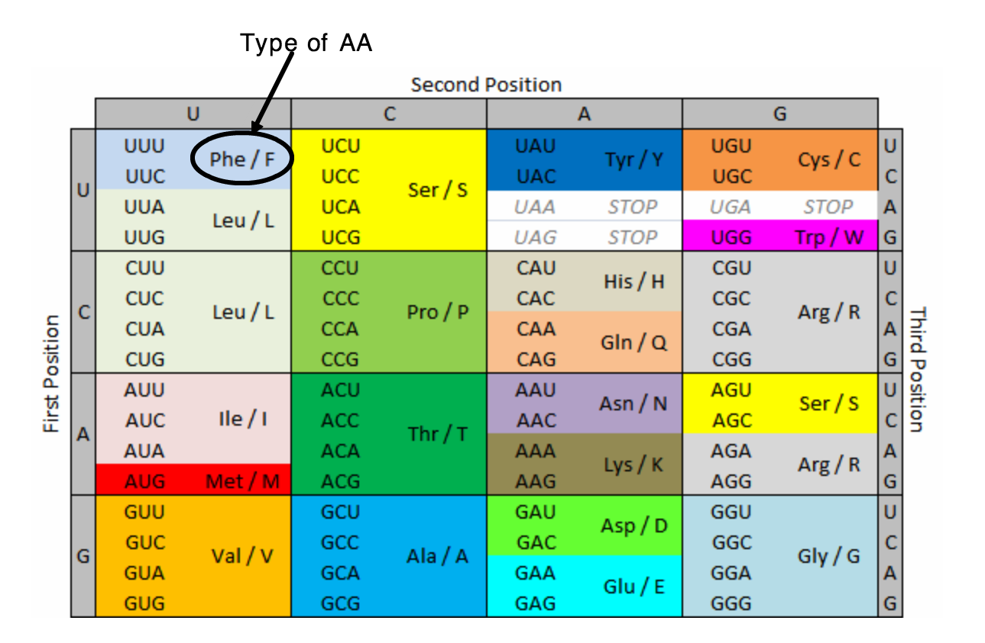
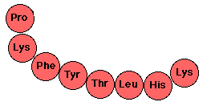
These are mRNA bases
What DNA sequence codes for this chain of amino acids...?

Slide 4
The chain of amino acids folds into protein.
The way it folds depends on the sequence of amino acids.
Different sequence = different folding = different protein

Slide 6
2.5 Enzymes
Applications:
Methods of production of lactose-free milke and its advantages
Understanding:
Enzymes have an active site to which specific substrates bind
Enzyme catalysis involves molecular motion and the collision of substrates with the active site
Temperature, pH and substrate concentration affect the rate of activity of enzymes
Enzymes can be denatured
Immobilized enzymes are widely using in industry
Nature of science:
Experimental design: accurate quantitative measurements in enzymes experiments require replicates to ensure reliability
Skills:
Design of experiments to test the effect of temperature, pH and substrate concentration on the activity of enzymes
Experimental investigation of a factor affecting enzyme activity

Slide 7
Enzymes are proteins
They can break down or build molecules
They are specific

Slide 9
1. Hit start
2. Could how many products are formed in 10 seconds. Hit stop
3. Change one condition:
Number of enzymes
Number of substrates
Temperature
pH
Hit setup
Make sure you reset before you change anything.
4. Could the number of substrates as you change the conditions.
What affects enzyme activity (number of products made)????
Enzyme simulation

Slide 10
1.What happens if you increase the number of enzymes (enzyme conc)?
2.What happens if you increase the number of substrate molecules (substrate conc)?
3.What happens if you decrease the temperature to 5 degrees?
4.What happens if you increase the temperature to 100 degrees?
5.What is the optimum temperature?
6.What is the relationship between temperature and how fast the molecules move?
7.What happens if you increase or decrease pH?

Slide 11
Designing Enzyme Investigations
Pg 101-102
You will:
Practice a method
Select your variables
Conduct the investigation
Create a PP presentation (which you will present)
Background research on your IV
Method
Results table
Graph
Conclusion (describe results & Explain results (using science)

Slide 12
Equipment for practicing method
___% hydrogen peroxide
Yeast
Gas syringe
All normal lab equipment

Slide 13
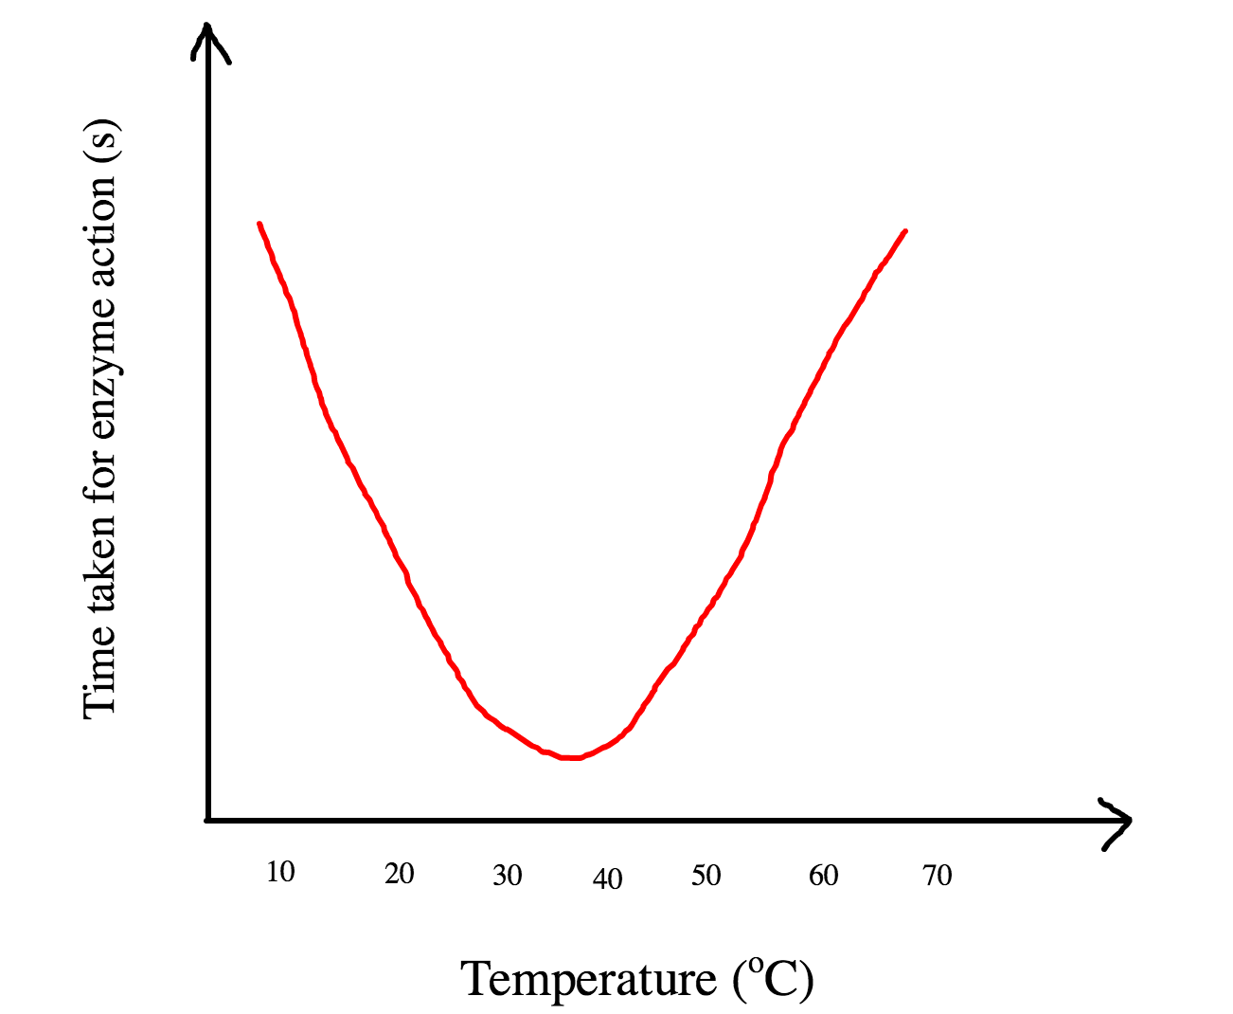
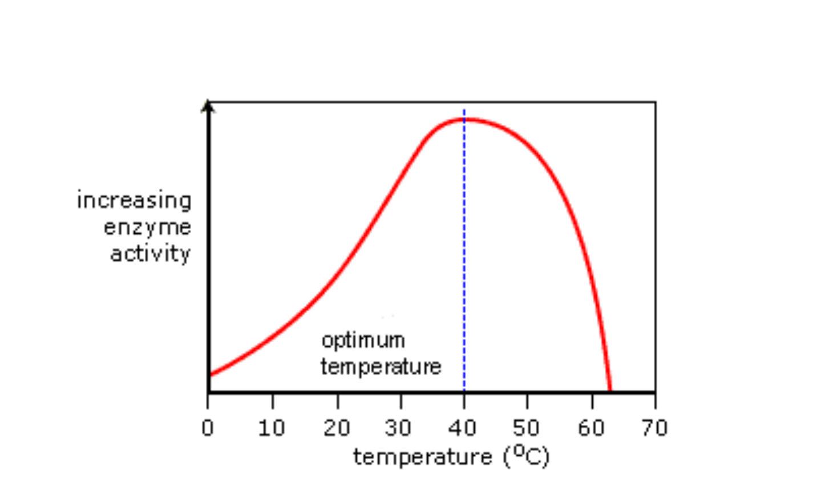
Enzyme activity

Slide 15
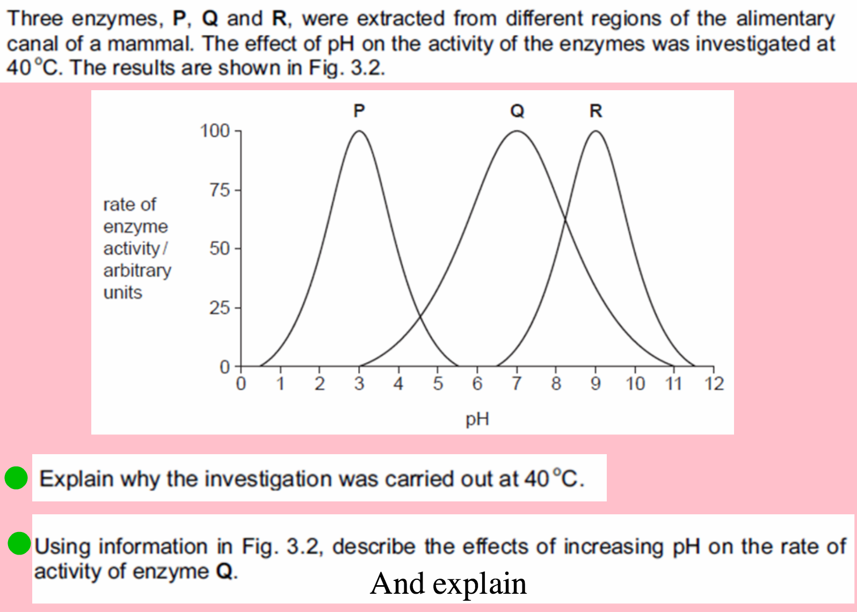

Slide 16
Vol oxygen (ml)
Rate (ml/s⁻¹) = 10.4
2

Slide 17
Lactose free milk
Explain…
Methods and advantages of producing lactose free milk

Slide 18
Immobilized Enzymes
What are immobilised enzymes?
What are the advantages of using immobolised enzymes?
Give 2 examples of where they are used in industry.

