Slide 1
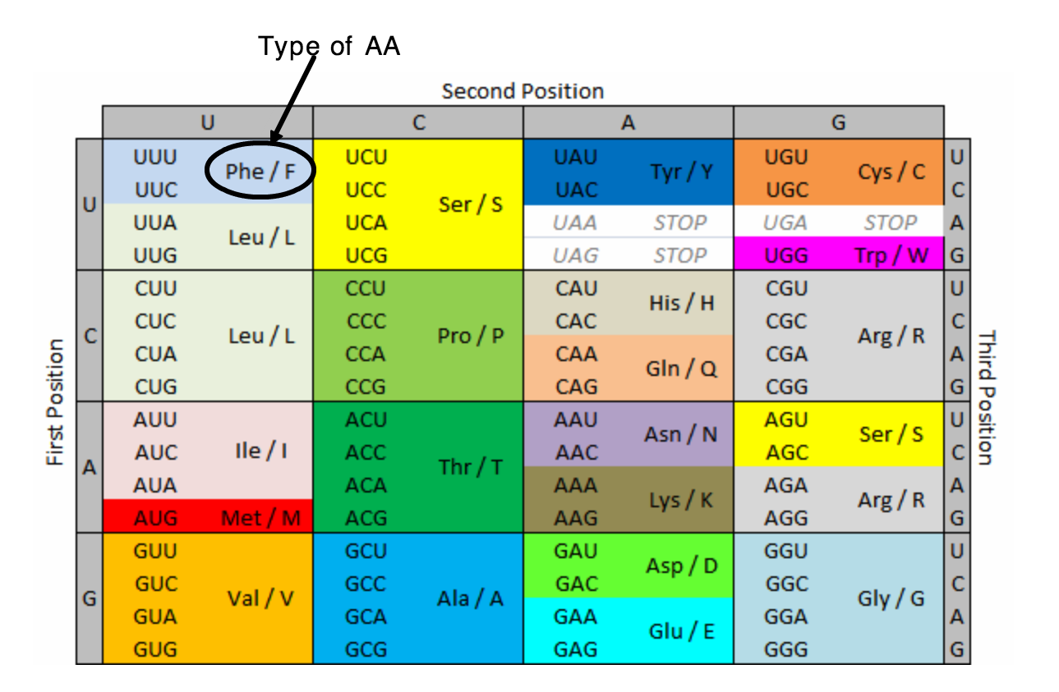
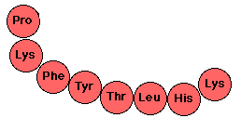
These are mRNA bases
What DNA sequence codes for this chain of amino acids...?

Slide 2
The chain of amino acids folds into protein.
The way it folds depends on the sequence of amino acids.
Different sequence = different folding = different protein

Slide 4
Enzymes

Slide 5
This reaction happens in cells…
Catalase (enzyme)
Hydrogen peroxide
water
oxygen

Slide 8
1. Hit start
2. Could how many products are formed in 10 seconds. Hit stop
3. Change one condition:
Number of enzymes
Number of substrates
Temperature
pH
Hit setup
Make sure you reset before you change anything.
4. Could the number of substrates as you change the conditions.
What affects enzyme activity (number of products made)????
Enzyme simulation

Slide 9
What happens if you increase the number of enzymes?
What happens if you increase the number of substrate molecules?
What happens if you increase decrease the temperature?
What happens if you increase the temperature to 35 degrees?
What happens if you increase the temperature to 100 degrees?
What is the relationship between temperature and how fast the molecules move?
What happens if you increase or decrease pH?

Slide 11
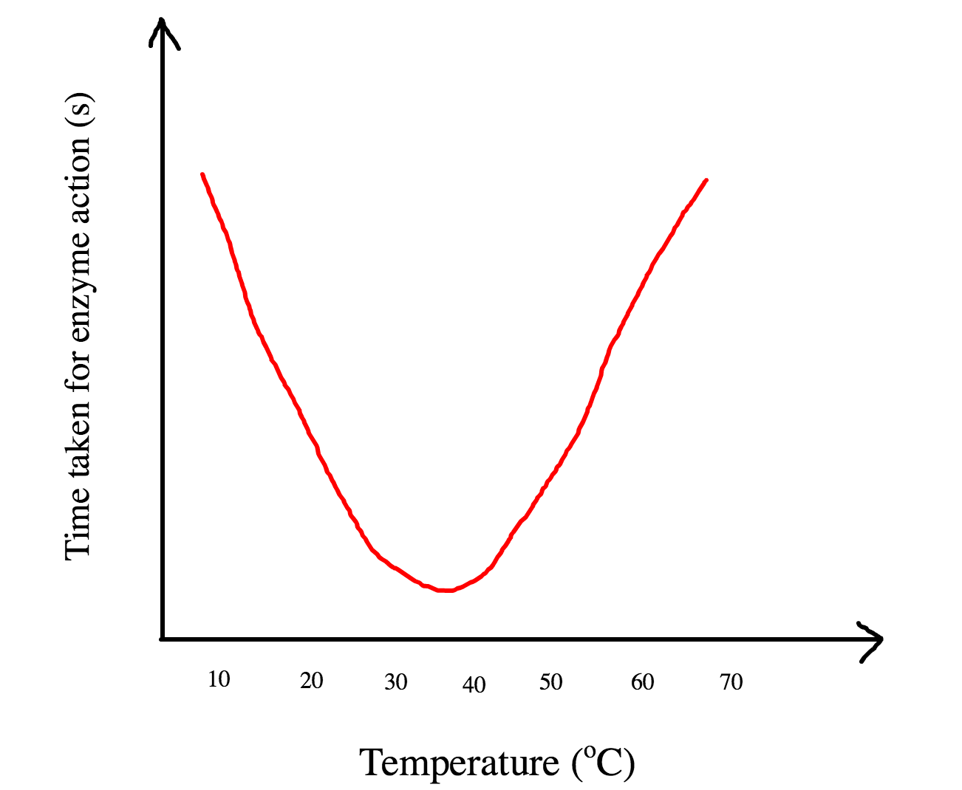
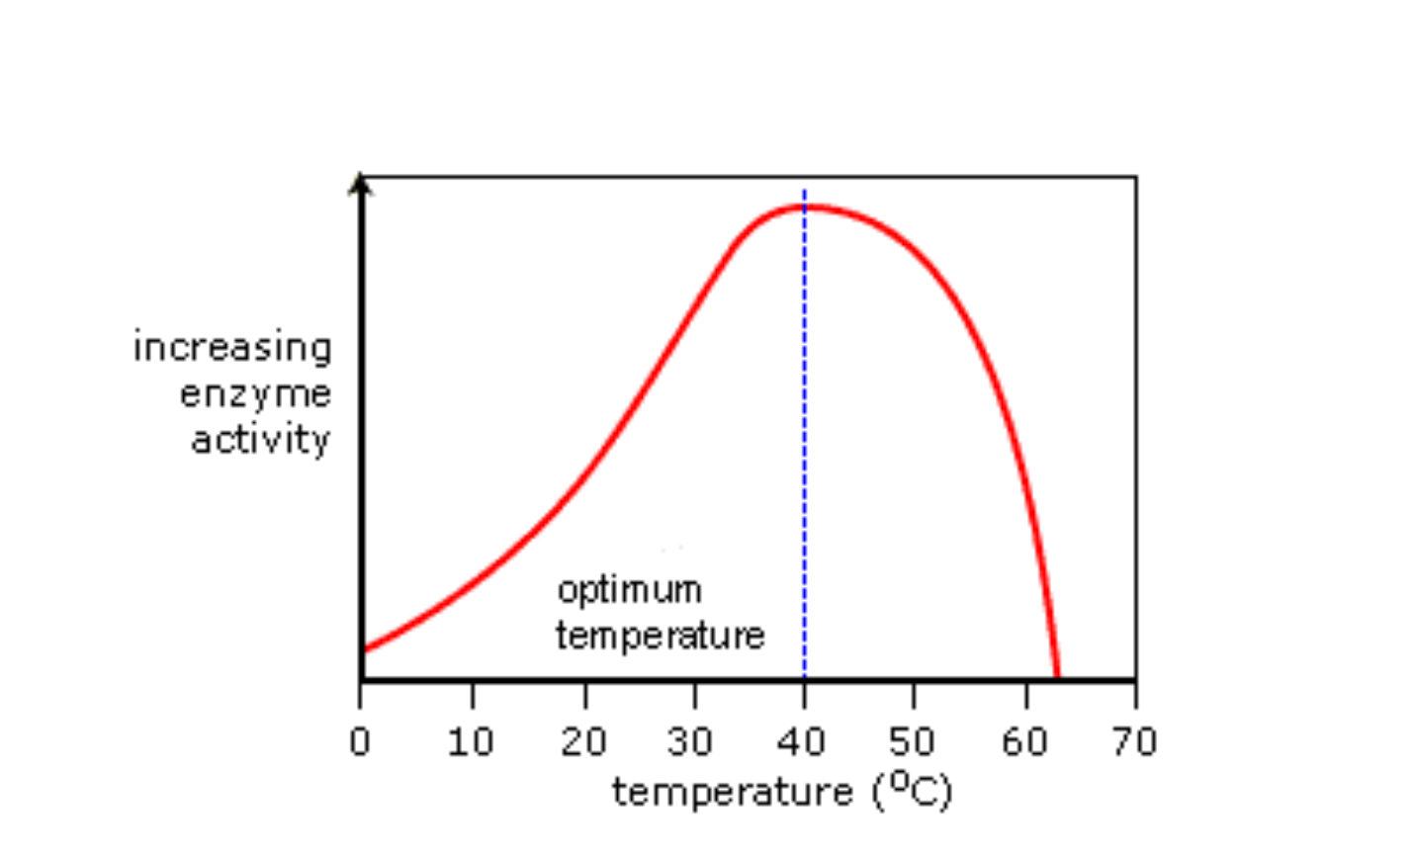

Slide 12
Shape of the active site changes shape so substrate can no longer bind to the active site and no products form

Slide 13
Enzymes have an optimum pH. All enzymes have a different optimum pH.
A change in pH away from the optimum will cause the enzyme to denature
Denature = change in the shape of the active site so no substrate can bind and no products will be formed (decreased enzyme activity)

Slide 15
