Slide 1
4.1 Species, communities and ecosystems
Skills:
Classifying species from knowledge of their nutrition
Testing for association between 2 species using statistical tests
Recognising and interpreting statistical significance
Setting up sealed mesocosms to try to establish sustainability
Understanding:
Species are groups of organisms that can potentially interbreed to produce fertile offspring
Members of a species may be reproductively isolated in separate populations
Species have either an autotrophic or heterotrophic method of nutrition
Consumers are heterotrophs that feed on living organisms by ingestion
Detritivores are heterotrophs that obtain organic nutrients from detritus by internal ingestion
Saprotrophs are heterotrophs that obtain organic nutrients from dead organic matter by external digestion
A community is formed by populations of different species living together and interacting with each other
A community forms an ecosystem by its interactions with the abiotic environment
Autotrophs and heterotrophs obtain inorganic nutrients from the abiotic environment
Nature of science:
Looking for patterns, trends and discrepancies: plants and algae are mostly autotrophic but some are not
Understanding:
The supply of inorganic nutrients is maintained by nutrient cycling
Ecosystems have the potential to be sustainable over long periods of time

Slide 2
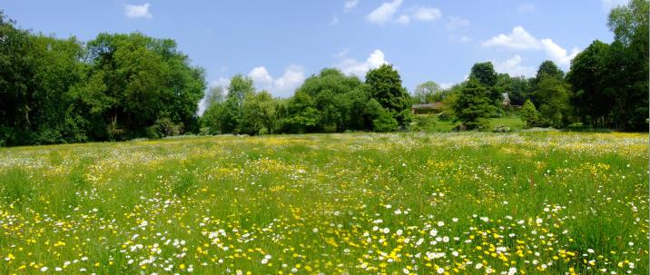
Biotic and Abiotic factors
Find out…....
What is meant by abiotic factors and biotic factors in an ecosystem?
Give examples of these factors here..
Ecosystems

Slide 3
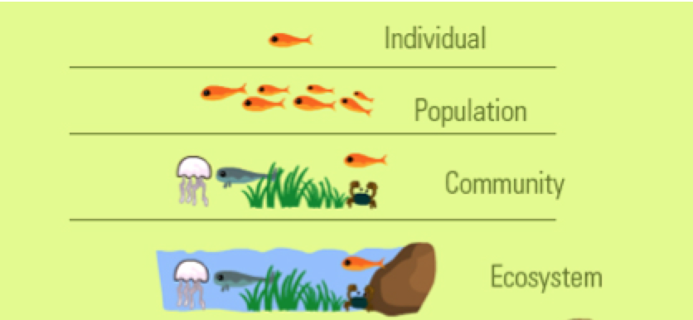
Ecosystem
A community forms an ecosystem by interactions with the abiotic environment
Living organisms could not live in isolation – they need the non-living surroundings (air, water, soil, rock)
species

Slide 4
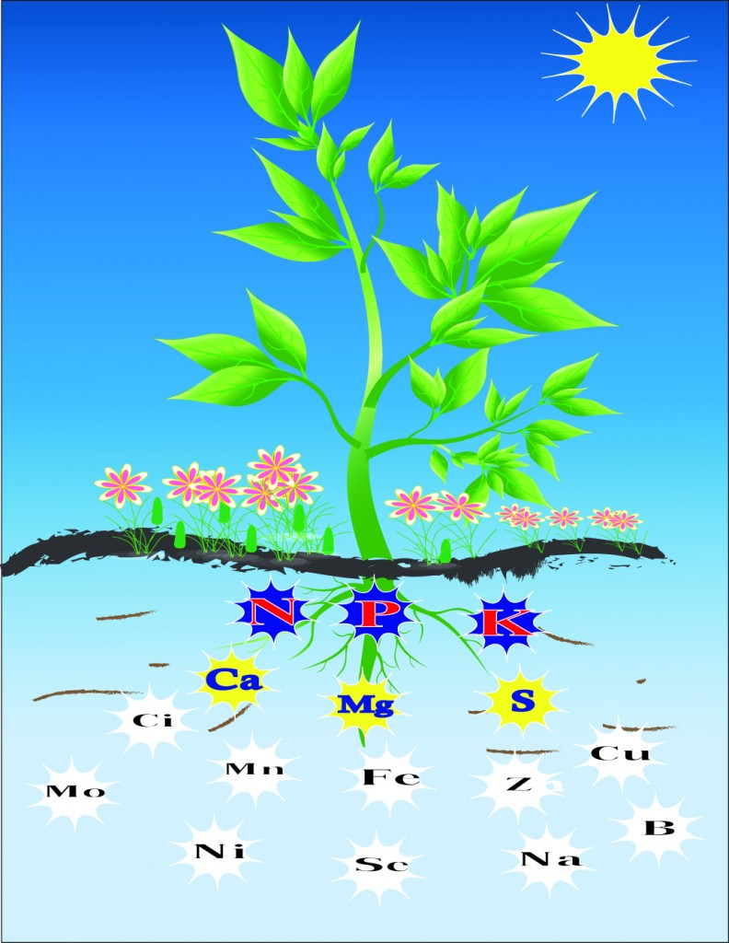
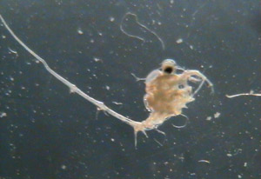
Inorganic Nutrients - abiotic
These are an essential abiotic part of an ecosystem
Both autotrophs and heterotrophs require them
Autotrophs:
Minerals from soil
Carbon dioxide and water used in photosynthesis
Heterotrophs:
Mostly from food (biotic)
Can obtain inorganic minerals from the abiotic environment (there are lots of mineral in water)

Slide 5
Earth’s resources
Living organisms have been using supplies on earth for billions of years – why have they not run out?
Carbon
Nitrogen
Hydrogen
Oxygen
Phosphorous
Chemical elements can be endlessly recycled
Organisms absorb elements as inorganic nutrients from the abiotic environment, use them and return them to the environment with the atoms unchanged.
You will study the N and C cycles later

Slide 6
Earth’s resources
Earth is a closed system – nothing leaves or enters - apart from rockets/meteorite (panspermea!)

Slide 7
Sustainability
Sustainable = can continue indefinitely
Supplies of fossil fuels are finite (will run out). They are not being renewed at the rate we use them they will run out quickly.
Nutrient availability
- If nutrients are recycled indefinitely there will not be a shortage.
Detoxification of waste
Waste product of one species usually used by another species
Energy availability
- Light from the sun (must be continually supplied)

Slide 8
Mesocosms
Small experimental areas set up as ecological experiments.
Seal a community of organisms together with air and soil or water inside a container.
You will create your own mesocosm ON MONDAY. What will you need for this?
You will be given plants, soil, water, rocks

