Slide 1
The route of blood
Left atrium
Left atrium

Slide 2
Heart Questions…
Last week.

Slide 3
Double Circulation
Recap the flow of blood around the heart and body
Explain the advantages of a double circulation

Slide 4
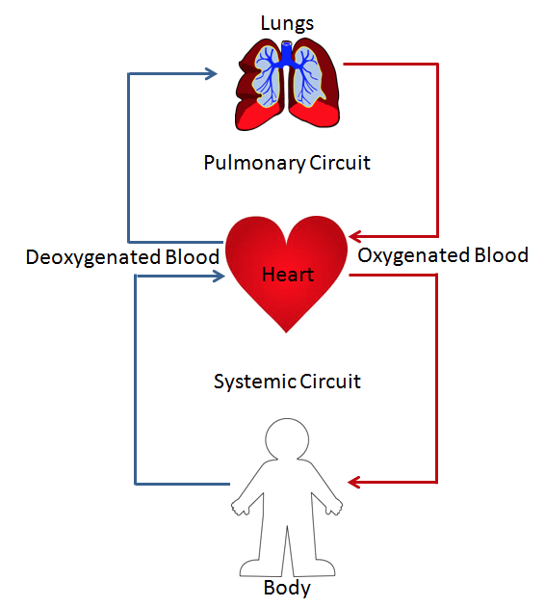
Wh
What are the advantages of
a double circulation?

Slide 5
Heart and Blood Vessel Questions
What is happening in the heart when the semi-lunar valves are closed?
I. Blood is entering the aorta.
II. Blood is entering the pulmonary artery.
III. Blood is entering the ventricles.
IV. The ventricles are contracting.
A. I and II only
B. I and III only
C. III only
D. III and IV only
(Total 1 mark)
2. Outline the events that occur within the heart, which cause blood to move around the body.
(Total 6 marks)
3. Explain the relationship between the structure and function of arteries, veins and capillaries.
(Total 8 marks)

Slide 6
1. C [1]
2.
blood is collected in the atria;
blood is pumped from the atria to the ventricles;
opened atrio-ventricular valves allow flow from the atria to the ventricles;
closed semi-lunar valves prevent backflow from the arteries to the ventricles;
blood is pumped out from the ventricles to the arteries;
open semi-lunar valves allow flow from ventricles to arteries;
closed atrio-ventricular valves prevent backflow to the atria;
pressure generated by the heart causes blood to move around the body;
pacemaker (SAN) initiates each heartbeat;
[6]

Slide 7
3. ([3 max] for information on arteries) thick wall / elastic fibres to help withstand the high(er) pressure; outer fibrous coat prevents artery from rupturing under the high pressures; lumen small compared to wall thickness to maintain high pressure; except lumen large near the heart to conduct a large volume of blood; valves in aorta and pulmonary artery to prevent back flow into ventricles in diastole; layers of (smooth) muscle to allow arteries to contract / elastic recoil; allows the pressure to be altered (vasoconstriction and vasodilation);
([3 max] for information on veins) lumen always large in relation to diameter; thin wall / more collagen and fewer elastic fibres (than arteries) since pressure low(er); very little muscle since not needed for constriction; valves to prevent back flow between pulses;
([3 max] for information on capillaries) no muscle / elastic tissue since pressure very low; endothelial layer one cell thick to allow permeability / diffusion of chemicals / tissue fluid; small diameter leads to exchange; some fenestration / pores to allow rapid diffusion; no valves since pressure very low;
[8]

Slide 8
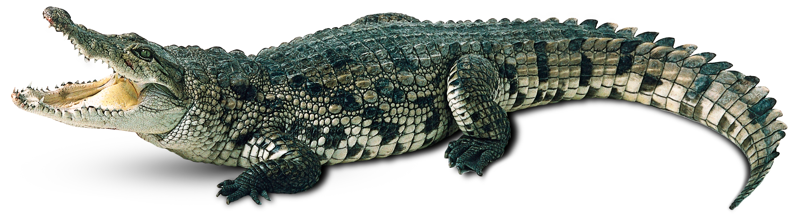
Croc circulation

