Slide 1
What stage of mitosis?
Double Helix

Slide 2
Maurice Wilkins
What did they do?

Slide 3
7.1 DNA structure and replication
Applications:
Rosalind Franklin’s and Maurice Wilkins’ investigation of DNA structure by X-ray diffraction
Tandem repeats are used in DNA profiling
Use of nucleotides containing dideoxyribonucleic acid to stop DNA replication
Understanding:
DNA structure suggested a mechanism for DNA replication
Nucleosomes help to supercoil the DNA
DNA replication is continuous on the leading strand and discontinuous on the lagging strand
DNA replication is carried out by a complex system of enzymes
DNA polymerase can only add nucleotides to the 3’ end of the primer
Some regions of DNA do not code for proteins but have some other important function
Skills:
Analysis of results of the Hershey and Chase experiment providing evidence that DNA is the genetic material
Utilisation of molecular visualisation software to anaylyse the association between proteins and DNA within a nucleosome
Nature of science:
Making careful observations: Rosalind Franklin’s X-ray diffraction provided crucial evidence that DNA is a double helix

Slide 4
Structure of DNA
Understand that the nucleus of a cell contains chromosomes and that genes are found on chromosomes
Show how DNA is supercoiled using histone proteins into a nucleosome
Describe DNA as being a double helix
State the components of a nucleotide
Identify the 3’ and 5’ ends of a nucleotide and DNA strand

Slide 5
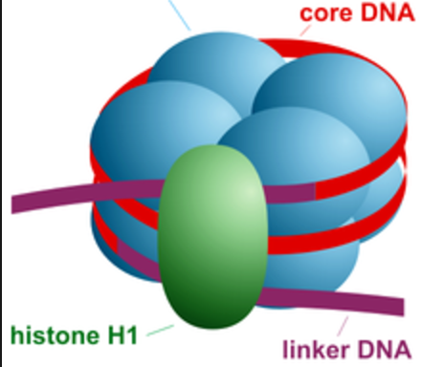
Supercoiling of DNA
Allows 3m of DNA to be packed into each cell
133
AU (Astronomical Units)
What is the problem if all the DNA is wrapped up?

Slide 6
5’
5’
3’
Bases are held together with hydrogen bonds.
Notice the number of bonds
DNA strands are antiparallel
3’
5’

Slide 7
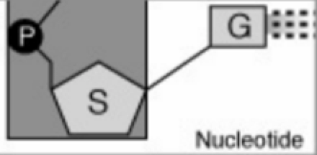
Deoxyribose Sugar
A nucleotide
Covalent bonds
Phosphate
Base
phosphodiester

Slide 8
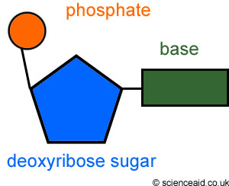
phosphodiester
Bond?

Slide 10
Calculating the number of bases
If 15% of bases in a gene are adenine, What is the % of cytosine bases in the gene?

Slide 11
D
C

Slide 12
phosphate
Covalent/phosphodiester

Slide 13
B

Slide 14
A

Slide 15
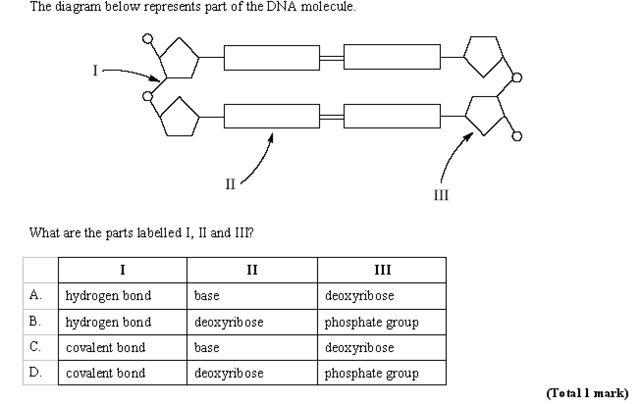
C

Slide 17
DNA as the genetic Material
It was known that there was a molecule that was involved in heredity. This would allow information to be passed from one generation to the next.
Was it proteins or DNA?
Hershey and Chase (1952) found out…

Slide 18
Hershey and Chase (1952)

