Slide 1
7.1 DNA structure and replication
Applications:
Rosalind Franklin’s and Maurice Wilkins’ investigation of DNA structure by X-ray diffraction
Tandem repeats are used in DNA profiling
Use of nucleotides containing dideoxyribonucleic acid to stop DNA replication
Understanding:
DNA structure suggested a mechanism for DNA replication
Nucleosomes help to supercoil the DNA
DNA replication is continuous on the leading strand and discontinuous on the lagging strand
DNA replication is carried out by a complex system of enzymes
DNA polymerase can only add nucleotides to the 3’ end of the primer
Some regions of DNA do not code for proteins but have some other important function
Skills:
Analysis of results of the Hershey and Chase experiment providing evidence that DNA is the genetic material
Utilisation of molecular visualisation software to anaylyse the association between proteins and DNA within a nucleosome
Nature of science:
Making careful observations: Rosalind Franklin’s X-ray diffraction provided crucial evidence that DNA is a double helix

Slide 2
DNA Replication (HL)
Identify the 3’ and 5’ ends of DNA strands
Describe the roles of enzymes in DNA replication
State the direction of relication and the formation of Okazaki fragments
Describe the process of semi-conservative DNA replication

Slide 3
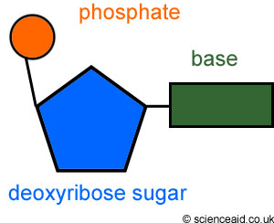

Slide 4
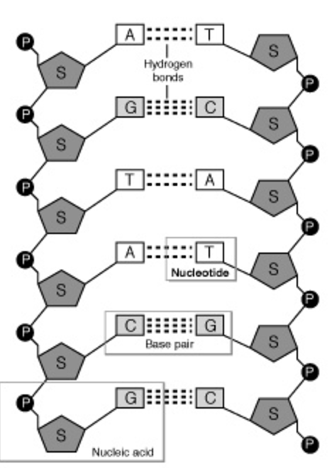
5' and 3'

Slide 5
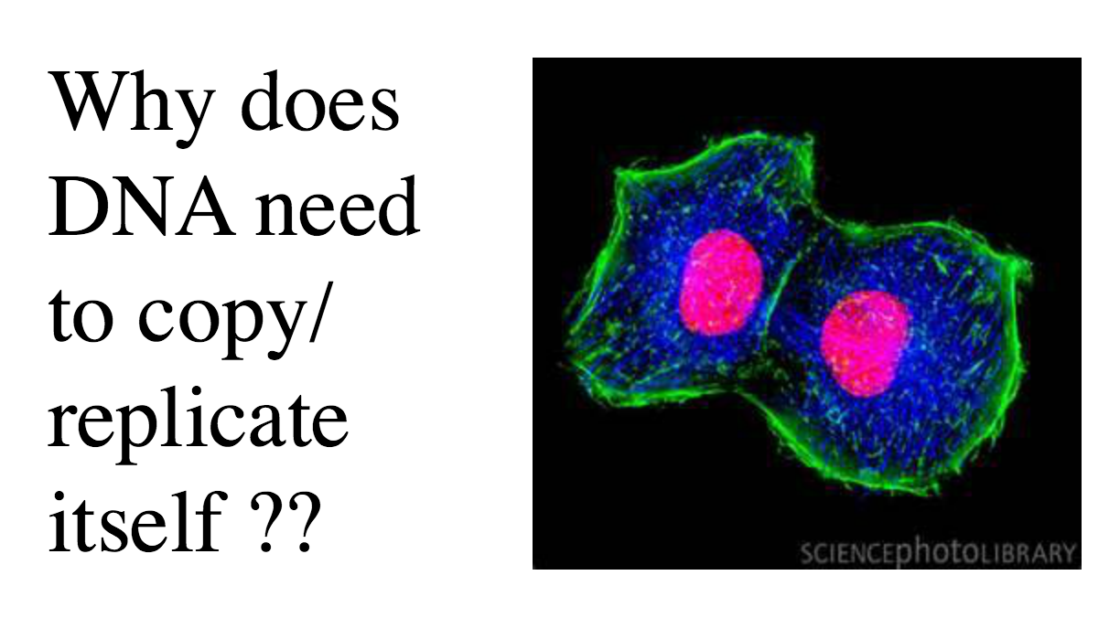

Slide 6
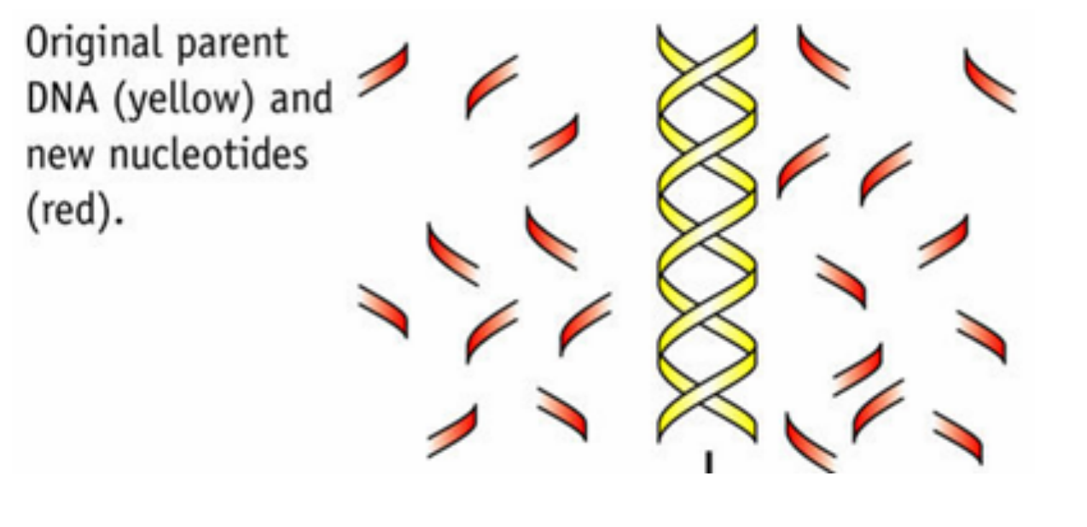

Slide 7
Who found out the truth?

Slide 8
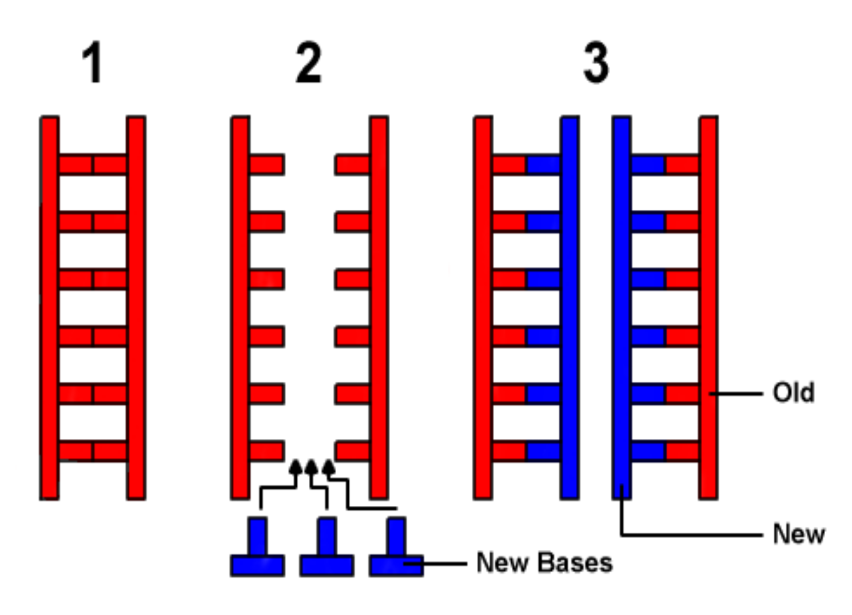
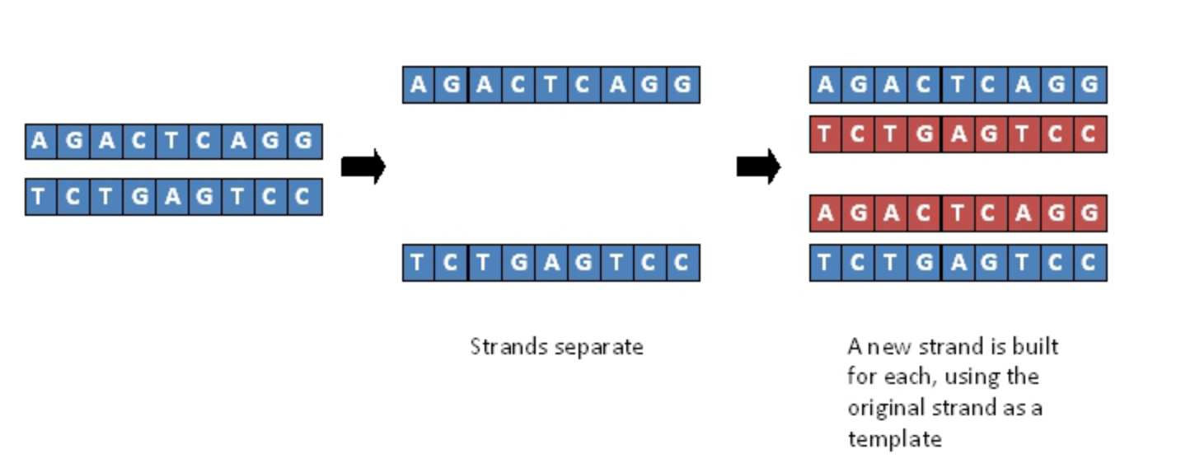

Slide 9
DNA polymerase I
DNA polymerase III
RNA primase
DNA ligase
Single stranded DNA binding proteins
Leading strand
3’
3’
3’
5’
5’
Replication is continuous on the leading strand and discontinuous on the lagging strand
3’
5’
5’
New strand made in fragments that move away from the replication fork
Lagging strand
5' to 3'

Slide 10
I
III

Slide 11
DNA Replication
Strands separated by enzyme helicase
Single stranded DNA binding proteins stop the strands from re-annealing
DNA polymerase III creates a new strand from 5’ to 3’ (leading strand)
Lagging strand also needs to form from 5’ to 3’ so must do in sections called Okazaki fragments
RNA primase lays down an RNA primer
DNA polymerase III then lays down new DNA
Repeats forming Okazaki fragments
DNA polymerase I replaces the RNA primers with DNA
DNA ligase then connects the Okazaki fragments

