Slide 1
Where in a cell are the chromosomes found?
How many chromosome pairs do humans have in their somatic (body) cells?
What is the function of a gene?
What are the three components of a nucleotide?
How many bonds form between A and T?
What kind of bonds are these?
Compare the DNA found in a skin cell and the DNA found in a liver cell.
In the cell cycle when does DNA replicate itself?
What are the products of mitosis?

Slide 2
DNA Replication
Identify the 3’ and 5’ ends of DNA strands
Describe the roles of enzymes in DNA replication
Describe the process of semi-conservative DNA replication

Slide 3
What stage of mitosis?
Double Helix

Slide 4
V
W
U

Slide 5
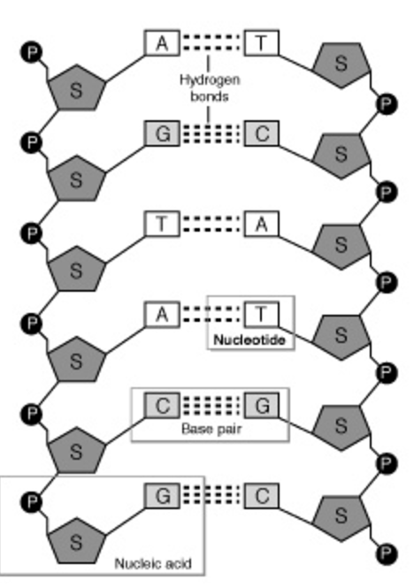
5' and 3'

Slide 7
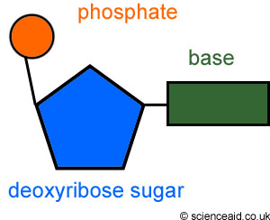
C
C
C
C

Slide 8
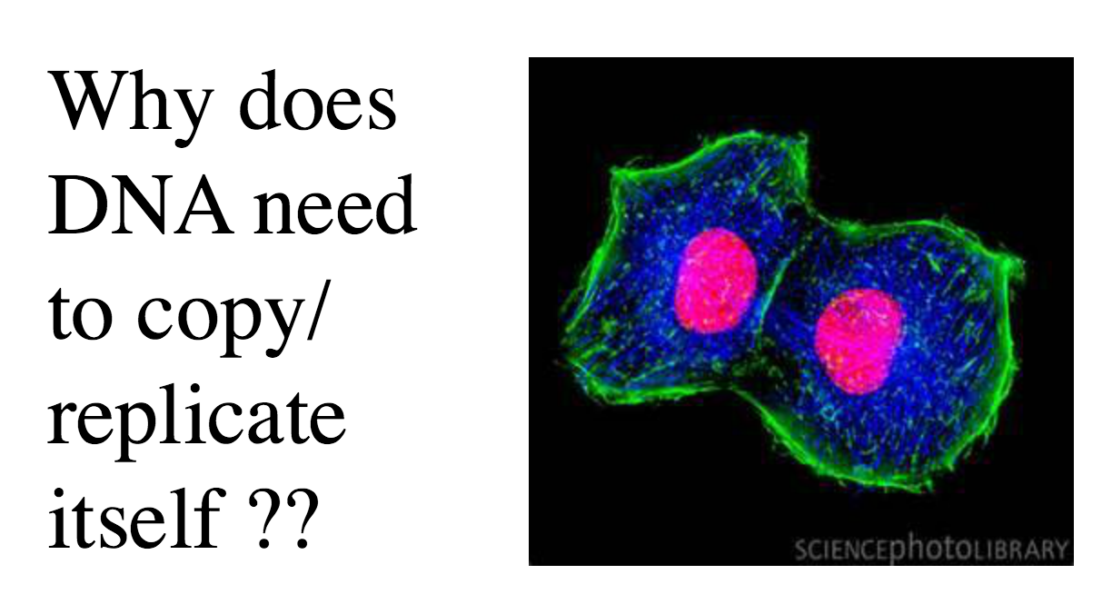

Slide 9
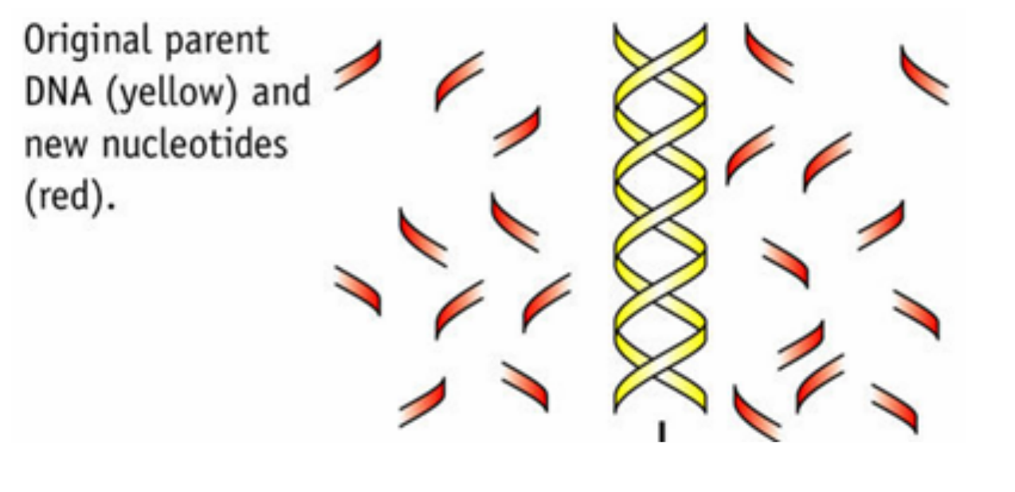

Slide 11
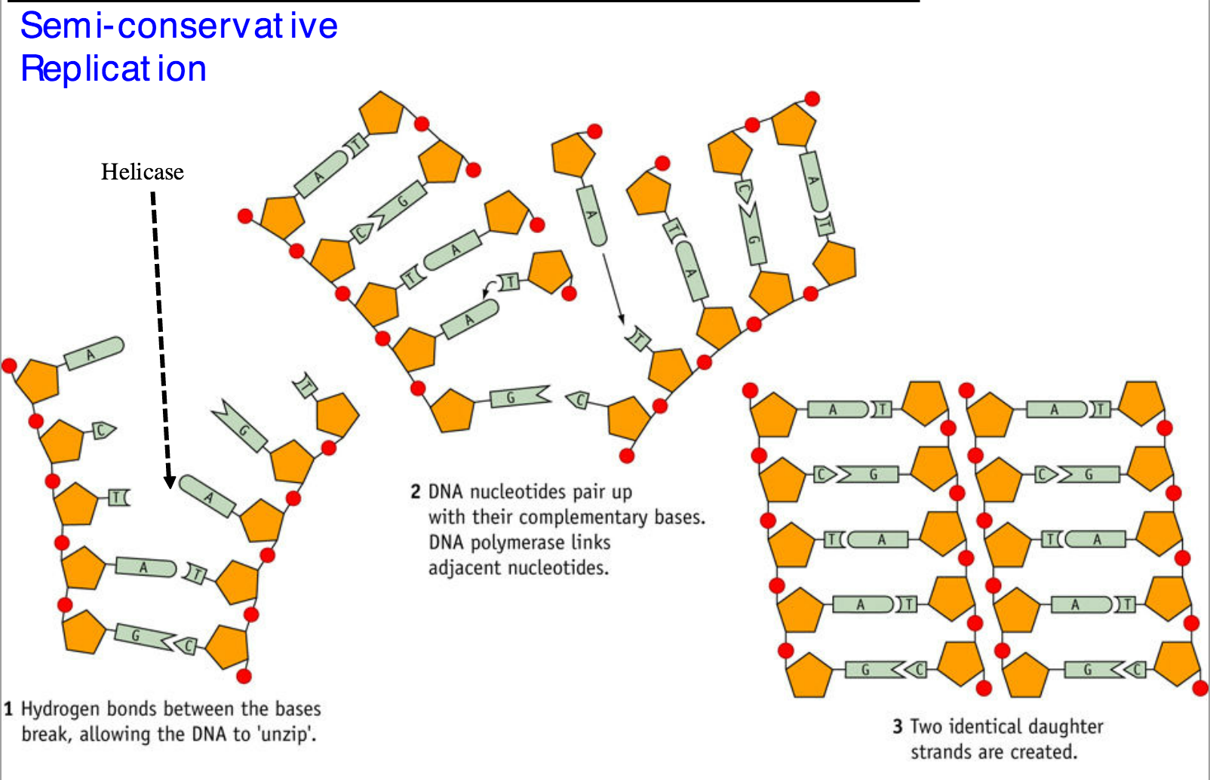
Janice

Slide 12
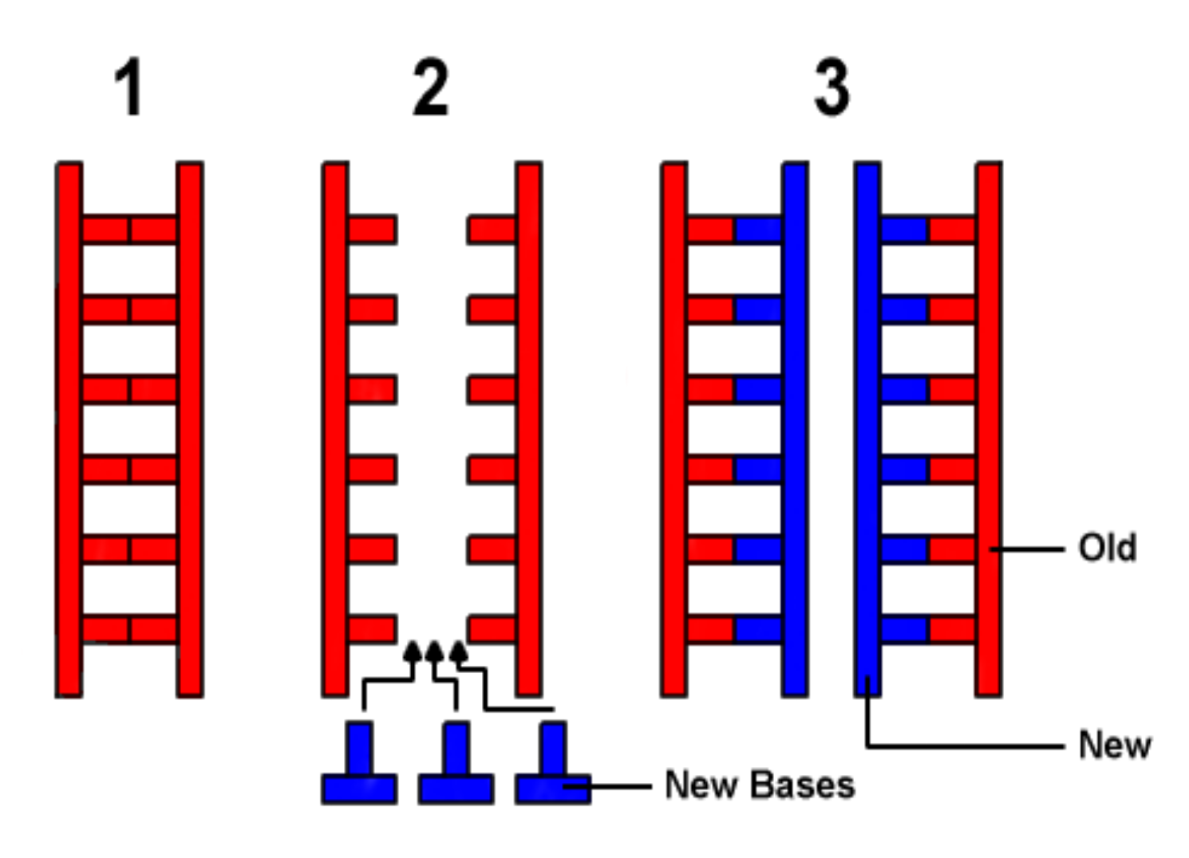
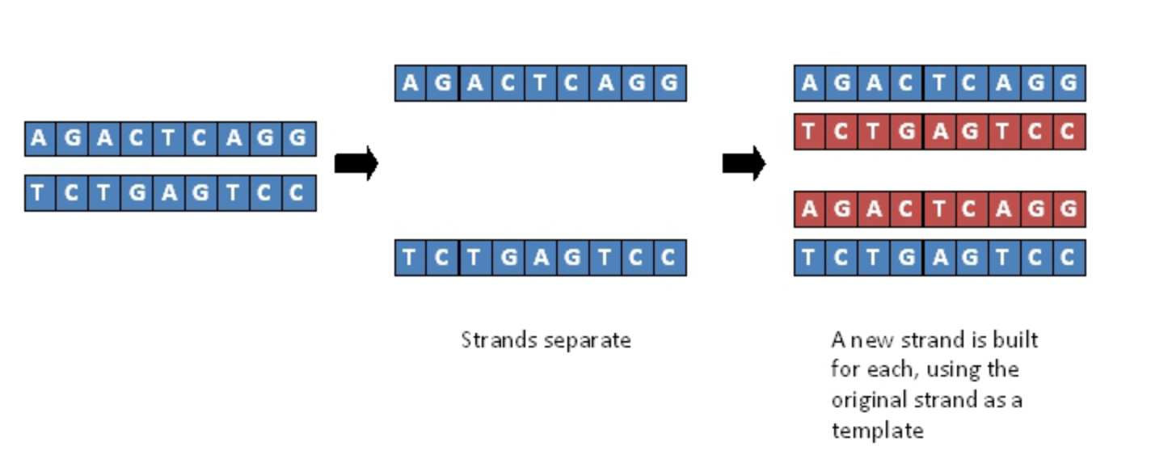

Slide 13
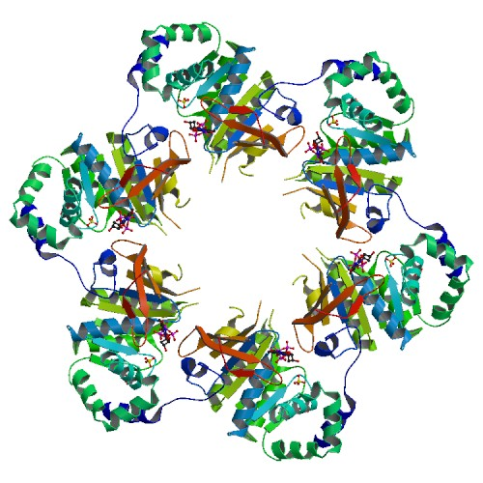
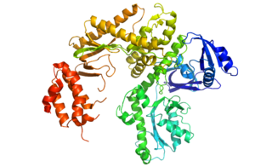
Helicase and DNA polymerase
Enzymes involved in DNA replication

Slide 15
Helicase
DNA rep
What does it do?
Moves down the strand. Unwinds the double helix
Breaks the hydrogen bonds, separating the strands
DNA polymerase
What does it do?
Moves down a DNA strand in the same direction. Each strand is copied from 5’ to 3’.
Attaches nucleotides – complementary base pairing

Slide 16
Qs

Slide 17
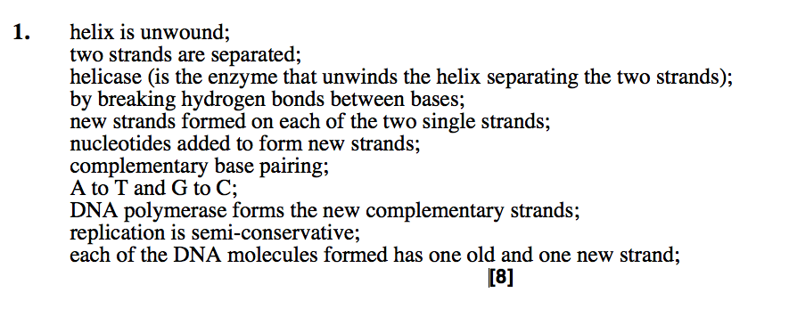

Slide 18
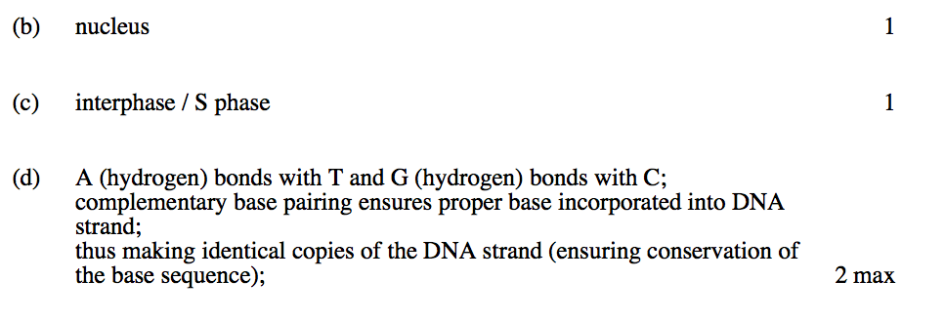
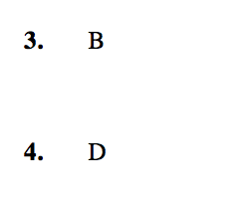

Slide 19
Mistakes?
DNA polymerase unzips DNA by breaking the covalent bonds. Helicase builds a new strand by attaching a to G and C to T by complex base matching.
A new strand is build from 5’ to 3’. A rimer is placed on the DNA to start replication. On the leading strand Ogawaki fragments are formed.

Slide 20
5' to 3'

Slide 22
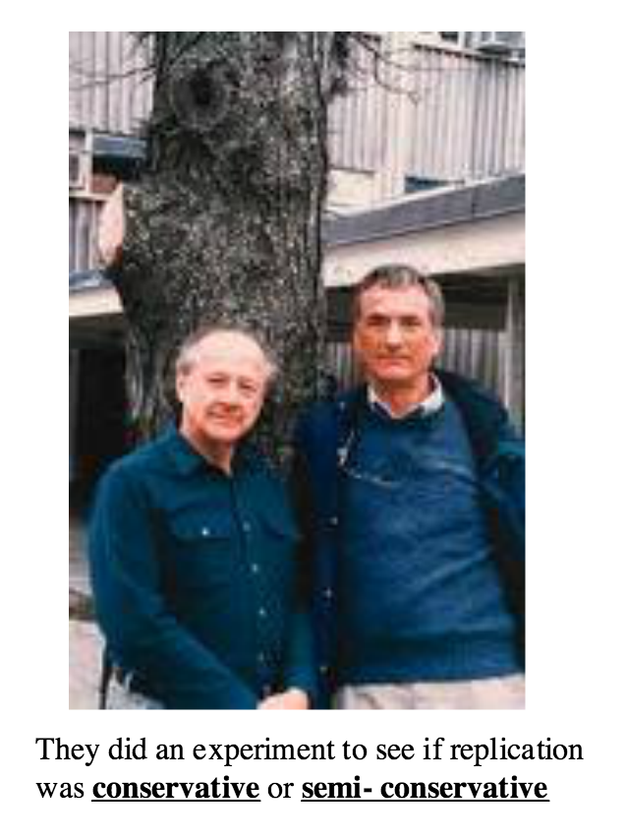

Slide 25
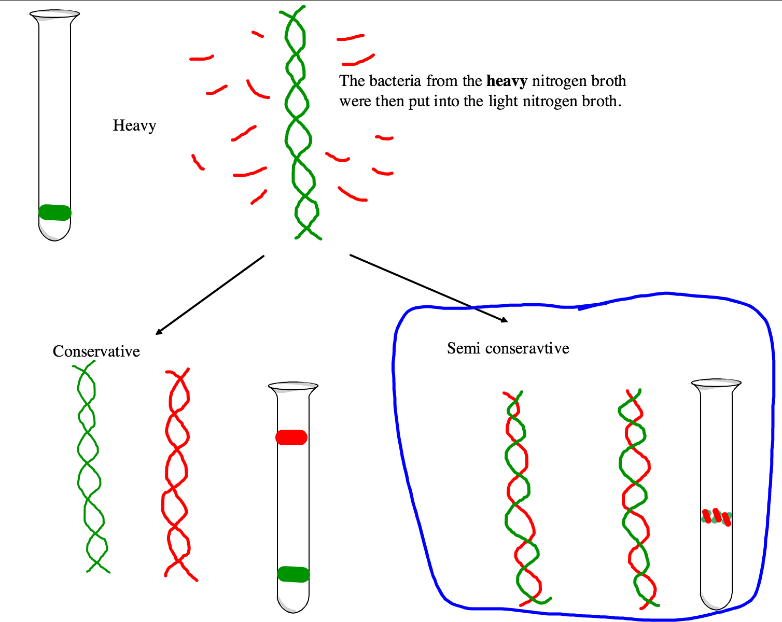

Slide 26
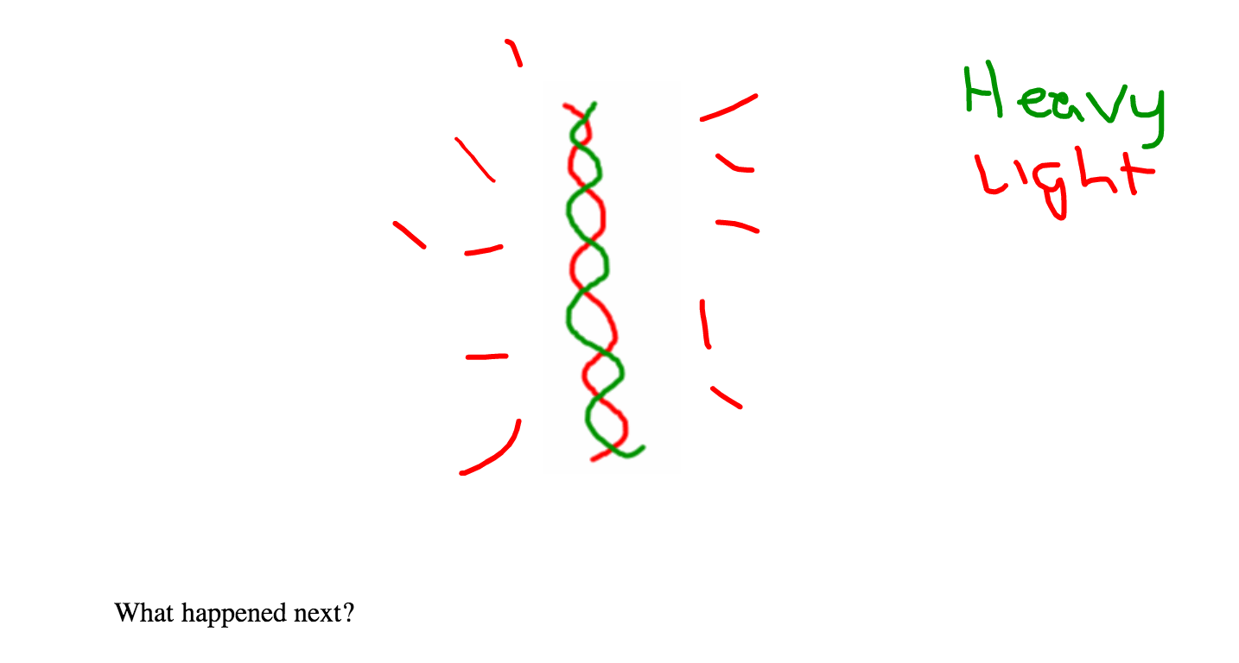

Slide 27
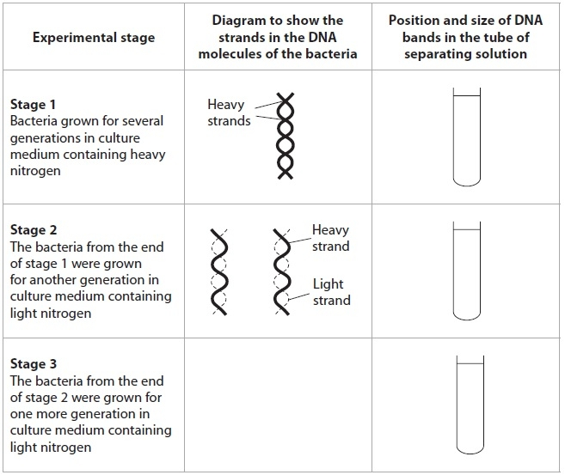

Slide 28
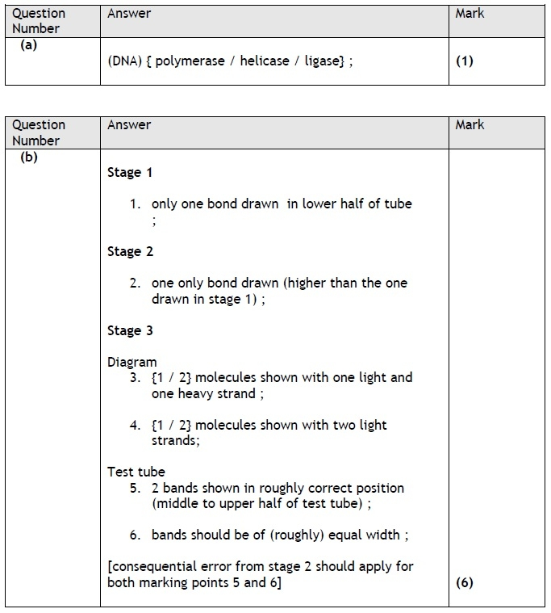

Slide 29
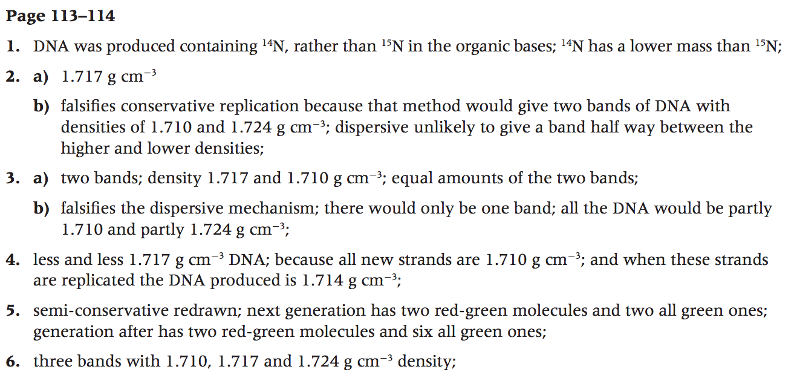
Q PAGE 113

Slide 30
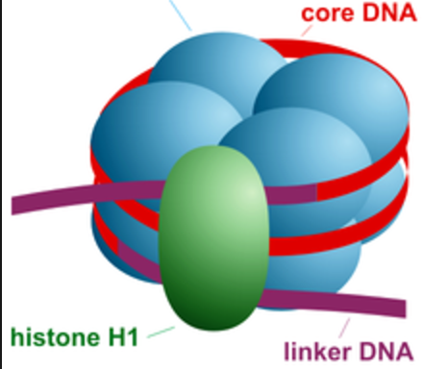
Supercoiling/wrapping of DNA
Allows 3m of DNA to be packed into each cell
133
AU (Astronomical Units)
Wrapping/supercoiling

