Slide 1
Used a magnet because iron is magnetic. Sand and salt are not
Added water
Used filtration because sand is insoluble in water but salt is soluble
Used evaporation to separate the salt and water because water boils at 100⁰C

Slide 2
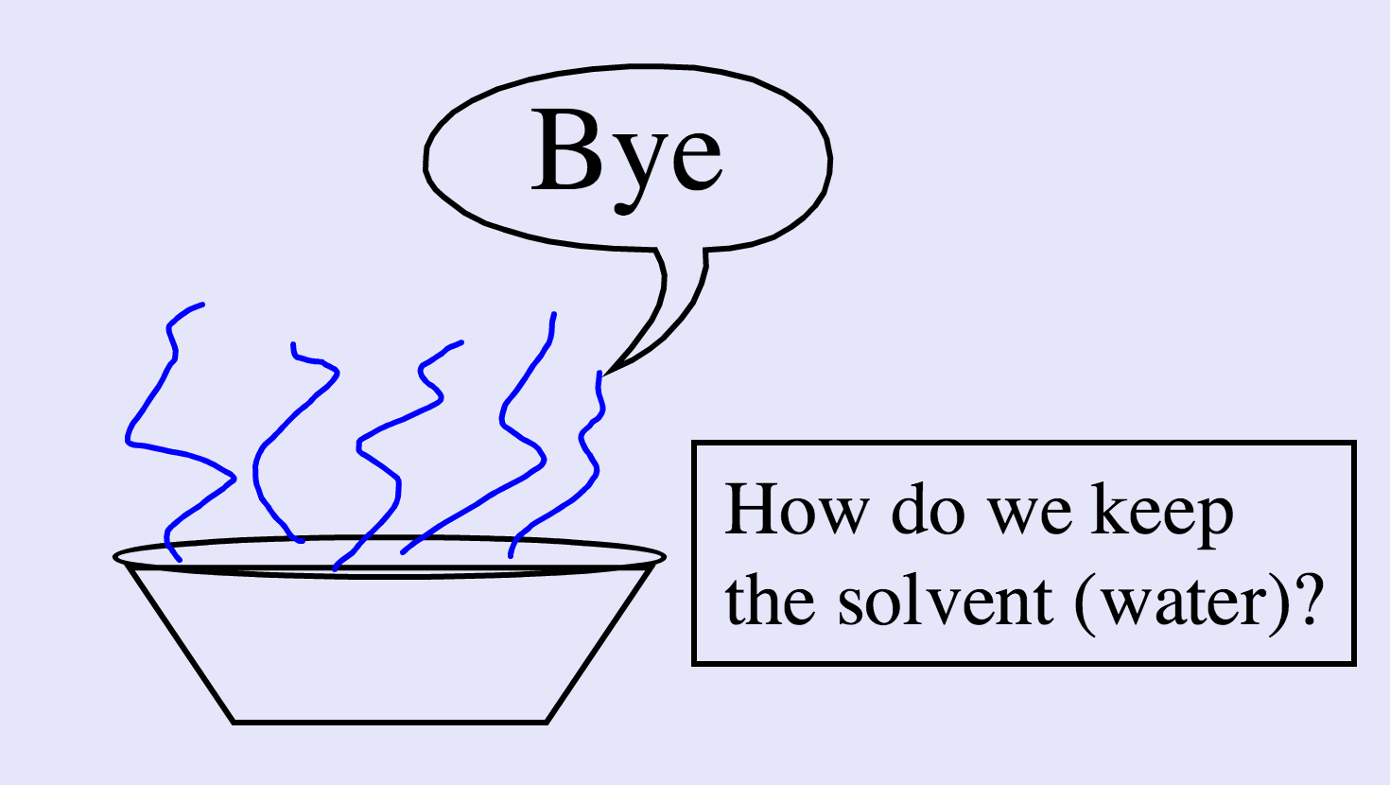
What did you use this technique for? What is this separating technique called?

Slide 3
Distillation
Define condensation and evaporation
Explain how the physical properties of liquids allow them to be separated
Explain how a Liebig condenser is used to separate a mixture of liquids

Slide 4
Definitions
Evaporation
When a liquid changes state into a gas
Condensation
When a gas changes state into a liquid

Slide 5
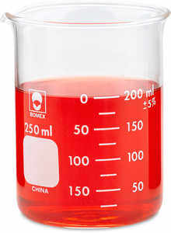
This a mixture of red food dye and water
How could we separate it?
What physical property do we know about water?

Slide 6
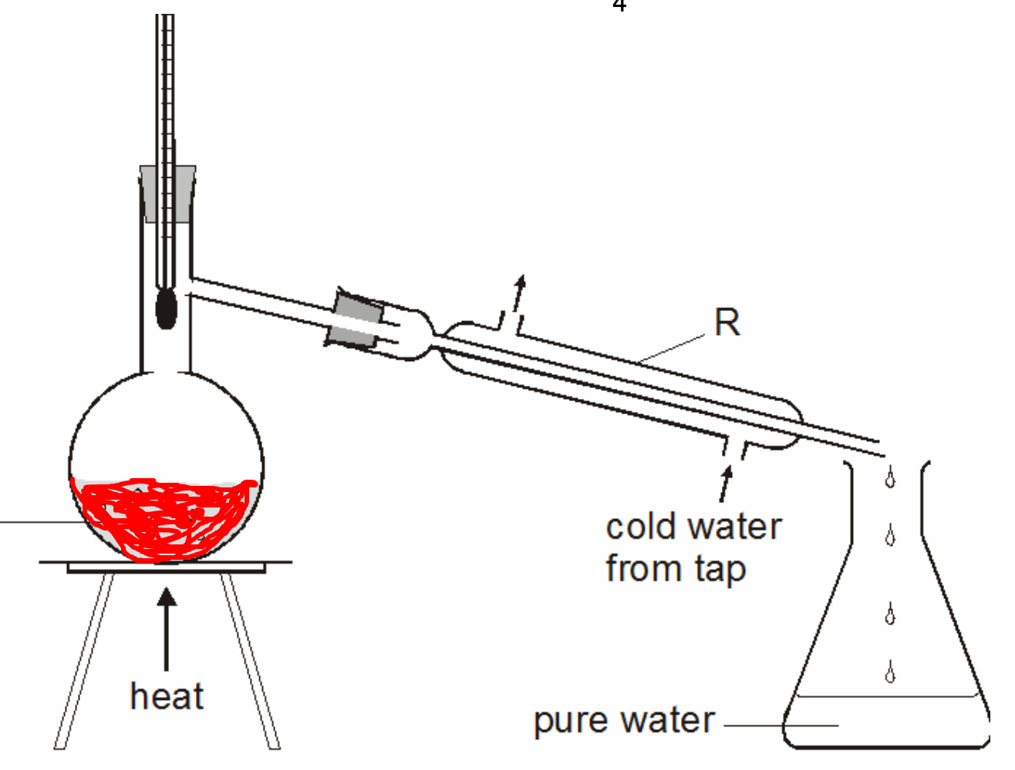
What else can you label?
Liebig condenser

Slide 7
1
Label the diagram
Explain what is happening at points 1 and 2
What is left in the round bottomed flask?
2
Liebig condenser
1

Slide 8
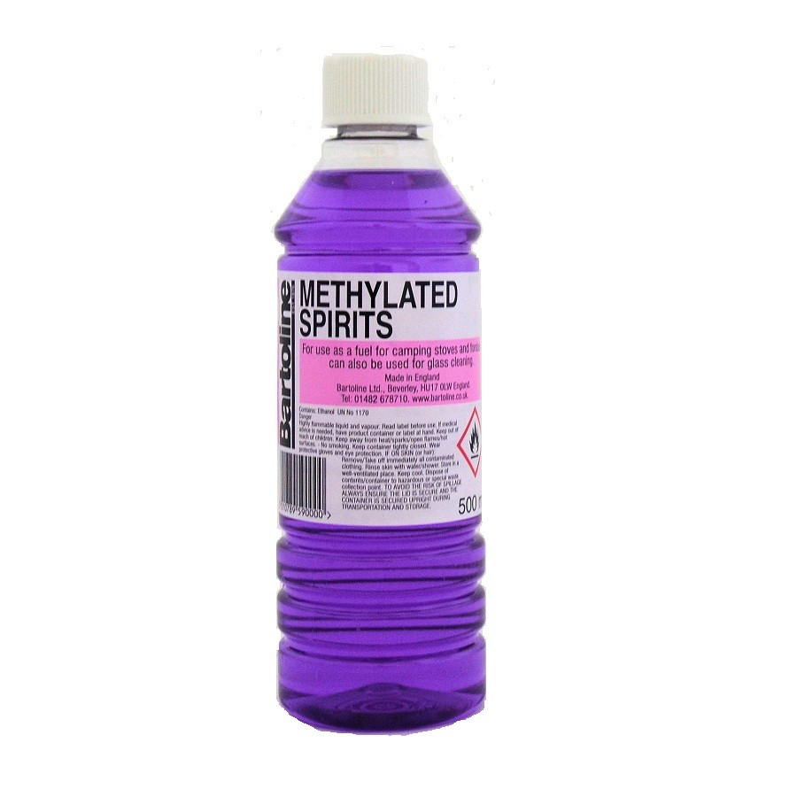
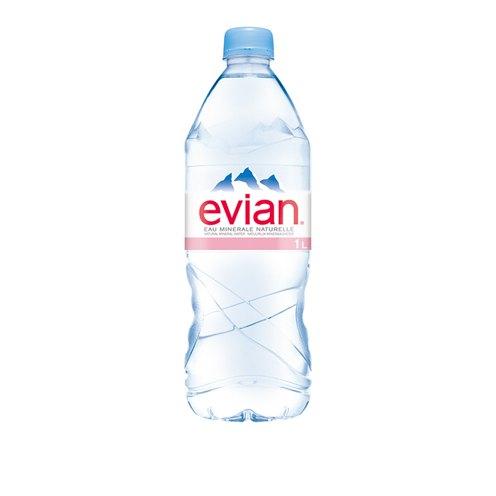
How could you separate a mixture of water and alcohol?

Slide 9
How could you separate a mixture of water and alcohol?
78.5ºC
100ºC

