Slide 2
10.2 Inheritance
Skills:
Calculation of the predicted genotypic and phenotypic ratio of offspring of dihybrid crosses involving unlinked autosomal genes
Identification of recombinants in crosses involving two linked genes
Use of a chi-squared test on data from dihybrid crosses
Understanding:
Unlinked genes segregate independently as a result of meiosis
Gene loci are said to be linked if on the same chromosome
Variation can be discrete or continuous
The phenotypes of polygenic characteristics tend to show continuous variation
Chi-squared tests are used to determine whether the difference between an observed and expected frequency distribution is statistically significant
Nature of science:
Looking for patterns, trends and discrepancies: Mendel used observations of the natural world to find and explain patterns and trends. Since then, scientists have looked for discrepancies and asked questions based on further observations to show exceptions to the rules. For example, Morgan discovered non-Mendelain ratios in his experiments with Drosophia
Applications:
Completion and analysis of Punnett squares for dihybrid traits
Morgan’s discovery of non-Mendelian ratios in Drosophia
Polygenic traits such as human height may also be influenced by environmental factors

Slide 3
Key Words
Locus: Location of a gene on a chromosome
Homologous chromosome: Two chromosomes with same sequence of genes
Alleles: Different forms of same gene

Slide 4
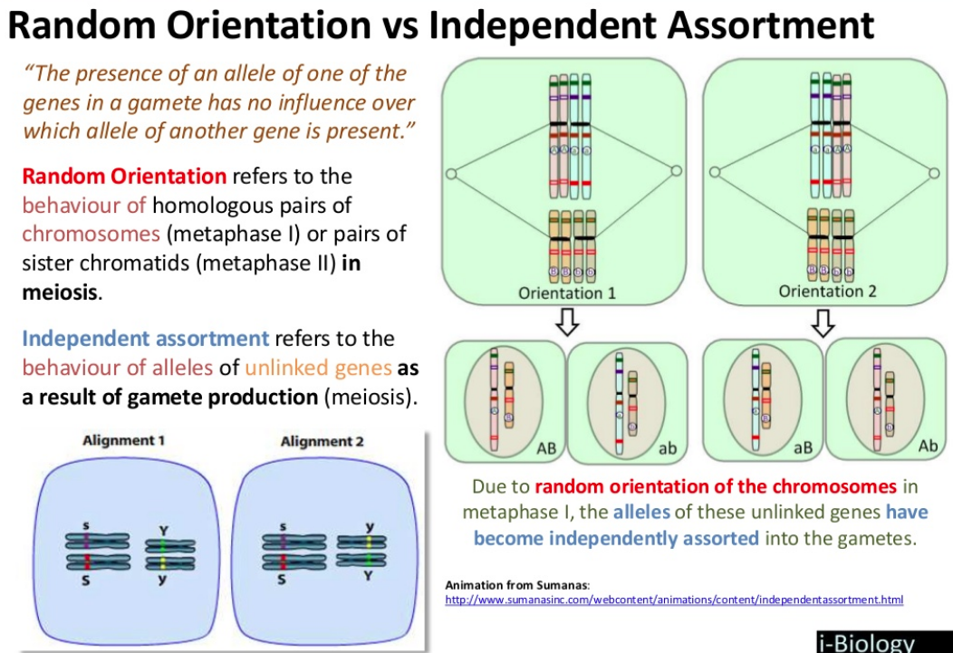

Slide 5
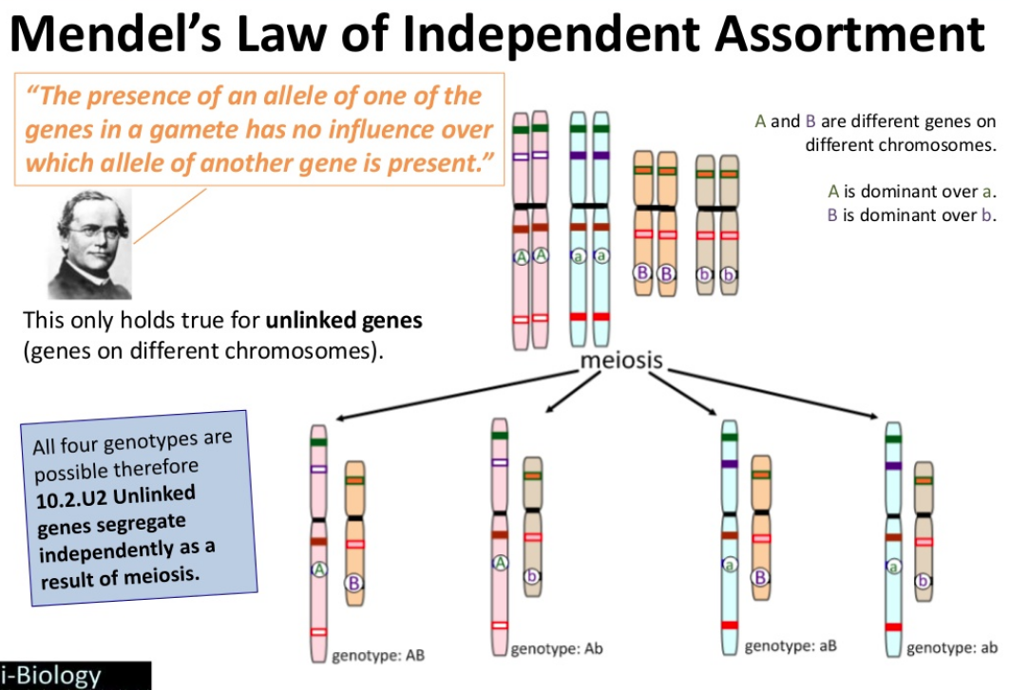

Slide 6
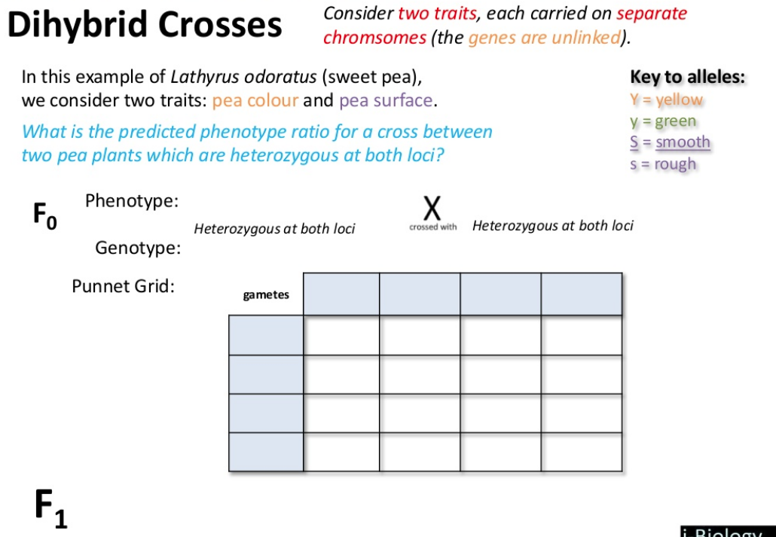

Slide 7
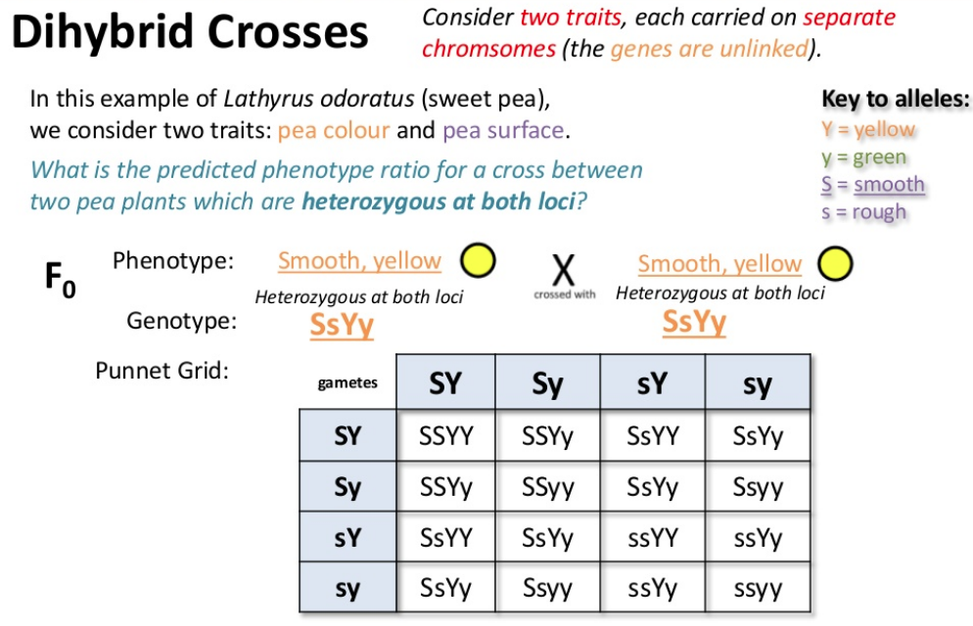

Slide 8
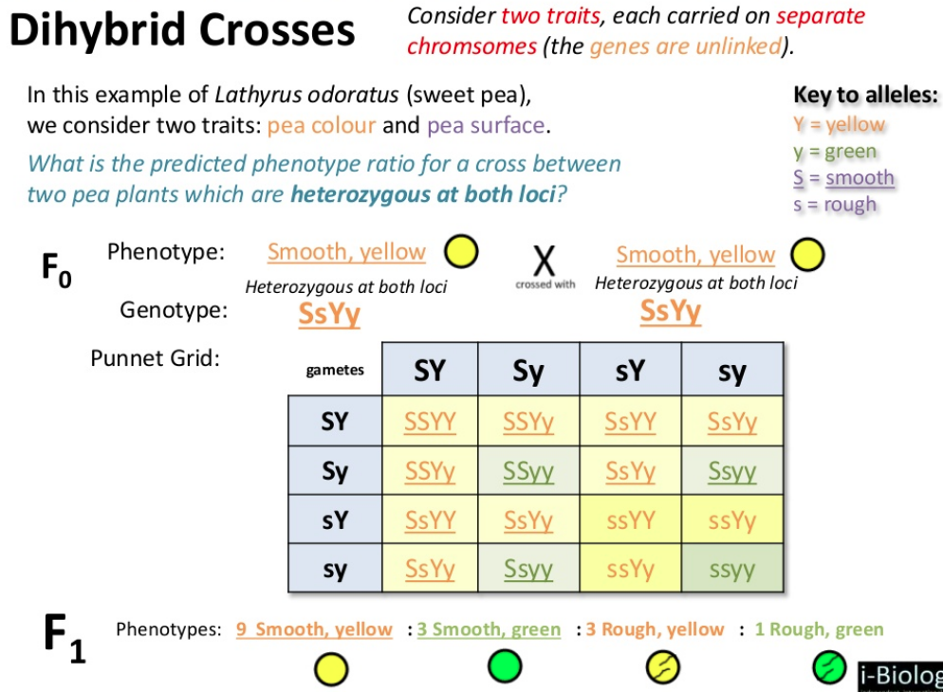

Slide 9
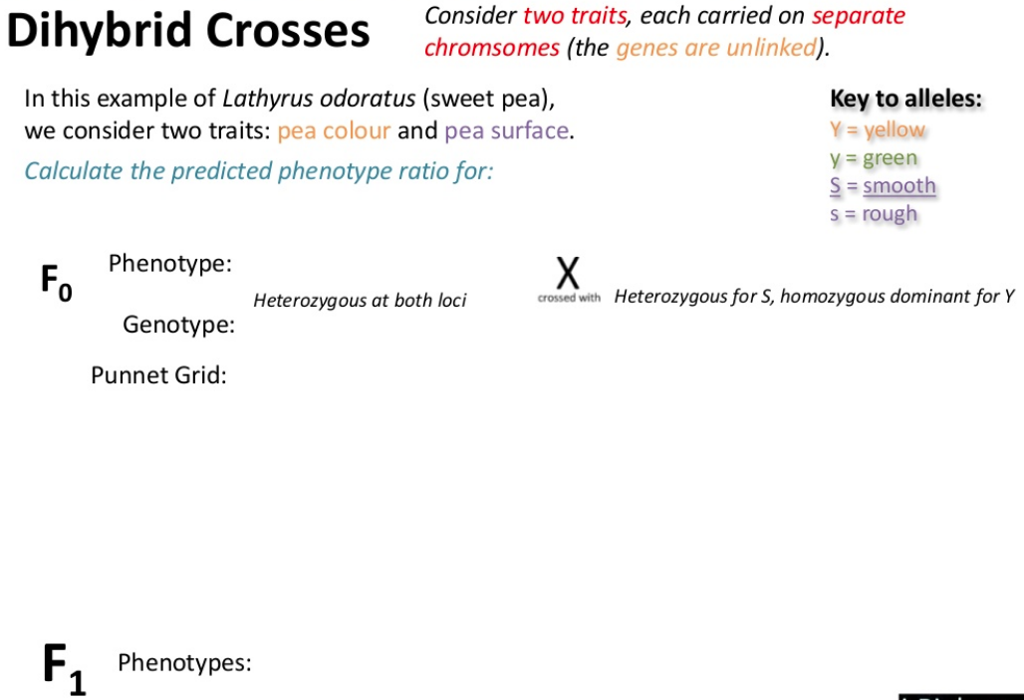

Slide 10
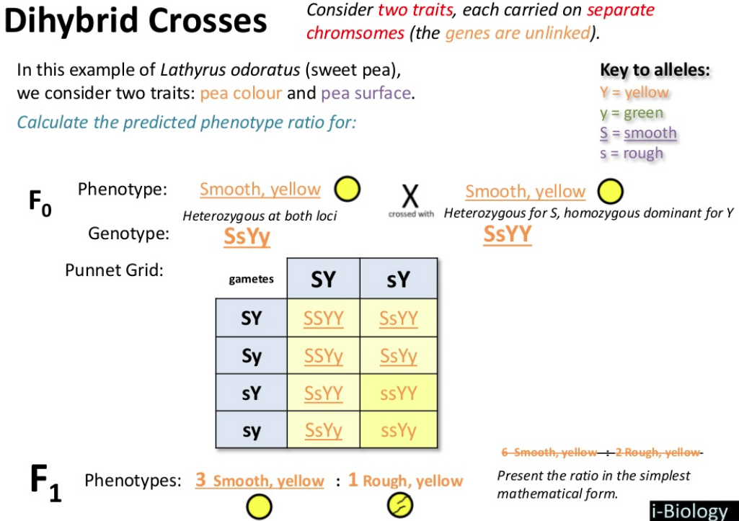

Slide 11
Pg 447 Q3
Independent assortment

