Slide 3
6.1 Digestion and Absorption
Understanding:
The contraction of circular and longitudinal muscle layers of the small intestine mixes the food with enzymes and moves it along the gut
The pancreas secretes enzymes into the lumen of the small intestine
Enzymes digest most macromolecules in food into monomers in the small intestine
Villi increase the surface area of epithelium over which absorption is carried out
Villi absorb monomers formed by digestion as well as mineral ions and vitamins
Different methods of membrane transport are required to absorb different nutrients
Applications:
Processes occurring in the small intestine that result in the digestion of starch and the transport of the products of digestion to the liver
Skills:
Production of an annotated diagram of the digestive system
Identification of tissue layers in transverse sections of the small intestine viewed with a microscope or in a micrograph
Nature of science:
Use models as representations f the real world: dialysis tubing can be used to model absorption in the intestine

Slide 4
Digestion??

Slide 6
Use your text books to label the diagram

Slide 8
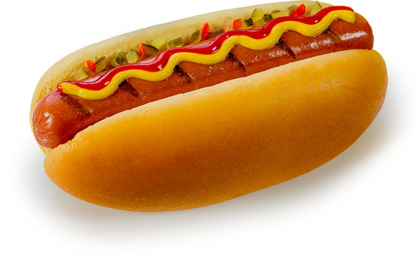
Route through the digestive system
List all the parts of the digestive system that food moves through. In the correct order…

Slide 9
The human digestive system is around 9m long.
It is basically one long tube called….?
Elephant digestive system
Elephant full

Slide 10
Markscheme
1. Award [1] for each two of the following structures clearly drawn and correctly labelled. Connections between organs must be correct for full marks.
mouth / teeth / tongue; esophagus; stomach; small intestine; large intestine / colon; anus; pancreas; liver; gall bladder; rectum; salivary glands;
[5]
2. C
[1]

