Slide 2
Day, night, years and seasons
State how long a day and year are on earth
Describe what this relates to
Explain why we have seasons on earth
Give a biological effect of seasons on earth

Slide 3
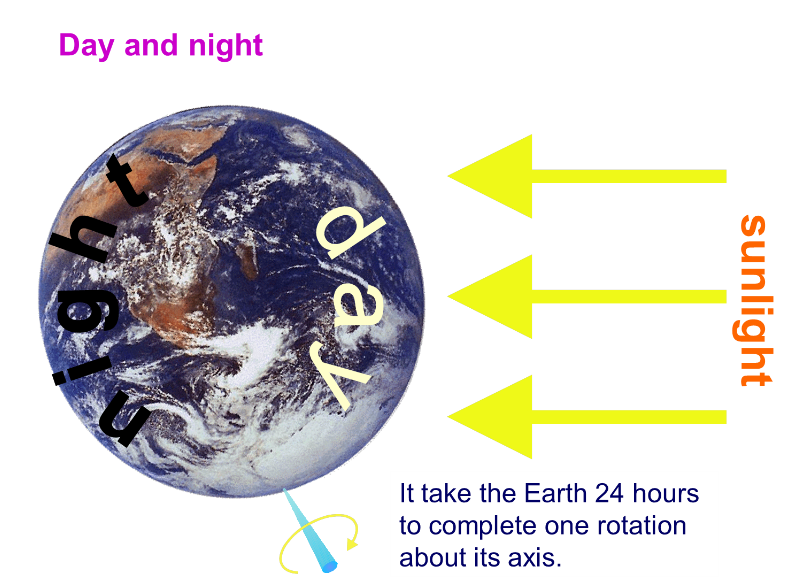
Day and Night

Slide 5
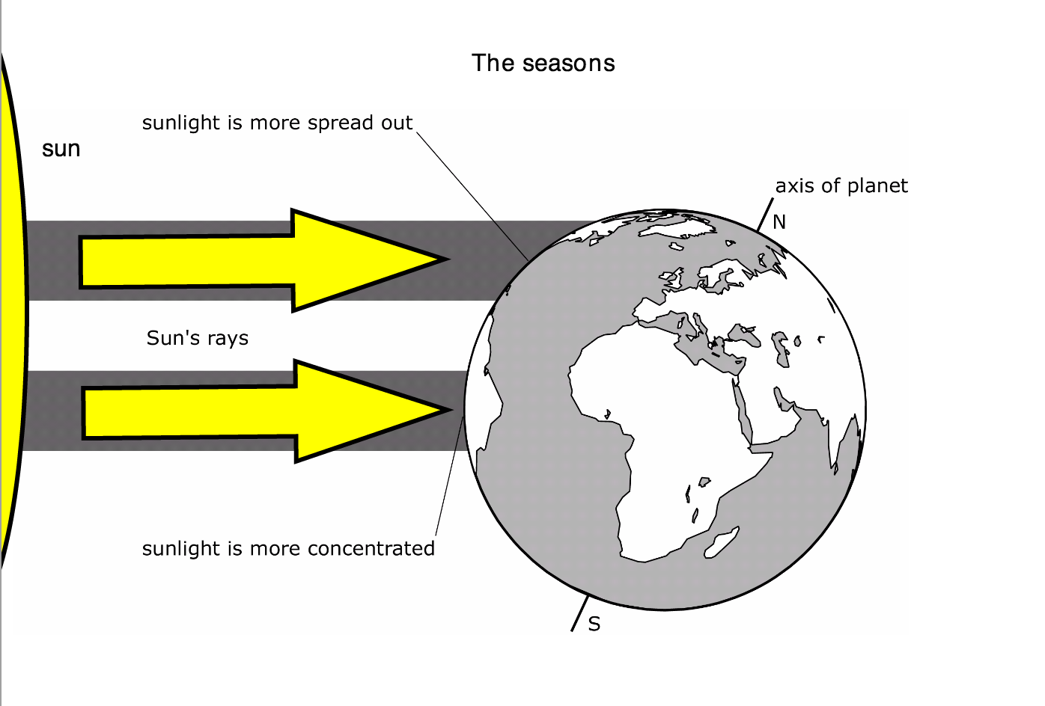
Seasons
Seasons and migration

Slide 6
Using the suns and earths provided make a revision sheet which explains:
What is a day?
How long is a day?
What is a year?
How long is a year?
Why do we have seasons?

