Slide 1
D6 transport of respiratory gases
Option d

Slide 2
Learning objectives
Understandings
Oxygen dissociation curves show the affinity of hemoglobin for oxygen
Carbon dioxide is carried in solution and bound to hemoglobin in the blood
Carbon dioxide is transformed in RBCs in hydrogencarbonate ions
The Bohr shift explains the increased release of oxygen by hemoglobin in respiring tissues
Chemoreceptors are sensitive to changes in blood pH
The rate of ventilation is controlled by the respiratory control centre in the medulla oblongata

Slide 3
Learning objectives
Understandings
During exercise the rate of ventilation changes in response to the amount of carbon dioxide in the blood
Fetal hemoglobin is different from adult hemoglobin allowing the transfer of oxygen in the placenta onto the fetal hemoglobin
Applications and Skills:
A: Consequences of high altitude for gas exchange
A: pH of blood is regulated to stay within the narrow range of 7.35 to 7.45
A: causes and treatments of emphysema
S: Analysis of dissociation curves for hemoglobin and myoglobin
S: Identification of pneumocytes, capillary endothelium cells and blood cells in light micrographs and electron micrographs of lung tissues

Slide 4
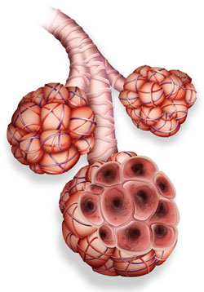
Alveoli
Site where gas exchange happens
Increase surface area
Thin walls – short diffusion pathway
Two types of cells:
Type I pneumocytes
Type II pneumocytes

Slide 5
Label the diagram
Explain how the two types of pneumocytes are adapted for their function

Slide 6
Label the diagram
Explain how the two types of pneumocytes are adapted for their function
phagocyte

Slide 7
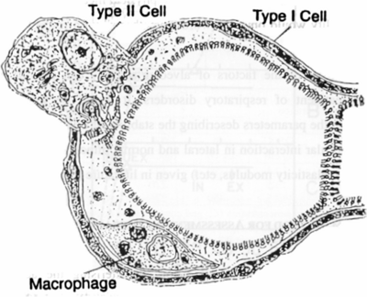
Type I pneumocytes
Extremely thin alveolar cells
Make up most of epithelial cells of alveoli
Flat cells
0.15um thick
Adjacent capillary also very thin
Very small diffusion space

Slide 8
Type II pneumocytes
Rounded cells
Occupy 5% of alveolar surface area
Secrete a fluid which coats the inner surface of the alveoli
Allows oxygen to dissolve before diffusing to the blood
Also prevents the capillary walls from sticking together and collapsing

Slide 9
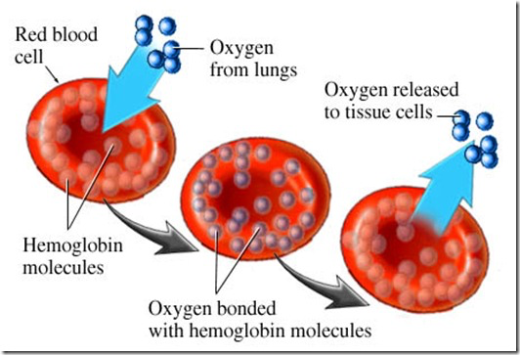
hemoglobin
Found in cytoplasm of erythrocyte (RBC)
No nuclei
4 oxygen molecules bind to iron in heme (4 heme groups and 4 pp chains)
1 CO₂ can bind to the amino groups of pp chain (4 in total per hemoglobin molecule)
The binding of oxygen changes the 3D shape of the hemoglobin to increase it’s affinity for more oxygen

Slide 10
Hemoglobin
There are millions of hemoglobin molecules in a RBC

Slide 11
‘Affinity of hemoglobin for oxygen’ refers to the likelihood oxygen will bind to a hemoglobin molecule
The degree to which oxygen binds to hemoglobin is determined by the partial pressure of oxygen in the blood (pO₂) surrounding the red blood cell.
High pO₂ – High affinity for oxygen

Slide 12
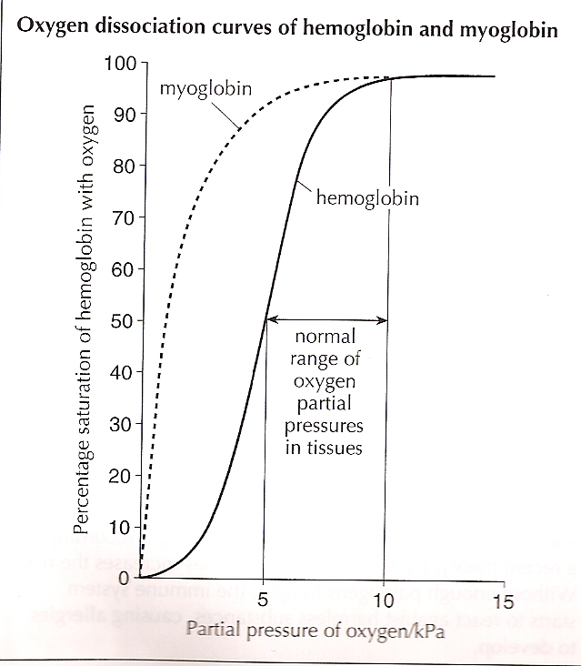
Oxygen dissociation curves
later
Show affinity of hemoglobin for oxygen
The degree to which oxygen binds to hemoglobin depends on the partial pressure of oxygen (pO₂) in blood.
Saturation = bonded to 4 oxygen molecules
At low pO₂ oxygen will dissociate (leave) from hemoglobin
Notes:
35-75mmHg – range of partial pressures in body (35 – tissues that have taken up O2 for respiration and 75 in lungs)
Show tendency of hemoglobin to bind to oxygen and separate from oxygen
Partial pressure of lungs is about 75mmHg – 90% saturation in lungs

Slide 13
Oxygen dissociation curves
later
Once the first oxygen has attached to a heme group there is a conformational change in the hemoglobin and subsequent (3) oxygen binding becomes easier
Same applies for the dissociation – when saturated hemoglobin loses an oxygen there is a change and the next three are lost more easily.
This accounts for the sigmoid curve
Notes:
35-75mmHg – range of partial pressures in body (35 – tissues that have taken up O2 for respiration and 75 in lungs)
Show tendency of hemoglobin to bind to oxygen and separate from oxygen
Partial pressure of lungs is about 75mmHg – 90% saturation in lungs

Slide 15
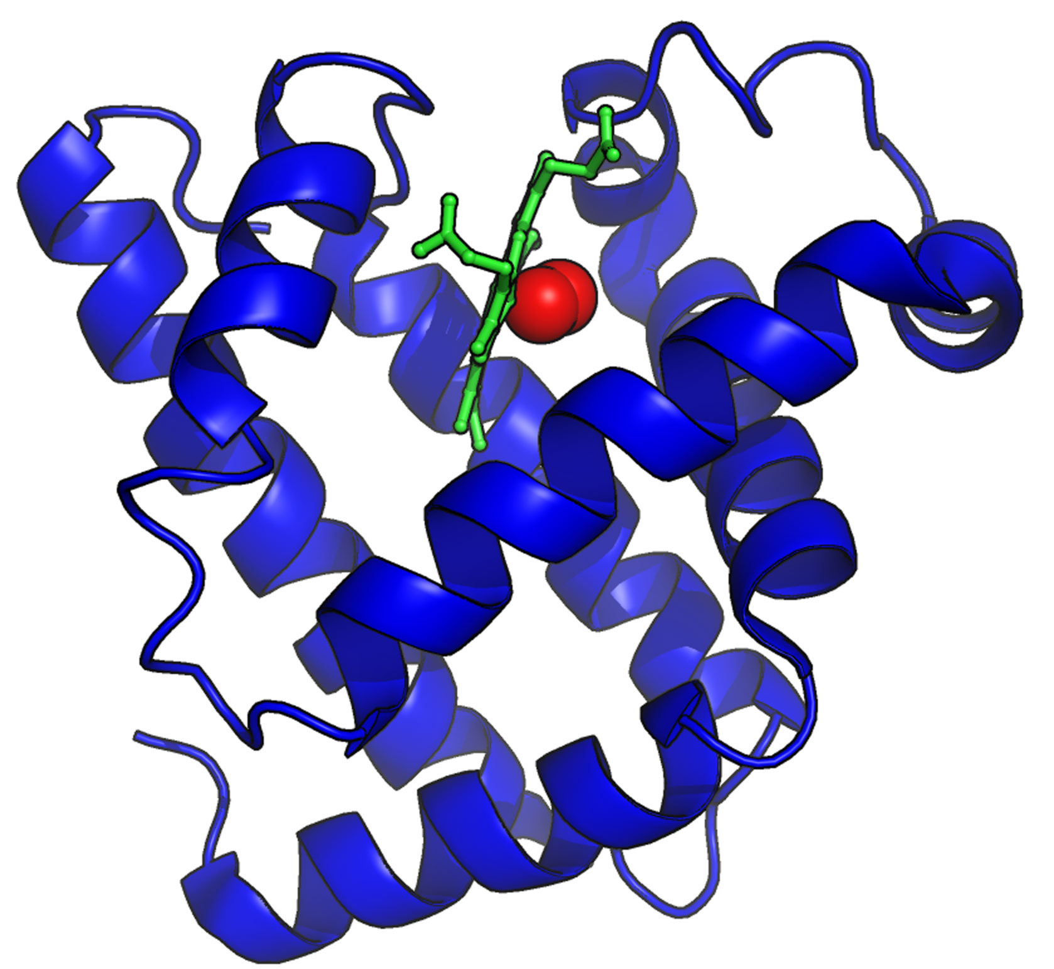
Myoglobin
muscle
polypeptide
Oxygen carrying protein in muscle tissues
Only contains one heme group so can only carry one oxygen
No conformational changes

Slide 16
Myoglobin
Myoglobin and hemoglobin
Compare the pO₂ in the lungs and in exercising muscle tissues
Compare % saturation of myoglobin and hemoglobin in exercising tissues
Why is myoglobin useful as an oxygen carrier in exercising tissues?

Slide 17
Hemoglobin vs. myoglobin
Myoglobin binds to oxygen in muscles
1 polypeptide + heme group + iron
Delays anaerobic respiration; oxygen is then released to delay onset of lactic acid fermentation
Oxygen remains bound even at low partial pressures
Notes:
Think of oxygen attached to myoglobin as providing final reservoir of oxygen during heavy exercise

Slide 18
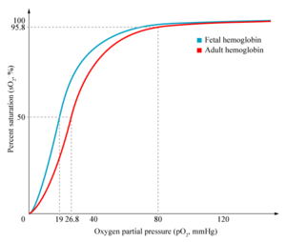
Fetal vs. adult hemoglobin
What do you notice about the affinity for oxygen with fetal and adult hemoglobin?
Why is this important?

Slide 19
Fetal vs. adult hemoglobin
Fetal hemoglobin must have greater affinity for oxygen
In placenta capillaries, adult hemoglobin is more likely to dissociate oxygen and fetal hemoglobin is more likely to bind to it
Fetal hemoglobin only dissociates oxygen when it reaches its respiring tissues

Slide 20
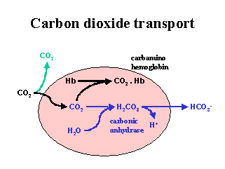
Carbon dioxide transport in blood
Transported either as:
Dissolved CO₂
Reversibly converted to bicarbonate (hydrogencarbonate, HCO₃⁻) ions in the plasma
Bound to plasma proteins

Slide 21
How are hydrogencarbonate ions formed?
Carbonic anhydrase is found in erythrocytes:
The ions exit via facilitated diffusion where 1 hydrogen carbonate ion is exchanged for 1 chloride ion (Chloride shift)
What are the affects of excess H⁺?
In respiring tissues the reaction proceeds right.
What happens in the lungs?
More soluble/less toxic
Notes:
Chloride shift: the exchange of negative charges keep a balance
Too much bicarbonate ions lowers pH of blood
Buffering of blood by Hb and other proteins in plasma (once H+ attaches to plasma proteins, it’s taken out of the plasma)

Slide 22
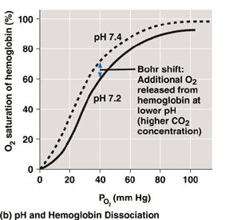
The bohr shift
Increased respiration in the tissues increases CO₂ in the blood. This lowers the pH of the blood. Oxygen dissociation curve shifts to the right?
What does this mean?
At lower pH more oxygen is released by the hemoglobin
Why is this important?
Bohr Shift
Notes:
Lungs – low; tissues high
Hb’s affinity for oxygen is reduced when pCO2 is high. Hb is INDUCED to dissociate from O2 → Bohr shift

Slide 23
Qs
How does the blood maintain pH (pg 702)
What is ventilation?
Describe the effect of excerise (and therefore carbon dioxide build up) on ventilation rate.
Explain how ventilation rate is effected by exercise.

Slide 24
pH in blood is maintained between 7.35 and 7.45
Buffering is needed to counter the H⁺ produced from carbonic acid during exercise
If the blood pH drops below 7.35, chemoreceptors send a signal to the medulla to increase ventilation rate
Increased ventilation (hyperventilation) removed CO₂ from the blood shifting the reaction (below) to the left.
Withdraws H⁺ from the blood raising pH
H⁺ can also be secreted into urine

Slide 25
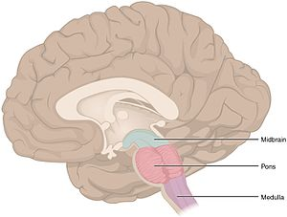
Respiratory control centre is in the medulla
Chemoreceptors in the inner walls of the aorta and carotid arteries detects changes in CO₂ and pH. Action potentials are sent to the medulla
The medulla also has the chemoreceptors
Medulla sends action potentials to the diaphragm (phrenic nerve), intercostal muscles (intercostal nerve) and muscles in the abdomen to change the ventilation rate

Slide 26
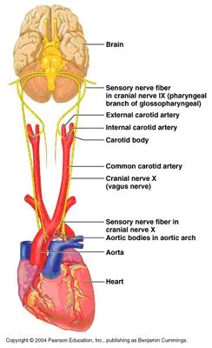
During exercise ventilation changes in response to CO₂ in blood…
metabolism
respiration
CO₂
_{Carbonic acid}
_{pH}
Ventilation rate
CO2
Notes:
High concentrations of carbon dioxide trigger a higher ventilation rate which helps expel the CO₂ from body

Slide 27
Adaptations to high altitude
What happens to pO₂ at high altitude?
What is the consequence?
What is the body’s response to deal with this?
Why do athletes train at altitude?
There are tribes that have always lived at high altitudes. Some have the same red blood cell count as people that live at sea level. What other adaptations could be present?

Slide 28
Adaptations to high altitude
What happens to pO₂ at high altitude?
Decrease
What is the consequence?
Lower saturation of hemoglobin. Lower respiration rates
What is the body’s response to deal with this?
Increased RBC production, ventilation rate, myoglobin production
Why do athletes train at altitude?
Elevated RBC count will remain when the return to sea level
There are tribes that have always lived at high altitudes. Some have the same red blood cell count as people that live at sea level. What other adaptations could be present?
Higher lung SA
Higher vital capacity
Increased capillary networks

Slide 29
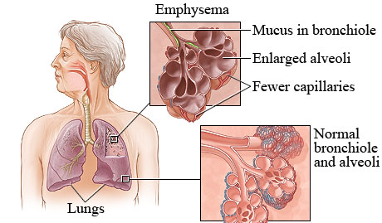
Causes, consequences and treatment of emphysema (COPD)
Disease where alveoli are damaged with holes; often have chronic obstructive pulmonary disease (COPD)
Causes
Smoking
Second hand smoke
Manufacturing fumes
Coal and silica dust
Treatments
Stop exposure to above agents
Medications to relieve symptoms
Supplemental oxygen
Notes:
Although tissue usually self-repairs when patients stop their exposure to the causative agents, most patients’ lungs are too damaged

Slide 30
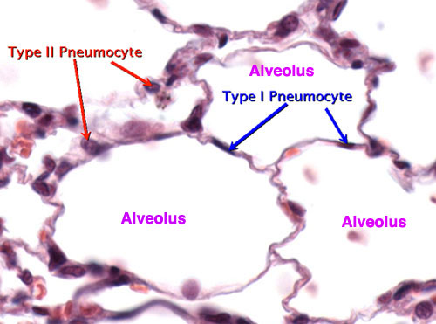
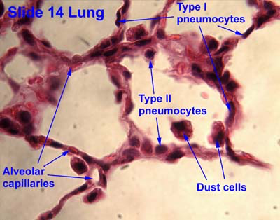
Lung tissue micrographs
Identify pneumocytes, capillary endothelium cells and bloods cells
Notes:
Walls of alveolus made of:
Type 1 pneumocytes: gas exchange (thin)
Type 2 penumocytes: release surfactant to reduce surface tension (microvilli, thicker)

