Slide 1
D5 hormones & metabolism
Option d

Slide 2
Learning objectives
Understandings
Endocrine glands secrete hormones directly into the bloodstream
Steroid hormones bind to receptor proteins in the cytoplasm of the target cell to form a receptor-hormone complex
The receptor-hormone complex promotes the transcription of specific genes
Peptide hormones bind to receptors in the plasma membrane of the target cell
Binding of hormones to the membrane receptors activates a cascade mediated by a second messenger inside the cell

Slide 3
Learning objectives
Understandings
The hypothalamus controls hormone secretion by the anterior and posterior lobes of the pituitary gland
Hormones secreted by the pituitary control growth, developmental changes, reproduction and homeostasis
Applications and Skills:
A: Some athletes take growth hormones to build muscles
A: Control of milk secretion by oxytocin and prolactin

Slide 4
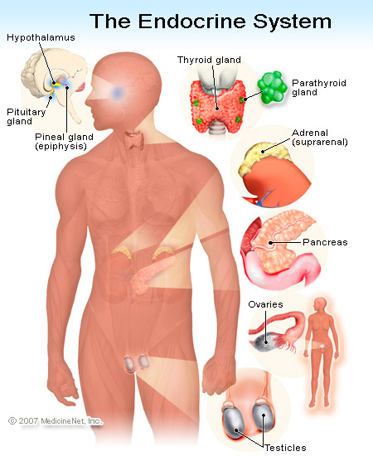
Endocrine glands
Endocrine glands produce and secrete hormones directly into blood
These hormones travel to target cells
What do you notice about the pancreas?
Where do exocrine glands secrete hormones to?
Notes:
The pancreas is the only gland that has both exocrine and endocrine functions

Slide 5
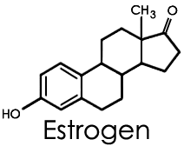
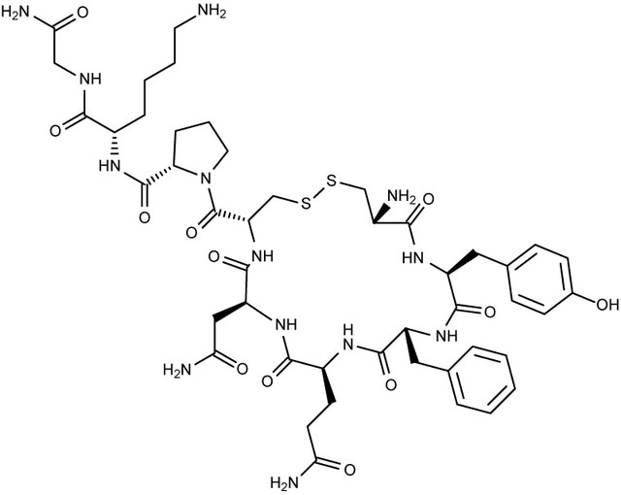
Hormone types
There are different types of hormones but the main two types are…
Steroid Hormones:
e.g. Estrogen
Synthesised from cholesterol – classified as lipis
Non polar
Peptide hormones:
e.g. ADH
Proteins – composed of amino acids
Often polar

Slide 6
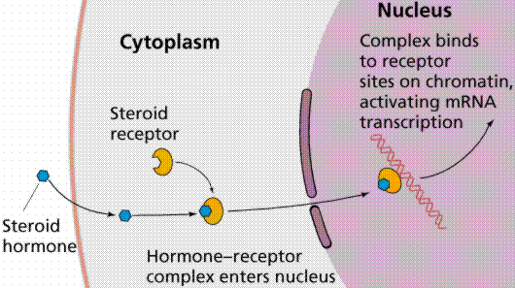
How do steroid hormones work?
Made from cholesterol which allows it to easily pass through cell membrane (non-polar)
Once in the cell the hormone binds to a receptor protein and forms a receptor - hormone complex.
Binding of steroid to gene(s) is selective (specific) in order to regulate transcription (promote or inhibit)
Notes:
Examples of steroid hormones: progesterone, testosterone, and estrogen

Slide 7
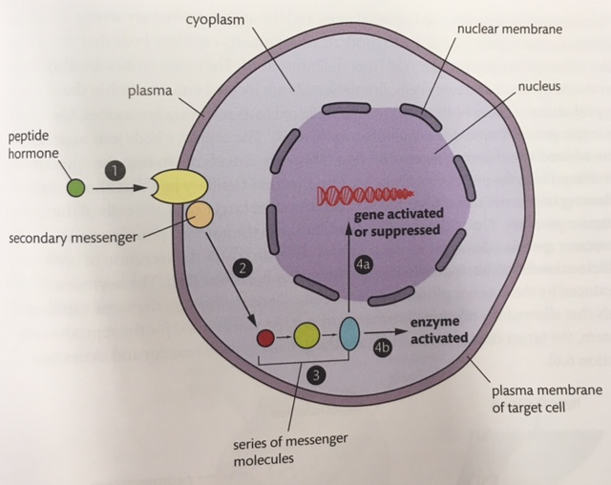
How do peptide hormones work?
Hormone action
Bind to receptors on the surface of membranes
Secondary messenger (often cAMP) molecule in cytoplasm is activated that triggers a cascade of reactions
The final messenger:
activates a cytoplasmic enzyme OR
activates a transcription factor

Slide 8
Hypothalamus and pituitary gland

Slide 9
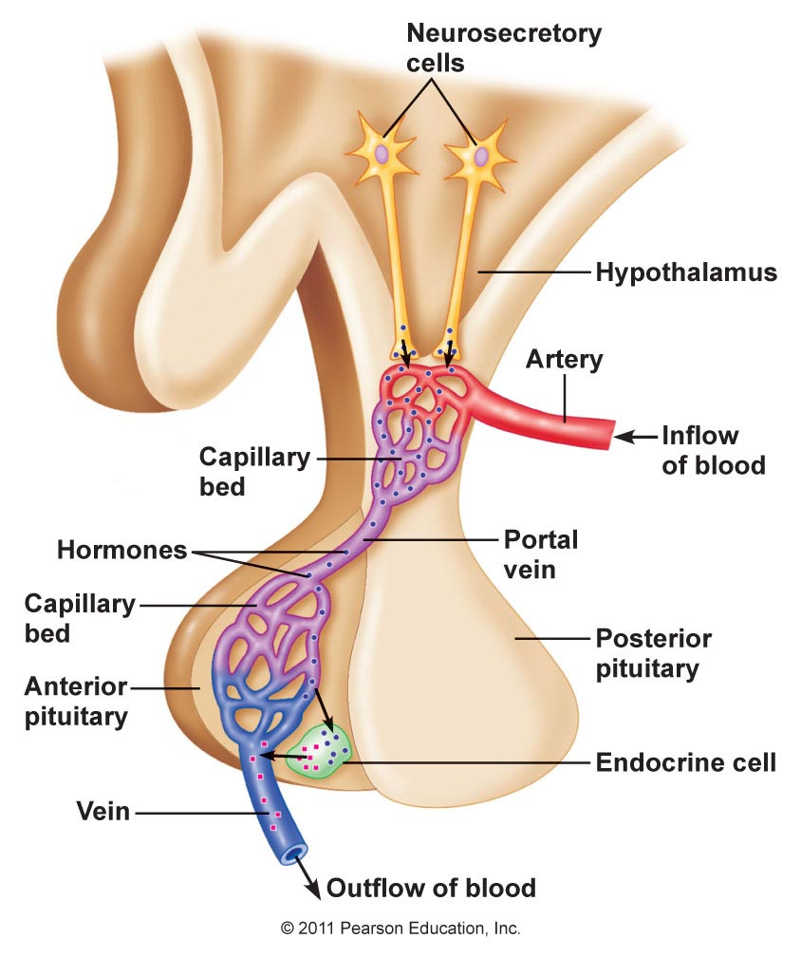
The hypothalamus & pituitary gland
Anterior pituitary
Synthesises and secretes many hormones that control growth, reproduction and homeostasis
Posterior pituitary
Secretes oxytocin and ADH.
These hormones not made there – they are made in the hypothalamus.

Slide 10
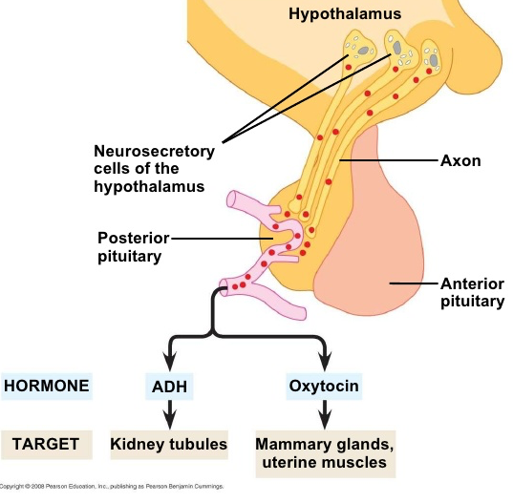
Posterior lobe
Contains axons of neurosecretory cells
Cell bodies are in hypothalamus
Oxytocin and ADH are made in cell bodies and transport along axons to the posterior pituitary lobe
They are secreted into blood from the axon terminal

Slide 11
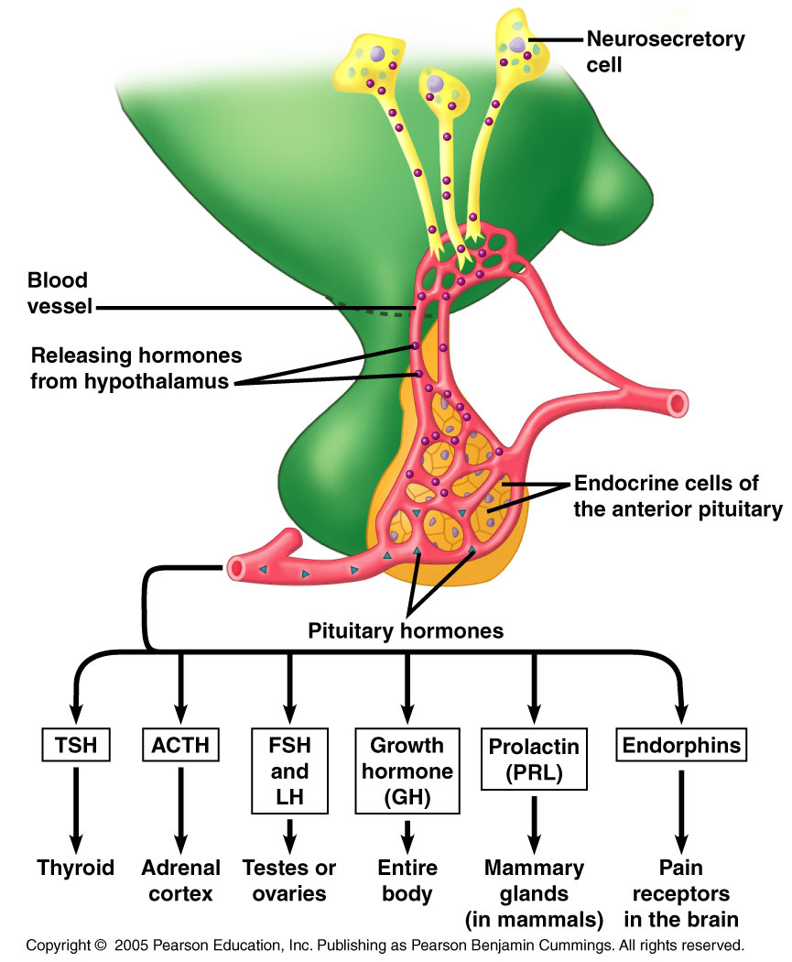
Anterior lobe
The hypothalamus contains capillary beds that take in hormones made by itself
The neurosecretory cells are entirely in the hypothalamus
“releasing hormones” made by hypothalamus
Capillary beds in hypothalamus and anterior lobe join together via the portal vein
Releasing hormones (from hypothalamus) stimulate the lobe to release specific hormones
Notes:
Target of releasing hormones is the anterior lobe (releasing hormones travel from capillary bed in hypothalamus via portal vein into the capillary bed in the lobe; this causes the lobe to release specific hormones)

Slide 12
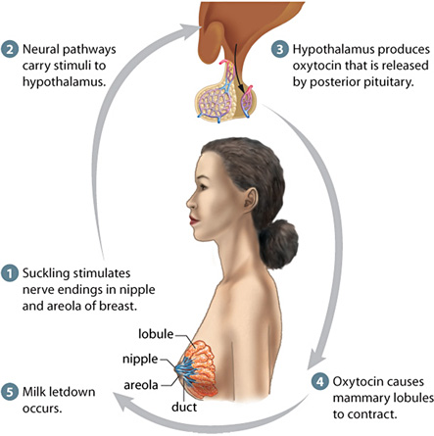
Milk secretion is controlled by prolactin and oxytocin
Prolactin stimulates development of milk producing cells.
Normally inhibited by high estrogen
Oxytocin: contraction of smooth muscle around ducts to eject milk
Positive feedback!
Notes:
Both are pituitary hormones
High levels of estrogen during pregnancy
2 events stimulate lactation:
-Drastic drop in estrogen after birth
-High oxytocin levels (that stimulated contractions during parturition)

Slide 13
Growth hormones in athletics
Main target is hepatocytes – stimulates bone and cartilage growth
Also increases muscle mass; performance enhancing
No evidence that greater muscle mass leads to greater strength
Notes:
GH – polypeptide hormone made by anterior pituitary and its main target is liver

