Slide 1
D4 the heart
Option d

Slide 2
Learning objectives
Understandings
Structure of cardiac muscle cells allows propagation of stimuli through the heart wall
Signals from the SA node that cause contraction cannot pass directly from atria to ventricles
There is a delay between the arrival and passing on of a stimulus at the AV node
This delay allows time for atrial systole before the AV valves close
Conducting fibres ensure coordinated contraction of the entire ventricle wall
Normal heart sounds are caused by the AV valves and semilunar valves closing causing changes in blood flow

Slide 3
Learning objectives
Applications and Skills:
S: Mapping of the cardiac cycle to a normal ECG trace
S: Analysis of epidemiological data relating to the incidence of CHD
Applications and Skills:
A: Use of artificial pacemakers to regulate the heart rate
A: Use of defibrillation to treat life-threatening cardiac conditions
A: causes and consequences of hypertension and thrombosis
S: measurement and interpretation of the heart rate under different conditions
S: Interpretation of systolic and diastolic blood pressure measurements

Slide 4
Heart muscle
How is heart muscle different from skeletal muscle?
Myogenic Heart Contraction

Slide 5
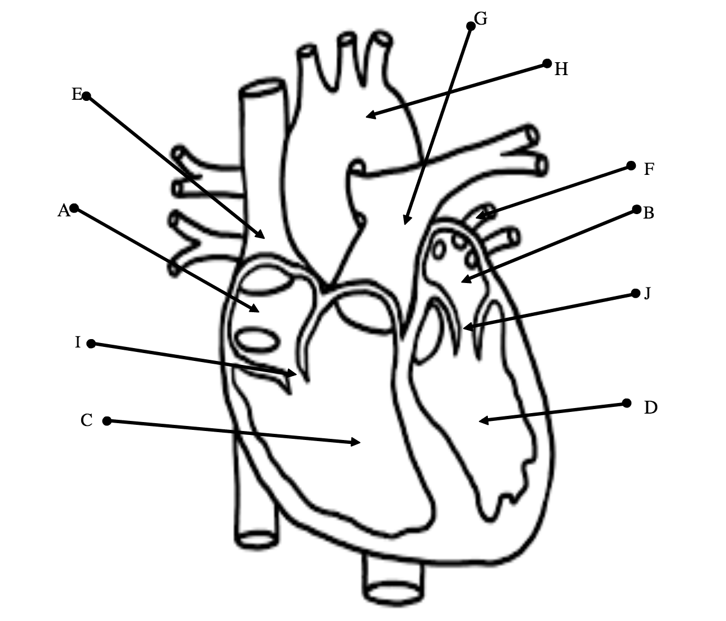

Slide 6
Control of Heart Rate
Draw on the locations of the SA and AV nodes.
Explain what the SA node does. Use arrows to show where impulses are sent.
Explain what the AV node does. Use arrows to show where impulses are sent.
State the time delay between atrial and ventricular systole and explain why this is important.
Locate and label the location of the medulla in the brain
State what the medulla detects
Draw and label the nerves from the medulla to the heart.
Explain how the medulla controls heart rate during times of excitement/exercise. (different nerves to speed up and slow does the heart rate).
298, 299, 301

Slide 8
Cardiac muscle Cells
Use page 685 to annotate your diagram describing the structure of cardiac muscle cells

Slide 9
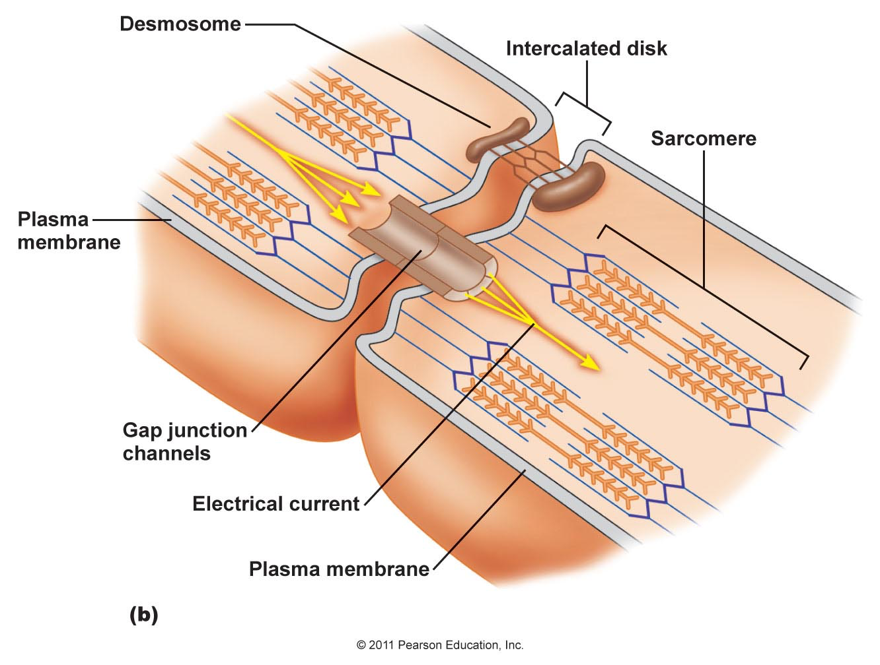
Cardiac muscle needs to work as a unit
Functional unit is the sarcomere
Cells shorter and wider with one nucleus
Y shaped – allows waves of depolarization to spread
Where one cell contacts another there is an intercalated disc
Gap junctions allow cytoplasm to freely pass between them so electrical signals can travel between cells
Heavily vascularized
Notes:
Vascularization helps prevent fatigue

Slide 10
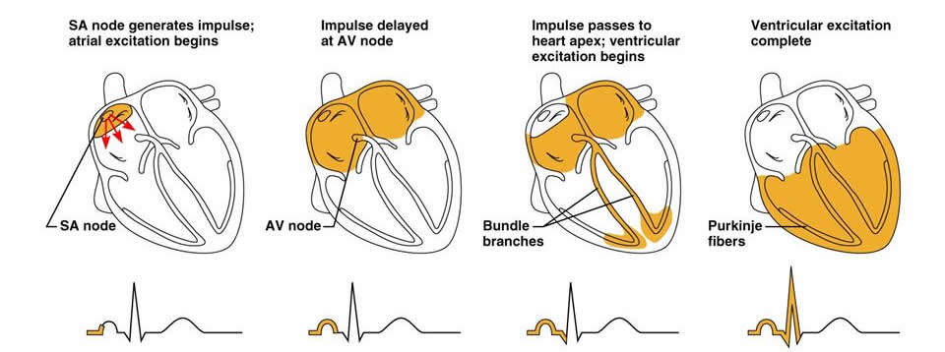
Read pages 685, 686 and 687
Annotate your diagram to explain the roles of the SA and AV node in heart contraction

Slide 11
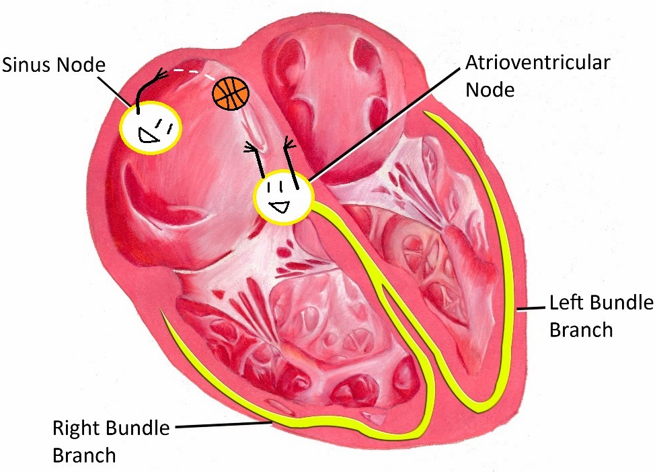
Myogenic control of heart
The SA node is the pacemaker and it generates action potentials that result in the atrial systole
Action potentials travel to AV node where it generates its own action potential
Delay of 0.1s and action potential travels down the septum through conducting fibres and Purkinje fibres. This results in ventricular systole
Why is a delay necessary?
Cardiac cycle
Heart contraction
Notes:
At rest, the heart beats on its own without nervous stimulation
Purkinje fibres are needed to ensure that the thick muscular walls of the ventricles contract

Slide 12
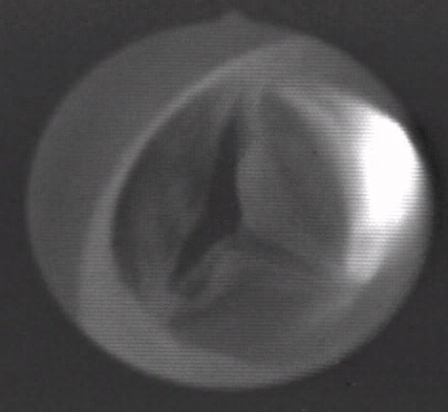
Heart beats
The sounds are caused by the AV valves and semilunar valves closing which changes blood flow

Slide 13
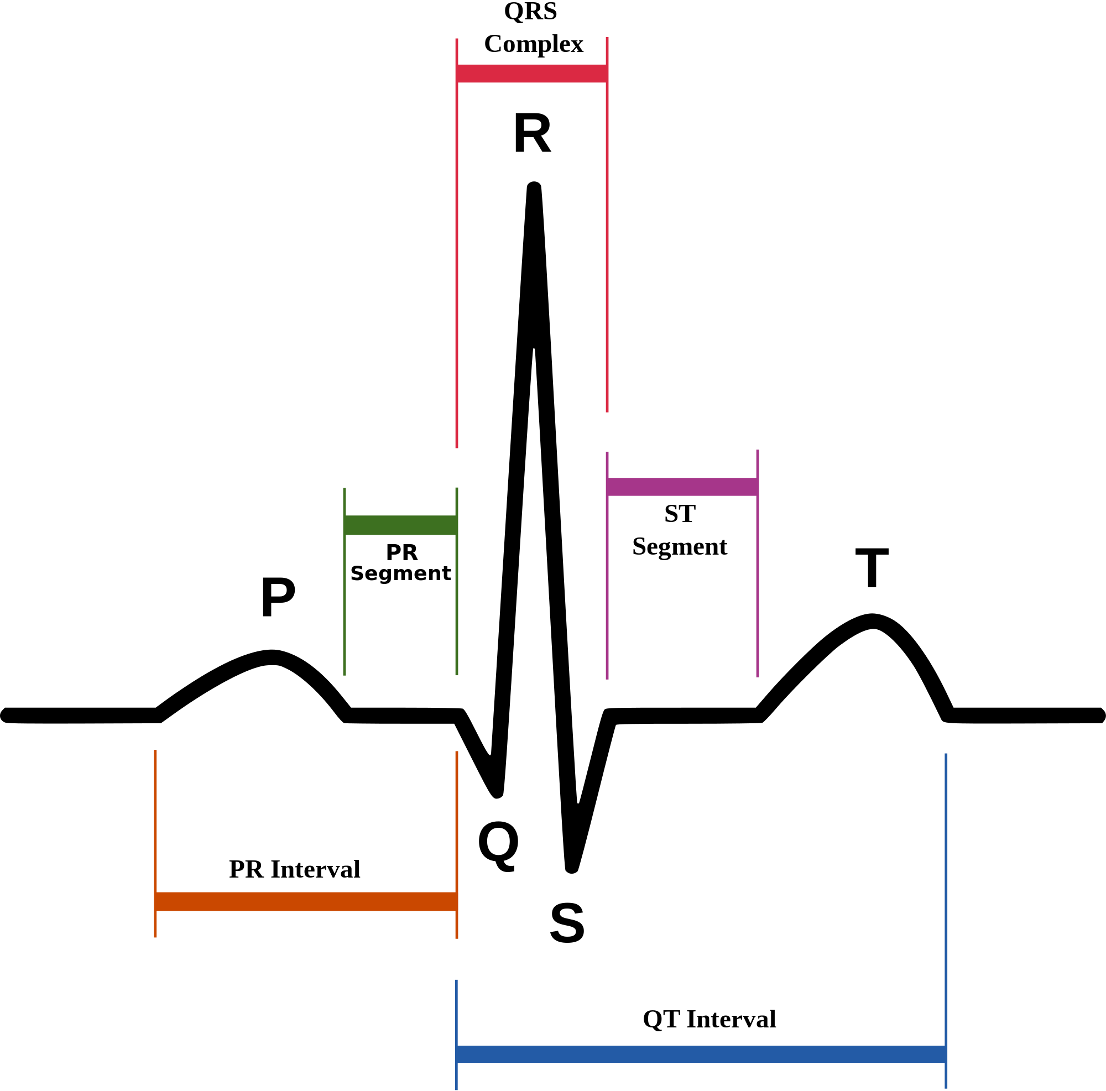
electrocardiogram trace
An ECG is a graph that plots the activity of the SA and AV nodes.
P wave: SA node; atrial systole
Q point: AV node sends impulse
QRS complex: spread of AV impulse to ventricles; ventricular sysole
T wave: AV node is repolarizing
ECG
Notes:
Every repeat is one cardiac cycle
SA node repolarises but is “hidden” behind the activity of the QRS complex
Clearly shows delay between firing of SA node and AV node

Slide 14
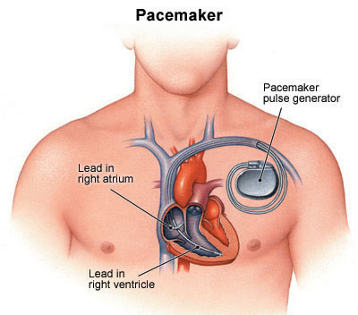
Artificial pacemakers
Problem: slow, fast or irregular heartbeats
Implanted battery operated device that helps trigger the cardiac cycle regularly by sending electrical shocks
It is threaded to blood vessels that lead to heart
Stimulates the heart nodes

Slide 15
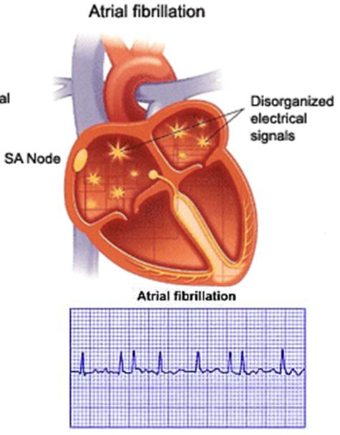
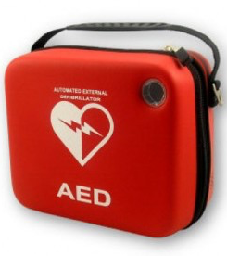
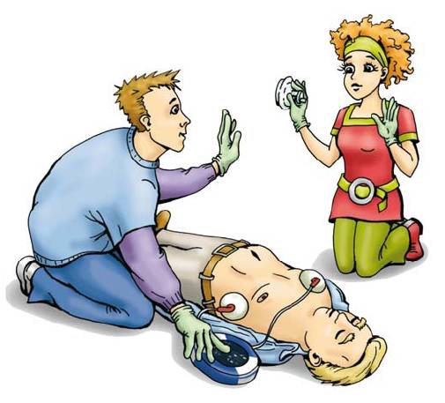
defibrillators
Ventricular fibrillation is where the ventricle muscle cells contract in a highly irregular way
Problem: heart attack, arrhythmia.
Delivers an electric shock to the heart and resets the SA node
Notes:
Arrhythmia: irregular electrical impulses

Slide 16
Qs

Slide 17
HW
Hypertension and thrombosis
Blood pressure measurements

Slide 18
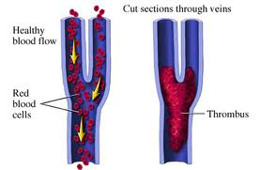
thrombosis
A clot (thrombus) forms within the blood vessel
In deep vein thrombosis (DVT), a clot develops in a larger vein and it can become a problem if it breaks off and blocks off a smaller vein
Anticoagulant (blood thinners)
Coronary thrombosis: if a thrombus lodges in coronary artery, this results in a myocardial infarction.

Slide 19
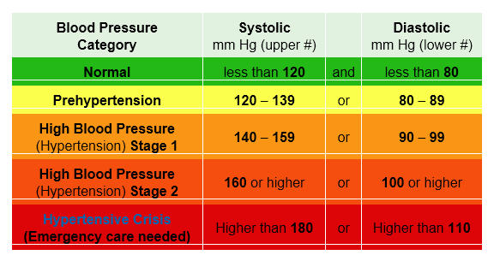
hypertension
Elevated blood pressure, which measures the force that blood pushes on the arterial walls
Blood pressure increases when:
Narrow lumen
High blood volume
Loss of elasticity
Build up of plaque
Notes:
Systolic pressure: measures pressure in arteries when heart beats/contracts
Diastolic pressure: measures he pressure in the arteries when the heart muscle is resting and refilling with blood

Slide 20
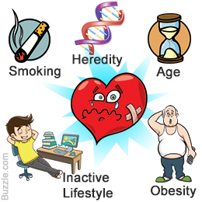
Risk factors for chd
This is a slow progressive build up of plaque in arteries and the problems that result from it
Overweight
High blood pressure
High cholesterol
Sedentary lifestyle
Stress
Smoking
Overeating
And MANY more…
Notes:
These risk factors are gathered from epidemiological studies; open to interpretation as there are interactions between factors

