Slide 1
D3 functions of the liver
Option d

Slide 2
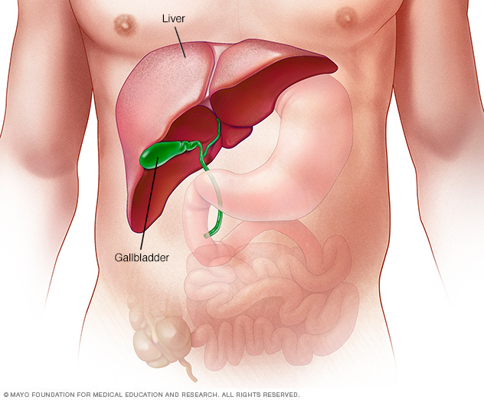

Slide 3
Learning objectives
Understandings
The liver removes toxins from the blood and detoxifies them
Components of the RBCs are recycled by the liver
The breakdown of erythrocytes (RBCs) starts with phagocytosis of RBCs by Kupffer cells
Iron is carried to the bone marrow to produce hemoglobin in new RBCs
Surplus cholesterol is converted to bile salts
ER and Golgi apparatus in hepatocytes produce plasma proteins

Slide 4
Learning objectives
Understandings
The liver intercepts blood from the gut to regulate nutrient levels
Some nutrients in excess can be stored in the liver
Applications and Skills:
A: Causes and consequences of jaundice
A: Dual blood supply to the liver and differences between sinusoids and capillaries

Slide 5
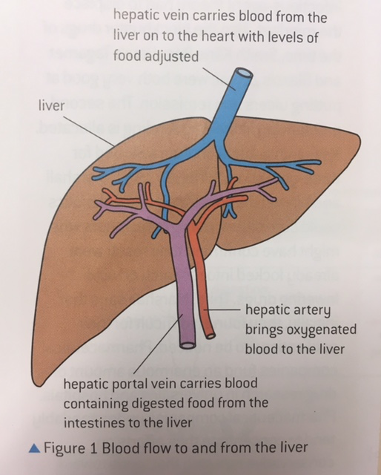

Slide 6
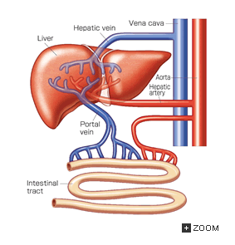
Dual Blood supply to liver
Blood enters liver via:
Hepatic artery: brings oxygenated blood
  Divides into arterioles that join with sinusoids at some points
Hepatic portal vein: brings blood from stomach and intestines
  Divides into sinusoids in the liver
  Sinusoids merge with venules that lead to hepatic vein
Notes:
Why are two supplies necessary? Blood from hepatic portal vein is low in oxygen as it comes from the aorta and dissociates most oxygen to the stomach and intestines first before going to liver
Variables in quantity of nutrients HPV
Low pressure in HPV

Slide 7
Liver Micrograph
Cross section of liver tissue
Hepatic Cells/Hepatocytes
Hepatic vein
Sinusoids

Slide 8
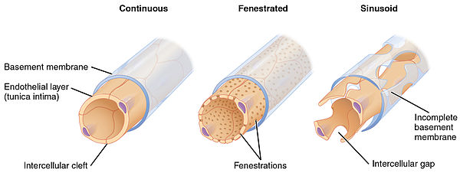
e.g. Glomerulus and intestines
Liver
e.g. Skin

Slide 9
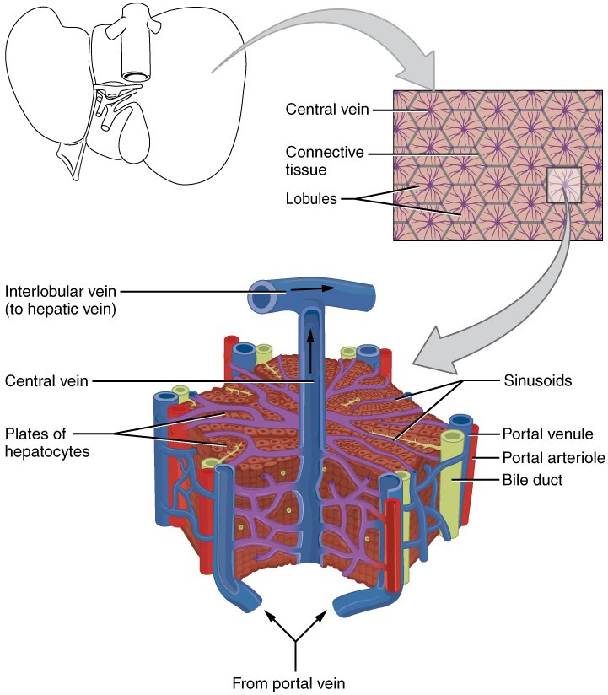

Slide 10
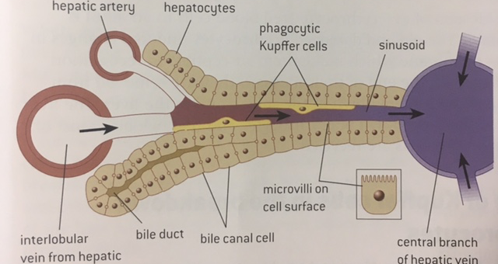
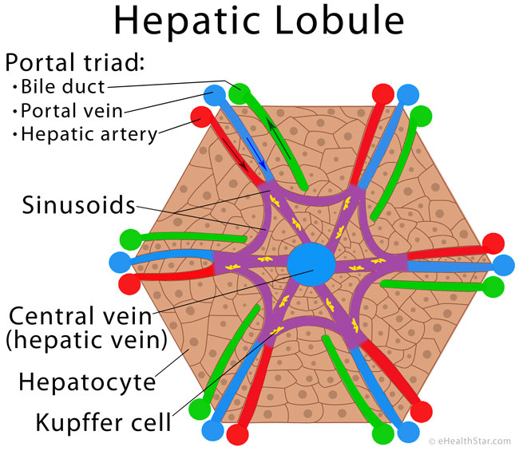

Slide 11
Sinusoids are different to capillaries
Wider
Lined by endothelial cells with gaps that allow large molecules (proteins) to be exchanged between hepatocytes and blood
Hepatocytes in direct contact with blood
Kupffer cells that break down hemoglobin released from “old” erythrocytes
Receive mix of blood from hepatic portal vein and hepatic artery

Slide 12
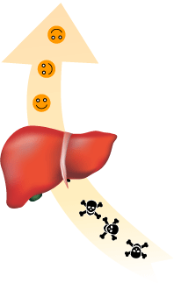
1) Liver removes toxins
What kinds of toxins does the liver eliminate?
Hepatocytes: extract toxins from plasma and modify them chemically to make it less harmful and water soluble in order to be eliminated by kidneys
E.g alcohol is broken down by ethanol dehydrogenase
E.g ammonia to urea
Notes:
What are some adaptations of Kupffer cells: lots of lysosomes
Alcohol, drugs, pesticides, preservatives

Slide 13
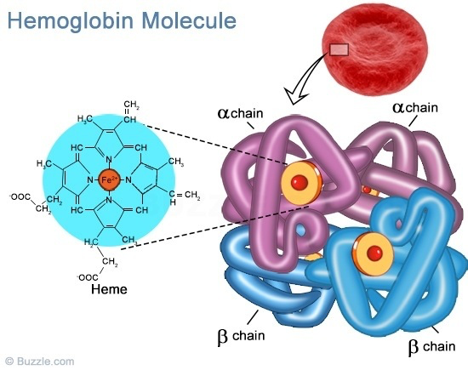
2) Breakdown and recycling of RBCs
Englufed by Kupffer cells (macrophages) into their components (heme group and globin chains).
AAs in chains are recycled; hemoglobin is broken down into iron and bilirubin.
Bilirubin is released into the blood then into hepatocytes and then released in bile
Iron is transported to liver and spleen for storage or to bone marrow for reuse (attached to transferrin). Stem cells in bone marrow have a many receptors for transferrin. Once inside the cell the iron joins the developing heme groups
Notes:
Why do RBCs need to be replaced? Anucleate so can’t undergo mitosis or make new proteins
4 month lifespan; replaced every 120 days by blood forming tissue in bone marrow
4 polypeptides, 4 hemes, 4 iron atoms
Bilirubin = bile pigment

Slide 14
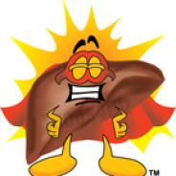
3)Regulation of nutrients in blood
Liver intercepts blood from to ensure that nutrients are within a homeostatic range
Blood glucose concentration (conversion to glycogen)
Breakdown of excessive proteins/amino acids (can’t be stored)
Manages lipids by processing it into different forms (VLDL, LDL, HDL)
Some nutrients can be stored
  glycogen
  Iron (from hemoglobin)
  Vitamin A, D

Slide 15
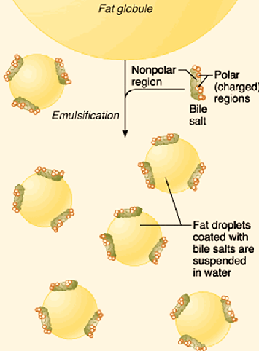
4) Production of bile
Bile enters the duodenum to emulsify fats for easier digestion
Bile is also alkaline so neutralises stomach acid to provide optimum pH for pancreatic enzymes
Hepatocytes convert surplus cholesterol into bile salts, which are added to bilirubin to make bile.

Slide 16
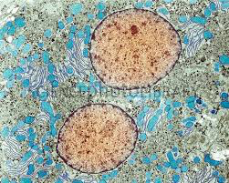
5) Production of plasma proteins
Active protein synthesis means that there are extensive RER and Golgi in cells
Albumin: carrier transport protein that helps regulate osmotic pressure in blood
Fibrinogen: when converted to fibrin, it aids clotting

Slide 17
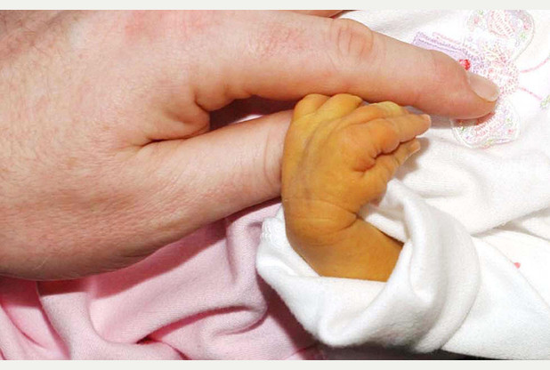
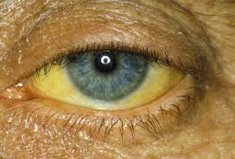
jaundice
Condition where there is too much bilirubin in the blood and tissues.
Premature newborns: until birth, the mom processes bilirubin through the placenta
  Blue/green light treatment
Adults: indication of liver malfunction (hepatitis, cancer, gallstones)
Notes:
Blue/green light treatment: changes shape/structure of bilirubin so it can be eliminated in waste. Gives time for liver to mature; can lead to acute bilirubin encephalopathy

Slide 18
Role of liver
Role | Description
Detoxification
Recycling of components of RBCs
Regulation of nutrients in blood
Production of bile
Production of plasma proteins

