Slide 1
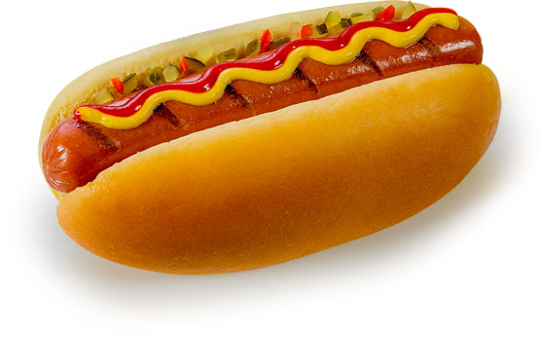
D.2 digestion
Option d

Slide 2
Learning objectives
Understandings
Nervous and hormonal mechanisms control the secretion of digestive juices
Exocrine glands secrete to the surface of the body or the lumen of the gut
The volume and content of gastric secretions are controlled by nervous and hormonal mechanisms
Acid conditions in the stomach favour some hydrolysis reactions and help to control pathogens in ingested food
The structure of cells of the epithelium of the villi is adapted to the absorption of food

Slide 3
Learning objectives
Understandings
The rate of transit of materials through the large intestine is positively correlated with their fibre content
Materials not absorbed are egested

Slide 4
Learning objectives
Applications and Skills:
A: The reduction of stomach acid secretion by proton pump inhibitor drugs
A: Dehydration due to cholera toxin
A: Helicobacter pylori infection is a cause of stomach ulcers
S: Identification of exocrine gland cells that secrete digestive juices and villus epithelium cells that absorb digested foods from electron micrographs

Slide 5
Digestive system overview

Slide 6
Route through the digestive system
List all the parts of the digestive system that food moves through. In the correct order…

Slide 7
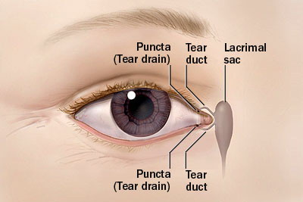
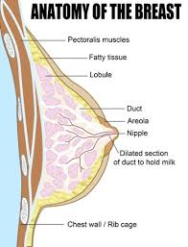
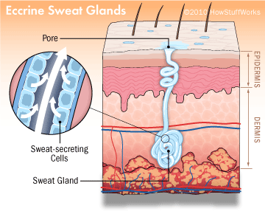
Exocrine glands
Produce a secretion that is transported to its target location via a duct
Surface of body
Tears
Milk
Sweat
Exocrine glands secrete to the surface of the body or the lumen of the gut
Notes:
Extensive RER to make enzymes
Mitochondria for ATP
Unlike Endocrine glands which secrete directly into blood

Slide 8
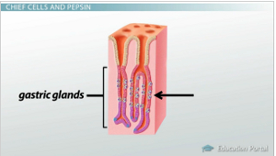
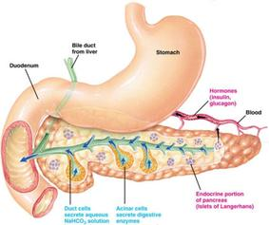
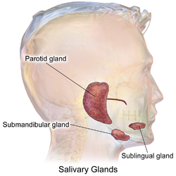
Exocrine glands
Lumen of gut
Saliva
Gastric juice
Pancreatic juice
Bile

Slide 9
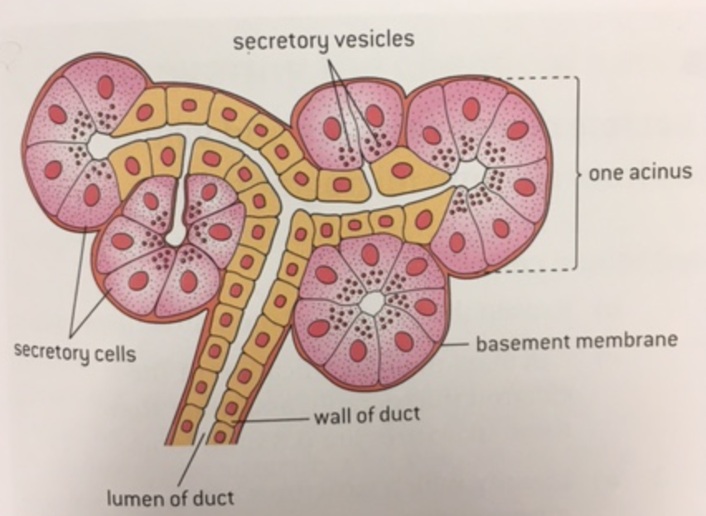
Exocrine glands
A group of cells called an acinus secretes into a duct branch.
Each branch feeds into the main duct

Slide 10
Adaptations?

Slide 11
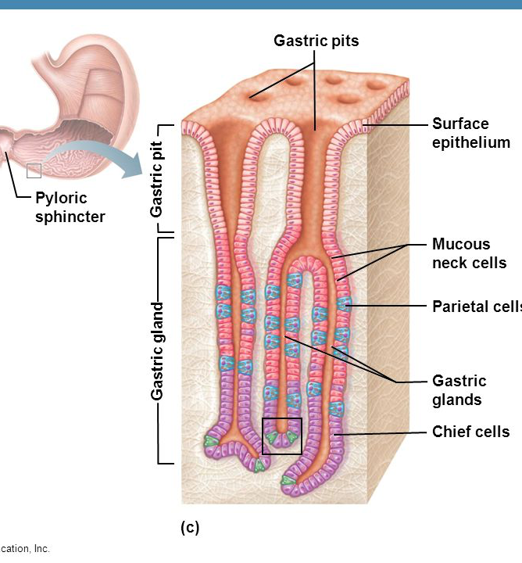
Gastric secretions (stomach) Nervous and hormonal control
Nervous and hormonal mechanisms control the release of digestive juices from the gastric pits of stomach
Sight and smell: from medulla via vagus nerve
Gland cells in stomach:
HCl and pepsinogen production
Gastrin production (stimulates HCl and pepsinogen secretion)
Notes:
Gastrin promotes secretion of HCl and pepsinogen
Pepsinogen (with HCl) converts to Pepsin (active)
Parietal cells release HCl in the pits

Slide 12
Gastric secretions Nervous and hormonal control
If chemoreceptors in the stomach detect peptides (proteins)
Or
If stretch receptors detect distention…
Impulses sent to brain.
Brain responds by sending an impulse down the vegus nerve to the stomach and duodenum.
Cells here secrete gastrin (hormone that stimulates the secretion of acid and pepsinogen from gastric gland cells)
Notes:
Gastrin promotes secretion of HCl and pepsinogen
Pepsinogen (with HCl) converts to Pepsin (active)

Slide 13
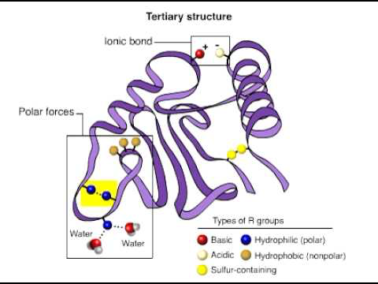
What is HCl for?
Helps break the bonds that maintain the 3D structure of proteins with low pH (denaturation)
Activates pepsinogen which is converted to pepsin
Allows enzymes (pepsin to more easily access peptide bonds
Kills ingested bacteria and fungi
Notes:
Pepsin – hydrolyses polypeptides to short peptides

Slide 14
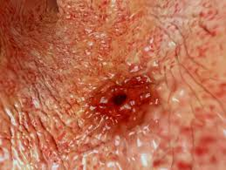
Stomach Ulcers
Stomach acid is corrosive.
Body produces a mucus barrier to protect the lining of the stomach
Sometimes mucus breaks down, causing bleeding - ulcer

Slide 15
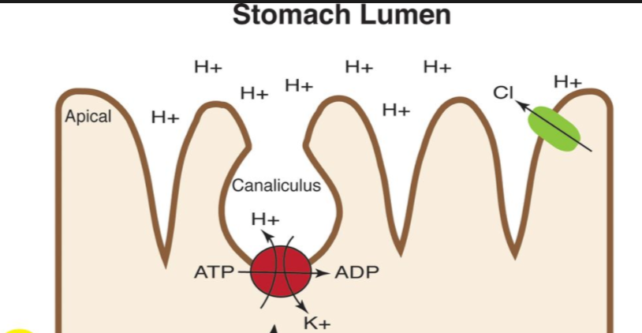
Proton pump to make stomach acid
The acidic environment in stomach is achieved by a proton pump called H⁺, K⁺ - ATPase
Two protons are pumped into the lumen for two K⁺
ATP provides energy
Notes:
Acidity causes a lot of problems: ulcers, heartburn

Slide 16
Proton pump inhibitors - Reducing stomach acid secretions
Proton pump inhibitors (PPIs) can be used to reduce stomach acid (if someone has acid reflux or an ulcer)
PPIs bind irreversibly to these pumps
Not permanent as pumps are broken down and resynthesised.
Notes:
Acidity causes a lot of problems: ulcers, heartburn

Slide 17
Pancreatic secretions (unit 6)
Another exocrine gland
Secretes enzymes into the pancreatic duct
Pancreatic ducts leads to the duodenum (start of the SI)
Secretions contain trypsinogen, amylase, lipase
Is alkaline

Slide 18
Adaptations of the villi
Draw a diagram to show the adaptations of the villus for absorption.
Green pen = I know already
Red pen = I had to look in the book

Slide 19
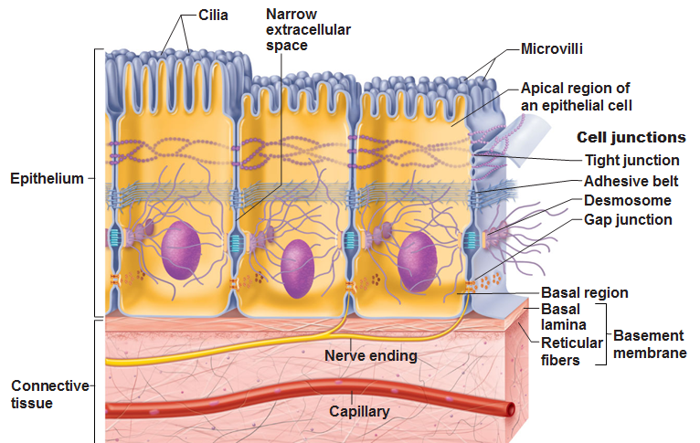
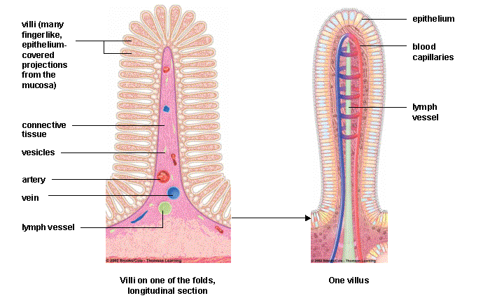
Adaptations of villi
Microvilli (brush border) – large surface area
Lots of mitochondria – why?
Tight junctions: ensure that the epithelial cells remain selective in allowing which nutrients can pass through
Pinocytosis vesicles present from endocytosis
Apical and basal surfaces have different proteins involved in transport
Notes:
Apical (facing lumen)
Basal (facing blood vessel)

Slide 20
Qs

Slide 21
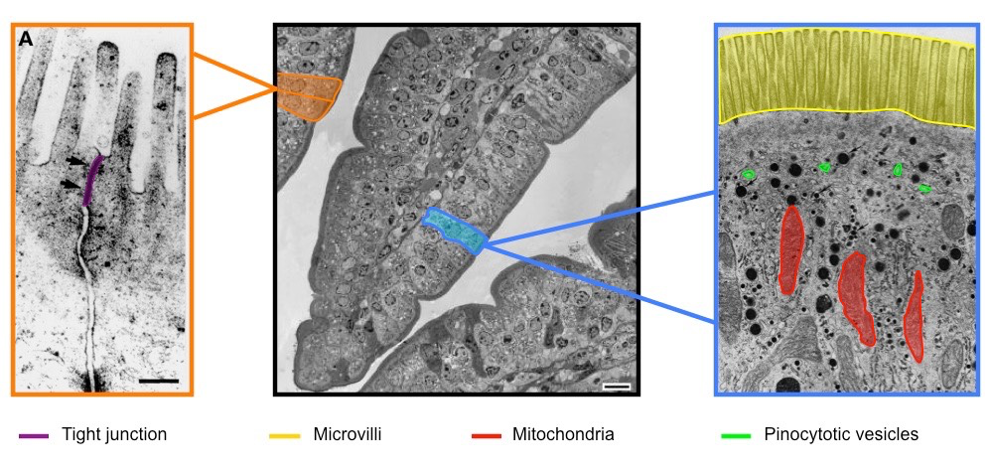
Identifying adaptations of the villus

Slide 22
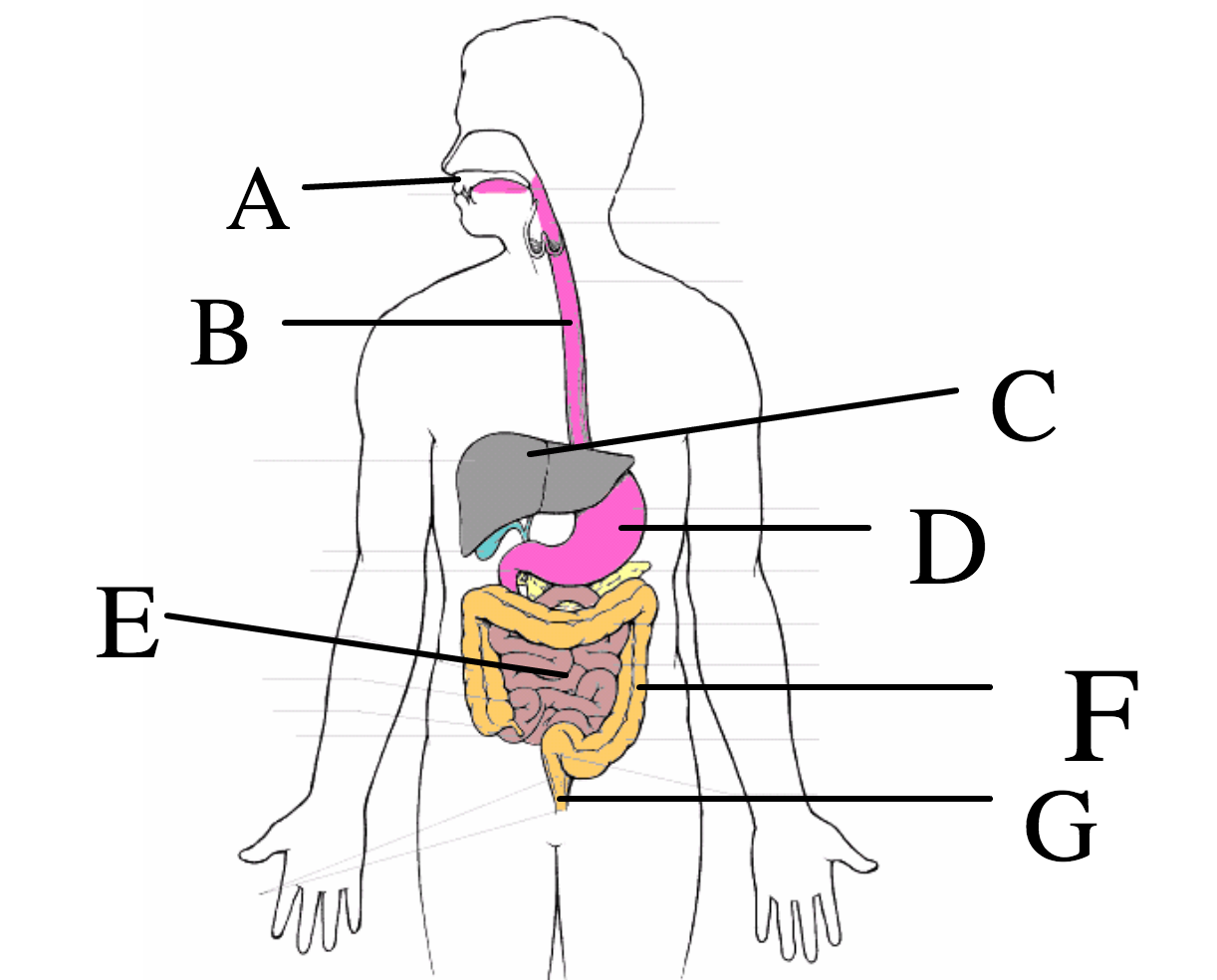
Not all food is digested and absorbed
Some substances can’t be digested and are not absorbed in the small intestine.
These substances move into the large intestine.
What else is present?
Mouth, stomach and SI secrete water
LI reabsorbs this water
FIBRE is mostly cellulose + lignin

Slide 23
Egestion
Everything that is left will become feces in the large intestine and finally egested:
Cellulose
Lignin
Bile pigments and bilirubin (from the breakdown of RBC)
Bacteria
Fibre provides bulk to help peristalsis
Use page 676-677 to explain what the benefits are of fibre in the diet

Slide 24
Data Q – 677
Positive correlation between rate of movement of material and fibre intake

Slide 25
This actually exists!

Slide 26
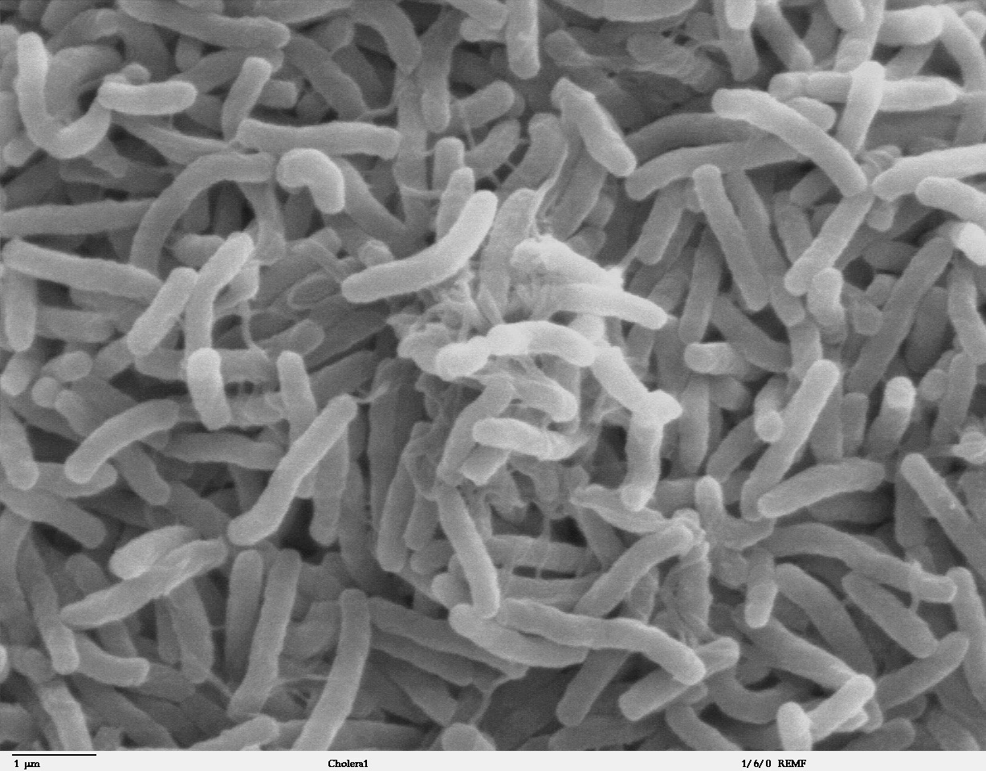
Dehydration by cholera
Draw an intestinal epithelial cell
Use the orange box on page 677 to annotate the diagram to show how Vibrio cholera infection can lead to dehydration

Slide 27
Dehydration by cholera
Cholera is caused by Vibrio cholera
A cholera toxin is released and binds to intestinal receptors where it is endocytosed into cells.
Leads to efflux of Cl⁻ and HCO₃⁻ ions and osmosis leads to diarrhea.
Water is drawn from blood into cells to replace fluid loss
Dehydration results

Slide 28
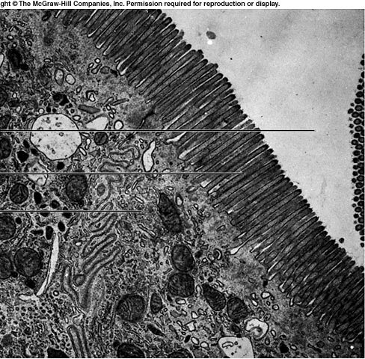
Identify the adaptations of Villus
Identify:
Lumen
Brush border
Tight junction
Mitochondrion
RER
Lysosome
Pinocytotic vesicles

