Slide 1
D1 human nutrition
Option d

Slide 2
Learning objectives
Understandings
Essential nutrients cannot be synthesised by the body, therefore they have to be included in the diet
Dietary minerals are essential chemical elements
Vitamins are chemically diverse carbon compounds that cannot by synthesised by the body
Some fatty acids and some amino acids are essential
Lack of essential amino acids affects the production of proteins
Malnutrition may be caused by deficiency, imbalance, or excess of nutrients in the diet
Appetite is controlled by a centre in the hypothalamus
Overweight individuals are more likely to suffer hypertension and type II diabetes
Starvation can lead to breakdown of body tissue

Slide 3
Learning objectives
Applications and Skills:
A: Production of ascorbic acid by some mammals, but not others that need a dietary supply
A: Cause and treatment of PKU
A: Lack of vitamin D or calcium can affect bone mineralization and cause rickets or osteomalacia
A: Breakdown of heart muscle due to anorexia
A: Cholesterol in blood as an indicator of the risk of CHD
S: Determination of energy content of food by combustion
S: Use of databases of nutritional content of foods and software to calculate intakes of essential nutrients from a daily diet

Slide 4
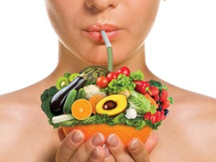
Essential nutrients
Why do you think some nutrients are described as ‘essential’?
These can’t be made by the body and have to be part of your diet
Essential amino acids
Essential fatty acids
Minerals
Vitamins (e.g. Vitamin C)
Non-essential nutrients: other nutrients can be used for same purpose or they can be made by the body
Notes:
M

Slide 5
Vitamin C (Ascorbic Acid)
Most animals and plants can produce vitamin C.
Needed for the synthesis of collagen (needed in the production of many structural tissues such as skin and blood vessel walls)
Mutations have occurred which means a protein required in the synthesis pathways is not produced.
EXPLAIN HOW A MUTATION CAN LEAD TO THIS PROTEIN NOT BEING PRODUCED….
GLO gene which codes for the enzyme L-gulono-y-lactone oxidase.

Slide 6
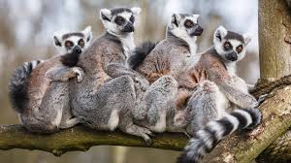
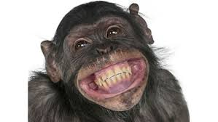
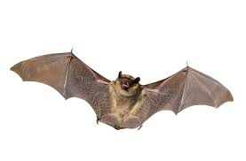
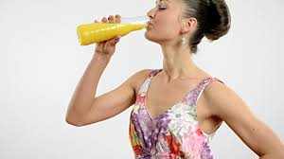

Slide 7
Phylogenetic distribution
Where did these mutations occur?

Slide 8
Amino Acids | Minerals | Vitamins | Fatty Acids | Malnutrition
Why we need them/functions in the body. Give examples. | Why we need them/functions in the body. Give examples. | Why we need them/functions in the body. Give examples. | Why we need them/functions in the body. Give examples. Including omega 3 and omega 6 | What is malnutrition? What are the different types? What is starvation?
Problems with deficiencies. Include: How essential amino acids are needed for protein synthesis. Consequences of blood plasma protein deficiency | Problems with deficiencies. Include: Consequences of iodine, iron and calcium deficiencies | Problems with deficiencies. Include: Consequences of vitamin C, D and B12 deficiencies | Problems with deficiencies. Include: Consequences of omega 3 and omega 6 deficiencies | What are some of the consequences of malnutrition and starvation?

Slide 9
Essential vitamins
Diverse carbon compounds
Roles in body:
Cofactors for enzymes
Antioxidants
Hormones
Water soluble: (lost in urine)
C (ascorbic acid)
B₁ thiamin
B₂ riboflavin
B₃ niacin
B₅ pantothenic acid
B₆ pyridoxine
B₇ biotin
B₉ folic acid
B₁₂ cobalamin
Fat soluble: (can be stored)
A, D*, E, K

Slide 10
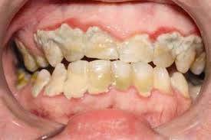
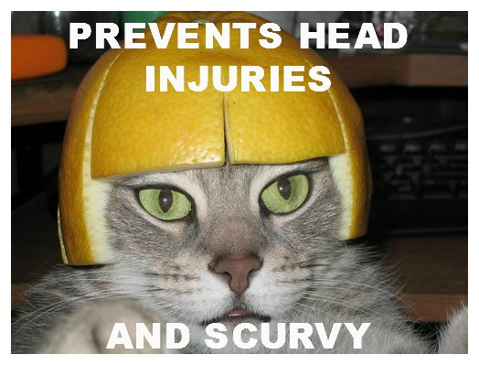
Vitamin C
Vitamin C (ascorbic acid) is needed for synthesis of collagen fibres and can be made by most animals (some mammals) and plants
Deficiency leads to scurvy
Notes:
Like minerals, we need vitamins in small quantities as they are typically used to make relatively long-lived substances in the body
Humans (and many primates) cannot produce vitamin C

Slide 11
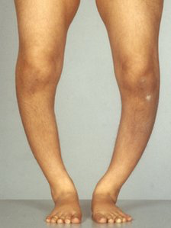
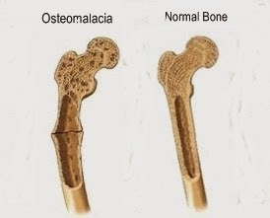
Rickets and Osteomalacia
Vitamin D is needed for calcium absorption and proper formation of bones
Rickets results when the growth plates of bones do not mineralise properly (children)
Osteomalacia occurs in adults who have “soft bones”
Notes:
Poor bone formation/condition results from lack of vitamin D and/or Ca
Epidermis of skin contains vitamin D precursors that can be converted to Vitamin D in the presence of UV rays

Slide 12
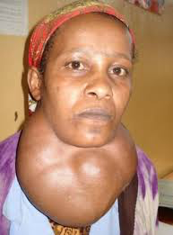
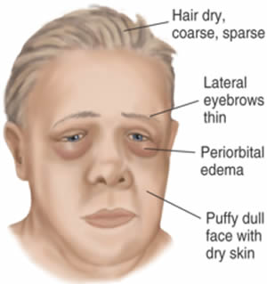
Dietary minerals are essential chemical elements
Usually chemical elements in ionic form (electrolytes) (i.e. Ca²⁺)
Needed in small quantities (mg, μg)
Deficiency leads to disease
Example: iodine needed to make thyroxin; deficiency causes IDD
Notes:
IDD: Iodine deficiency disorder
Minerals have either an anatomical role (Ca in bones) or physiological role (Fe in hemoglobin). Since this means minerals stay in the body for a long time, they are only needed in small and constant quantities. (Constant because body needs to constantly repair)
Some muscle cramps are caused by mineral depletions

Slide 13
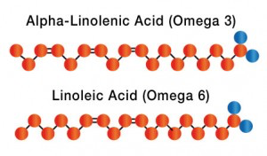
Essential fatty acids
Two are essential: omega-3 and omega-6 fatty acids (alpha-linolenic acid and linoleic acid are used in the synthesis of other compounds involved in the development of the brain and eyes)
Not all fats are bad for you!
Notes:
Number refers to the position of the double bond in relation to end of molecule

Slide 14
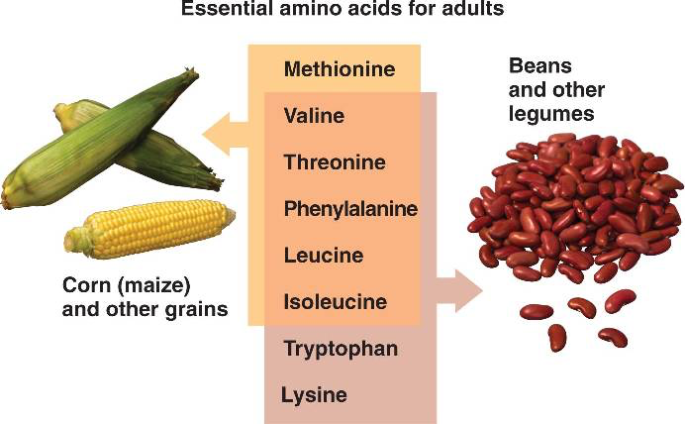
There are 9 essential amino acids
If any of these are missing, certain proteins cannot be synthesized.
Histidine Isoleucine Leucine Lysine Methionine | Phenylalanine Tryptophan Valine Threonine (only if phenylalanine is not in diet)
Notes:
Number refers to the position of the double bond in relation to end of molecule

Slide 15
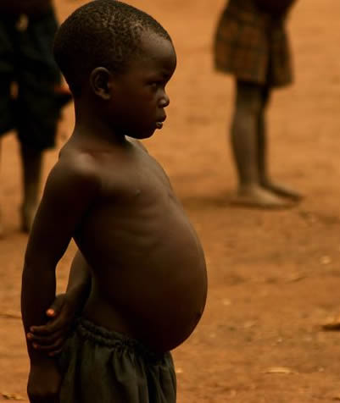
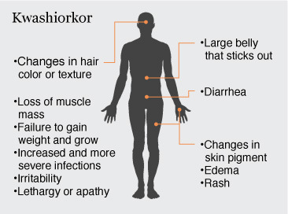
Essential amino acids
Lack of these affects protein production.
This leads to protein deficiency malnutrition.
Lack of blood plasma proteins = fluid retention in tissues (edema)
Children have stunted growth and development
Adults waste away
Notes:
Insufficiency may be due to lack of certain Aas in diet or lack of variety in diet
Kwashiorkor is a severe protein/energy malnutrition

Slide 16
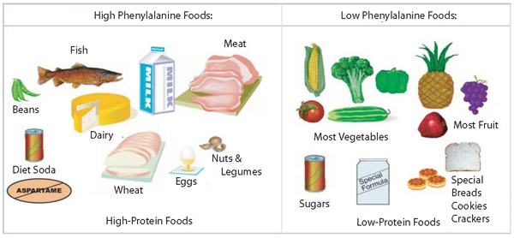
Phenylketonuria (PKU)
An recessive genetic disease due to a mutation in the gene that codes for phenylalanine hydroxylase (enzyme), which converts phenylalanine (aa) to tyrosine (aa)
High phenylalanine levels result in reduced growth of head and brain, mental retardation, hyperactivity, and seizures
Notes:
Test carried out within 24hr of being born

Slide 17
Inheritance of PKU
Show how two parents who do not have PKU can have a child with PKU. Use a genetic diagram using the letter A/a.

Slide 18
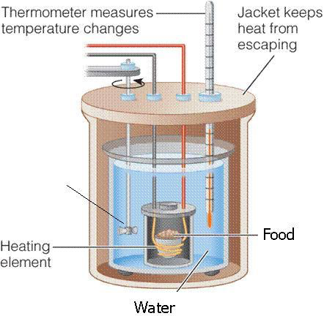
Determining the energy content of food using Calorimetry
It is based on the knowledge that the specific heat capacity of water is 4.186J of energy to raise the temperature of 1g of water by 1ºC
Notes:
Assumptions: must cap water (evaporated water decreases mass of water)
If using metal can, some heat is used to heat up the coke can AND water (change in temperature is the same)
Assumes complete combustion of food (if incomplete combustion, look at change in food mass)
Q = mC(delta T)
Heat (J) = mass (g) x 4.18J/C/g x change in temperature (C)
Divide by 1000 to convert to kCal

Slide 20
Sample problem
Mass of nut = 0.60g
Volume of water = 25mL
Initial water temperature = 20 degree Celcius
Final water temperature = 65 degree Celcius
Calculate the energy released by this nut (J/g)

Slide 21
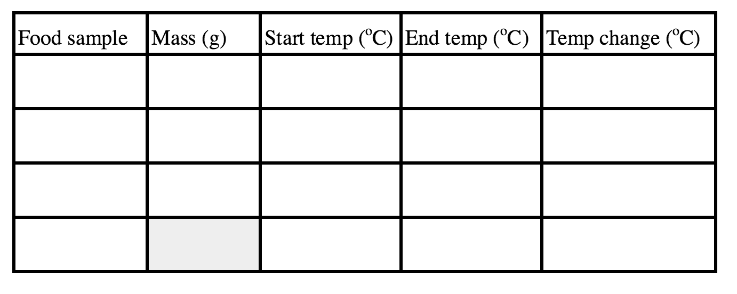
You can now calculate Q.

Slide 22
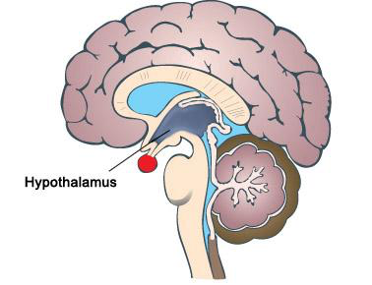
hypothalamus
Hypothalamus is the appetite control centre. It reduces the desire to eat when these things happen?
The small intestine releases the hormone PYY3-36 when it contains food
The pancreas secretes the hormone insulin when blood sugar levels are high
Adipose tissue secretes leptin when amounts of stored fat increase
If the appetite control centre receives these hormones appetite will decrease

Slide 23
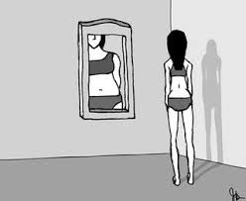
anorexia
A psychiatric illness which results in the breakdown of tissues due to starvation.
So little is eaten that the body breaks down it’s supply energy
Symptoms:
Wasting of muscles (including heart)
Thin and sparse hair
Dry skin, easily bruised
Low blood pressure
Poor circulation
Infertility in females

Slide 24
Problems with being overweight
Type II diabetes
Hypertension
What is it?
What is it caused by?
How is it detected?
Consequences

Slide 25
Problems with being overweight
1. Type II diabetes:
Risk factors: diets rich in fat and low in fibre, obesity due to overeating and lack of exercise, genetic factors
Symptoms: high blood glucose, glucose in urine, dehydration and thirst
Problems: atheroschlerosis, hypertension, CHD

Slide 26
Problems with being overweight
2. Hypertension: positive correlation between weight and BP
Weight gain = more blood needed
Weight gain = stiff and narrow arteries
High salt intake

Slide 27
Cholesterol

Slide 33
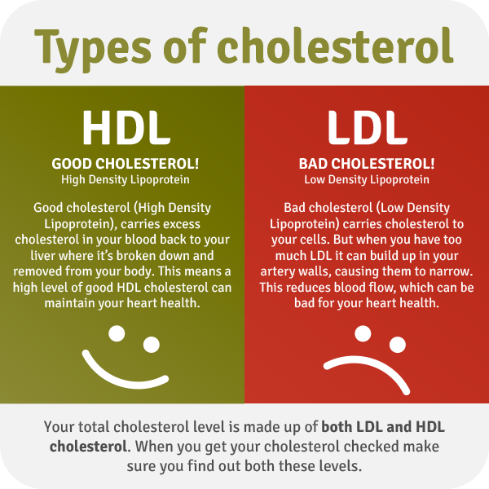
Blood cholesterol and heart disease
Cholesterol is a risk factor for CHD but relationship is unclear
Distinguish between HDL and LDL
Lowering dietary cholesterol has little impact on body
Liver makes it’s own cholesterol
Genetic factors seem to play a larger role

Slide 34
Supertracker
Make a diary of what you ate yesterday.
Calculate your intake of essential nutrients for this meal
https://www.supertracker.usda.gov/

