Slide 1
Starter Questions
Which strand of DNA does mRNA form next to?
How many bases code for 1 amino acids?
If a section of a gene is 15 bases long how many amino acids can it code for?
What is the name for the triplet of bases on mRNA?
What is the name for the triplet of bases on tRNA?
If one DNA triplet has the code TAG, what will be the corresponding triplet codes on mRNA and tRNA?

Slide 2
Codons and the nature of the genetic code
Describe the function of start and stop codons
Describe the genetic code as degenerate
Analyse the genetic code to predict codons, anticodons and amino acids

Slide 6
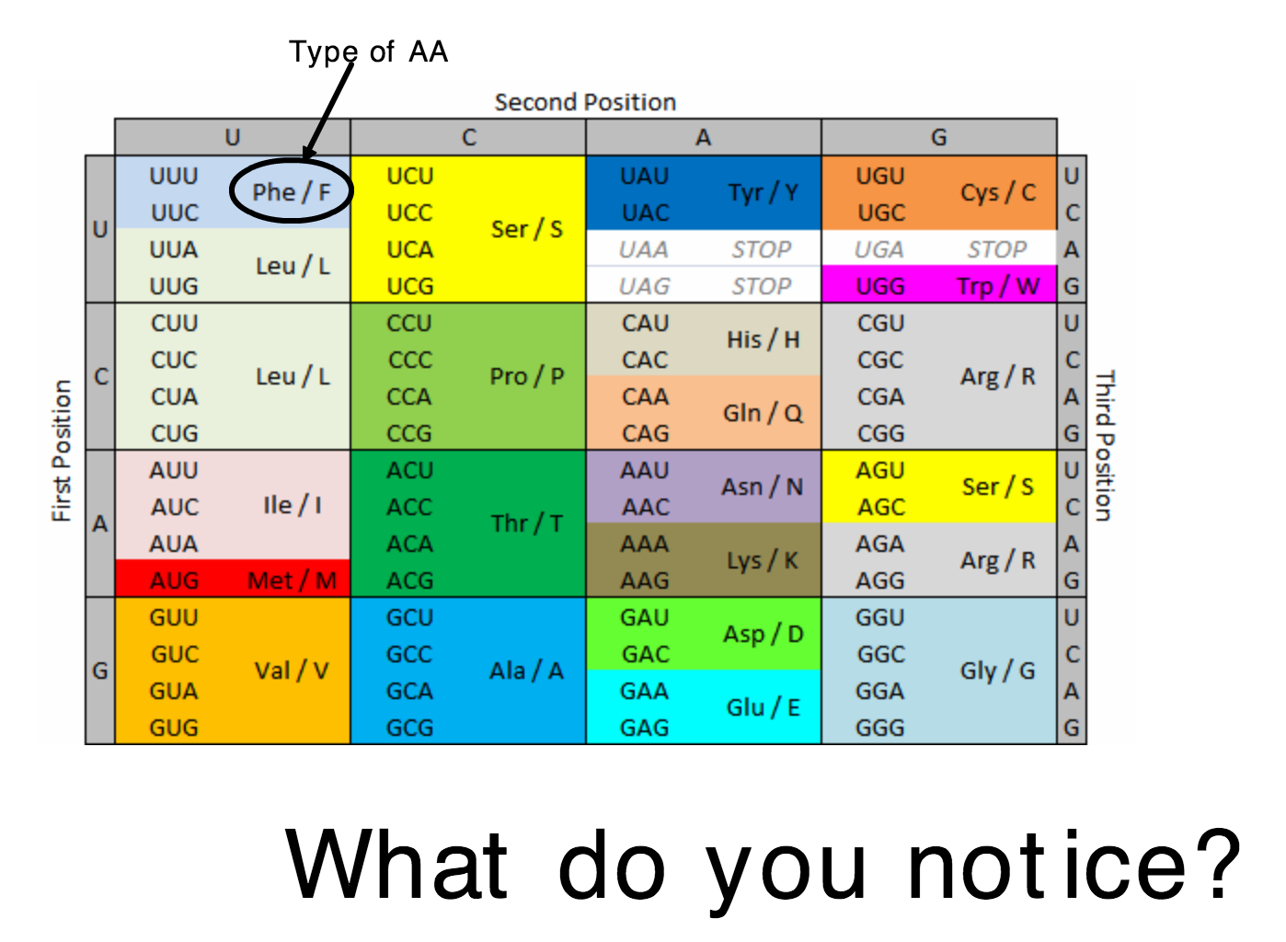

Slide 7
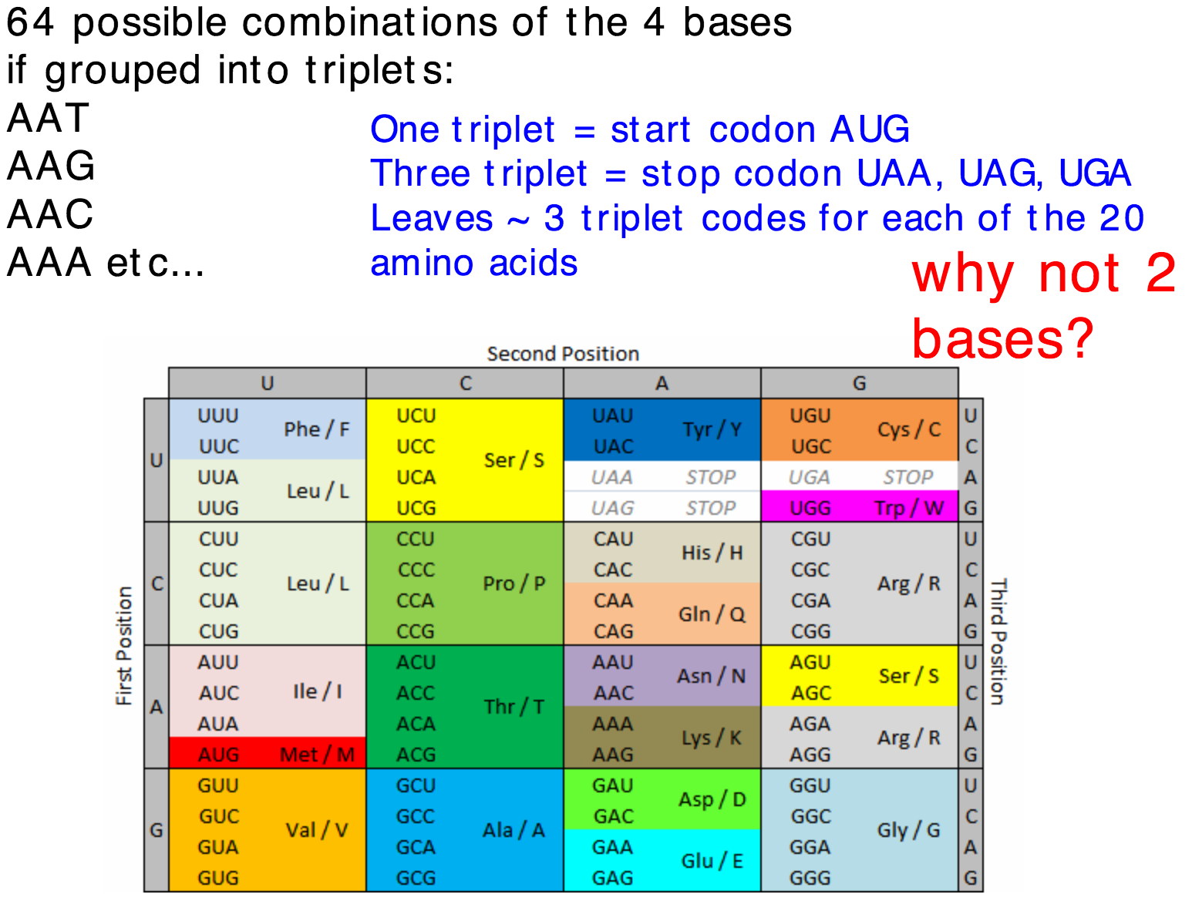
Degenerate code

Slide 8
d

Slide 9
Complete Questions of Page 120
a) UGG b) UAU, UAC
c) CGU, CGC, CGA, CGG, AGA, AGG
2. a) Thr b) His,Gly c) Arg,Ala,Arg
3. a) Leu,Ile,Glu Stop
b) GAG TAG CTT ATT GGG

Slide 10
Universal Code - DNA

