Slide 1
Earth average surface temperature:
14⁰C
Moon average surface temperature:
-77⁰C
stable
unstable
Why?

Slide 2
Thin blue line

Slide 3
4.4 Climate change
Understanding:
Carbon dioxide and water vapour are the most significant greenhouse gases
Other gases including methane and nitrogen oxides have less impact
The impact of a gas depends on its ability to absorb long-wave radiation as well as on its concentration in the atmosphere
The warmed earth emits longer-wave radiation
Longer wave radiations is reabsorbed by greenhouse gases which retains the heat in the atmosphere
Global temperatures and climate patterns are influenced by concentrations of greenhouse gases
There is a correlation between rising atmospheric concentrations of carbon dioxide since the start of the industrial revolution two hundred years ago
Recent increases in atmospheric carbon dioxide are largely due to increases in the combustion of fossilised organic matter
Nature of science:
Assessing claims: assessment of the claims that human activities are not causing climate change
Applications
Correlations between global temperatures and carbon dioxide concentrations on earth
Evaluating claims that human actiites are not causing climate change
Threats to coral reefs from increasing concentrations of dissolved carbon dioxide

Slide 4
Greenhouse Gases - Main
Gases in atmosphere retain heat so keep earth warm
Carbon dioxide
Released by respiration and combustion
Removed by photosynthesis and dissolve in oceans
Water vapour
Formed by evaporation and transpiration
Removed by rainfall and snow

Slide 5
Other Greenhouse Gases
Have less of an effect on the earth’s temperature
Methane
Produced in waterlogged areas and landfill sites
Released during extraction of fossil fuels
Nitrous oxide
- Released by bacteria, agriculture vehicle (car, plane) exhausts.

Slide 6
Impacts
Warming impact of greenhouse gases determined by:
How readily the gas absorbs long-wave radiation
Concentration of the gas in the atmosphere
(Methane causes more warming per molecule than carbon dioxide, but there is less of it so it impacts less)
Notes:
How much a greenhouse gas warms the atmosphere depends on 1. and 2.

Slide 7
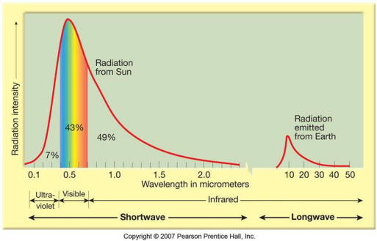
Radiation
The earth absorbs short wave radiation from the sun (400nm)
Re-emits (reflects) as long wave radiation (usually infrared at 10,000nm)
Show this on your sheet

Slide 8
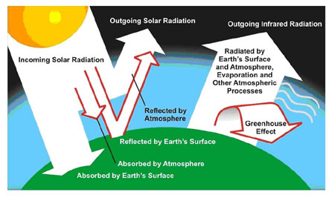
Absorption
25-30% short wavelength radiation from the sun is absorbed before it reaches earth (ozone – O₃)
70-85% of re-emitted long wavelength radiation absorbed by greenhouse gases
Show this on your sheet

Slide 9
No greenhouse gases
Average global temperature would be -18 degrees

Slide 10
Draw the greenhouse effect
Include:
Incoming solar radiation
Absorbed by earth
Wavelengths of sun and earth radiation
How much absorbed by ozone
How much absorbed by greenhouse gases
Reflection of sun’s rays off earth
Reflection of rays by atmosphere
Radiation from earth
Green house effect
4 greenhouse gases (2 common, 2 less common)
Pages 229-232

Slide 12
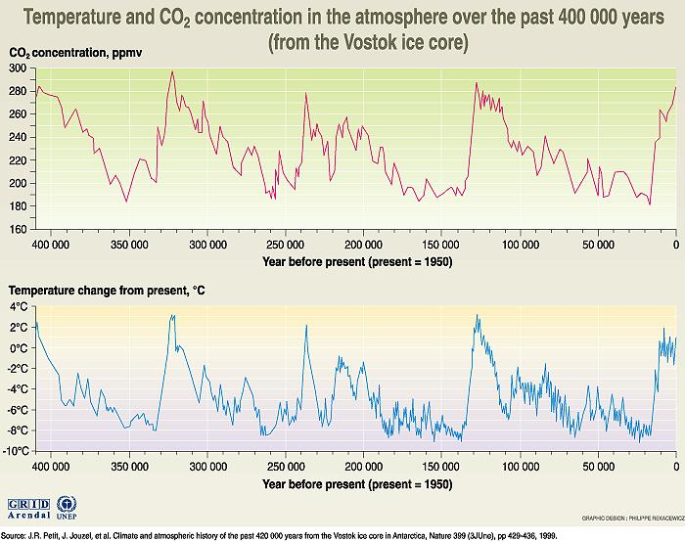
Carbon Dioxide concentrations
Brian
Are carbon dioxide concentrations linked to global warming?
Look at your graph.
Are global temperatures linked to carbon dioxide concentrations?

Slide 14
Carbon Dioxide concentrations
Shows a positive correlation between carbon dioxide and global temperature – one goes up so does the other
Scientists use ice cores to determine carbon dioxide levels 400,000 years ago

Slide 15
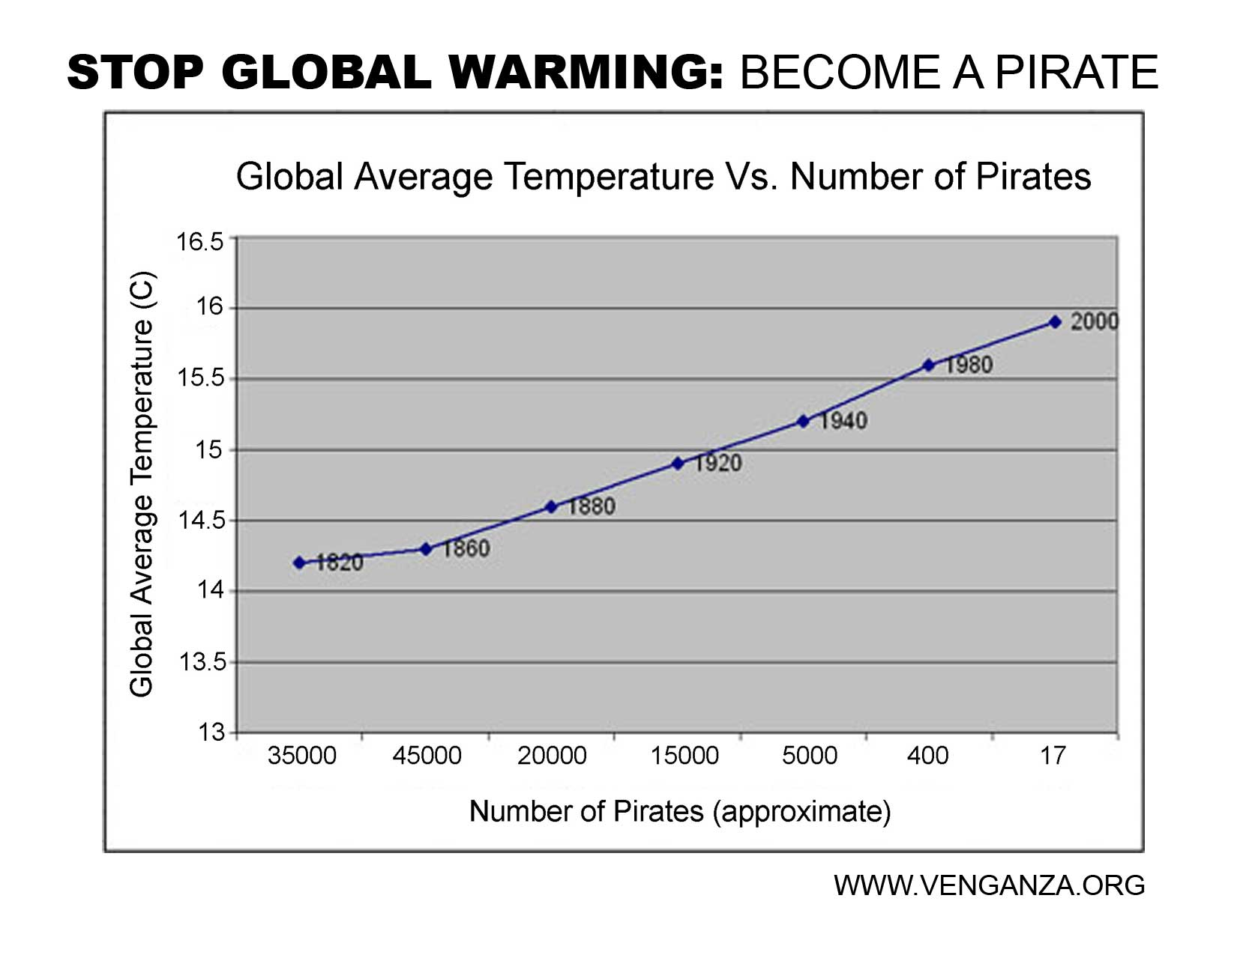
What does this suggest?

Slide 16
Causation?
Things are not always as they seem!
Video
14 mins

Slide 17
Human involvement
Many claims humans are not causing climate change
Must base claims on reliable evidence.
Skeptics

Slide 18
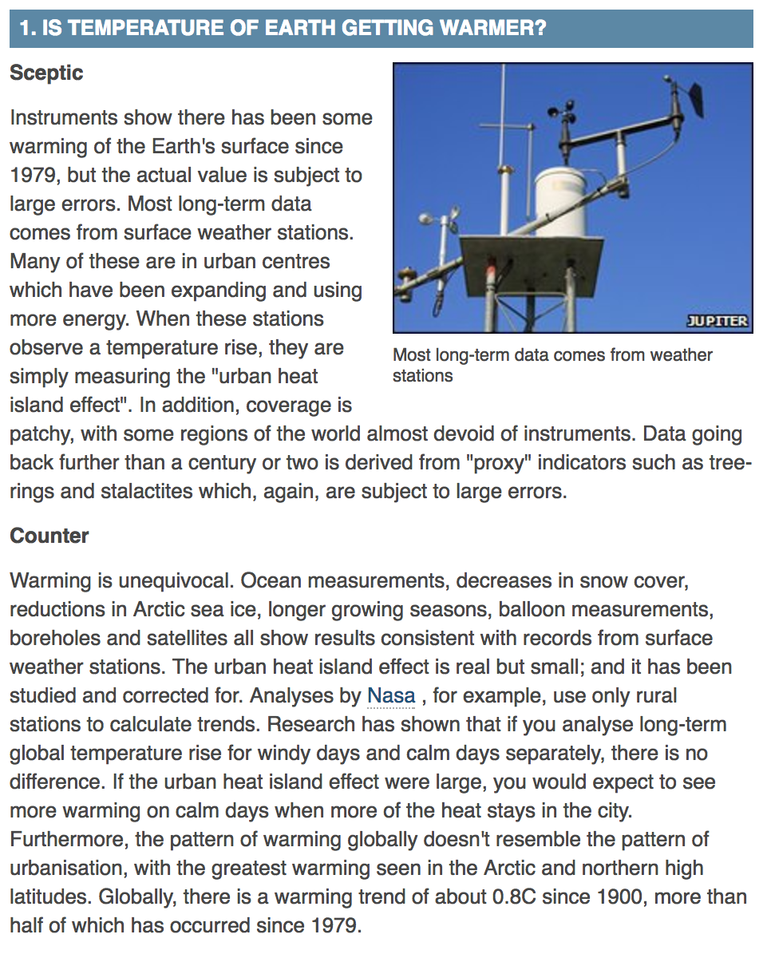

Slide 20
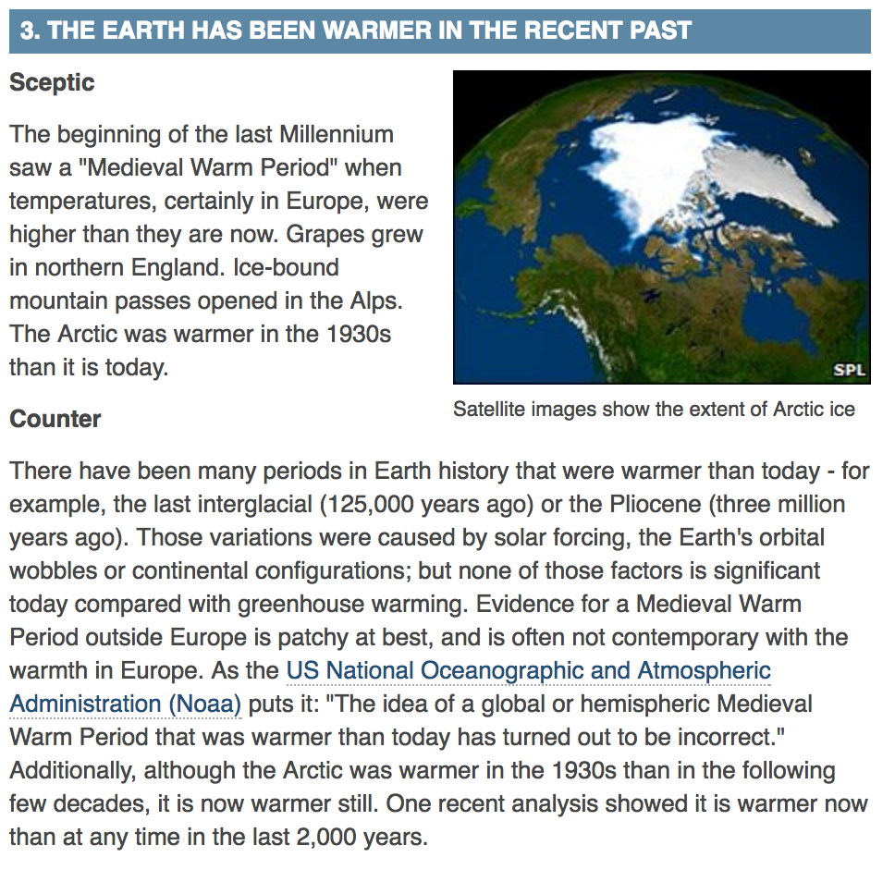

Slide 26
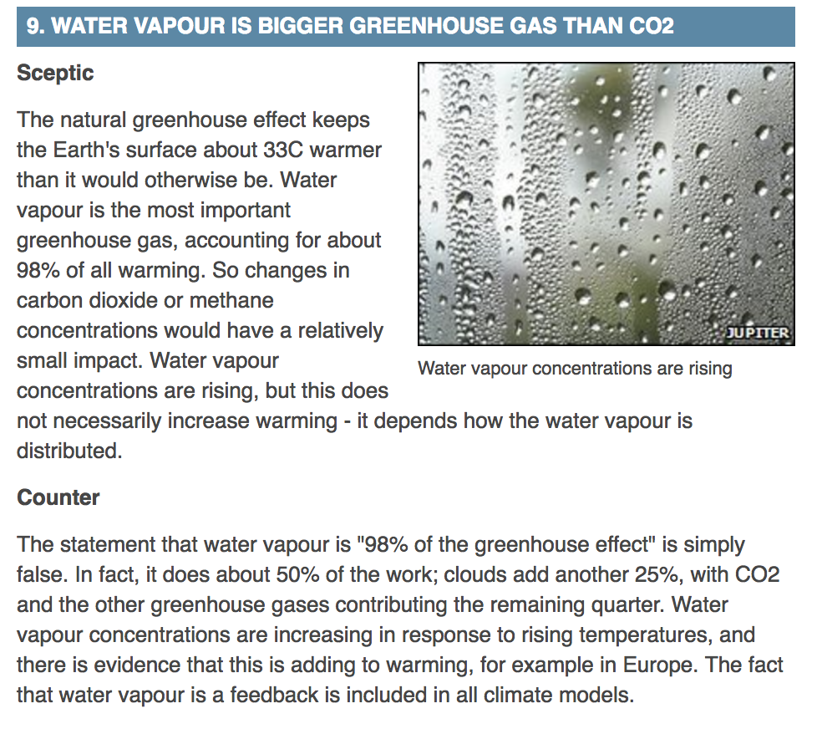

Slide 27
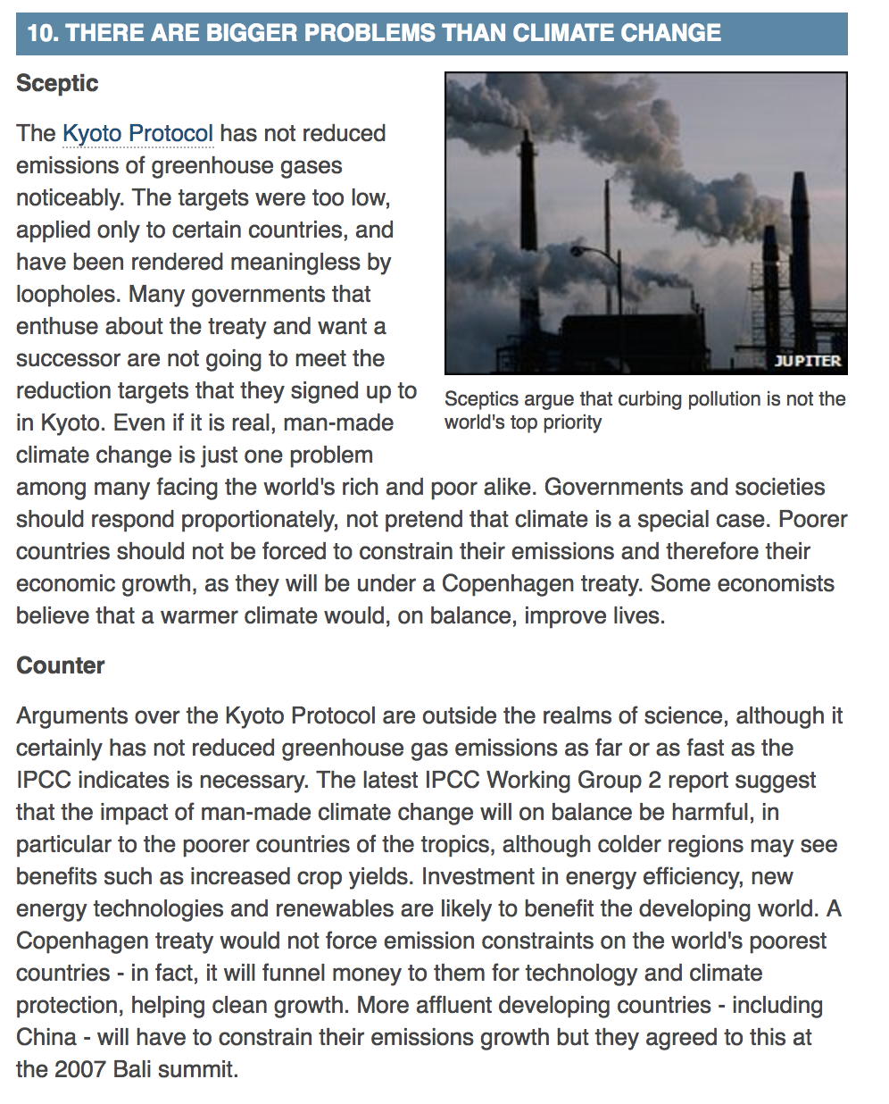
Debate

Slide 28
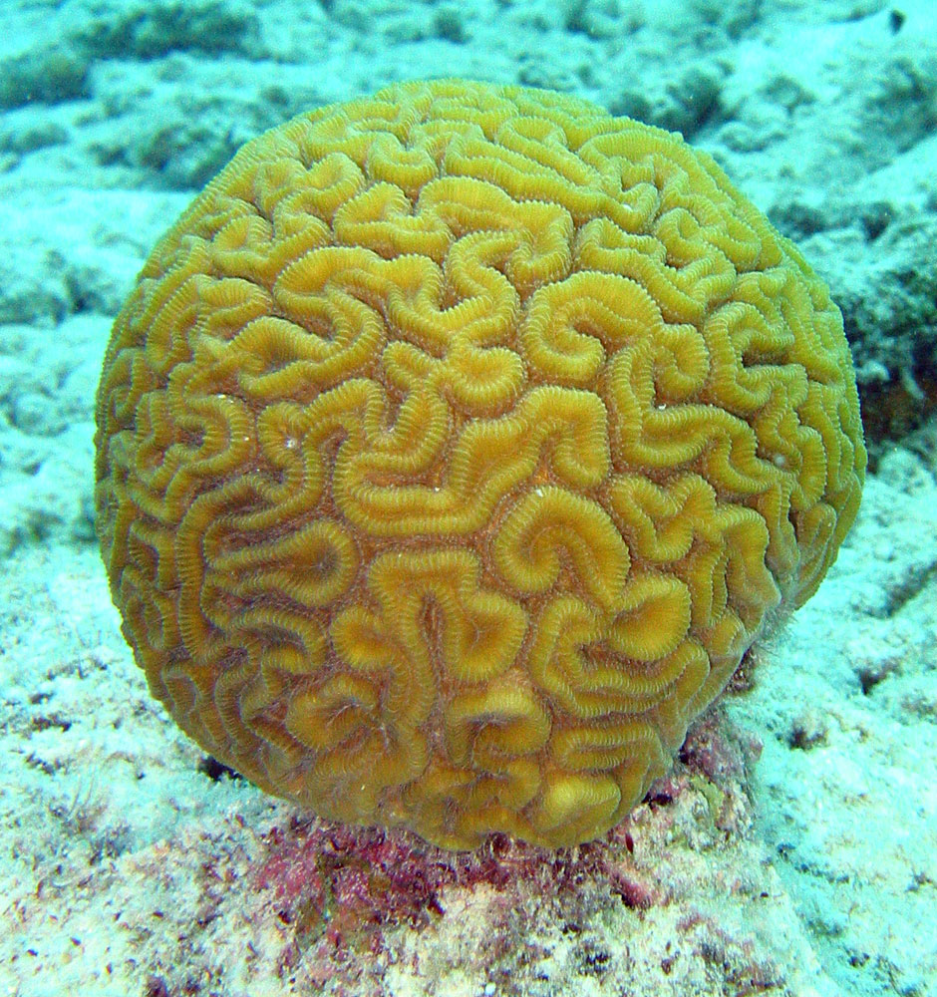
Coral Reefs
Over 500 billion tonnes of carbon dioxide released by humans since start of industrial revolution has dissolved in the oceans. (end of 1700s, start of 1800s)
30% increase in acidification of the oceans
pH 8.179 to pH 8.104

Slide 29
Coral Reefs
Corals need carbonate ions to create their calcium carbonate skeleton
Carbonate ions (CO₃²⁻) exist in low concentrations in the ocean
Increased dissolved CO₂ in the ocean reduces the concentration of CO₃²⁻
CO₂ + H₂O H₂CO₃ H⁺ + HCO₃⁻
Hydrogen ions reduce pH and they can also react with the carbonate ions (this decreasing them)
H⁺ + CO₃²⁻ HCO₃⁻

