Slide 1
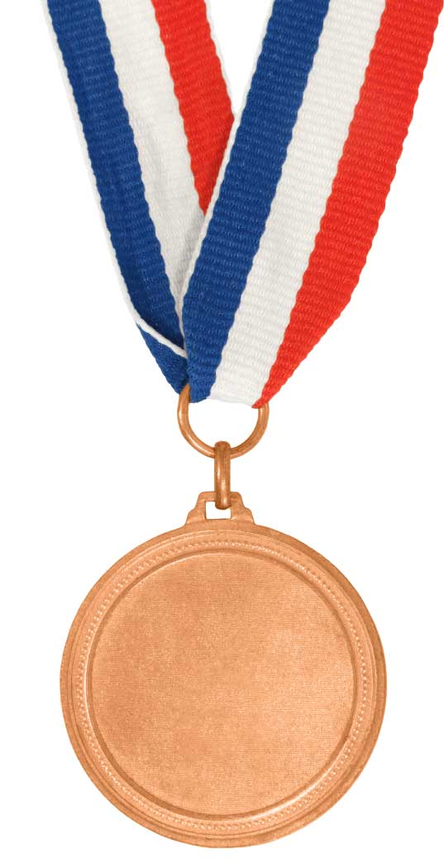
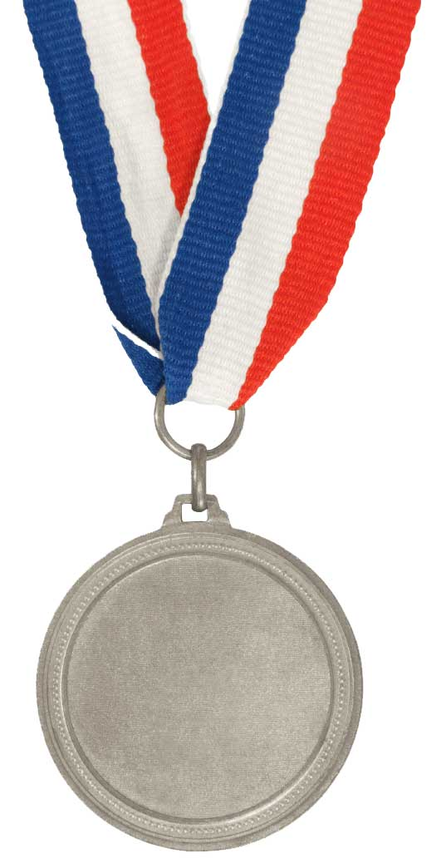
Understand why animals are classified
Define the word classification
Bronze
Follow an identification key
Silver
Create your own identification key
Gold

Slide 3
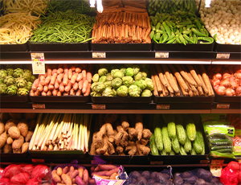
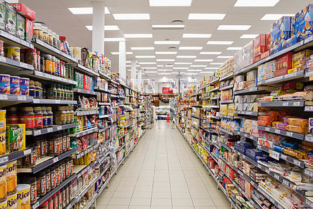
Why are supermarkets organised like this?
Where else do you see classification?

Slide 4
Classification…
All living things arranged into groups according to their similarities

Slide 5
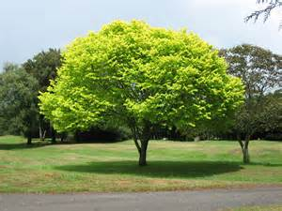
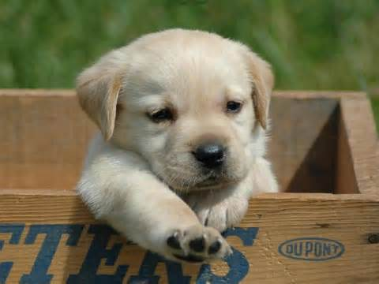
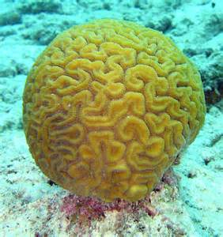
HOW DO IDENTIFY LIVING THINGS?
Who has a dog?

Slide 6
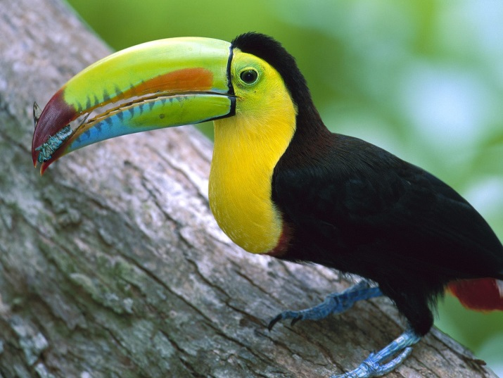
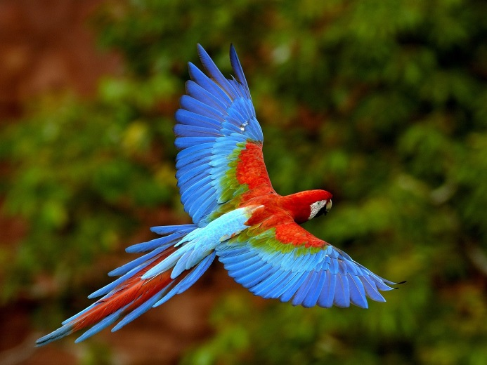
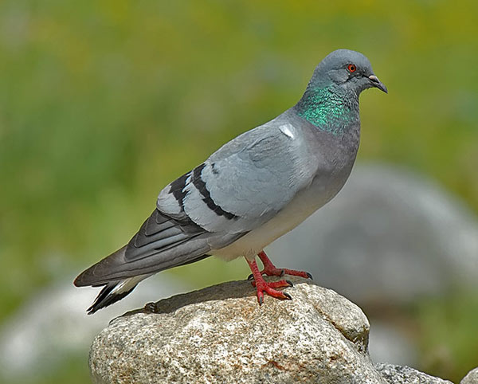
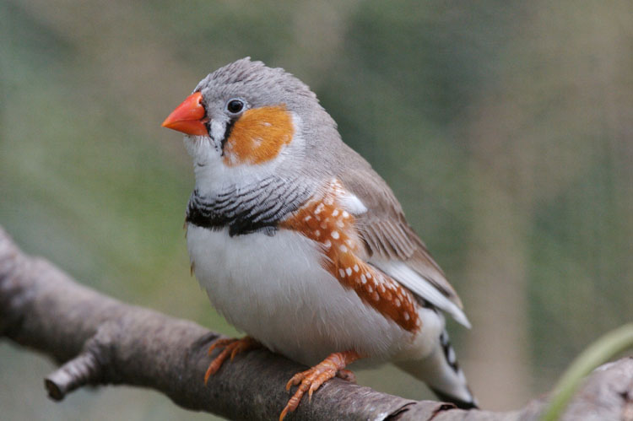
What are these?
BIRDS

Slide 7
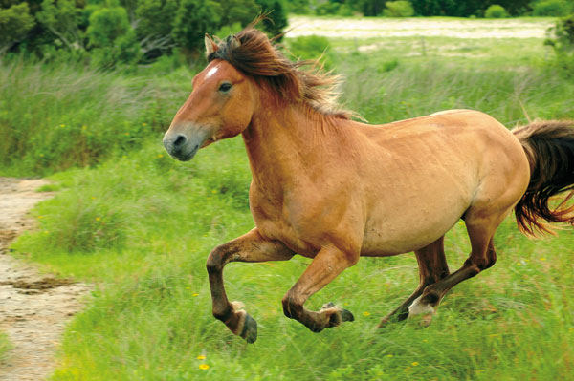
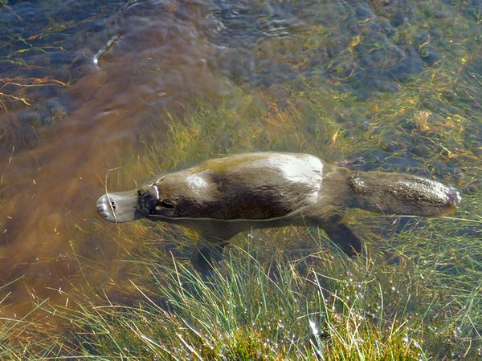
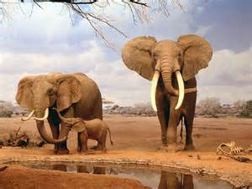
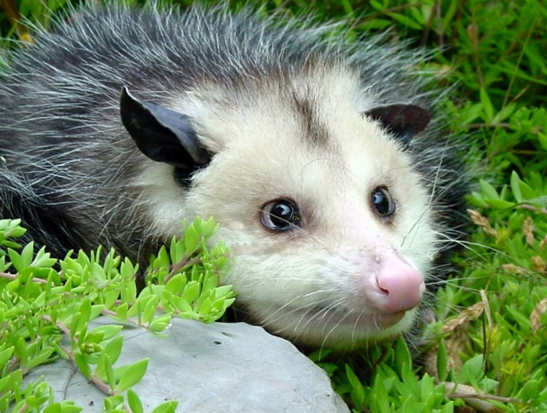
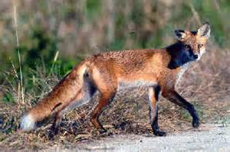
What are these?
MAMMALS

Slide 8
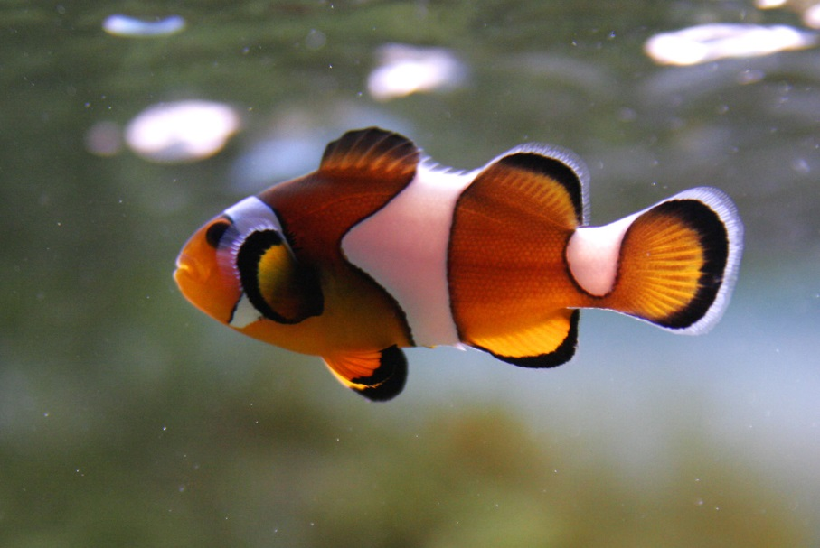
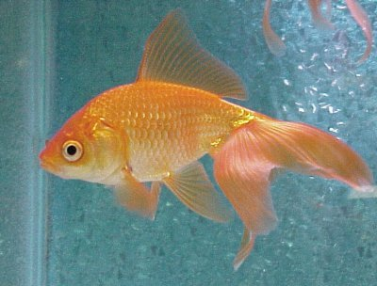
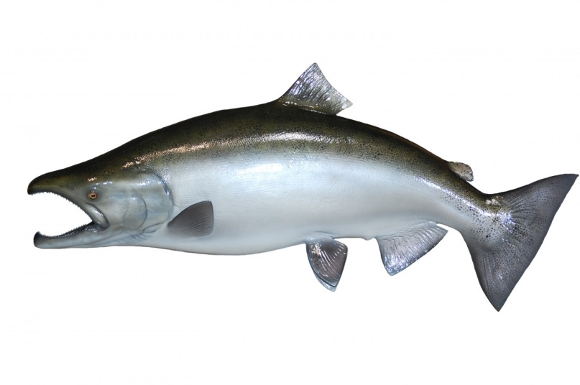
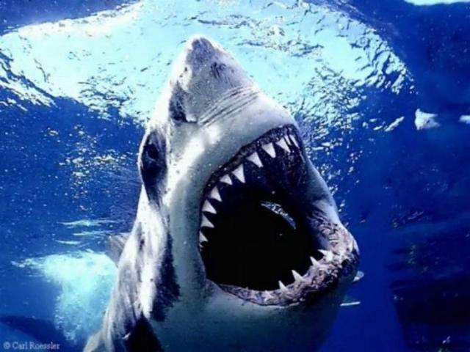
What are these?
FISH

Slide 9
We can create a classification/identification keys to split these animals up.
To do this we need to ask questions about them to find their differences.
How are fish, mammals and birds different?

Slide 10
BIRDS
Feathers
MAMMALS
Fur
FISH
Scales

Slide 11
This is how we construct a classification key…
Does it have scales?
yes
Does it have feathers?
no
yes
no

Slide 12
Your task
You need to be able to read classification keys and be able to create your own.
Complete the two classification worksheets (you need to do both of them yourself)
Create your own classification key using 5 (minimum) animals from the cards provided

Slide 13
Understand why animals are classified
Define the word classification
Bronze
State what MRS NERG stands for
Silver
Create your own classification key
Gold

