Slide 1
Chromatography
Perform chromatography techniques to produce a chromatogram
Identify the food colourings in M&Ms and Skittles
Extract the pigment from leaves. Is it just green?

Slide 2
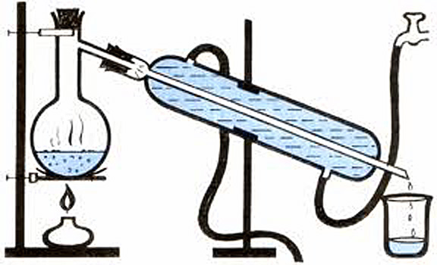
How does distillation allow you to separate two liquids?
Different boiling points

Slide 3
Chromatography
If a chemical dissolves in a liquid it is ___________
Chromatography separates based on solubility (how well a chemical dissolves)
Allows you to separate the chemicals in a mixture.

Slide 4
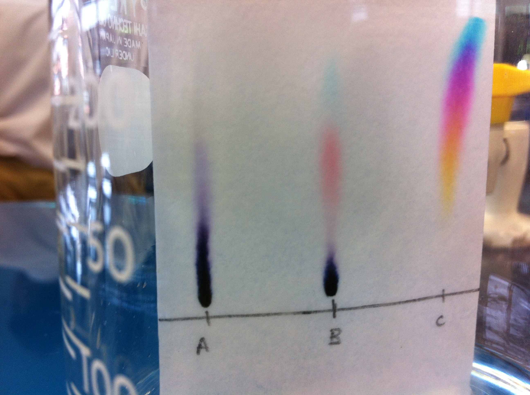

Slide 5
Chrmomatography Technique
Draw a line in pencil 1cm from the bottom of the paper
Attach top of paper to a wooden splint using a paper clip
Add the solvent to the beaker/gas jar
Add sample(s) to the line
Place paper in beaker/gas jar making sure that the bottom of the paper (but not the sample) is in the water

Slide 6
Investigations
Marker
Try your pens
Leaves
What colours are in leaves. They look green, but is that all the colours present?
Candy
I wonder if the red colour they put on Skittles is the same red colour they put on M&Ms.

Slide 7
Investigations
Marker
Press pen on the pencil line
Leaves
Grind the leaves with a little water to release the green pigment. Use a capillary tube to take a sample. You must use ethanol for the solvent in this experiment
Candy
Put a candy in the watch glass. Add a little water. Wait for the colour to be released. Take a sample using a capillary tube. Repeat for the other candy. Put the two samples side by side on the pencil line. Use water as the solvent

