Slide 1
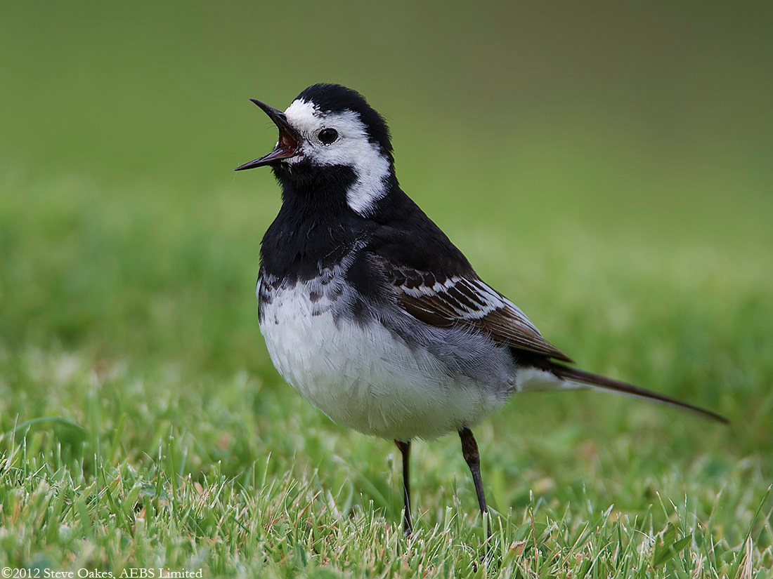
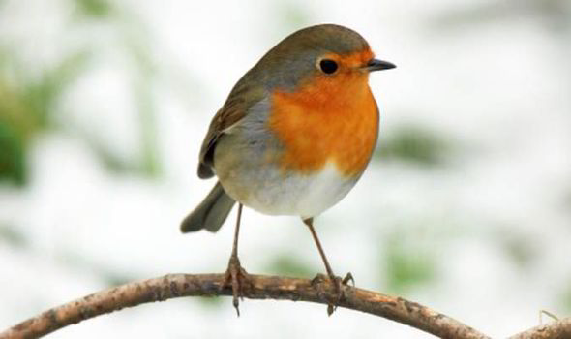
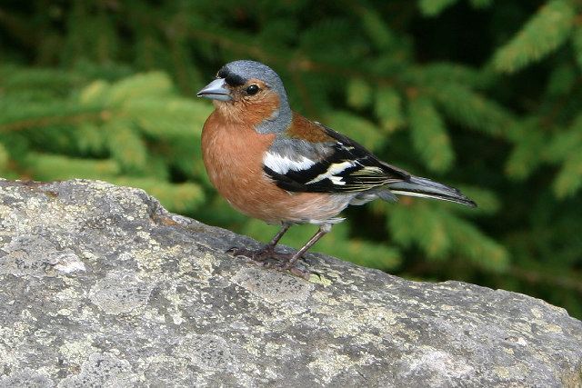
Chi-Squared Test
Looks at differences in frequencies between groups
e.g. Is there a significant difference between the frequency (populations) of three different bird species at two different locations
 | Species of bird
Site | Robin | Pied Wagtail | Chaffinch | Total
Site 1 | 22 | 17 | 21 | 60
Site 2 | 21 | 19 | 20 | 60
Total | 43 | 37 | 41

Slide 2
Null Hypothesis
This is required in your IA and EE. It needs to be written as a statement of fact...
H₀: There will be no significant difference between the frequency of bird species at two different locations
The point of an investigation is to ‘disprove’ a null hypothesis rather than to ‘prove’ a hypothesis

Slide 3
Data Collection

Slide 4
Plant Populations at two sites
Randomly select a square in site 1. Use two random number generators. (on calc (Google it))
Count the numbers of each species.
Repeat 10 times.
Calculate the mean.
You now hove a mean for each species for one square. Multiply by the size of the site.
Repeat for site 2.

Slide 5
If there is no significant difference between population/frequency of birds in a species between sites the results might look like this.
The null hypothesis would be accepted.
 | Species of bird
Site | Robin | Pied Wagtail | Chaffinch | Total
Site 1 | 22 | 17 | 21 | 60
Site 2 | 21 | 19 | 20 | 60
Total | 43 | 37 | 41
The results below might show some significant differences. Let’s find out if we can reject our null hypothesis
 | Species of bird
Site | Robin | Pied Wagtail | Chaffinch | Total
Site 1 | 2* | 18 | 40* | 60
Site 2 | 37* | 19 | 4* | 60
Total | 39 | 37 | 44
*big differences

Slide 6
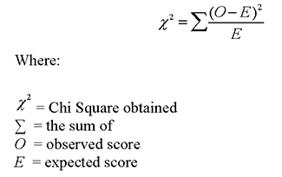
 | Species of bird
Site | Robin | Pied Wagtail | Chaffinch | Total
Site 1 | 2 | 18 | 40 | 60
Site 2 | 37 | 19 | 4 | 60
Total | 39 | 37 | 44 | 120
E is the expected frequency if the null hypothesis is true..
Expected
frequency
Row total x column total
=
Overall total
Expected
frequency
=
60 x 39 = 19.5
120

Slide 7
 | Species of bird
Site | Robin | Pied Wagtail | Chaffinch | Total
Site 1 | 2 | 18 | 40 | 60
Site 2 | 37 | 19 | 4 | 60
Total | 39 | 37 | 44 | 120
(2 – 19.5)² = 15.71
19.5

Slide 8
 | Species of bird
Site | Robin | Pied Wagtail | Chaffinch | Total
Site 1 |  |  |  | 60
Site 2 |  |  |  | 60
Total |  |  |  | 120
Do the rest
2 d.p.

Slide 9
You now need to work out the degrees of freedom before you can see if the results are significant or not
df = (number of rows – 1) x (number of columns – 1)
df = (2– 1) x (3– 1) = 2
Look at the critical value for chi-squared in the probability table. If your value for chi-squared (X²) is equal or greater than the critical value then you have a significant result and can reject the null hypothesis.

Slide 10
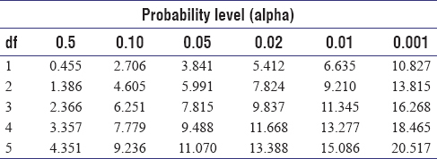
A probability level of P = 0.05 means that the probability that the difference is due to chance is less than 5%.
P = 0.05 is always used in biology. You can find justification for this in literature so make sure you include this in your IA and EE

Slide 11
Apply to your plant data

Slide 12
 | Moth Colour
Town | Dark | Light | Total
A | 23 | 42 | 65
B | 55 | 30 | 85
Total | 78 | 72 | 150
GO!

