Slide 2
Chi Squared!
Determine whether the difference between an observed and expected frequency distribution is statistically significant
Complete your work sheet.

Slide 3
Before we begin
Independent assortment states that when gametes are produced the segregation of one pair of alleles is independent of the segregation of another pair of alleles.
When homologous chromosomes separate during meiosis I, it is random which pole each chromosome travels to.

Slide 4
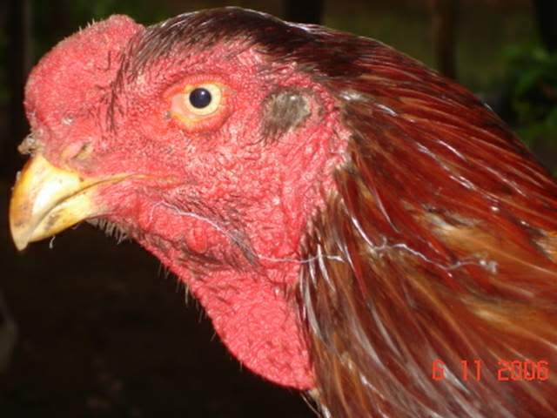
Chi Squared!
White leghorn chickens with large single combs
X Indian game fowl with dark feathers and small pea combs
Ho = the traits are assorted independently
H1 = the traits do not assort independently

Slide 5
Start with contingency table
Fill in your contingency table with the observed frequencies
 | White pea | White single | Dark pea | Dark single | Total
Observed | 111 | 37 | 34 | 8 | 190
Expected

Slide 6
Expected values
Complete the expected values using what you would expect the ratio to be (remember 9:3:3:1)
Use the total number as 16
 | White pea | White single | Dark pea | Dark single | Total
Observed | 111 | 37 | 34 | 8 | 190
Expected | (9/16) x 190 | (3/16) x 190 | (3/16) x 190 | (1/16) x 190 | 190

Slide 7
Expected values
Complete the expected values using what you would expect the ratio to be (remember 9:3:3:1)
Use the total number as 16
 | White pea | White single | Dark pea | Dark single | Total
Observed | 111 | 37 | 34 | 8 | 190
Expected | 106.9 | 35.6 | 35.6 | 11.9 | 190

Slide 8
Degrees of freedom
One less than the total number of classes
(4 – 1) = 3 degrees of freedom
 | White pea | White single | Dark pea | Dark single | Total
Observed | 111 | 37 | 34 | 8 | 190
Expected | 106.9 | 35.6 | 35.6 | 11.9 | 190

Slide 9
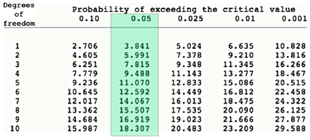
Critical region
Use the critical values table to find the critical region for your chi-squared test
Remember to use a significance level of 0.05 (5%)
Critical value: 7.815

Slide 10
Critical region
Use the critical values table to find the critical region for your chi-squared test
Remember to use a significance level of 0.05 (5%)
Critical value: 7.815

Slide 11
Complete chi squared test
(O – E)²
χ² =
Σ
E
(O – E)²
(O – E)²
(O – E)²
(O – E)²
E
E
E
E

Slide 12
Chi Squared Test
(O – E)²
χ² =
Σ
E
(111-106.9)²
(37-35.6)²
(34-35.6)²
(8-11.9)²
106.6
35.6
35.6
11.9

Slide 13
Chi Squared value
Chi squared = 1.56

Slide 14
Which hypothesis
Chi squared = 1.56
Critical region = 7.815
Compare calculated chi squared value to critical region
Higher than critical region = reject null hypothesis (the traits do not assort independently)
Equal to or lower than critical region = keep null hypothesis (Ho = the traits are assorted independently)

Slide 15
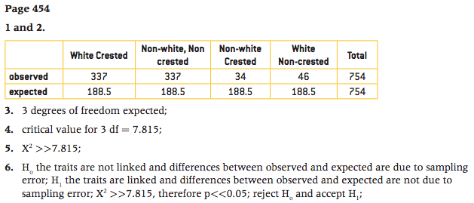
Now complete the Q on page 454
ccii x CcIi
468.33

