Slide 3
Cardiac Cycle
Recap the structure of the heart
Discuss how the structure of the heart relates to its function
Describe the stages of the cardiac cycle
Interpret electrocardiograms (ECG)

Slide 5
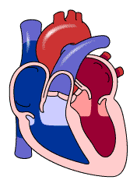
Diastole = Relax
Systole = Contract

Slide 6
Cadiac Cycle

Slide 7
Ventricular Systole
Why?

Slide 8
A
B
C
D
E
F
A= …...
B= ......
etc

Slide 9
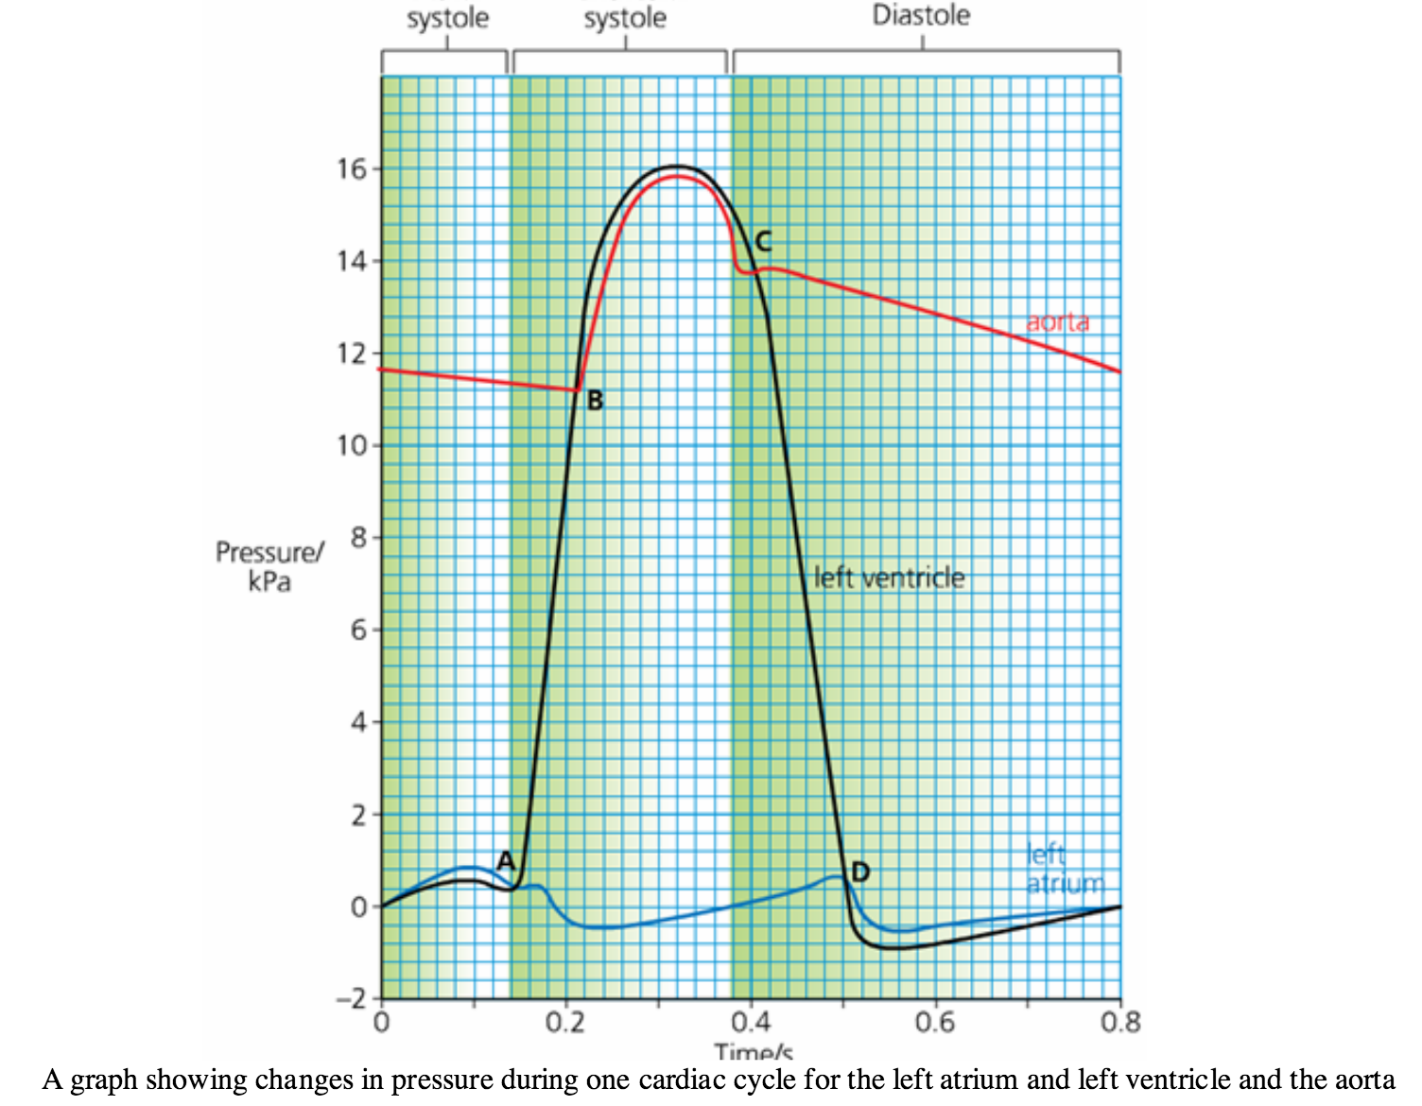

Slide 10
ECG Questions
When is blood being pumped from the atria into the ventricle? Give the start and end time.
Which letter represents when the ventricular systole begins.
At what time does the semi lunar valve in the aorta open?
What letter represents when the semi lunar valve closes?
At what time is the volume of blood in the ventricle:
at its maximum
at its minimum

Slide 11
Control of Heart Beat
Myogenic Heart Contraction
Muscle cells contract without electrical stimulation. This is called myogenic contraction.
These contractions need to be controlled.
They are controlled by the ‘pacemaker’ of the heart called the sino-atrial (SA) node.

Slide 12
Control of Heart Rate
Draw on the locations of the SA and AV nodes.
Explain what the SA node does. Use arrows to show where impulses are sent.
Explain what the AV node does. Use arrows to show where impulses are sent.
State the time delay between atrial and ventricular systole and explain why this is important.
Locate and label the location of the medulla in the brain
State what the medulla detects
Draw and label the nerves from the medulla to the heart.
Explain how the medulla controls heart rate during times of excitement/exercise. (different nerves to speed up and slow does the heart rate).

