Slide 1
Compare the structures of alpha and beta glucose

Slide 2
Monosaccharide

Slide 3
Carbohydrates
Describe how monosaccharide's join together
Describe the structures of the polysaccharides starch, glycogen and cellulose

Slide 4
e.g.

Slide 6
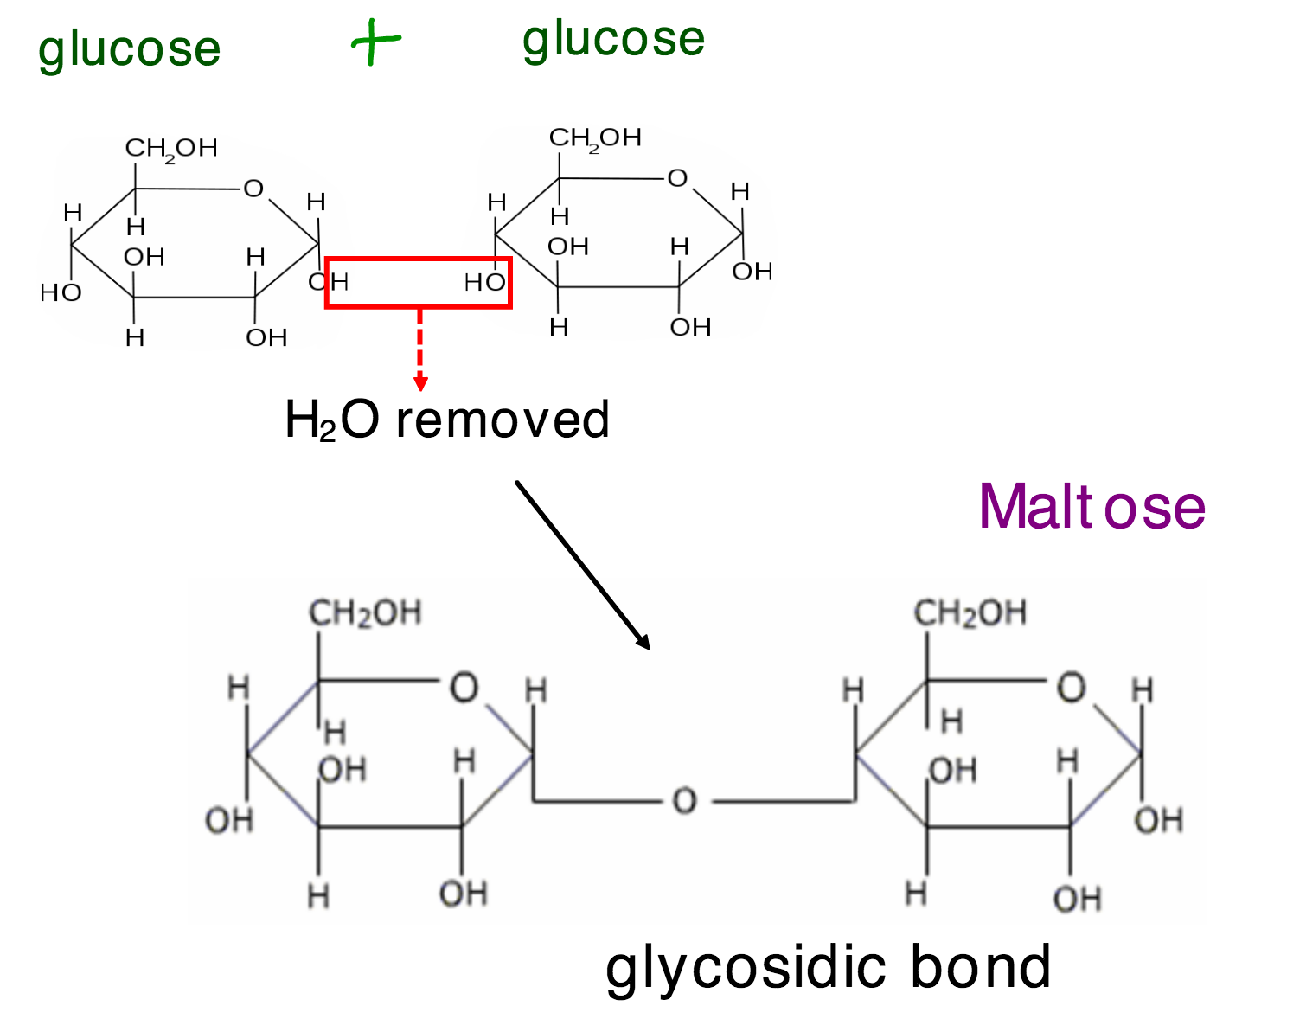

Slide 8
How are disaccharides split?

Slide 11
Starch, Cellulose and Glycogen
Describe the structure
What bonds are formed?
Relate structure to function
How is it different to the other 2?

Slide 15
Starch and Glycogen

Slide 18
animals

Slide 21
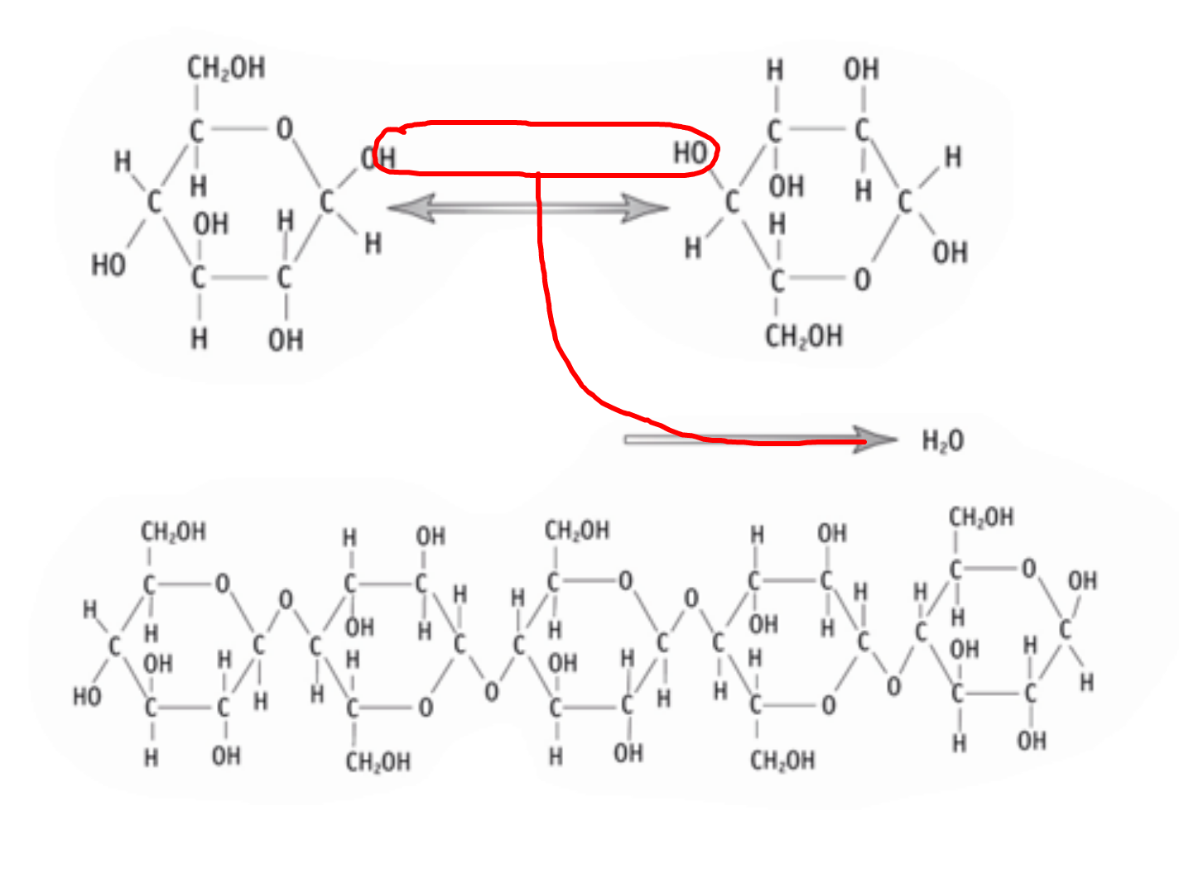

Slide 23
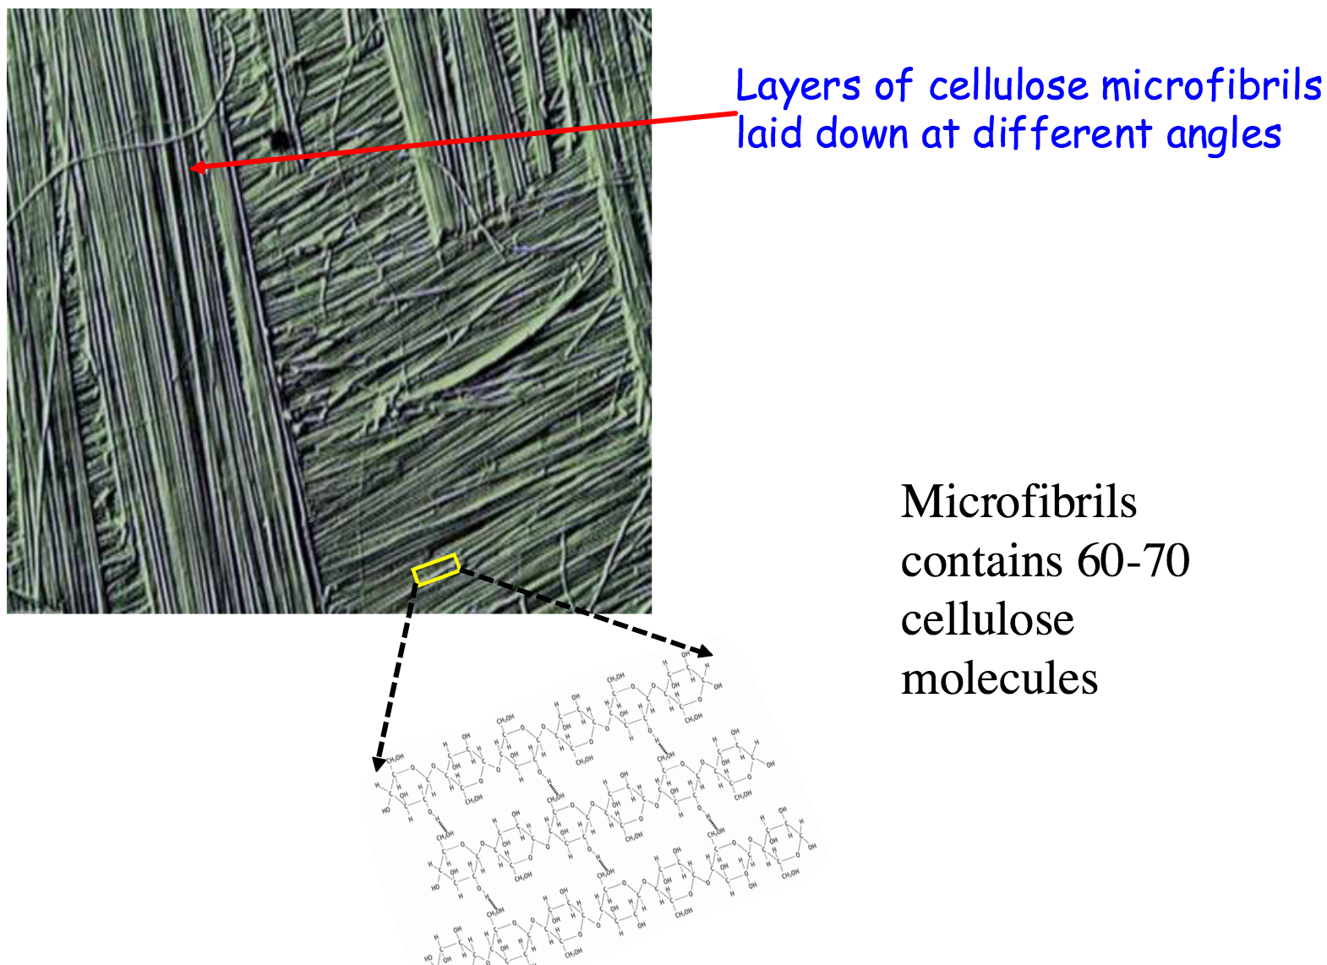
Polysaccarides

