Slide 1
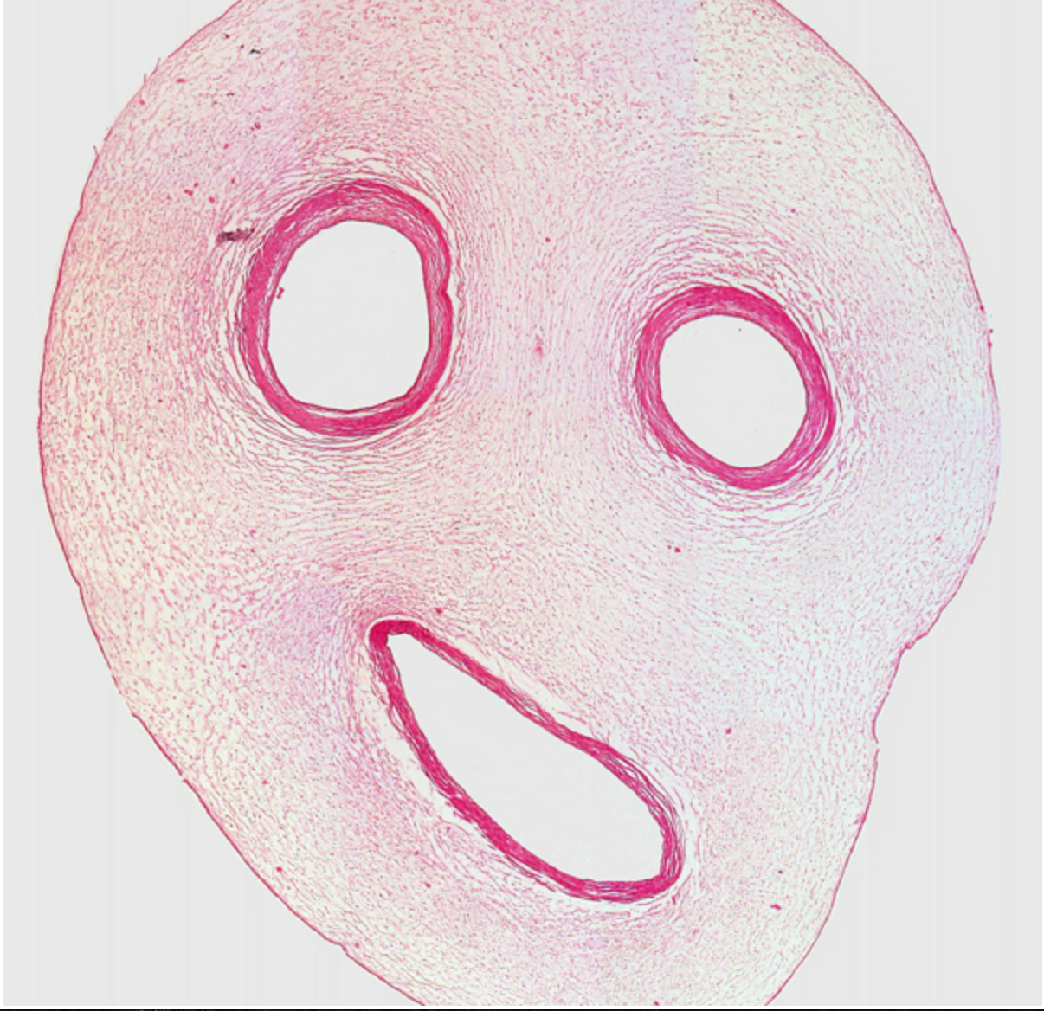

Slide 2
Blood Vessels
Draw and label arteries, veins and capillaries
Relate structure to function of the blood vessels
Identify vessels from micrographs
Heart and circulation

Slide 3
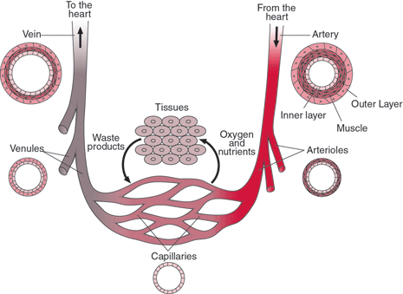

Slide 4
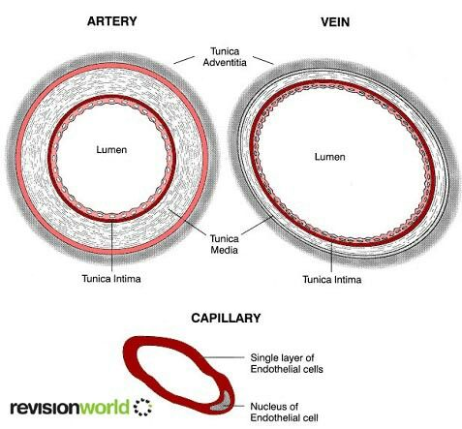
externa

Slide 5
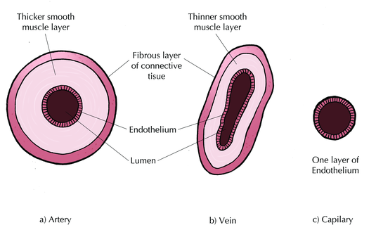
/Elastic fibres
/Elastic fibres

Slide 6
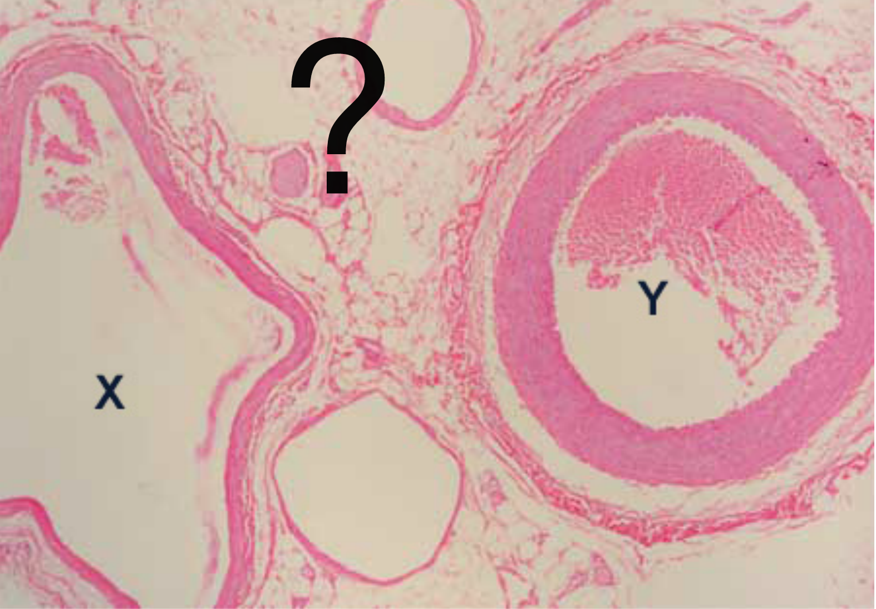

Slide 7
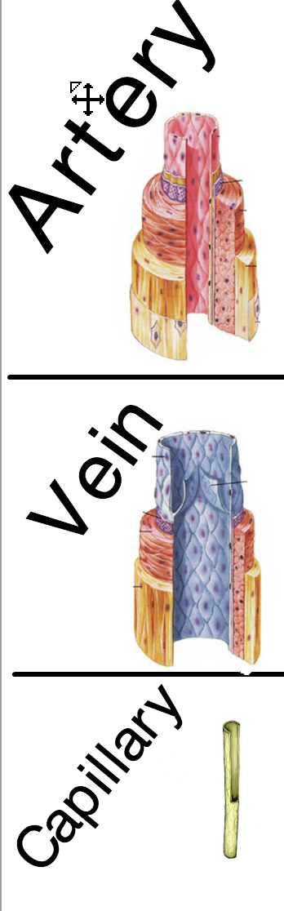
Thick muscle/elastic layer
Thinner muscle/elastic layer
Thin permeable walls
Narrow lumen
Valves
No exchanges
No valves
Wide lumen

Slide 8
Structure
Function
Narrow lumen
Thick muscle/elastic layer
No exchanges
No valves
Thinner muscle/elastic layer
No exchanges
Wide lumen
Valves
Thin permeable walls

Slide 9
Find out…
How does blood move in veins?
How is blood pressure maintained in the arteries?

