Slide 1
Levels of Classification
State the levels of classification
Explain how to name species using binomial classification
State the 5 kingdoms

Slide 2
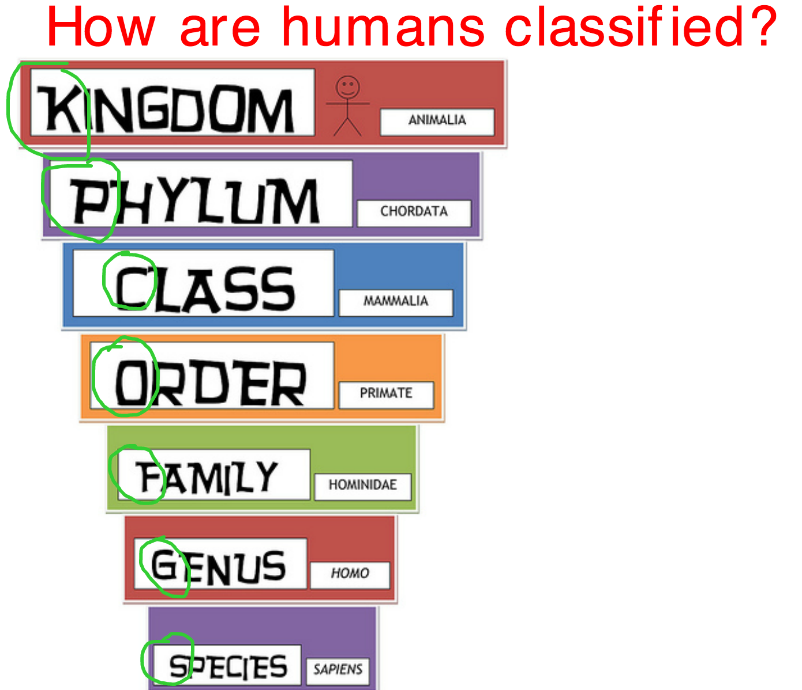

Slide 3
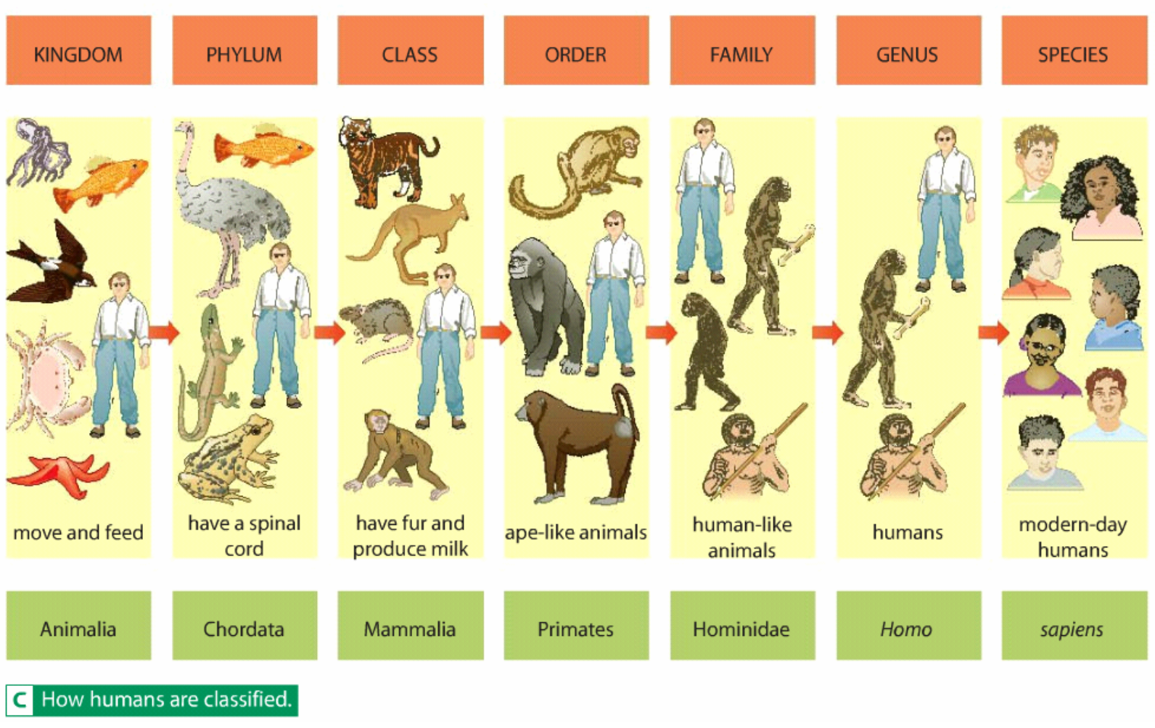

Slide 4
Binomial Classification
Classification
Qs
1. What kingdom is a tree in?
2. What phylum is a deer in?
3. What do you use to give a species its scientific name?
4. What is a lion’s scientific name?

Slide 6
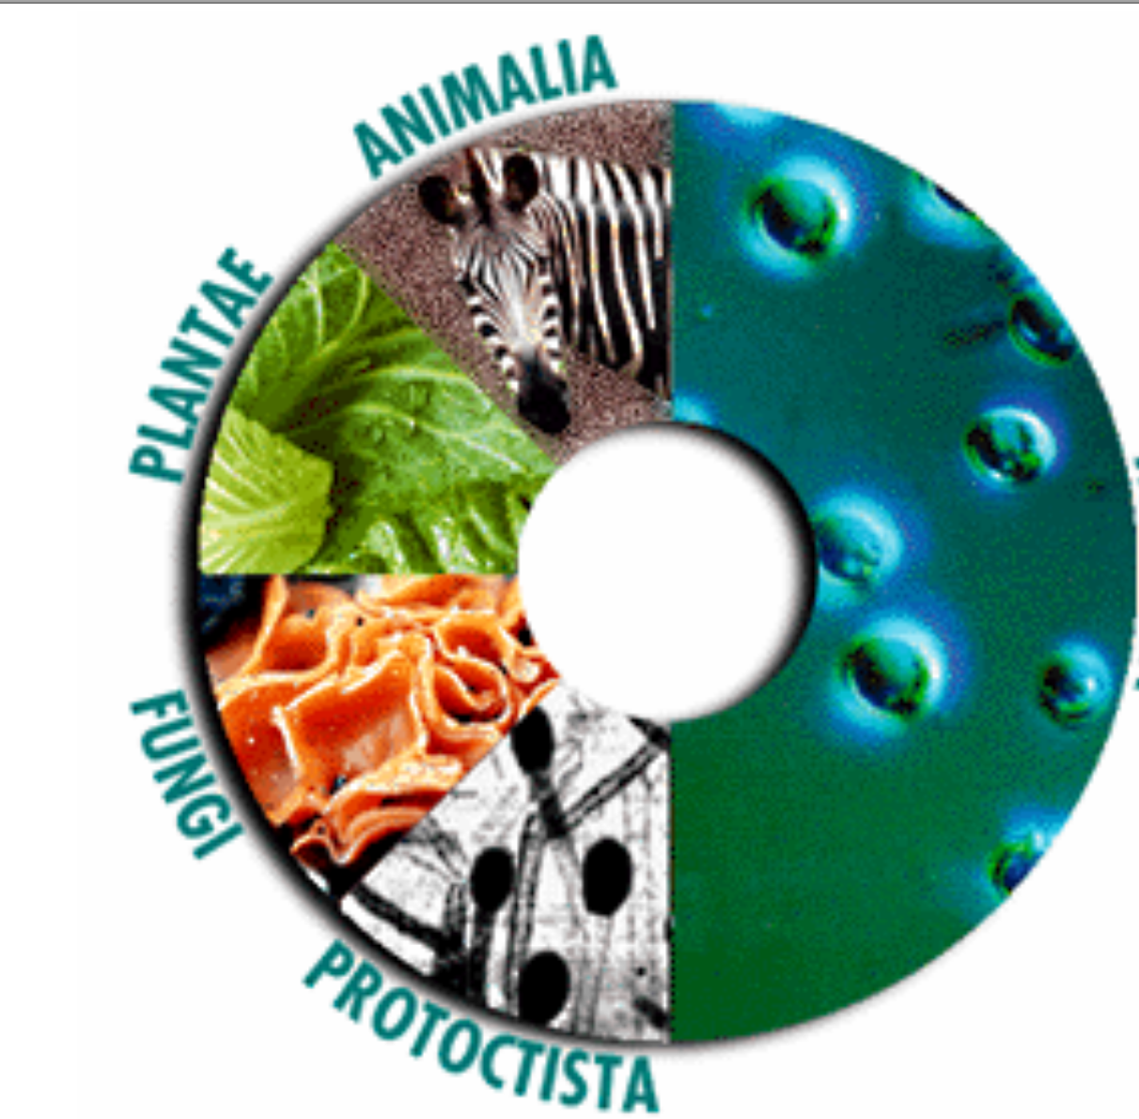
Bacteria!!

Slide 7
Research
In your pairs you need to produce a document that includes:
The name of your kingdom
Examples of organisms in your kingdom
Pictures of these organisms
Features of your kingdom

Slide 8
1 2 3 4 5

Slide 10
Class
We are going to look at CLASS
The 5 groups of animals that are in the phylum chordata are:
Mammals
Fish
Birds
Reptiles
Amphibians

Slide 11
Classifying vertebrates

Slide 12
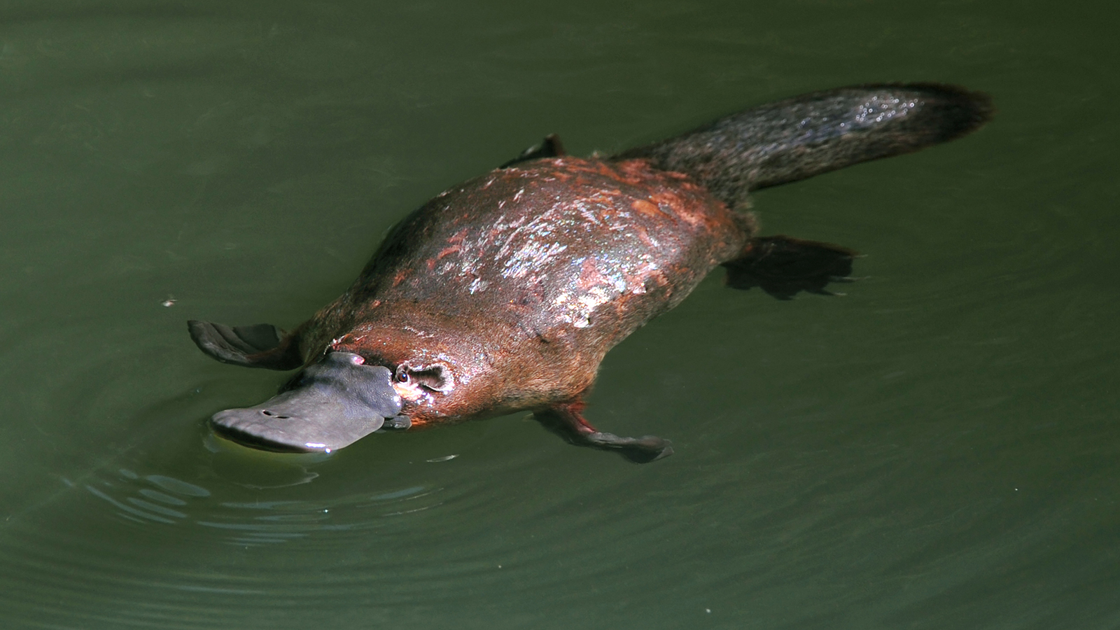
Platypus
Platypus
How would you classify the platypus?

