Slide 2
ATOMS
Define atom, element and compound
Identify the atomic number of an element from the periodic table

Slide 3
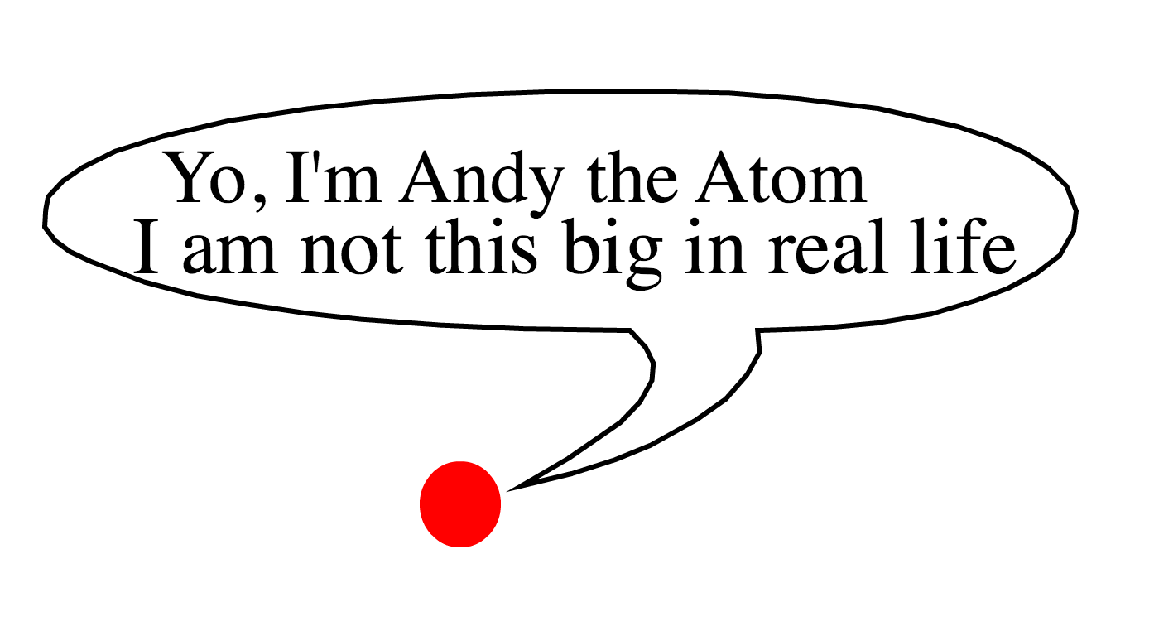

Slide 6
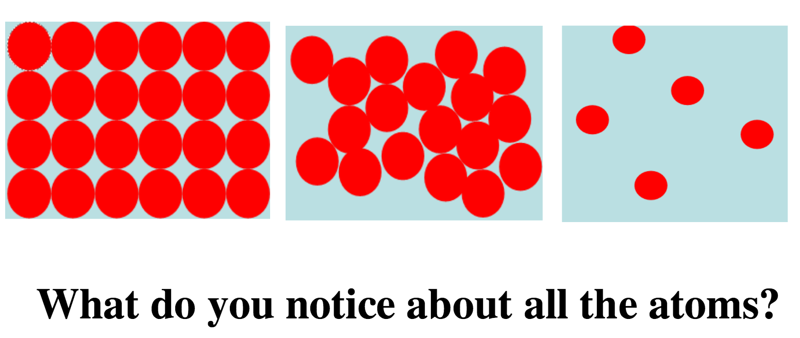

Slide 8
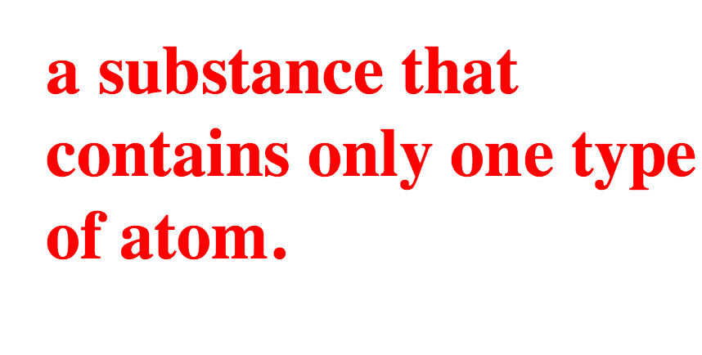

Slide 11
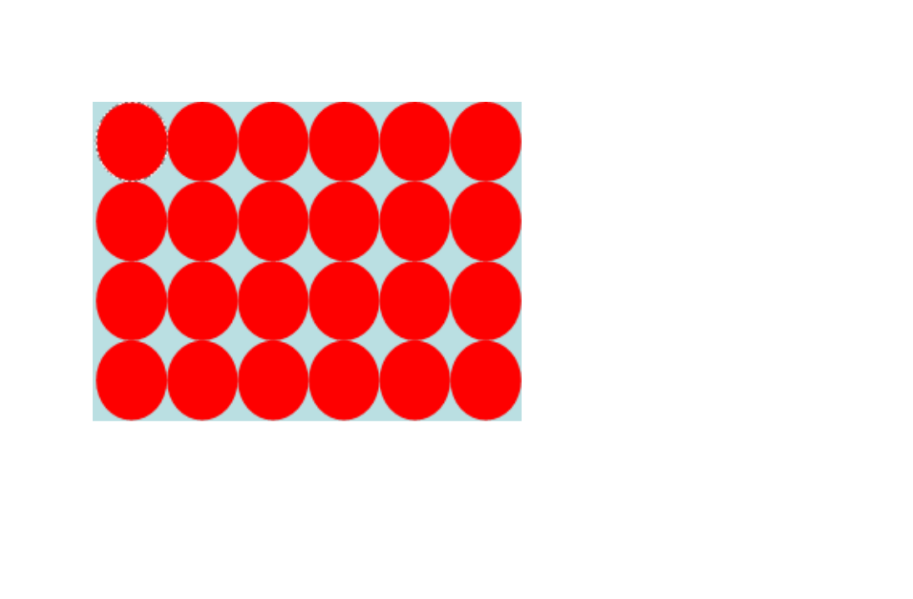

Slide 13
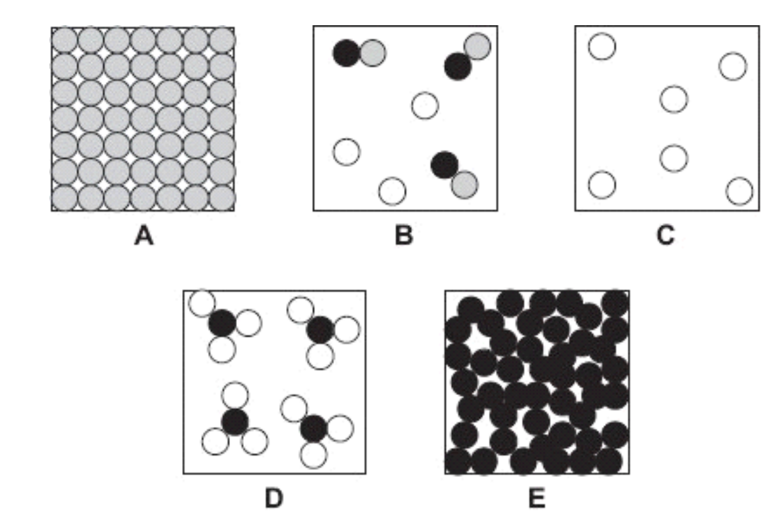

Slide 14
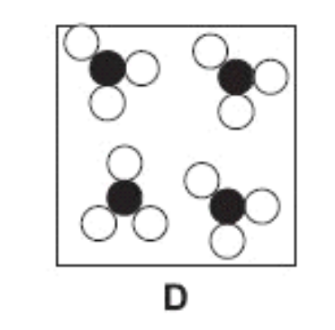
Compound
A substance made from more than one type of atom

Slide 19
But….
Are all atoms the same?????????
NO

Slide 21
-
-
+
+
+
+
-
-

Slide 22
-
+

Slide 23
-
-
-
-
+
+
+
-
+
-
+
+
+
+
+
+
-
-
+
+
-
-
-
-

Slide 24
-
-
+
+
+
-

Slide 25
-
-
-
-
+
+
+
+
+
+
-
+
+
-
-
-

Slide 26
-
-
-
+
+
+
+
+
+
-
-
-

Slide 27
-
-
-
+
-
+
+
-
+
+
+
+
+
+
-
-
-
-

Slide 28
-
-
-
-
+
-
+
+
+
+
+
+
-
-
+
+
+
-
-
-

Slide 29
-
-
-
-
+
+
+
-
-
+
-
+
+
+
+
+
+
+
-
-
-
+
+
+
-
-
-
-

Slide 30
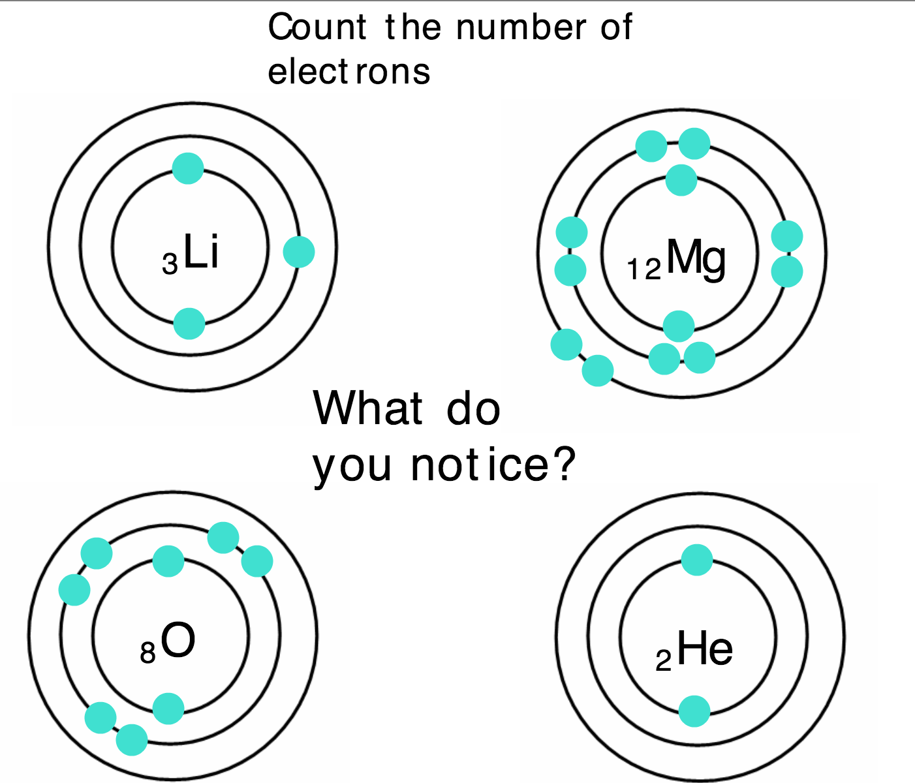

Slide 34
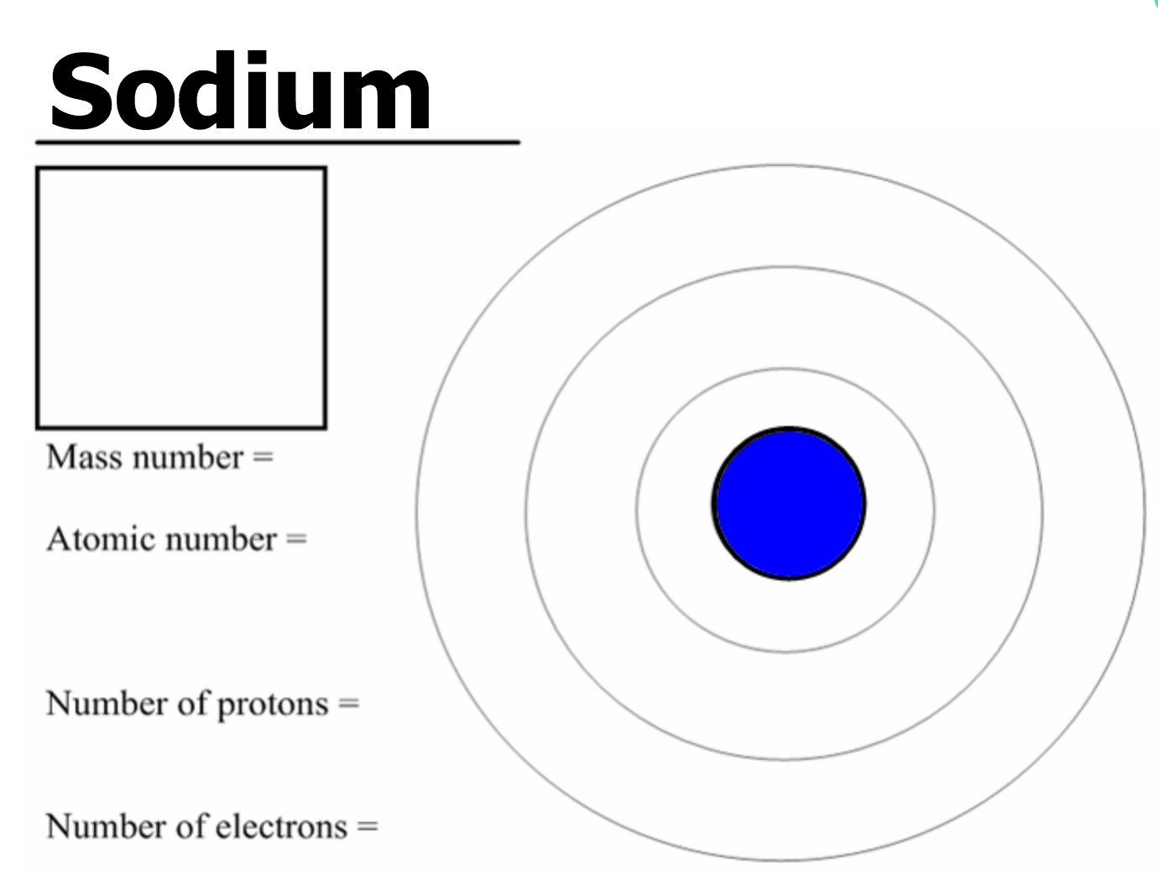

Slide 35
Helium
Lithium
Beryllium
Boron
Carbon
Nitrogen
Oxygen
Fluorine
Neon
Sodium
Magnesium
Aluminum
Silicon
Phosphorus
Sulphur

Slide 36
Instruction Document
Task:
You need to create a set of instructions to teach someone atomic structure
Needs to include:
- Definitions of atoms and elements
- Structure of an atom
How do you use the periodic table to find out the number of protons, neutrons and electrons
How to use the atomic number to draw the electrons in an atom
The rules when drawing atoms with their electrons

Slide 37
atoms

