Slide 1
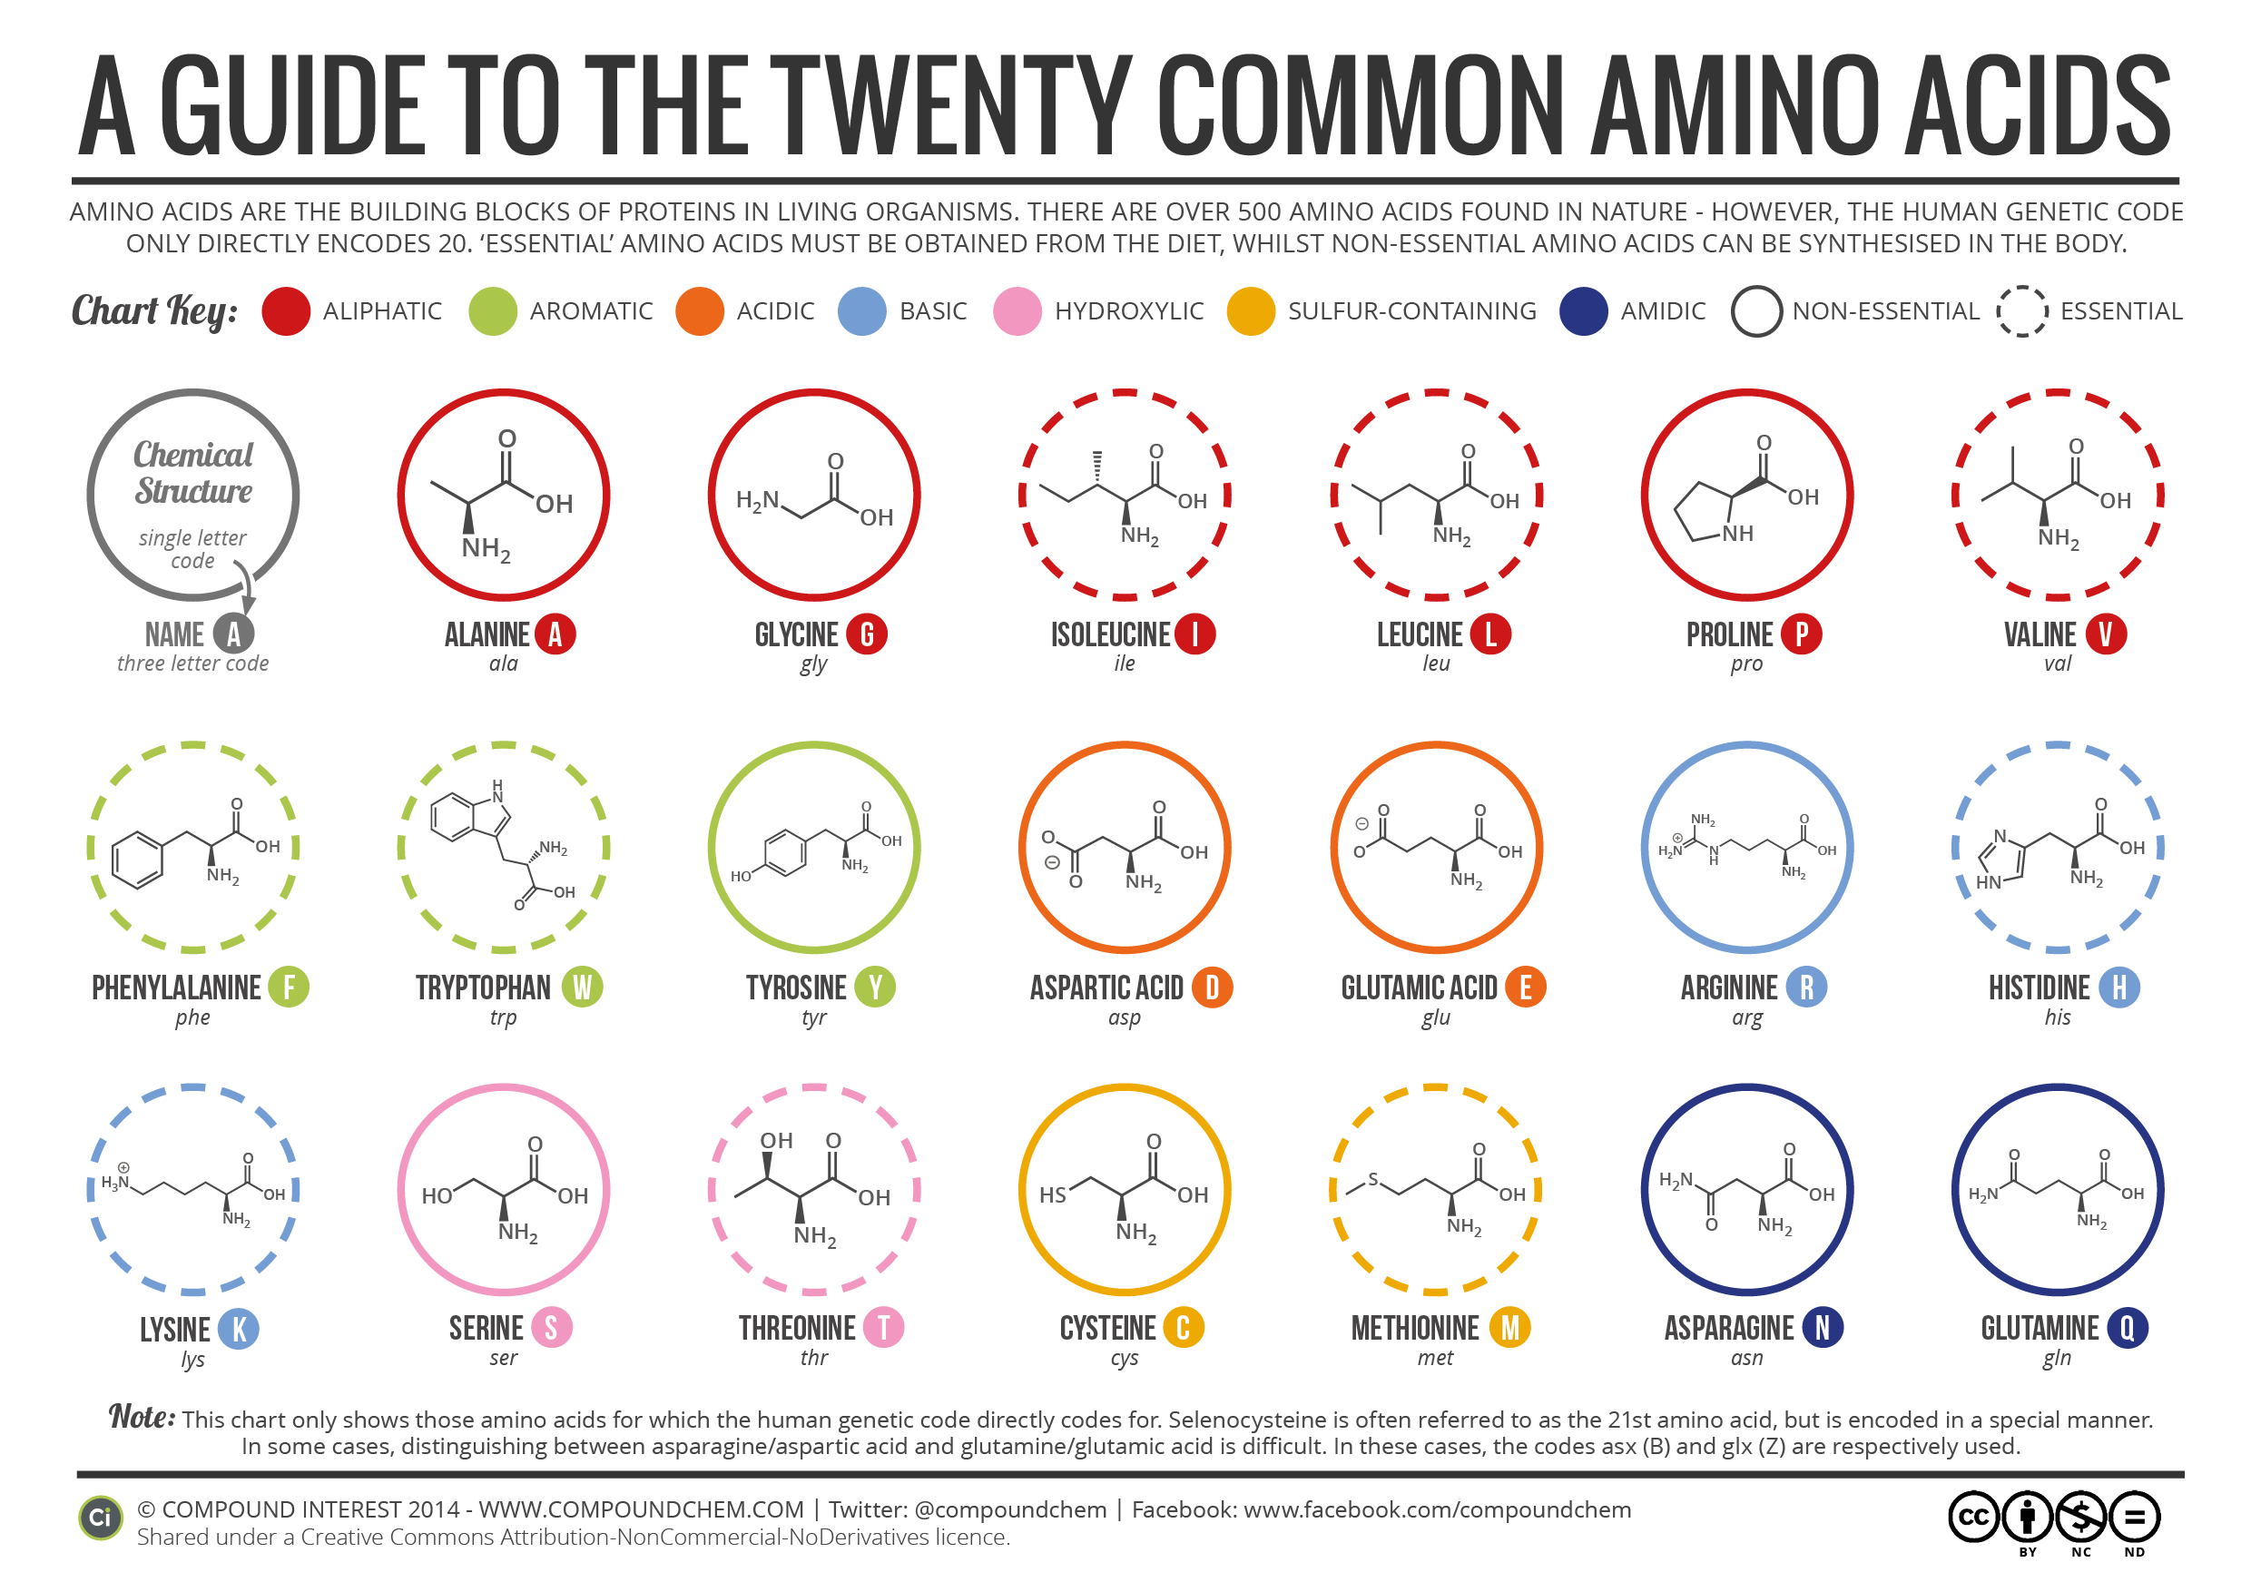
Amino Acids
Athena Lai and Thomas Lip

Slide 2
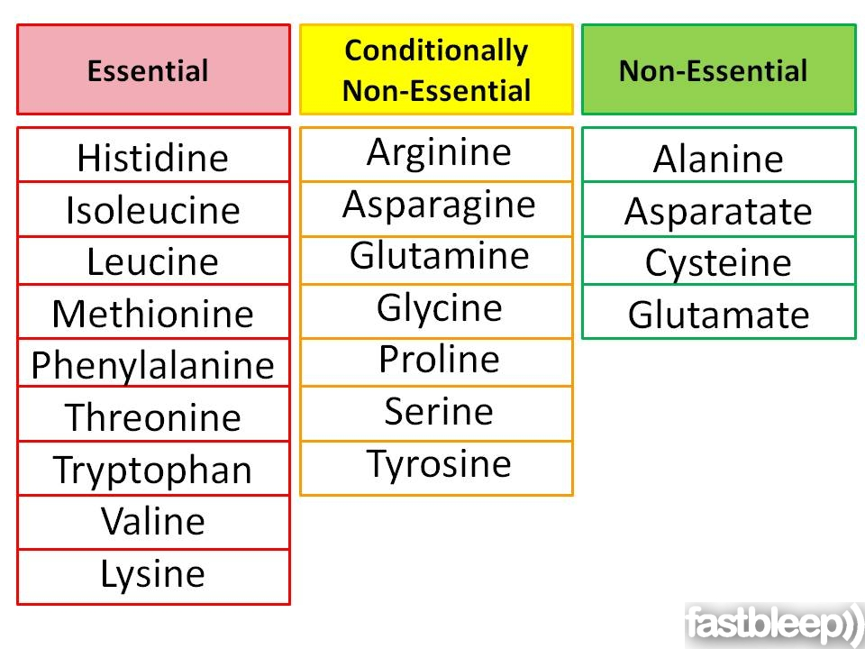
Types of Amino acids
Essential amino acids are those that cannot be synthesized by the body and must be obtained from diet.
Non-essential amino acids are those that the body can manufacture from the essential amino acids or normal breakdown of proteins.
Conditional amino acids are usually not essential, except in times of illness and stress.

Slide 3
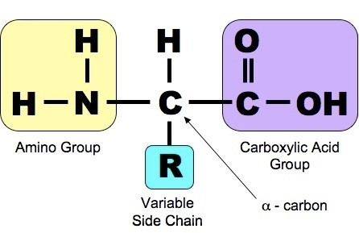
Functions of Amino acids
Needed for protein synthesis (during translation) as proteins are used for:
Break down food with enzymes (Maltase, Amylase)
Repair body tissue (Collagen)
Antibody production (Immunoglobin)
Hormones regulation (Oxytocin)
Carriers and Transports (Hemoglobin)

Slide 4
Consequences of blood plasma protein deficiency
3 main categories of proteins that are found in blood plasma:
Albumins, Globulins and Fibrinogen
Albumins
Reductions in plasma albumin content can result in a loss of fluid from the blood and a gain of fluid in the interstitial space (space within the tissue), which may occur in nutritional, liver and kidney disease.
Globulins
Used in in lipid transport carrying fats to cells for use in energy metabolism, membrane reconstruction and hormone function
Carries cholesterol and fats to tissues for use in manufacturing steroid hormones and building cell membranes
Fibrinogen
Fibrin plays a key role in coagulation of blood, which is discussed later in this article under Platelets.

