Slide 1
1.4 Membrane Transport
Applications:
Structure and function of sodium potassium pumps for active transport and potassium channels for facilitated diffusion in axons
Tissues or organs to be used in medical procedures must be bathed in a solution with the same osmolarity as the cytoplasm to prevent osmosis
Understanding:
Particles move across membranes by simple diffusion, facilitated diffusion, osmosis and active transport
The fluidity of membranes allows materials to be taken into cells by endocytosis or released by exocytosis
Vesicles move materials within cells
Skills:
Estimation of osmolarity in tissues by bathing samples in hypotonic and hypertonic solutions
Nature of science:
Experimental design: accurate quantitative measurements in osmosis experiments are essential

Slide 2
Active Transport
Define active transport
Describe how membrane proteins are involved in active transport

Slide 3
How would you define active transport?

Slide 4
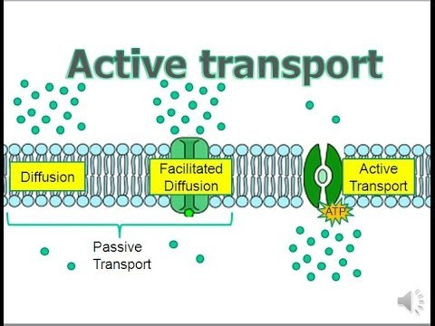
Movement of particles from a low to high concentration (against their concentration gradient)
Required energy (ATP)
From respiration (in the mitochondria)
Energy is used to change the shape of the transmembrane protein
Often called protein pumps

Slide 5
Why is this a good/bad diagram of active transport?
Active transport

Slide 6
How will the minerals ( ) enter the root hair cell? (1)
How is the root hair cell adapted for taking in minerals by this process? (3)
Gardeners aerate the soil (dig to get more air into the soil). Why do you think they do this? (3)

Slide 7
An example of active transport

