Slide 1
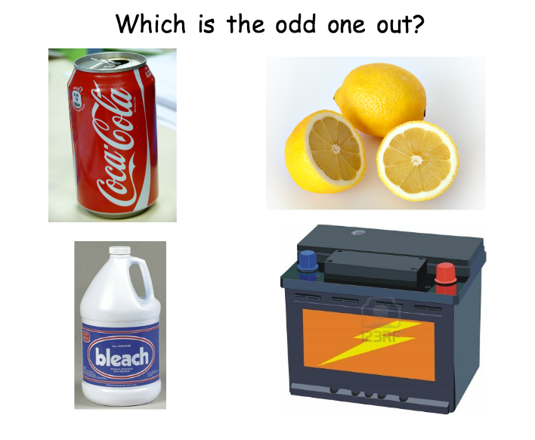

Slide 3
Acids and Alkalis
Investigate household and lab chemicals to determine whether they are acid, alkali or neutral.
State safety precautions when dealing with acids and alkalis
Evaluate the use of different indicators
Acids and Alkalis

Slide 5
Results

Slide 6
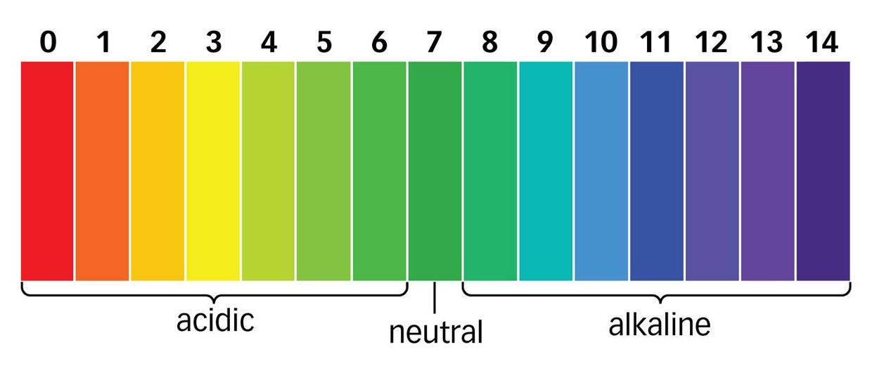
Universal Indicator and the pH scale
Allows you to see how strong acids and alkalis are
pH scale

Slide 7
How would you describe the following:
pH 0 –
pH 14 –
pH 6 –
pH 8 -

Slide 8
Finding the pH of substances
Results

Slide 9
2 test tubes
Pestle and mortar
Pipette
Test tube rack
Sodium hydroxide
Hydrochloric acid
Making Beetroot/Cabbage indicator
Put on your eye protection and keep them on throughout.
Grind up the beetroot/cabbage in the mortar using the pestle. (Take care not to splash your clothes!)
Use a pipette to put half of the solution (liquid) into test tube 1 and the other half into test tube 2.
Record the colour of the two solutions.
Add a few drops of hydrochloric acid to one of the tubes
Add a few drops of alkali (sodium hydroxide) to the other tube
Record the colours you see.
Wash up all the equipment you have used.

