Slide 1
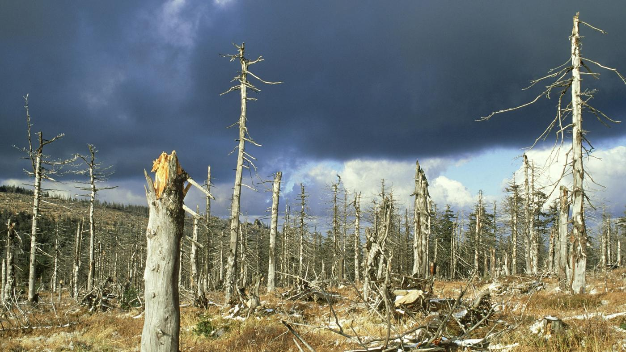
Acid Rain

Slide 2
Create a Graphic – Acid Rain
In many cases the energy comes from burning fossil fuels—coal, oil and natural gas. This is how humans generate electricity. Factories, cars, aeroplanes all release harmful gasses into the atmosphere. This causes pollution and pollution has onsequences for living things
How acid rain is produced:
Cars, aeroplanes and factories that burn fossil fuels release harmful gases (sulphur dioxide and nitrous oxide)into the atmosphere. These gases dissolve in the water vapour in clouds. This forms acid rain in the clouds. Clouds can travel great distances, due to winds, before releasing the rain. This means that the effects of scid rain can be seen far from where the harmful gases are produced.
The consequences of acid rain:
When it rains the acid rain falls to the ground. This can have negative consequences on living things in the ecosystem, disrupting feeding relationships. If acid rain falls into water it can kills plants, insects and fish that live in the water. If acid rain lands on the ground it can kill plants which could effect the animals that eat the plants.
Use the information above to complete the textbook section worksheet

