Slide 1
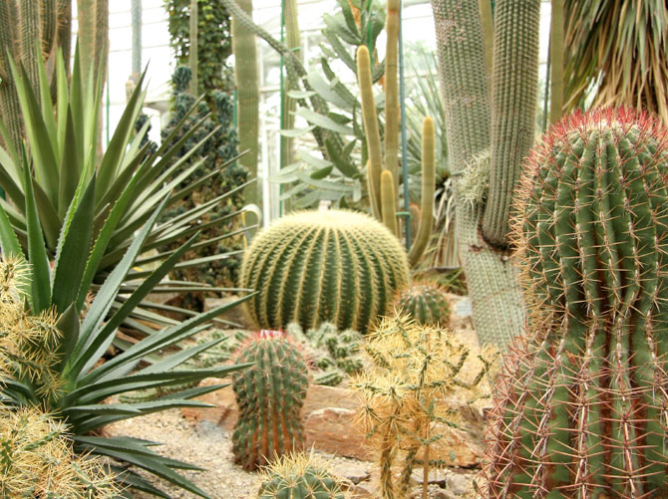
Plant Adaptations
Adaptations

Slide 2
Problems?
Solutions?

Slide 3
Adaptations for water conservation
Xerophytes: Plants adapted to growing in deserts and dry places (cactus)
They use strategies so they can survive in those dry habitats → increase rate of uptake of water & reduce rate of water loss by transpiration
Leaves reduced in size (just spines – why?)
Stem contains water storage tissues
Stems have pleats so they can expand quickly
Stomata in the stems – not many (why?) and only open at night (why?)
CO₂ taken in at night is stored as malic acid

Slide 4
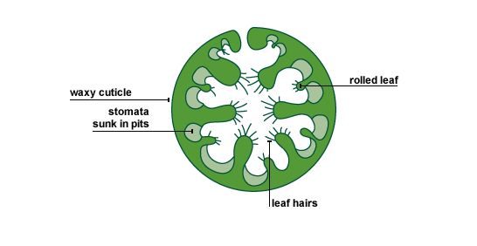
Adaptation
Marram Grass: rolled leaf which creates a localized environment of water vapour → prevents water loss
Folded leaves has hairs on the inside to slow air movement which reduces amount of water vapour being lost

Slide 5
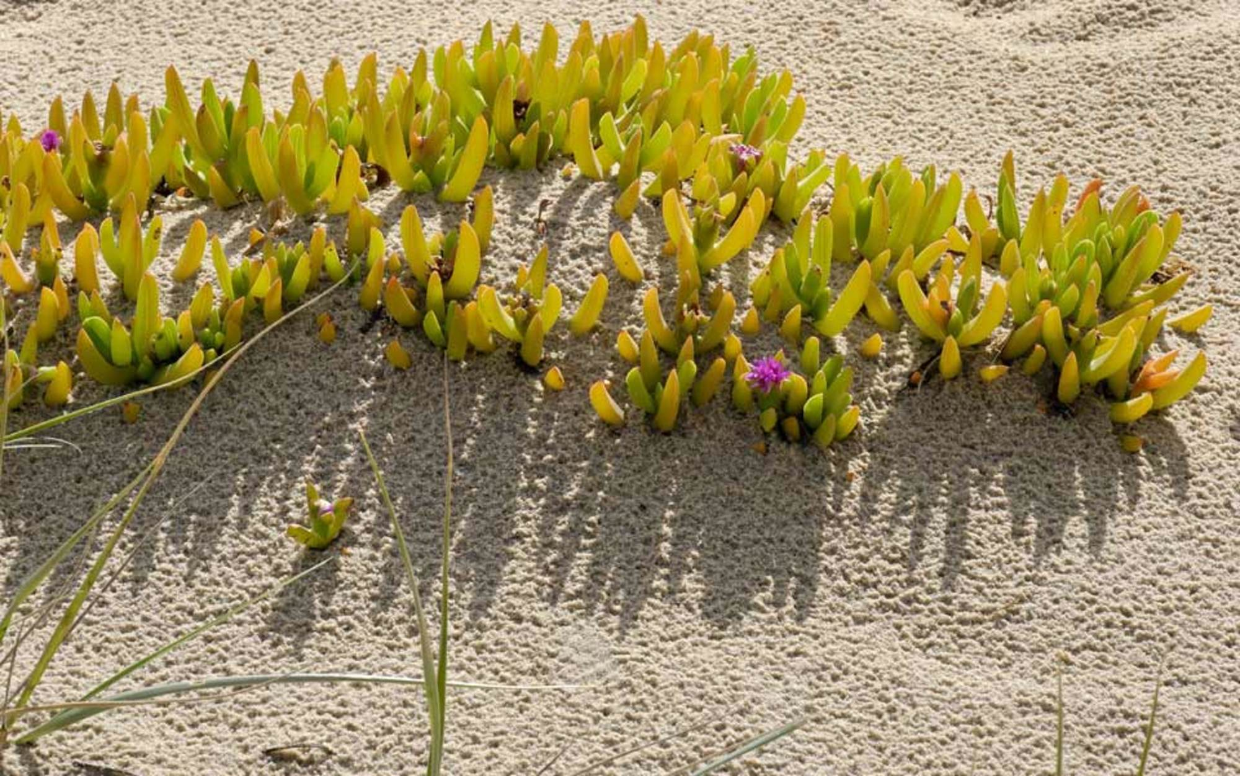
Adaptations - Halophytes
What are the problems with living in high salt environments?
How are halophytes adapted?

