Slide 1
Measuring Transpiration rate

Slide 2
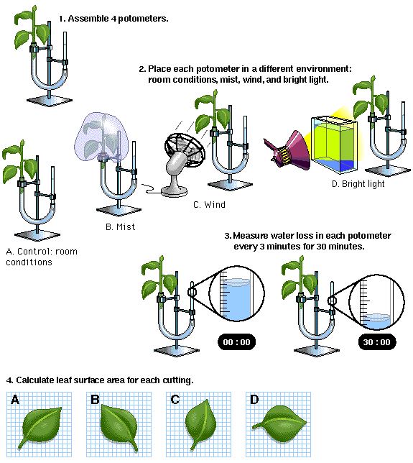
Transpiration Rate What factors do you think could affect transpiration rate?
Temperature
Wind speed
Humidity
Light intensity
Leaf SA

Slide 3
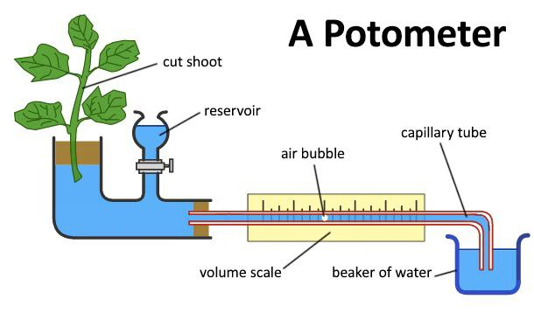
What other info do you need?
Used to measure transpiration rate
How could you use this piece of equipment to measure transpiration rate?

Slide 4
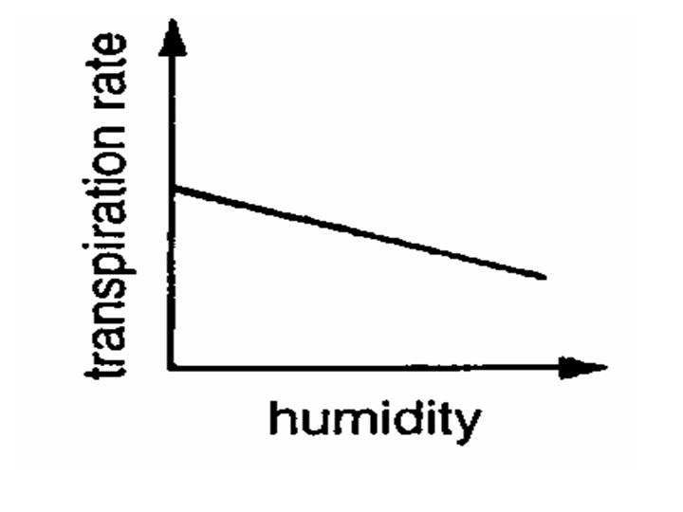
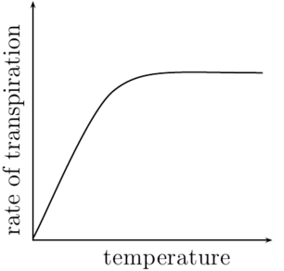
Factors that affect transpiration
Humidity
Temperature

