Slide 1
Xylem Structure
Describe the structure of the xylem as thickened with lignin
State the functions of xylem vessels
Drawing the structure of primary xylem vessels in sections of stems based on microscope images

Slide 2
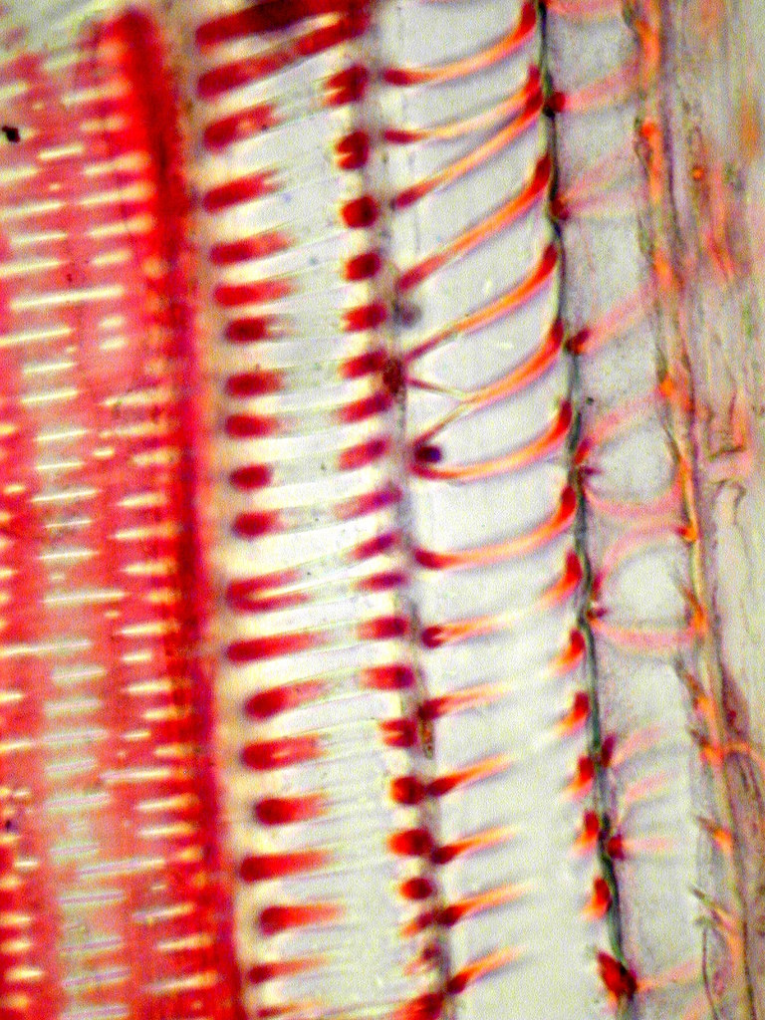
Structure of xylem – withstanding pressures
Long continuous tubes of dead cells lined up end to end.
Walls thickened (spirals) with a polymer called lignin.
Lignin provides support against low pressures in xylem (stops collapse) and also waterproofs the xylem.
Xylem walls are hydrophilic creating adhesive forces
Provide structural support for the whole plant

Slide 3
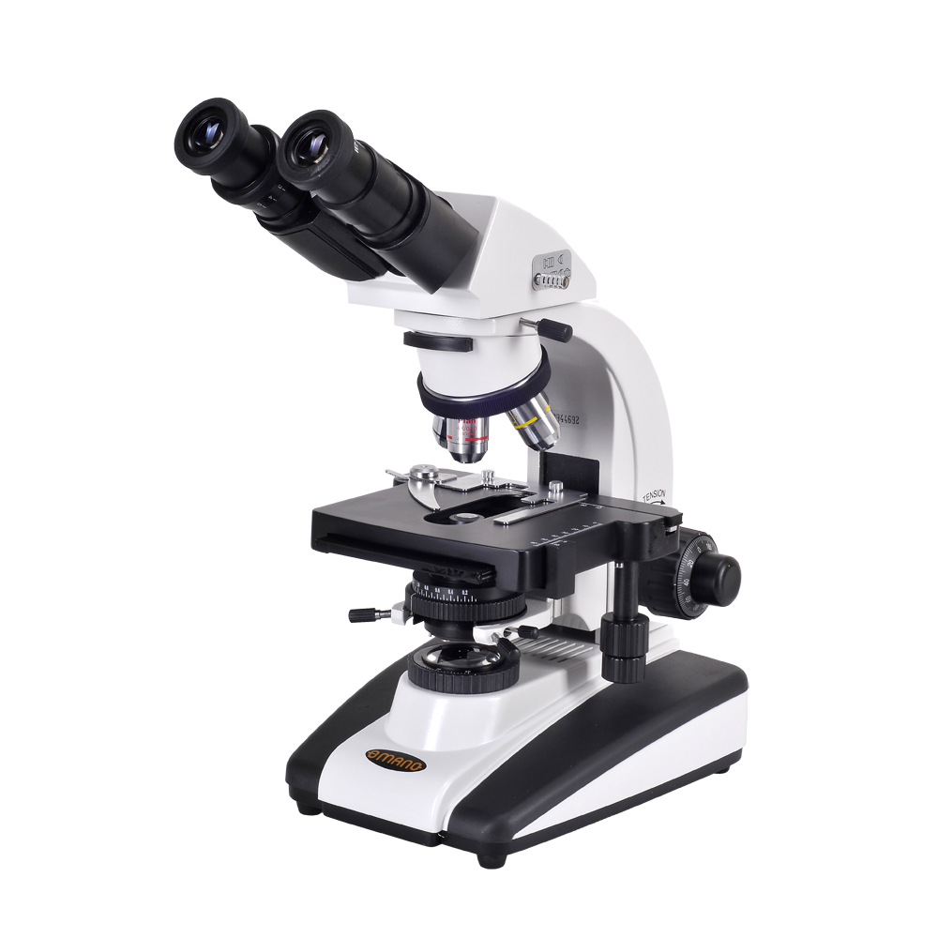
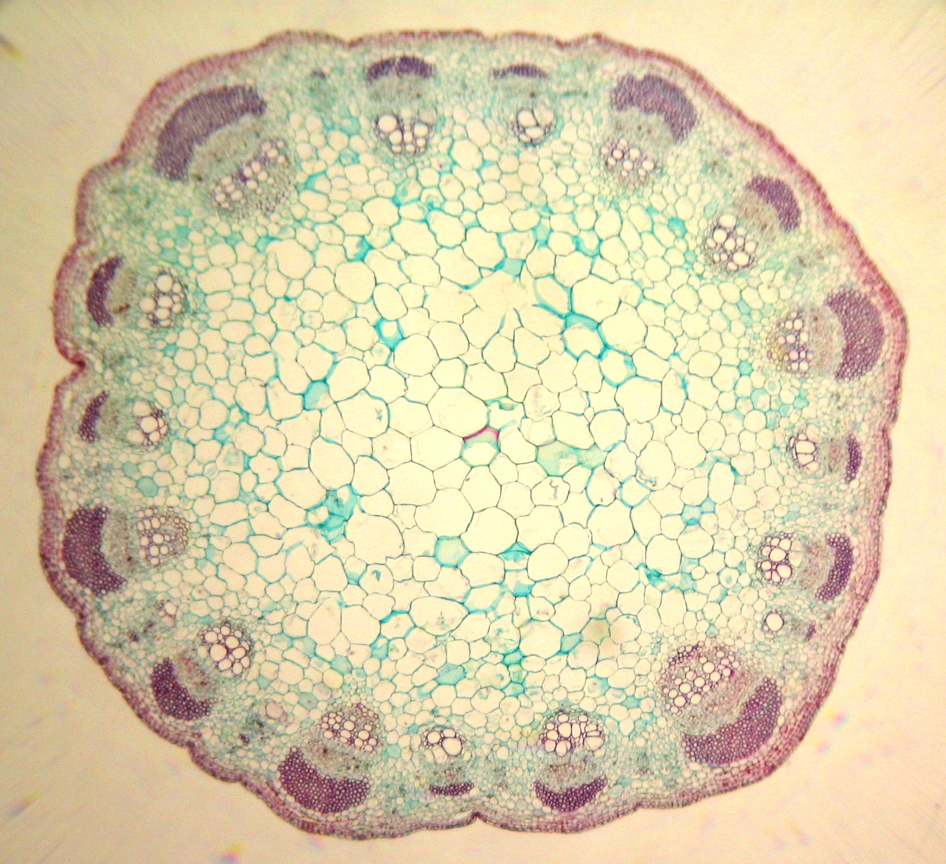
Follow the instructions on page 411 to draw xylem vessels and vascular bundles

Slide 4
How to draw xylem vessels
Include:
Epidermis
Crotex
Pith
The vascular bundle (xylem, cambium, phloem)

