Slide 1
Comparing a camera and an eye
Label the key parts of both a camera and an eye
Bronze
Describe who part matches which between a camera and lens
Silver
Explain what each part of the camera and eye do
Gold

Slide 2
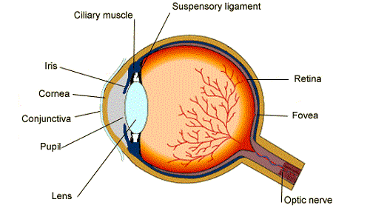
Eyes
You have already labeled a diagram of an eye and have described what each part does.
Now you must compare an eye with a camera…

Slide 3
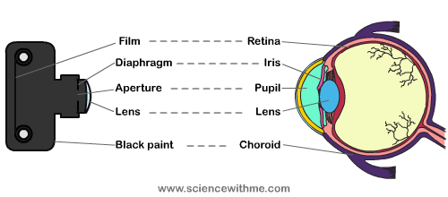
Part on camera | Part on eye | Function

