Slide 1
6.3 – Defense against infectious disease Primary Defence
The skin and mucous membranes form a primary defence against pathogens that cause infectious disease
Cuts in the skin are sealed by blood clotting
Clotting factors are released from platelets
The cascade results in the rapid conversion of fibrinogen to fibrin by thrombin

Slide 2
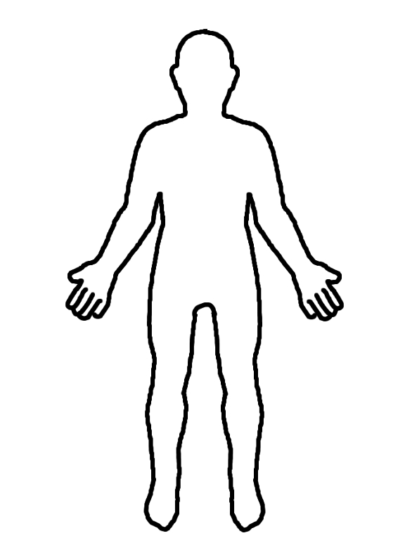
Label all the areas that pathogens can enter the body
Explain how the following prevent pathogens entering the blood stream
Skin
Mucous membranes
Stomach acid
Tears

Slide 3
Microbes
How do they enter the body?
They can be taken in through the mouth or nose
Microbes (or the poisons they produce) damage cells – these are the symptoms of a disease.
They can enter through cuts or bites in the skin
All natural openings

Slide 4
First line of defence
SKIN
MUCUS
STOMACH ACID
TEARS
PREVENTION
Notes:
Skin
Chemical in tears
Chemicals in sweat
Stomach acid
Passive immunity

Slide 5
Clotting
When skin is cut – blood vessels in it are severed and start to bleed.
Clotting is important:
Prevents blood loss (problem?)
Prevents entry of pathogens

Slide 6
Clotting
Cascade of reactions – each stage a catalyst for the next.
Clotting must be closely controlled so it does not happen inside blood vessels.
Platelets plug the site that has been cut, then must release clotting agents to trigger the process.

Slide 7
Clotting
Cascade of reactions results in production of the enzyme thrombin.
Thrombin converts fibrinogen (soluble protein) into fibrin (insoluble).
Fibrin forms a mesh in cuts to trap more platelets and blood cells.
When exposed to the air – this clot dries into a scab

Slide 8
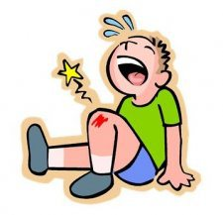
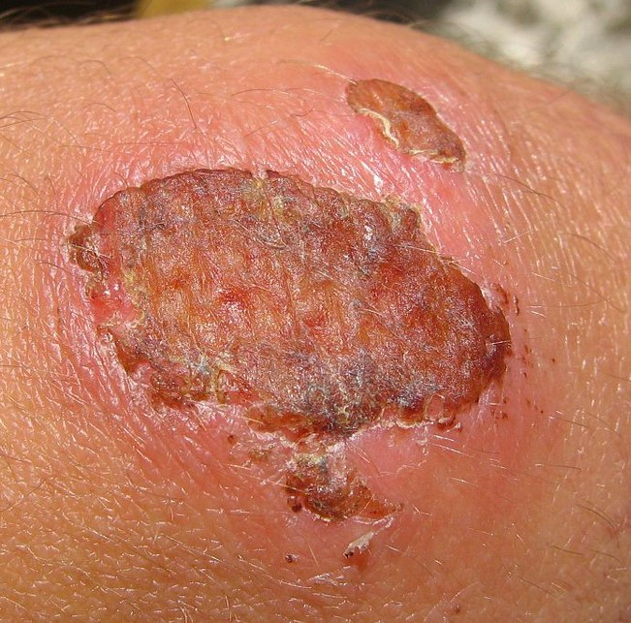
Clotting
Cut forms
Platelets plug site
Release clotting agent
CASCADE OF REACTIONS
Thrombin enzyme produced
Fibrinogen broken down into fibrin
Clot dries into a scab in the air

Slide 9
Starter
Task: Match up these key words
Antigen
Microbe
Pathogen
Immune system
Disease
Immunity
Vaccine
Antibody
A microorganism that causes disease
A foreign molecule that provides an immune response
Proteins in the blood that detect and destroy pathogens
A microorganism (bacteria)
A system that protects the body
A disorder of function
A substance used to provide immunity
The ability to resist a particular toxin

Slide 10
Starter
Task: Match up these key words
Antigen
Microbe
Pathogen
Immune system
Disease
Immunity
Vaccine
Antibody
A microorganism that causes disease
A foreign molecule that provides an immune response
Proteins in the blood that detect and destroy pathogens
A microorganism (bacteria)
A system that protects the body
A disorder of function
A substance used to provide immunity
The ability to resist a particular toxin

