Slide 1
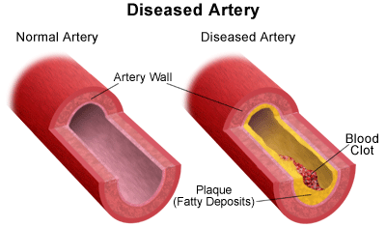
What is a blood clots develops in the coronary artery!!!

Slide 2
Second & third line of defence
Describe how phagocytes fight pathogens
Describe how lymphocytes produce antibodies
Explain specific and non specific responses

Slide 3
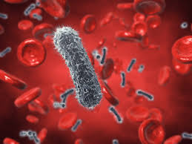
Second line of defence
If the bacteria gets past the primary defence…..

Slide 4
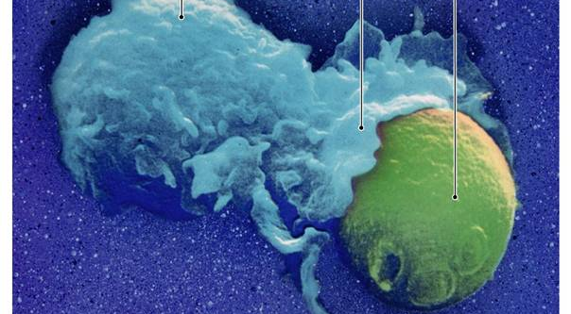
Phagocytes
Phagocytosis

Slide 5
Phagocytes
Recognise antigens
Engulf pathogen
Digest using enzymes found in lysosomes
Neutrophils, Macrophages
Create a simple cartoon strip

Slide 6
Lymphocytes –Third Line of Defence
Produce antibodies to bind to antigens on the outside of pathogens

Slide 7
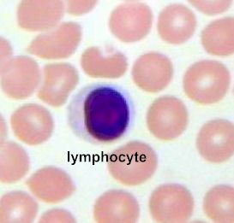
Lymphocytes
Create a simple cartoon strip for the action of lymphocytes.

Slide 8
Lymphocytes
Recognise an antigen on a pathogen
Specific lymphocyte is clones to form plasma cells
Plasma cells produce antibodies
Antibodies attach to antigens on pathogen
Some of the lymphocytes produced are not active plasma cells. They are memory cells
If the infection appears again a faster response will happen
The memory cells will clone into plasma cells
defence

