Slide 1
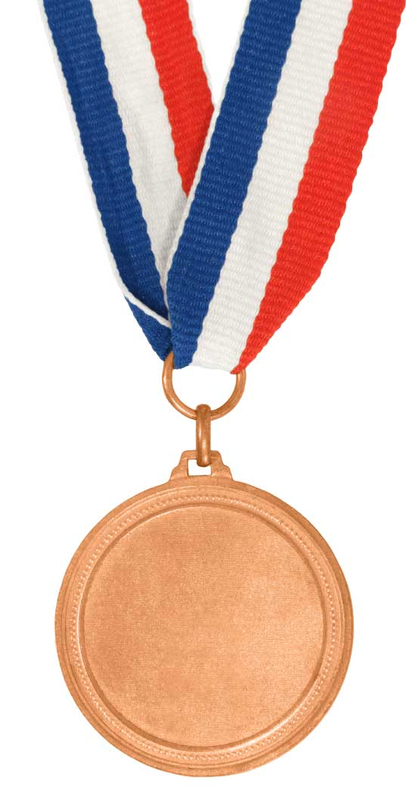
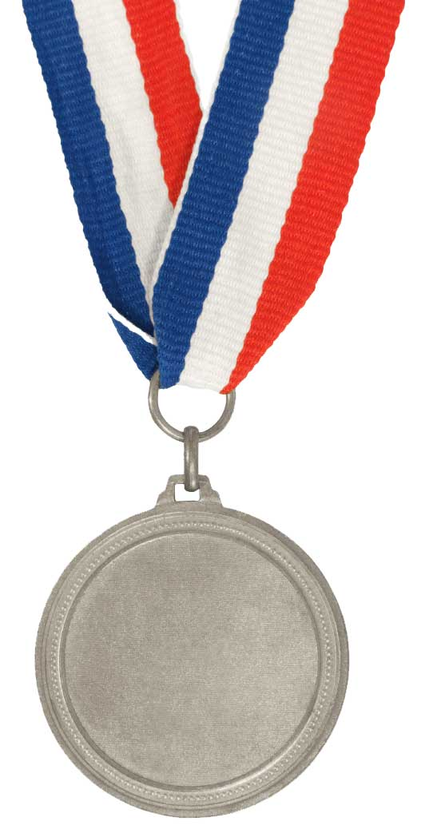
Understand convex and concave lenses
Define refraction
Bronze
Label how light bends in a convex and a concave lens.
Silver
Explain how a lens forms an image.
Gold

Slide 2
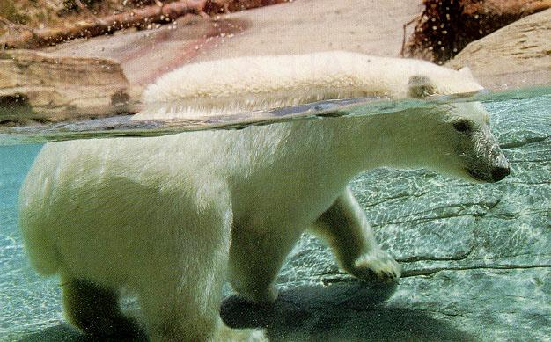
Refraction

Slide 6
Try it
Find the concave and convex lenses from your packs.
Shine a beam of light through them. What happens? How is the light refracted?
Look through them. What happens to the image?

Slide 7
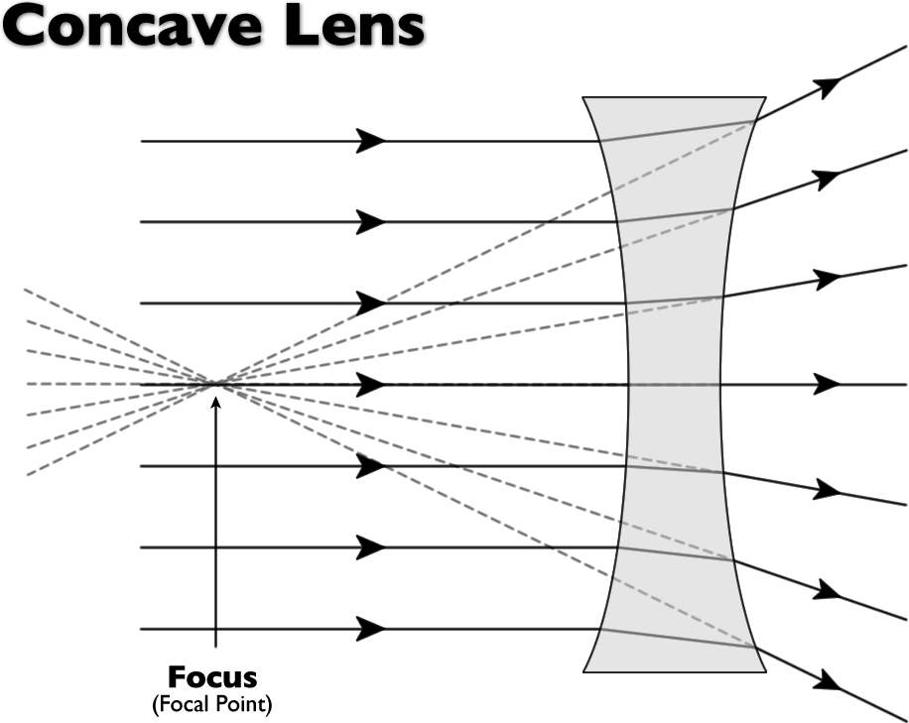
Complete your diagrams to show how the light rays are refracted
Stick the sheets in your book.
Answer these questions…
What happens to the image when you loo at it through a concave lens?
What happens to the image when you loo at it through a convex lens?
Can you think of where convex and concave lenses are used?

Slide 8
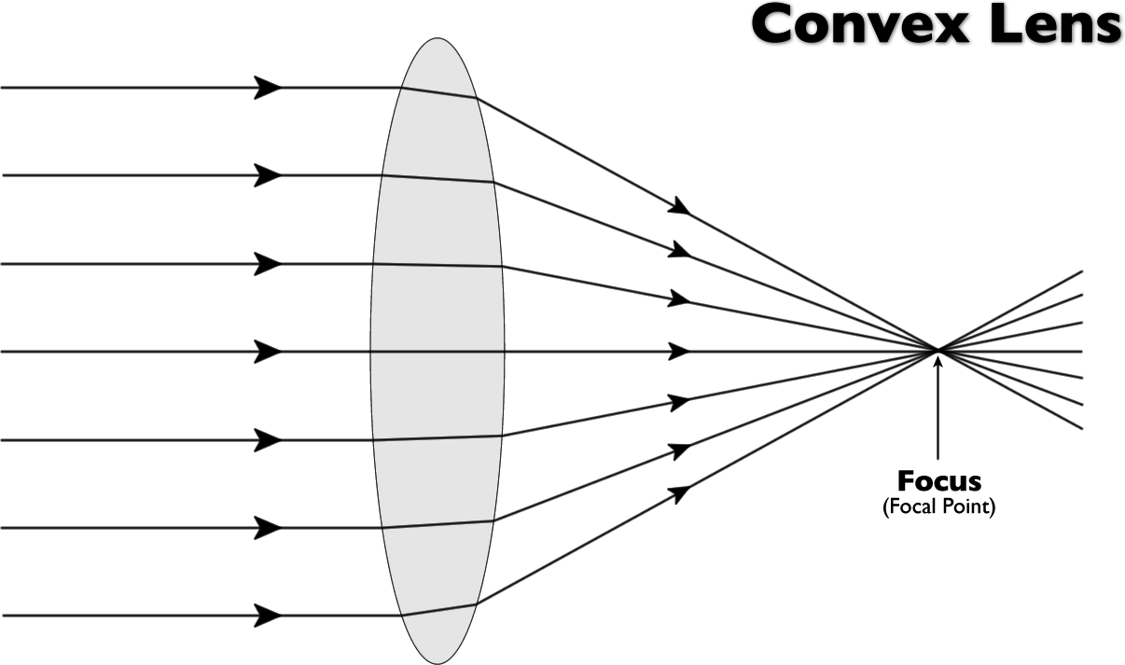

Slide 9
Convex lens
Transparent block causing light to refract
Curved out on both sides
Light rays coming out of it come together at a focal point – they converge
Focal point is where the light rays meet
Focal length is the distance between the centre of the lens and the focal point.
Measure the focal length on your diagrams
Produce a magnified image

Slide 11
Concave lens
Transparent block to refracted light rays
Curved in on both sides
Produces an image smaller in size than the object
Light rays refract away from the centre – they diverge

Slide 12
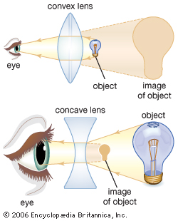
Notes:
Arrows point into the eye

Slide 14
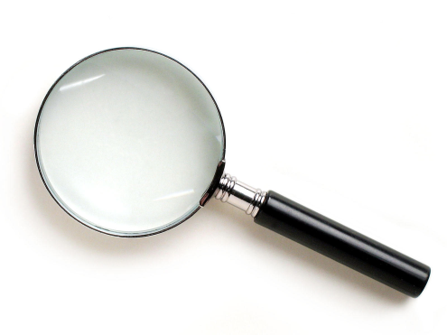
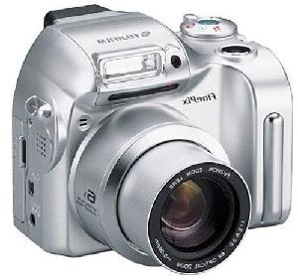
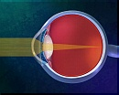
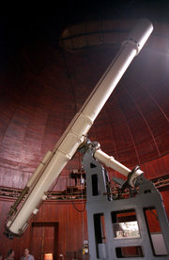
Examples of CONVEX lenses
Magnifying glass
Cameras
Telescopes
Our Eyes
Glasses

Slide 15
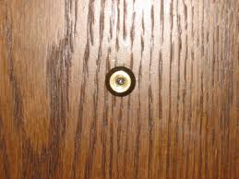
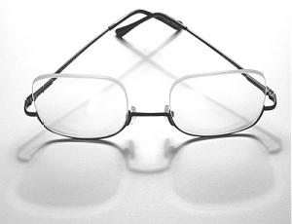
Example of CONCAVE lenses
Nearsighted eyeglasses
(can’t see far away)
Peep holes in doors

Slide 16
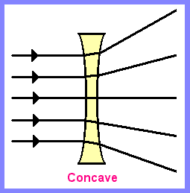
CONCAVE AND CONVEX LENSES
Concave lenses make light rays move away from each other or spread out
A convex lens can focus the light that enters it and direct it to one point.

Slide 17
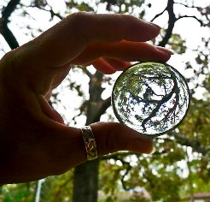
Convex Lenses and Images
Depending on where you hold the lens--the image you see will either be right side up (real image) or upside down(virtual image)

Slide 18
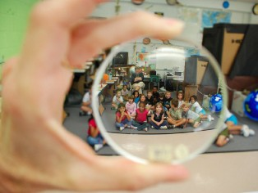
Concave Lenses and Images
A concave lens produce upright images that are smaller than the real object.

Slide 20
Examples of CONVEX lenses
Magnifying glass
Cameras
Telescopes
Our Eyes
Glasses

Slide 21
Conclusion
When light rays pass through a lens they are ___________.
A __________ lens is curved outwards on both sides. It brings the rays of light closer together. The rays meet at a point called the ____________. These types of lenses are used in ______________.
A _________ lens is curved inwards on both sides. It makes the light rays spread out. Images viewed through these lenses appear _______________.

Slide 22
Label the diagrams and describe the function of each part
eye
eye 2 - brain

Slide 23
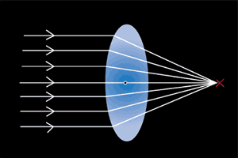
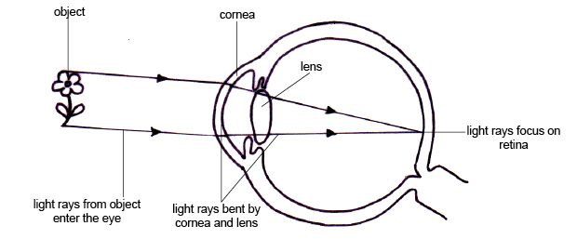
Our Eyes

Slide 24
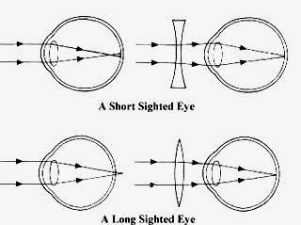
What does the dot represent?
What kind of lens would you use to correct short sighted vision?
Why would you use this kind of lens?
Keywords:
Light ray
Lens
Convex
Concave
Diverge
Converge
Focus
Retina
What does the dot represent?
What kind of lens would you use to correct short sighted vision?
Why would you use this kind of lens?

